Slide 1
Real-Time Quantitative Reverse Transcription
Polymerase Chain Reaction (qRT-PCR) Analysis
Jelena Brkic
BIOL5081

Slide 2
What is Real-Time qRT-PCR?
An in vitro method for enzymatically amplifying defined sequences of RNA
From all the available quantification techniques it has the highest sensitivity, reproducibility, simplicity and dynamic range
Variety of applications:
  Relative expression of mRNAs
  Validation of microarray data
  Clinical Diagnostics

Slide 3
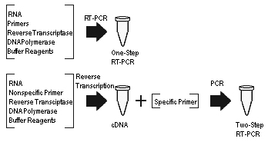
Real Time
  signals (generally fluorescent) are monitored as they are generated and are tracked throughout the program
Quantitative
  Quantitatively measures the amplification of template
Reverse Transcription
  Refers to the reverse transcription of the RNA starting material into cDNA
  This step can be conducted in a one-step or more traditionally two-step method
Polymerase Chain Reaction
  Method dependent on thermo cycling and enzymes allowing for amplification of small starting material of DNA
First generate cDNA
then perform PCR

Slide 4
Analyzing qRT-PCR Data
Two most commonly used methods to analyze data:
  Absolute Quantification
    Used for copy number determination, viral load etc.
    Conducted by relating the PCR signal to a standard curve
    Will give you absolute quantification that can be expressed in units
  Relative Quantification
    Gene expression studies
    Measured against a calibrator sample and expressed as an n-fold difference relative to the calibrator
    Often normalized to an internal control – housekeeping gene
      Controls for loading artificats

Slide 5
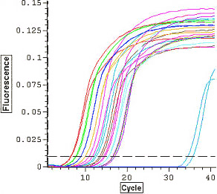
qRT-PCR – The Basics
Isolate RNA from samples
Reverse Transcription
Pick Reference Gene
Design Primers
Run qRT-PCR
  Fluorescent signal (eg. Taqman, SYBERGreen)
  Acquire signal at end of each cycle
Analyze
  Set Threshold
  Obtain C_{T} values

Slide 6

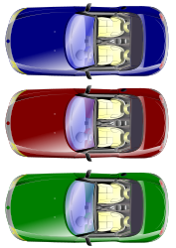
qRT-PCR – The Basics
qRT-PCR exploits the fact that the quantity of PCR products in exponential phase is in proportion to the quantity of initial template under ideal conditions
Threshold: an arbitrary level of fluorescence chosen on the basis of the baseline variability
  Can be adjusted for each experiment so that it is in the region of exponential amplification across all plots
Ct: “Cross threshold” is a basic principle of real time PCR and is an essential component in producing accurate and reproducible data
  Defined as the fractional PCR cycle number at which the reporter fluorescence is greater than the threshold
Threshold
C_{T}
Starting amount of template (?)
Reaction Tubes

Slide 7
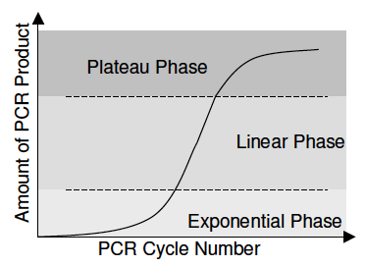
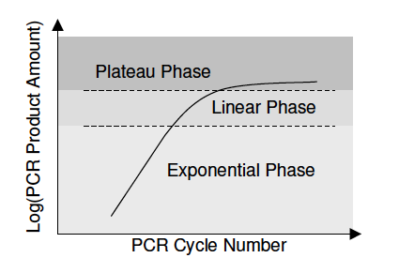
Understanding the Output…
PCR has three phases:
Exponential
  Earliest segment in the PCR
  Product increases exponentially
  Reagents are not limited
Linear
  Linear increase in product
  PCR reagents become limited
Plateau
  Later cycles of PCR
  Reagents become depleted
  Amplification not equal

Slide 8
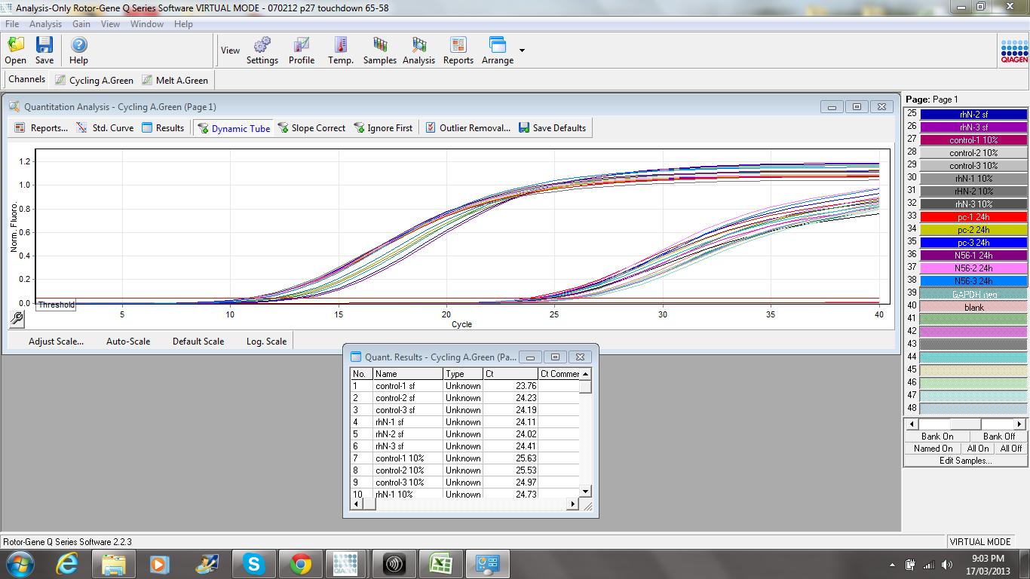
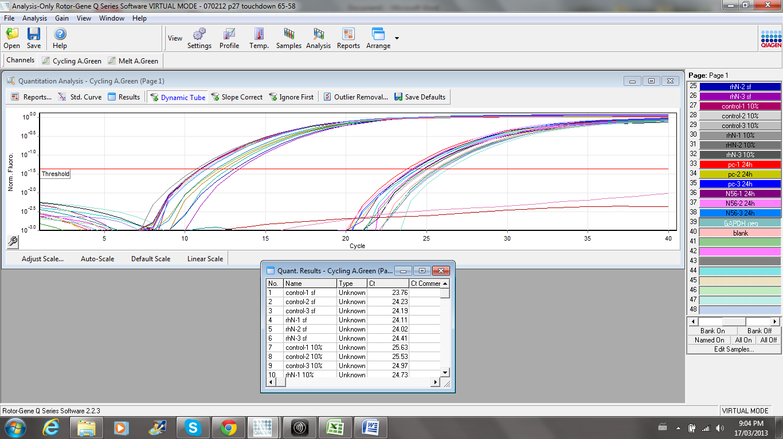
Picking the best C_{T} value
The threshold for Ct determination should be set up as close as possible to the base of the exponential phase

Slide 9
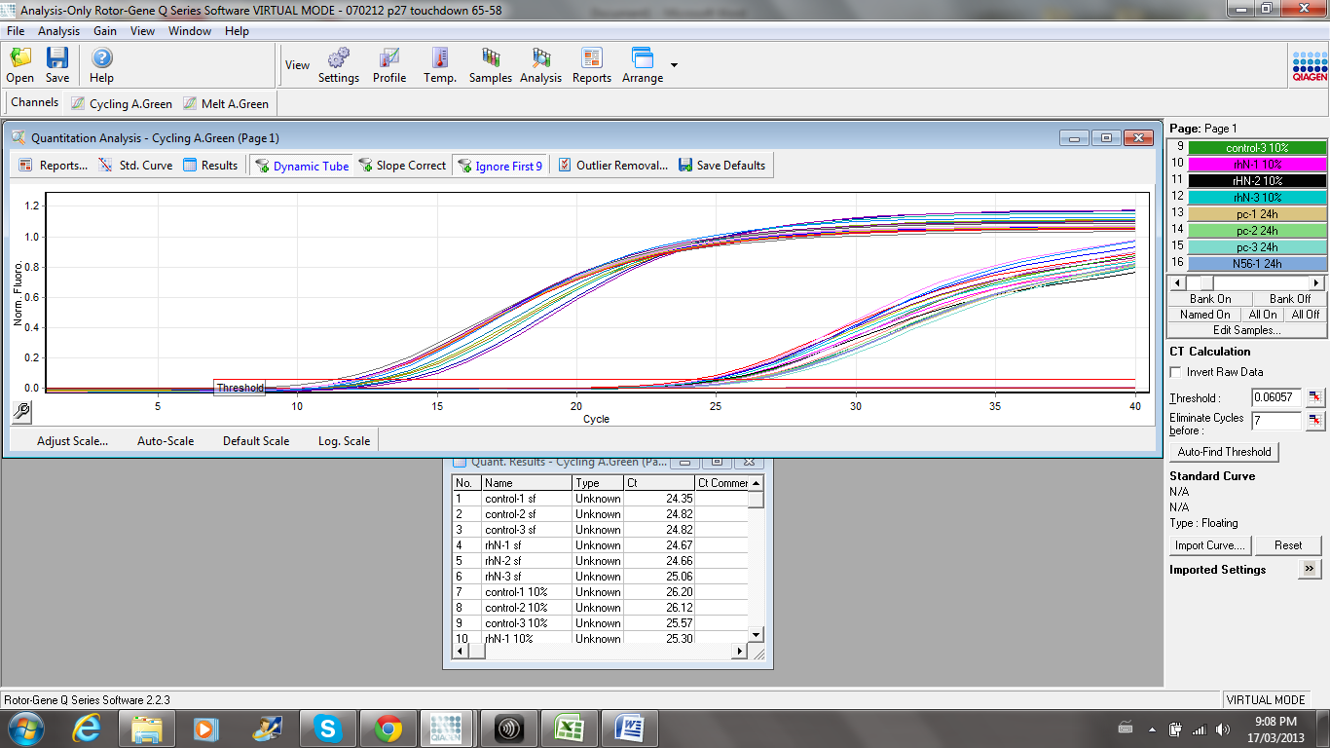
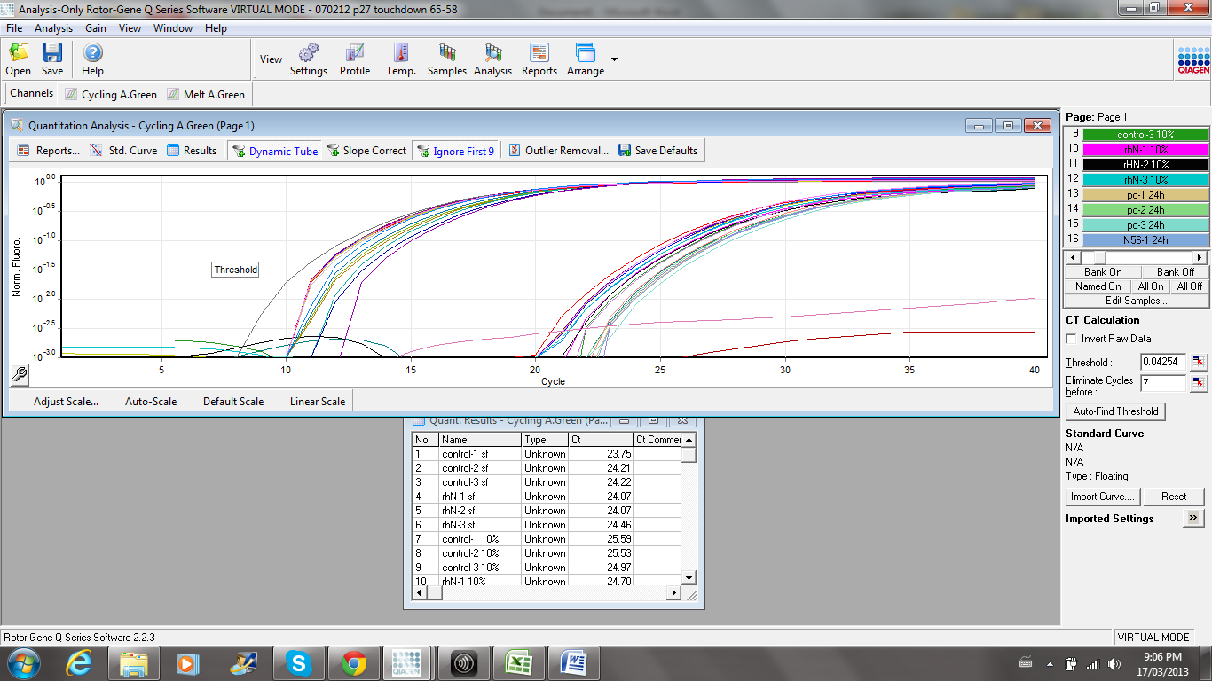
Picking the best C_{T} value

Slide 10
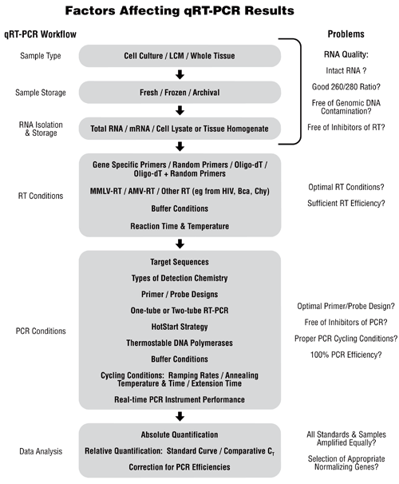
Factors Affecting qRT-PCR Results
Normalization
Relative Quantification Methods
Amplification Efficiency
Power and Sample Size
Specificity of primers
can easily be checked by
gel electrophoresis

Slide 11
Normalization
Most commonly expression of target genes is normalized against an endogenous control (HKG)
KEY ASSUMPTION: the expression level of the gene remains constant across different experimental conditions. Therefore serves as a control for loading artifacts.
Selecting a HKG from literature may not always be the best choice – should be part of experimental protocol:
Gene Stability Parameter (M)
ANOVA

Slide 12
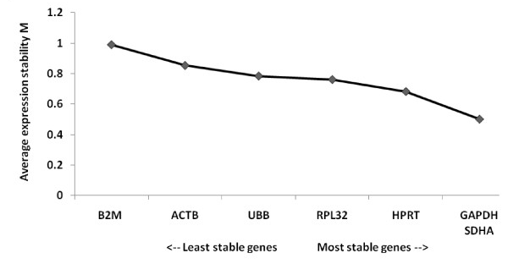
Methods for Housekeeping Gene selection
Gene-stability parameter (M):
  The average pairwise variation of a particular gene with all other control genes
  Genes with small M are considered to be most stable
Genorm, Normfinder,
Bestkeeper algorithms

Slide 13
Example:
We want to assess the relative expression levels of gene X in mice ovaries after treatment of
mice with different doses of hormone Y. First we must choose the best housekeeping gene
to use in our relative quantification. Two housekeeping genes (HK001 and HK002) were
selected for an experiment with 5 dose groups (A-E) with 5 animals (n=5) in each dose
group. QRT-PCR was performed and C_{T} values were obtained for both genes.
Animal | Dose Group | HK001 | HK002
1 | A | 20.3 | 19.68
2 | A | 20.57 | 19.69
3 | A | 20.54 | 19.8
4 | A | 20.2 | 19.95
5 | A | 20.2 | 19.93
6 | B | 20.57 | 19.97
7 | B | 20.95 | 19.93
8 | B | 20.78 | 20.02
9 | B | 20.88 | 20.27
10 | B | 20.87 | 19.93
11 | C | 20.8 | 19.88
12 | C | 20.83 | 19.9
13 | C | 19.97 | 19.91
14 | C | 19.92 | 19.98
15 | C | 20.33 | 20.57
16 | D | 19.7 | 19.68
17 | D | 19.72 | 19.95
18 | D | 19.47 | 19.85
19 | D | 20.58 | 20.27
20 | D | 20.57 | 20.08
21 | E | 20.41 | 20.07
22 | E | 20.58 | 20.1
23 | E | 20.85 | 20.07
24 | E | 20.48 | 20.1
25 | E | 20.3 | 20.25
a = number of treatments = 5
N = number of animals = 25

Slide 14
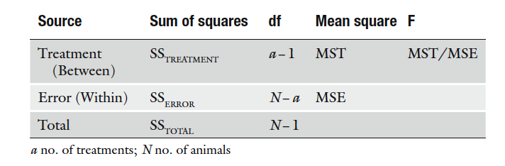
Analysis of Variance (ANOVA) – One way
Partition the variability in a set of data into component parts
SS_{Total} = SS_{Treatment} + SS_{Error}
Total variance = Differences between groups due to treatment +
Variances within groups due to “error”

Slide 15
Analysis of Variance (ANOVA) – One way
To make sources of variability comparable the sum of squares is divided by the respective degrees of freedom to obtain mean squares
The ratio of Mean Square yields the F statistic
DFG = a-1 = 4
DFE = N-a = 20
DFT = N-1 = 24

Slide 16
Continue in SAS…
data table;
input anim dose$ gene$ Ct;
Cards;
1 A HK001 20.30
2 A HK001 20.57
data missing …
24 E HK002 20.10
25 E HK002 20.25
;
proc ANOVA;
by gene;
class dose;
model Ct=dose;
run;
Order of input:
Animal, dose, gene notation and Ct value
Cards = data immediately follows on next line
Insert all data values in order specified above
for all genes you are comparing
Proc ANOVA → for balanced design
CLASS: Classification statement
MODEL: Response = treatment levels

Slide 17
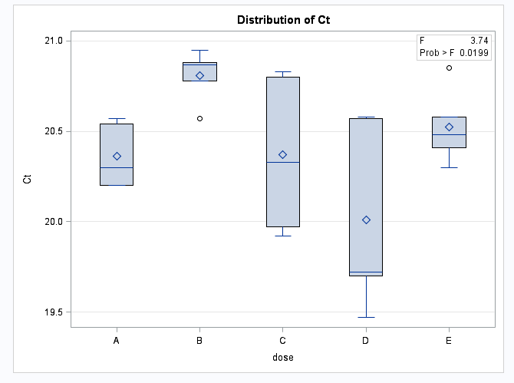
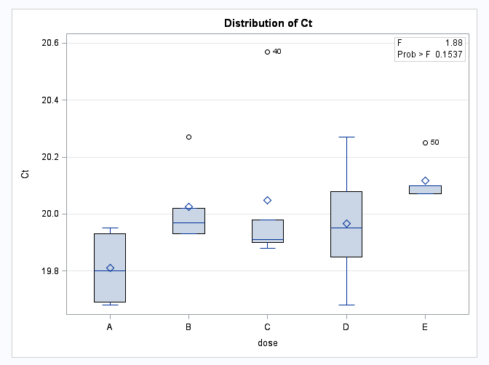
Continue in SAS…
Box Plots of dose vs. Ct
HK001 more variable
Continue by looking at the F-statistic and P-value
HK001
HK002

Slide 18
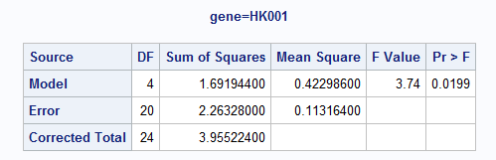
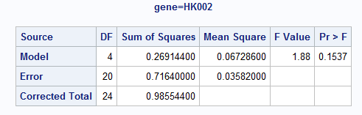
Continue in SAS…
F-statistic close to 1 =
the two sources of variability are approximately equal
A HKG that remains constant across different conditions will have a small F-statistic compared to other genes
“Optimum HKG” is defined based on a non-significant (p>0.05),
minimum F-statistic
If none of the genes yield a non-significant F-statistic then none is suitable to be used as a housekeeping gene.

Slide 19
Normalization gene selected
☑
Example:
Mice were treated with or without Hormone Y for 10 days after which ovaries
were removed and expression levels of TG001 and TG002 were measured along
with HK002 as the reference gene. For each dose n=4, and each sample was
performed in triplicate.
Animal | Treatment | TG001 | TG002 | HK002
1 | Control | 23.22 | 29.08 | 19.68
1 | Control | 23.34 | 29.04 | 19.69
1 | Control | 23.13 | 29.39 | 19.8
2 | Control | 24.06 | 28.23 | 19.95
2 | Control | 24.15 | 28.01 | 19.93
2 | Control | 24.15 | 28.12 | 19.97
3 | Control | 23.18 | 28.79 | 19.93
3 | Control | 23.13 | 28.43 | 20.02
3 | Control | 23.1 | 28.49 | 20.27
4 | Control | 24.78 | 31.37 | 19.93
4 | Control | 24.45 | 30.74 | 19.88
4 | Control | 24.67 | 31.09 | 19.9
5 | Treatment | 23.11 | 27.11 | 19.91
5 | Treatment | 22.99 | 27.24 | 19.98
5 | Treatment | 23.1 | 27.37 | 20.57
6 | Treatment | 22.77 | 25.52 | 19.68
6 | Treatment | 22.99 | 25.72 | 19.95
6 | Treatment | 23.06 | 25.52 | 19.85
7 | Treatment | 23.73 | 27.43 | 20.27
7 | Treatment | 24.01 | 26.73 | 20.08
7 | Treatment | 23.8 | 26.65 | 20.07
8 | Treatment | 23.73 | 27.96 | 20.1
8 | Treatment | 23.83 | 28.84 | 20.07
8 | Treatment | 23.73 | 27.98 | 20.1
Are the Ct values too high/low?
How do the technical triplicates look?

Slide 20
Relative Quantification Methods:
ΔΔC_{T} Method – Livak Method
KEY ASSUMPTION: Amplification efficiency is 2 for both the target and reference gene
  This indicates a doubling of PCR product with each cycle (exponential growth)
Presented as a ratio:
Ratio = 2^{-ΔΔCt}

Slide 21
Understanding the Ratio…
Where ΔΔCt = ΔCt_{treated} – ΔCt_{control}
ΔCt_{treated} = Ct difference of a reference and target gene for a treatment sample →
  ΔCt_{treated} = Ct_{target} – Ct_{ref}
ΔCt_{control} = Ct difference of a reference and target gene for a control sample →
  ΔCt_{control} = Ct_{target} – Ct_{ref}
  Note: for a full derivation of the above equation refer to Ref 1.
Ratio = 2^{-ΔΔCt}

Slide 22
Thinking about your experimental set-up…
Exactly how the averaging is performed depends on your experimental set up.
Biological replicates (separate RNA preparations)
  Treat each sample separately
  Average the results after the ratio is calculated
Technical replicates (PCR replicates)
  More appropriate to average the Ct data before performing the ratio
Separate wells:
  There is no reason to pair any particular target well with any particular reference well.
  First we want to average the target and reference Ct values separately before performing the ΔCt calculation
Same well:
  Same starting cDNA with the use of multiple dyes
  Can calculate the ΔCt value for each well separately
  The ΔCt values can be averaged before proceeding with the ratio

Slide 23
Separate wells…
ΔΔCt = ΔCt_{treated} – Δct_{control}
 | TG001 Ct | HK002 Ct
Control | 23.78 | 19.9125
Treatment | 23.40416667 | 20.0525
1st we average all of the target and reference Ct values
=AVERAGE(Cell1:Cell12)
 | dCT
Control | 3.8675
Treatment | 3.351666667
2nd we normalize our target Ct values to our internal control
= Avg taget Ct- Avg ref Ct
= 23.78 - 19.91 = 3.87
 | ddCt | Ratio
Control | 0 | 1
Treatment | -0.5158 | 1.43
Calibrate our treatment to our control and find the ratio
= AvgΔCt- Avg ΔCt_{calibrator}
= ΔΔCt
= 2^^{-ΔΔCt}

Slide 24
Check for variability in control…
2^(-((CtT_{target}-CtT_{ref})-($CtC_{target}-$CtC_{ref})))
Animal | Treatment | TG001 | HK002 | Ave of Calibrator | Ratios | Average Ratio
1 | Control | 23.22 | 19.68 | 23.78 | 1.254837023 | 1.102980589
1 | Control | 23.34 | 19.69 |  | 1.162717005
1 | Control | 23.13 | 19.8 | 19.9125 | 1.451455157
2 | Control | 24.06 | 19.95 |  | 0.845279285
2 | Control | 24.15 | 19.93 |  | 0.783225695
2 | Control | 24.15 | 19.97 |  | 0.805245166
3 | Control | 23.18 | 19.93 |  | 1.534214286
3 | Control | 23.13 | 20.02 |  | 1.69055857
3 | Control | 23.1 | 20.27 |  | 2.052667568
4 | Control | 24.78 | 19.93 |  | 0.506101972
4 | Control | 24.45 | 19.88 |  | 0.614506425
4 | Control | 24.67 | 19.9 |  | 0.534958914
5 | Treatment | 23.11 | 19.91 |  | 1.588318236 | 1.48439151
5 | Treatment | 22.99 | 19.98 |  | 1.811895812
5 | Treatment | 23.1 | 20.57 |  | 2.527130209
6 | Treatment | 22.77 | 19.68 |  | 1.714157888
6 | Treatment | 22.99 | 19.95 |  | 1.774607536
6 | Treatment | 23.06 | 19.85 |  | 1.57734692
7 | Treatment | 23.73 | 20.27 |  | 1.326385371
7 | Treatment | 24.01 | 20.08 |  | 0.957603281
7 | Treatment | 23.8 | 20.07 |  | 1.099997313
8 | Treatment | 23.73 | 20.1 |  | 1.178947929
8 | Treatment | 23.83 | 20.07 |  | 1.077359696
8 | Treatment | 23.73 | 20.1 |  | 1.178947929
E2
E4
=AVERAGE(Cell1:Cell12)
=2^(-((C2-D2)-($E$2-$E$4)))

Slide 25
Simple in Excel…
 | TG001 | SD | SE
Control | 1.102980589 | 0.500545006 | 0.144494897
Treatment | 1.48439151 | 0.442464133 | 0.127728393
=STDEV(Cells of Control)
=STDEV/SQRT(12)
Test the hypothesis:
H₀ : μ_{c} = μ_{t}
H_{a} : μ_{c} ≠ μ_{t}
T-test, ANOVA etc.

Slide 26


Efficiency Corrected Model – Pffafl Method
If the assumptions behind the ΔΔC_{T} Method are not valid, the efficiency corrected model can be employed instead
Where:
  E_{TARGET} = target gene amplification efficiency
  E _{REF} = ref gene amplification efficiency
  ΔCt_{target} = Ct_{control}– Ct_{treated} ← diff. btw Ct of treated vs control for target gene
  ΔCt_{ref}= Ct_{control}– Ct_{treated} ← diff. btw Ct of treated vs control for ref gene
  E is in the range from 1 (minimum) to 2 (theoretical maximum/optimum)
The “efficiency adjustment” is defined as EA=log₂(efficiency)
The above equation can be re-written as:

Slide 27

Efficiency Corrected Model
Sample Calculation:
HK002 E=1.85, TG001 E=2
Avg Control-Avg Treatment
Animal | Treatment | TG001 |  | HK002
1 | Control | 23.22 | 23.78 | 19.68 | 19.9125
1 | Control | 23.34 | 23.40416667 | 19.69 | 20.11083333
1 | Control | 23.13 | 0.375833333 | 19.8 | -0.198333333
2 | Control | 24.06 |  | 19.95
2 | Control | 24.15 |  | 19.93
2 | Control | 24.15 |  | 19.97
3 | Control | 23.18 |  | 19.93
3 | Control | 23.13 |  | 20.02
3 | Control | 23.1 |  | 20.27
4 | Control | 24.78 |  | 19.93
4 | Control | 24.45 |  | 19.88
4 | Control | 24.67 |  | 19.9
5 | Treatment | 23.11 |  | 20.61
5 | Treatment | 22.99 |  | 19.98
5 | Treatment | 23.1 |  | 20.57
6 | Treatment | 22.77 |  | 19.68
6 | Treatment | 22.99 |  | 19.95
6 | Treatment | 23.06 |  | 19.85
7 | Treatment | 23.73 |  | 20.27
7 | Treatment | 24.01 |  | 20.08
7 | Treatment | 23.8 |  | 20.07
8 | Treatment | 23.73 |  | 20.1
8 | Treatment | 23.83 |  | 20.07
8 | Treatment | 23.73 |  | 20.1
EA = log₂(1.85)
= 0.8875

Slide 28
Amplification Efficiency
In order to use the efficiency corrected model we need to be able to estimate the amplification efficiencies for all of our genes
Many ways of doing this…
Relative Standard Curve
  Serial dilutions of all genes analyzed run with samples
  Plotted as Ct vs. log₁₀(cDNA input)
  PCR efficiency calculated according to the relationship:
  E=10^{(-1/slope)}
Fitting linear, sigmoidal or multiple models

Slide 29
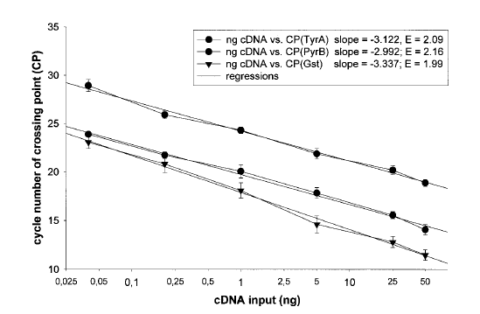
Relative Standard Curve
This is a very reproducible method however it often reports efficiencies greater than 2 which are not theoretically possible and implies an overestimation of the ‘real’ efficiency (Efficiencies range from 1.60- over 2)

Slide 30
Power and Sample Size
Power is dependent on sample size, significance criterion (α), effect size and sample standard deviation
Prospective sample size calculations are important in the planning of an experiment
Insufficient power may render any conclusions from an experiment as useless
Due to high variability of same samples in different laboratories the power calculation can be calculated after the effect and SD are observed from a pilot study

Slide 31
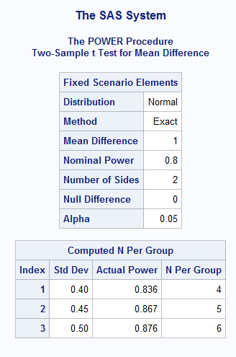
Calculate in SAS…
How many animals do we need per group to achieve power of 0.80, detect a group mean difference of 1.0 between treated and control Ct values? The SD ranges between 0.40-0.50.
proc power;
twosamplemeans
meandiff=1
stddev = 0.40 0.45 0.50
power = 0.8
npergroup=.;
run;

Slide 32
Conclusions
No housekeeping gene is perfect for all applications
Multiple housekeeping genes should be run for each experimental set up – varies by sample type, primer/probe combination, detection chemistry, tubes, real-time cycler platform
Relative quantification must be highly validated to generate useful and biologically relevant information
Careful think about the experimental set-up
  Block effects?
  RT Efficiencies?
  PCR inhibitors in exogenous control set ups etc.
Many mathematical models exist, as well as software, choose carefully which model is best suited for your experimental set-up, question and limitations
Use of three biological replicates and at least two technical replicates is advised for greater validity
Reproducibility can be tested with the coefficient of variability for intra and inter-assay variation

Slide 33
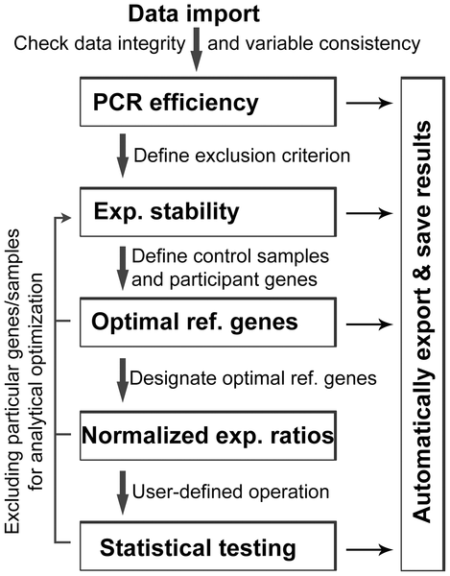
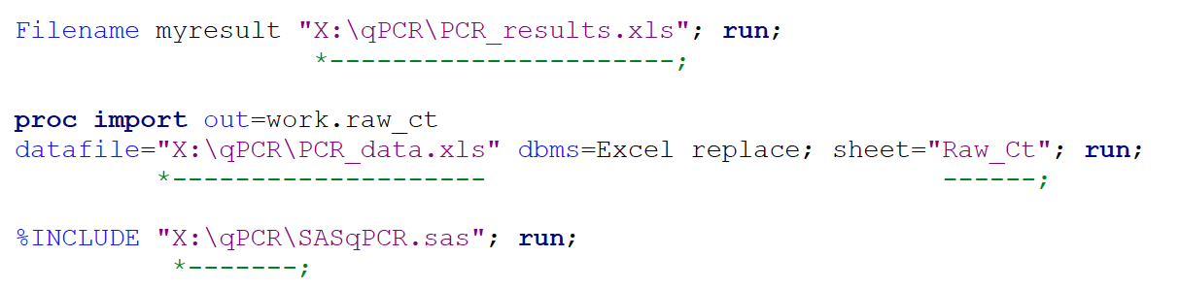
SASqPCR: Robust and Rapid Analysis of RT-qPCR Data in SAS
An all-in-one computer program allowing users to perform RT-qPCR data analysis in a more flexible and convenient way
Developed using SAS software
https://code.google.com/p/sasqpcr/downloads/list

Slide 34
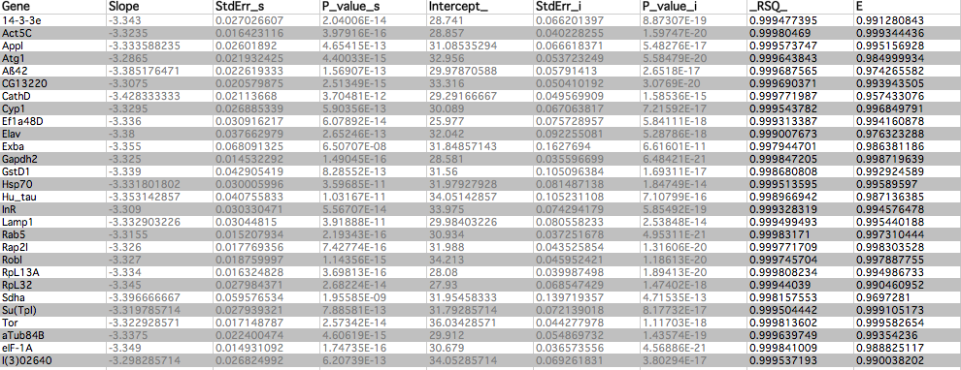
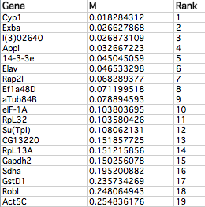
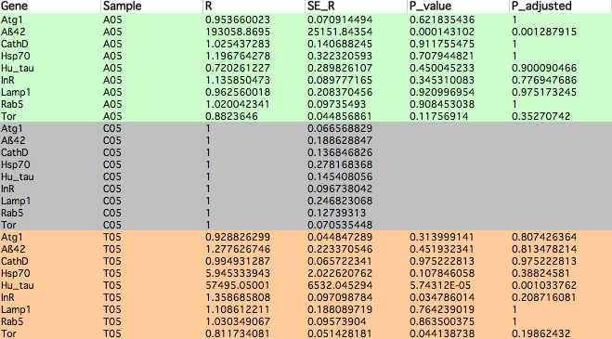

Slide 35
Useful Resources and References
Livak, K. J. and T. D. Schmittgen (2001). "Analysis of relative gene expression data using real-time quantitative PCR and the 2(-Delta Delta C(T)) Method." Methods 25(4): 402-408.
Khan-Malek, R. and Y. Wang (2011). "Statistical analysis of quantitative RT-PCR results." Methods Mol Biol 691: 227-241.
Pfaffl, M. W. (2001). "A new mathematical model for relative quantification in real-time RT-PCR." Nucleic Acids Res 29(9): e45.
Yuan, J. S., A. Reed, et al. (2006). "Statistical analysis of real-time PCR data." BMC Bioinformatics 7: 85.
http://www.vetmed.ucdavis.edu/vme/taqmanservice/pdfs/qPCR_guidelines.pdf

Slide 36
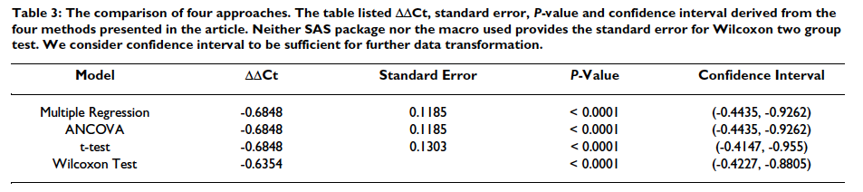
Further Readings…

