Slide 1


STUDY TIPS FOR EXAMS
___Bethune SOS Seminar___
Presenters: Dami Oyewunmi & Sarah Safea
Date: Wednesday, March 12, 2025.
Note: This presentation contains hyperlinks to websites. The presentation will be posted online under the Bethune College Workshops webpage: https://www.yorku.ca/colleges/bethune/events-workshops/workshops/

Slide 2
MEET OUR MENTORS
Dami Oyewunmi Sarah Safea
Notes:
Share your year, program and a fun fact about yourself

Slide 3
Overview
Preparing For An Exam
Strategies for Success
Before, During & After Your Exam
Summary
Advice From Our Mentors

Slide 4
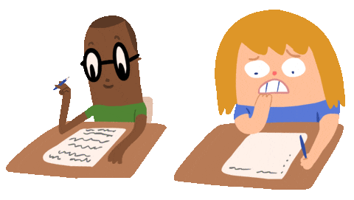
Preparing For An Exam

Slide 5
First things first: GATHER INFORMATION!
As soon as you can, figure out:
When is your exam?
What format is your exam?
Is it cumulative? What does it cover?
What type of questions will be asked? Multiple choice, true/false, essay, etc.?
Read course the syllabus carefully and talk to your TA and/or Professor if you have any questions/concerns.

Slide 6
Plan Your Time
Now that you know WHAT you need to do, PLAN how to do it.
Create writing and/or study plans
Write down your plans
Work backwards to plan for each exam
  Try to refrain from “marathon sessions”
Remember!
DON’T wait until the last minute! Plan ahead and make sure to schedule time for self-care and breaks. Keep your eye on the prize!

Slide 7

Strategies For Success

Slide 8
PHONE AWAY
I’m not kidding, HIDE it so you’re too lazy to go find it
Out of sight, out of mind !!!!!
Notes:
WIWC upcoming event promo lol

Slide 9
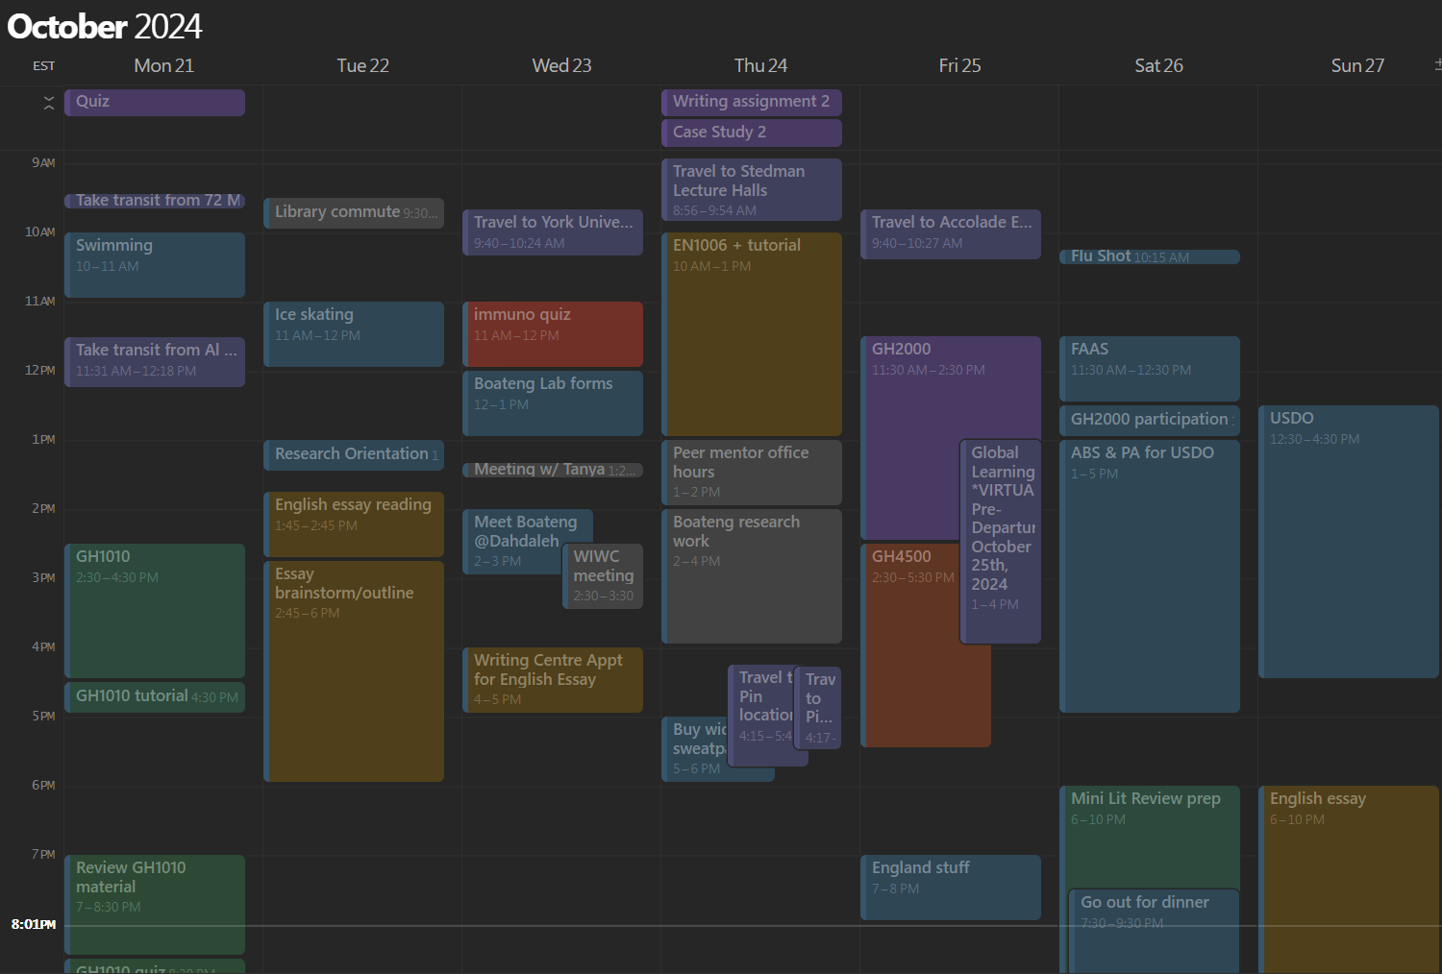
Study Schedule
Organize study materials
Create a study guide for yourself
Google Calendar
Notion Calendar
Notes:
WIWC upcoming event promo lol

Slide 10
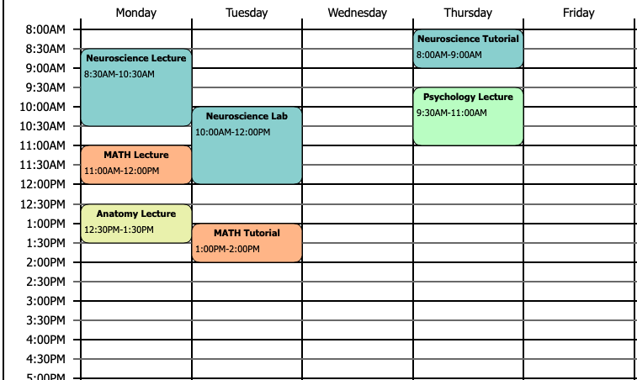
BUILDING AN EFFECTIVE SCHEDULE
Consider extracurricular commitments
Breaks!
Consider your activity level
Consider time off

Slide 11

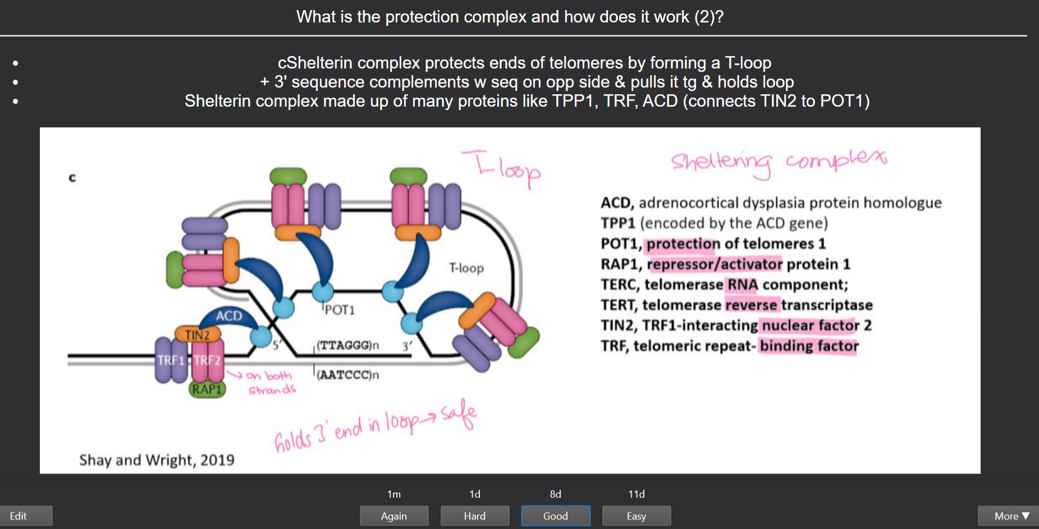
Anki or Quizlet
Personalized Spaced repetition
Active recall
Notes:
WIWC upcoming event promo lol

Slide 12
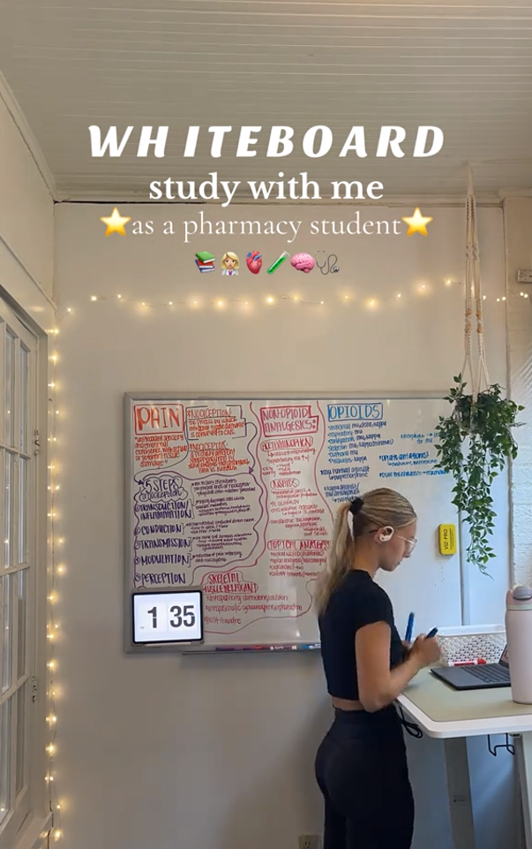
WhiteBoard Brain Dump
Active recall
Writing is organized thought!
Forces you to think
Use in conjunction with flashcards
Notes:
WIWC upcoming event promo lol

Slide 13
Practice Questions
Textbook
Practice Exam
Find questions online
Make your own
Strategies for Success
Notes:
WIWC upcoming event promo lol

Slide 14
Teach someone or study group
See if another person understands your explanation
Explain it to a child
Quiz each other
Ask questions if you’re confused
Strategies for Success
Notes:
WIWC upcoming event promo lol

Slide 15
“Cheat” sheet
Making summary sheets forces you to explain ideas concisely
Key concepts & formulas
Strategies for Success
Notes:
WIWC upcoming event promo lol

Slide 16
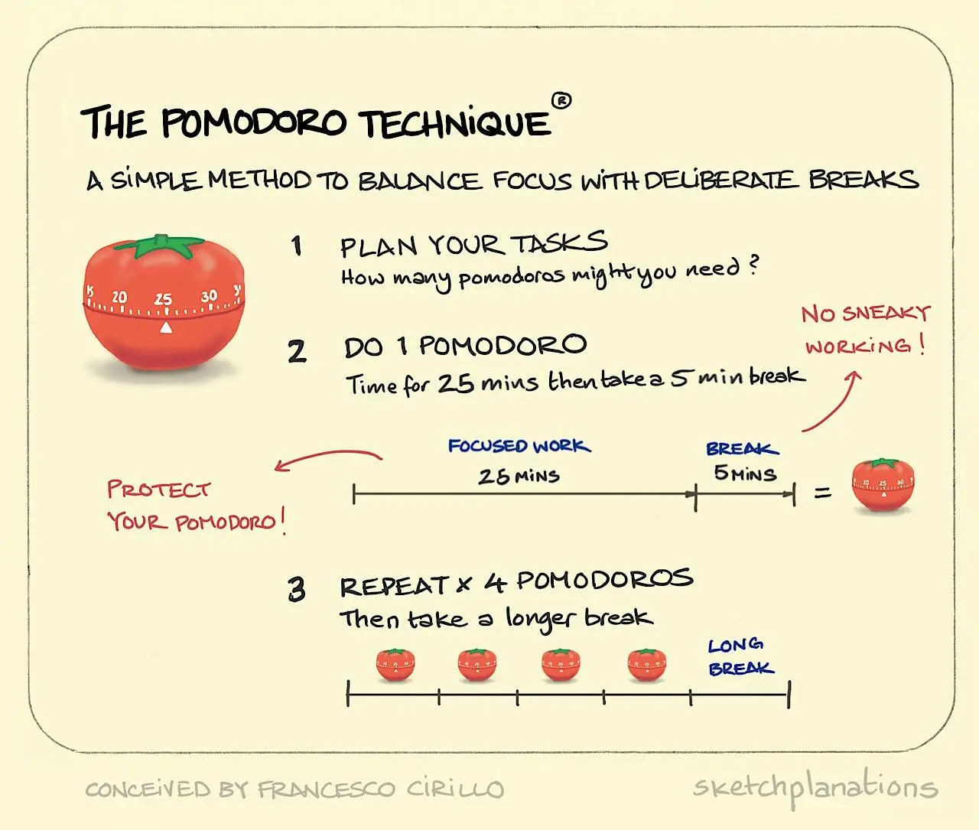
Pomodoro
Good for those who can’t study continuously for long periods
Study in chunks
Good for a long study day
Keep active during break
Common: 25/5 or 50/10
Notes:
WIWC upcoming event promo lol

Slide 17

Before, During & After Your Exam

Slide 18
Before Your Exam
1. SLEEP
Get a good night’s sleep! You need to recharge your body and mind so that you can feel your best at the exam. Don’t pull an all-nighter!
2. PACK
Get all your supplies together the night before so that you don’t forget anything! (pens, pencils, erasers, calculators, student card, sweater etc.)
3. FUEL YOUR MIND
Make sure you eat some food, but nothing too big or too sugary/caffeinated. You don’t want to feel sick or feel a sugar/coffee high during the exam.

Slide 19
Before Your Exam
4. GIVE YOURSELF EXTRA TIME
Arrive at least 15 minutes before your scheduled exam time. This will give you time to calm down, use the washroom & find a seat.
5. SET STUDY BOUNDARIES
Try not to study RIGHT before your exam → more stressed if you find you can’t remember something

Slide 20

Setting Up for Success
1. GET COMFY
Check Your Environment: Adjust chair and desk or comfort.
Prepare Essentials: Gather pens, pencils, erasers, ID, water bottle, and any allowed materials.
Wear Layers: Dress in layers for temperature control.
Relax Your Body: Maintain good posture and stretch subtly if needed.

Slide 21
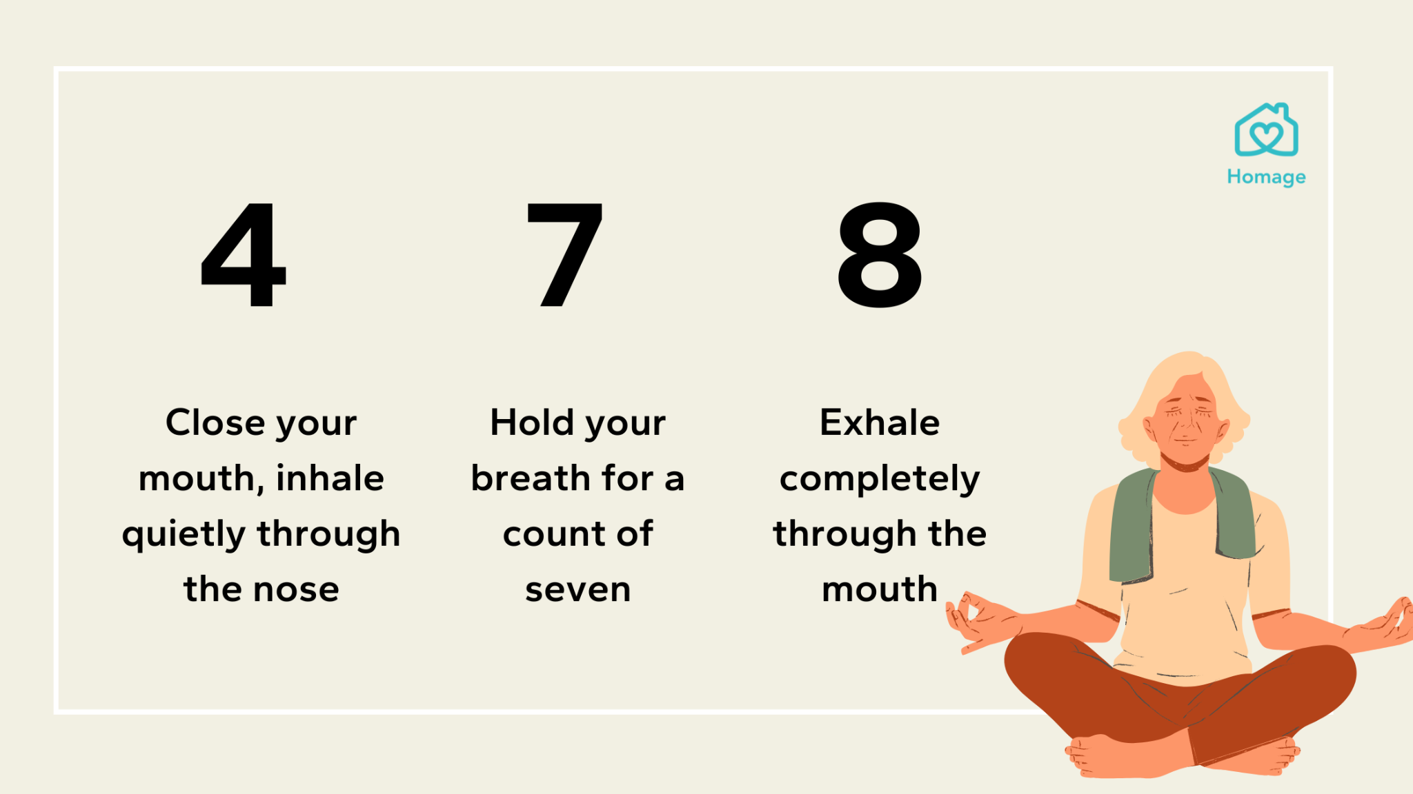

Believe in yourself
2.BREATHE
Deep Breathing: Use the "4-7-8" technique (inhale for 4 counts, hold for 7, exhale for 8) to reduce anxiety.
Positive Visualization: Picture yourself succeeding and feeling proud after the exam.
Positive Self-Talk: Remind yourself that you’ve prepared for this moment. Focus on the effort you've put in and trust yourself to do your best. Replace negative thoughts like "I’m going to fail" with "I’m ready for this.”

Slide 22
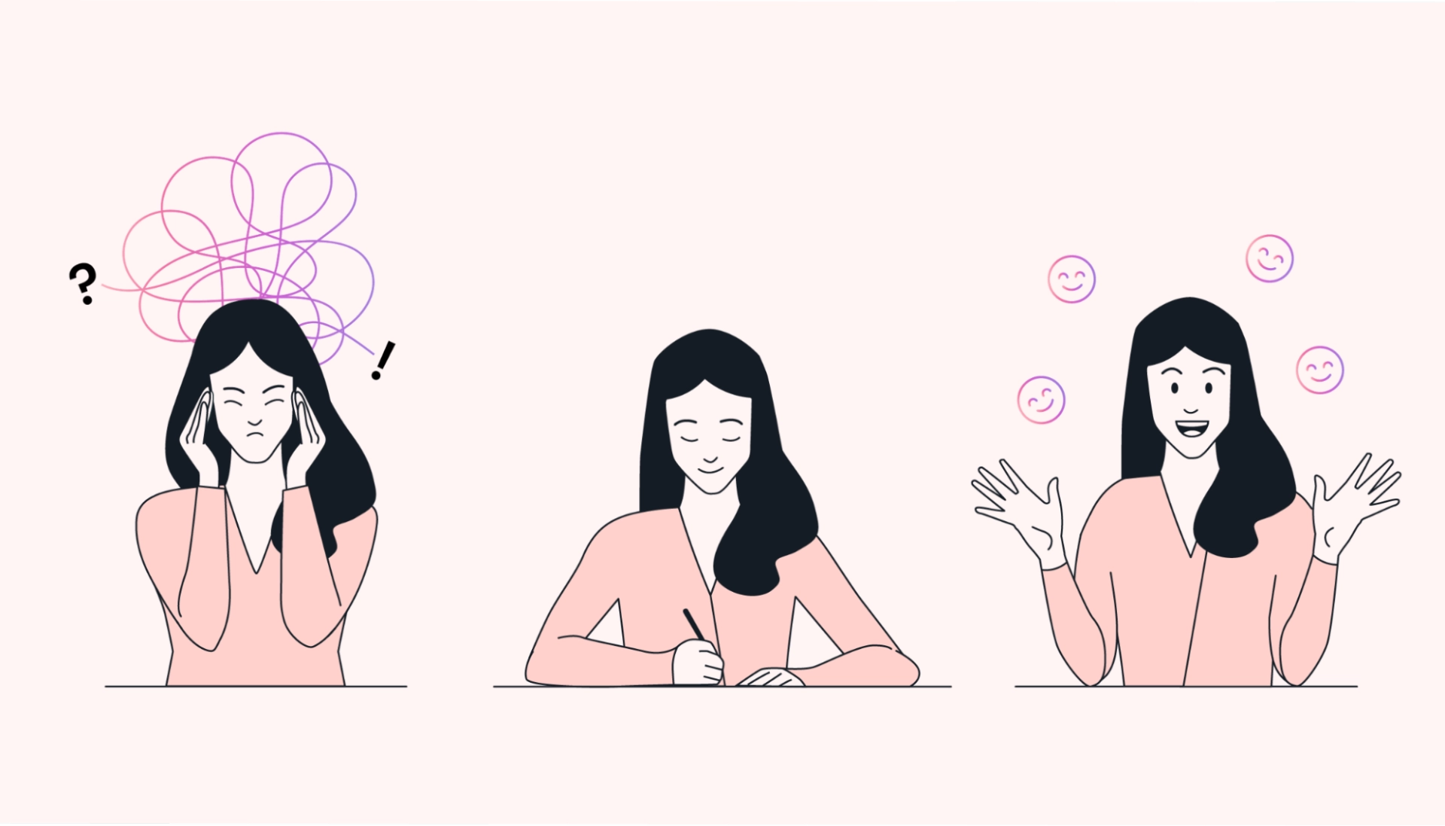
Brain Dump & Organize
3. RECALL
Brain Dump: Write down key formulas, equations, or important info at the start of the exam for quick reference.
Organize Your Thoughts: For essays or long-answer questions, write down a quick outline or key points before starting so that you can structure your answer without worrying about missing important details.

Slide 23
During Your Exam
4. READ CAREFULLY
Read through all the exam instructions and each question thoroughly before starting. Make sure you have all the exam pages.
5. SET TIME-BASED GOALS
Make up a rough “time budget”. Allot more time to questions worth more marks. Do the questions you know first (give yourself a confidence boost!). If possible, try to give yourself 10-15 minutes to review your answers.
6. DO YOUR BEST
Do your best to write down something for each question, even if it's just a formula or a few key points. Something is (usually) better than nothing!

Slide 24
Ready, Set, Go! Exam Prep & Time Hacks
Follow Instructions Precisely: Pay attention to specific instructions (e.g., "One sentence answer," "No partial credit").
Check for Missing Pages: Quickly verify all pages are included in the exam and notify the examiner if something is missing.
Time Management: Divide the total exam time by the number of questions; adjust based on complexity.
Start with Easy Questions: Answer confident questions first to build momentum and secure easy marks.
Prioritize Higher-Mark Questions: Focus more time on questions worth more points if time runs short

Slide 25
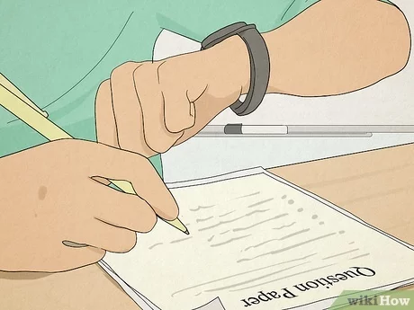
Stay Cool, Keep Calm & Conquer the Exam!
Don’t Leave Questions Blank: Write something, even if incomplete, to earn partial credit.
Show Your Work: In math/science exams, detail your process for potential partial credit.
Stay Calm and Persistent: If stuck, move on and return to difficult questions later. Keep a steady pace

Slide 26
After Your Exam
1. RELAX
Give yourself time to decompress and relax your brain for at least at hour if possible.
2. REVIEW
Review your exams once they are marked. See where you did well and where you made mistakes.
3. REFLECT
Reflect on which study strategies you used, and it they worked for you. Keep using the ones that worked and change up the others that didn’t!

Slide 27

Post-Exam Reflection & Growth
Stress Management: Take a break after the exam to recharge and avoid overthinking results.
Physical Relaxation: Engage in relaxing activities (walk, read, hobby) to reduce stress.
Rest is Productive: Relaxation aids recovery and improves future performance—take at least an hour to unwind.
Learn from Mistakes: Review your exam to understand errors and improve for next time.
Celebrate Successes: Acknowledge strengths and areas where you did well to boost confidence.
Ask for Feedback: Seek clarification from professors/TAs on mistakes or unclear questions.
Self-Assessment: Reflect on your study methods to see what worked and what didn’t.
Continuous Improvement: Adapt and refine your study strategies for better performance next time

Slide 28
Helpful Resources

Slide 29
Helpful Resources
1. PASS
https://www.yorku.ca/colleges/bethune/help/pass/schedule/
2. PEER TUTORING
https://www.yorku.ca/colleges/bethune/help/tutoring/
3. STUDY TASK BREAKDOWN FOR EXAMS PLANNER
https://www.yorku.ca/scld/wp-content/uploads/sites/36/2023/11/Study-Task-Breakdown.pdf
4. WRITING CENTRE
https://www.yorku.ca/colleges/bethune/writing/

Slide 30

Summary
Gather all the information you can about each exam as soon as possible
Plan your time to study
Write notes and create a study guide
Before your exam, make sure you sleep, pack your bag, and eat some food
During your exam, read carefully, set time-based goals, and try your best
After your exam, relax, review, and reflect
Seek extra support ahead of time if needed

Slide 31
Advice From Our Mentors

Slide 32
I have so many midterms in the same week, how do I organize my time?
Create a clear schedule: List your midterms by date and difficulty. Start early, use time blocks, and rotate subjects.
Use active study techniques: space out study sessions so you're not cramming. Explain the concepts to yourself out loud for each class. Summarize key concepts too!

Slide 33
How did you know when to practice self-care and take breaks?
When I kept getting burned out & could not study after X hours → studying past your limit is a waste of time
Staying active helps fight off fatigue & better focus

Slide 34
What on or off campus resources did you seek for extra help?
Peer Tutoring
PASS (Peer Assisted Study Sessions)
Office Hours
Professor Review Sessions: Helpful tips and prioritizing topics.
Practice Questions/Old Exams: Familiarize yourself with the exam format and boost confidence.

Slide 35
HAVE ANY QUESTIONS?
Send us an email: BCMENTOR@YORKU.CA
Visit:
bethune.yorku.ca

