Slide 1
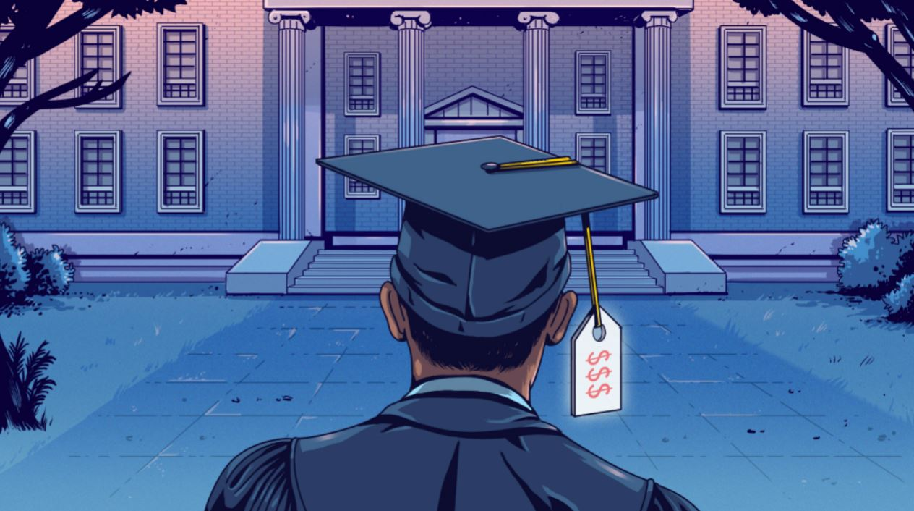

Money Matters
Financial Wellness Series
Harvey, G. (2019). [Picture of a student looking at an educational institution with a price tag over his hat] [Digital Image]. TVOntario. https://www.tvo.org/article/ontario-colleges-need-international-tuition-it-could-cost-them
Unless otherwise noted, all content in this document was created by Hari Chand Balachandran Pillai, Hashir Ahmad, Deepinderjit Kaur Labana, Nicholas Cheng, Jennifer Diep, Kaman Hui, Simi Sahota, Maria Palermo, Jennine Rawana, Mazen Hamadeh, & Agata Stypka in 2021, and is available under a Creative Commons Attribution-NonCommercial 4.0 International license. If you reuse this work, please attribute The Financial Wellness Project, York University and Emery Collegiate Institute.
Notes:
Hey, my name is Hari and today I am going to talk about the different money attitudes, the importance of saving and the value of goal-setting.

Slide 2
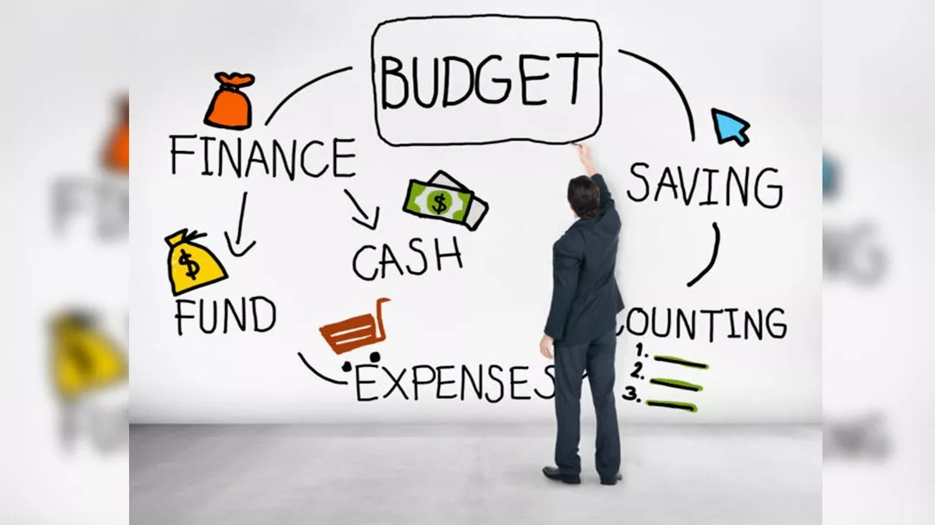
What’s your
current understanding of financial literacy?
Wight, C. (2019). [Picture of a person looking at the elements of financial literacy on a whiteboard] [Photograph]. New Mexico Restaurant Association.
https://www.nmrestaurants.org/financial-literacy-for-restaurants/
Unless otherwise noted, all content in this document was created by Hari Chand Balachandran Pillai, Hashir Ahmad, Deepinderjit Kaur Labana, Nicholas Cheng, Jennifer Diep, Kaman Hui, Simi Sahota, Maria Palermo, Jennine Rawana, Mazen Hamadeh, & Agata Stypka in 2021, and is available under a Creative Commons Attribution-NonCommercial 4.0 International license. If you reuse this work, please attribute The Financial Wellness Project, York University and Emery Collegiate Institute.
Notes:
For these three questions, I want an answer from you guys. Read Question. Feel free to respond in the chat, or you use your mic, that would be great.
Ask the questions to the group, and the answer to each question is in the next slide that consists of a picture that can be easily described.

Slide 3
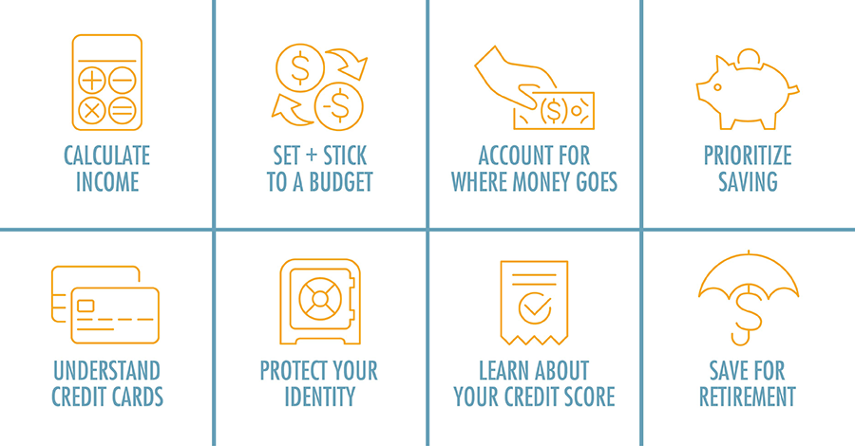
8 Essential Components of Financial Literacy
(2021). 8 Essential Components of Financial Literacy [Digital Image]. Consolidated Community Credit Union.
https://www.consolidatedccu.com/financial-literacy
Unless otherwise noted, all content in this document was created by Hari Chand Balachandran Pillai, Hashir Ahmad, Deepinderjit Kaur Labana, Nicholas Cheng, Jennifer Diep, Kaman Hui, Simi Sahota, Maria Palermo, Jennine Rawana, Mazen Hamadeh, & Agata Stypka in 2021, and is available under a Creative Commons Attribution-NonCommercial 4.0 International license. If you reuse this work, please attribute The Financial Wellness Project, York University and Emery Collegiate Institute.
Notes:
First of all, I just want to point out how great that animation was.
Back to the question, this image shows eight components that sum up financial literacy in a simple way.
Some are calculating income, prioritizing savings, and learning about credit score.
(Wait few seconds) Alright, onto the next question…

Slide 4

How have you used
financial
literacy in your life?
Randolph, K. (2020). The 5 Key Components of Financial Literacy [Digital Image]. Fastweb.
https://www.fastweb.com/student-life/articles/the-5-key-components-of-financial-literacy
Unless otherwise noted, all content in this document was created by Hari Chand Balachandran Pillai, Hashir Ahmad, Deepinderjit Kaur Labana, Nicholas Cheng, Jennifer Diep, Kaman Hui, Simi Sahota, Maria Palermo, Jennine Rawana, Mazen Hamadeh, & Agata Stypka in 2021, and is available under a Creative Commons Attribution-NonCommercial 4.0 International license. If you reuse this work, please attribute The Financial Wellness Project, York University and Emery Collegiate Institute.
Notes:
When you’re an adult, I think you need to use financial literacy to make important decisions on spending your money carefully.
Some common examples are: setting and sticking to a budget, understanding credit cards and prioritizing savings.

Slide 5
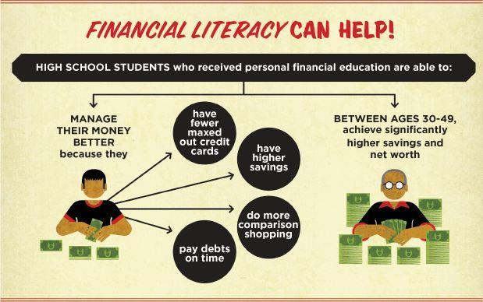
Bodhi, G. (2019). [Picture of a section in an infographic called American Spending Habits] [Digital Image]. Financial Freedom 101.
https://financialfreedom101.blog/2019/10/01/should-financial-literacy-be-taught-in-high-school/
Unless otherwise noted, all content in this document was created by Hari Chand Balachandran Pillai, Hashir Ahmad, Deepinderjit Kaur Labana, Nicholas Cheng, Jennifer Diep, Kaman Hui, Simi Sahota, Maria Palermo, Jennine Rawana, Mazen Hamadeh, & Agata Stypka in 2021, and is available under a Creative Commons Attribution-NonCommercial 4.0 International license. If you reuse this work, please attribute The Financial Wellness Project, York University and Emery Collegiate Institute.
Notes:
Financial literacy is important and beneficial. How you may ask?
Well, high school students who received personal financial education are able to manage their money better because they use techniques they learn from their financial education such as doing more comparison shopping and having higher savings.
And these same students between the ages 30-49 are able to achieve significantly higher savings and net worth.
Alright, next question...

Slide 6

What is the difference between financial wellness and financial literacy?
(2020). [Picture of piggy bank on books along with the words learn, invest, save] [Digital Image]. ADVFN News.
https://uk.advfn.com/newspaper/advfnnews/56758/the-global-impact-of-low-financial-literacy-rates-worldwide
Unless otherwise noted, all content in this document was created by Hari Chand Balachandran Pillai, Hashir Ahmad, Deepinderjit Kaur Labana, Nicholas Cheng, Jennifer Diep, Kaman Hui, Simi Sahota, Maria Palermo, Jennine Rawana, Mazen Hamadeh, & Agata Stypka in 2021, and is available under a Creative Commons Attribution-NonCommercial 4.0 International license. If you reuse this work, please attribute The Financial Wellness Project, York University and Emery Collegiate Institute.
Notes:
Read Question.

Slide 7


Financial wellness is taking control of your money so it doesn't take control of you.
Financial literacy is the ability to understand and effectively use various financial skills.
Examples:
Spending wisely and within your means.
Having an emergency fund.
Having access to tools and education to make beneficial financial decisions.
Examples:
Planning what to do with your money
Paying off debt
Understanding the time/money trade-off
Retirement planning
White, J. (2019). Why you should care about Financial Wellness in the Workplace [Digital Image]. Olympia Benefits Inc.
https://www.olympiabenefits.com/blog/why-you-should-care-about-employee-financial-wellness-in-the-workplace
Charles, A. (2020). Financial literacy 101: banking and budgeting [Photograph]. Manulife Bank.
https://www.manulifebank.ca/personal-banking/plan-and-learn/personal-finance/financial-literacy-101-banking-and-budgeting.html
Unless otherwise noted, all content in this document was created by Hari Chand Balachandran Pillai, Hashir Ahmad, Deepinderjit Kaur Labana, Nicholas Cheng, Jennifer Diep, Kaman Hui, Simi Sahota, Maria Palermo, Jennine Rawana, Mazen Hamadeh, & Agata Stypka in 2021, and is available under a Creative Commons Attribution-NonCommercial 4.0 International license. If you reuse this work, please attribute The Financial Wellness Project, York University and Emery Collegiate Institute.
Notes:
Financial wellness means you taking full control of your money so that it doesn’t negatively impact you, whereas financial literacy means your ability to use financial skills, some examples of both are included onscreen. (Wait a few seconds)
Alright, I just want to take this chance to thank you for this amazing opportunity to work with such a wonderful team and learn so much about post secondary education and finances. Back to you Mr. Chichester!

Slide 8
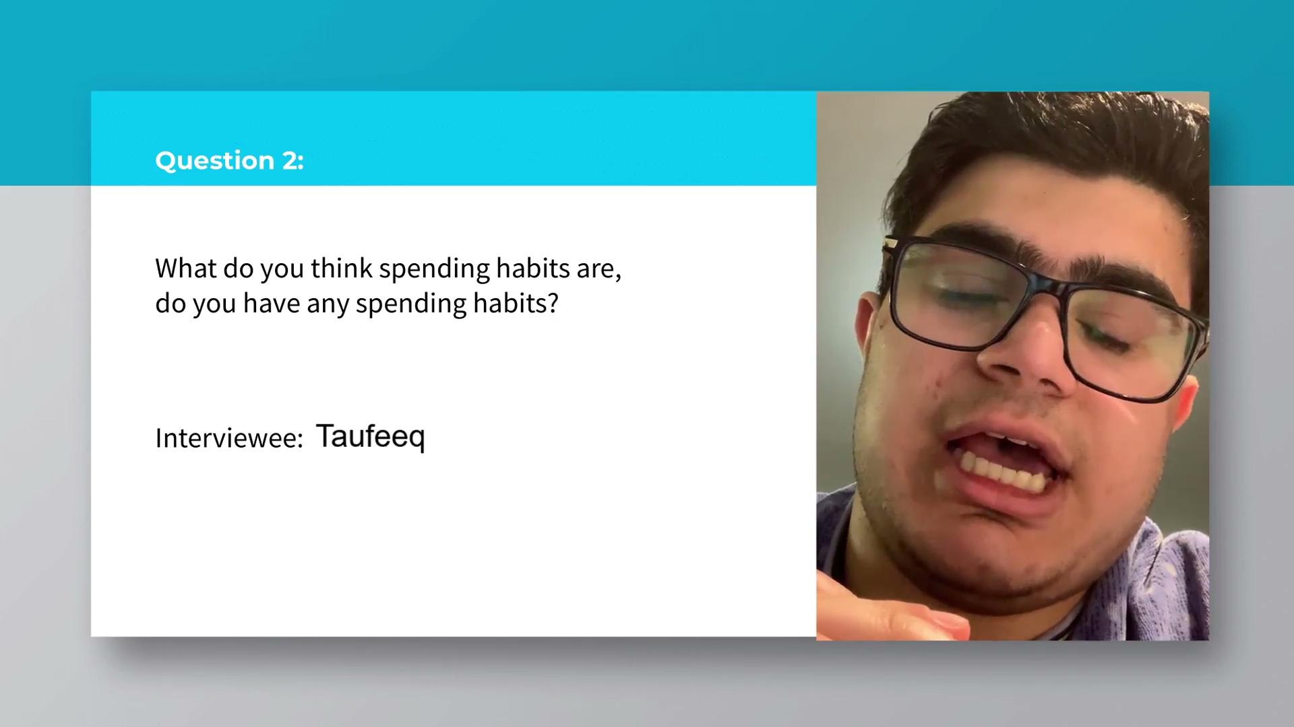
Unless otherwise noted, all content in this document was created by Hari Chand Balachandran Pillai, Hashir Ahmad, Deepinderjit Kaur Labana, Nicholas Cheng, Jennifer Diep, Kaman Hui, Simi Sahota, Maria Palermo, Jennine Rawana, Mazen Hamadeh, & Agata Stypka in 2021, and is available under a Creative Commons Attribution-NonCommercial 4.0 International license. If you reuse this work, please attribute The Financial Wellness Project, York University and Emery Collegiate Institute.
Notes:
Here is a Q&A Video made by Hashir asking Emery students for their response to some financial questions.

Slide 9

Money Attitudes
Zahan, F. (2020). [Picture of Canadian dollar bills] [Photograph]. Osgoode Hall Law School.
http://www.thecourt.ca/michel-v-graydon-scc-clarifies-law-on-retroactive-child-support-orders-from-a-feminization-of-poverty-lens/
Unless otherwise noted, all content in this document was created by Hari Chand Balachandran Pillai, Hashir Ahmad, Deepinderjit Kaur Labana, Nicholas Cheng, Jennifer Diep, Kaman Hui, Simi Sahota, Maria Palermo, Jennine Rawana, Mazen Hamadeh, & Agata Stypka in 2021, and is available under a Creative Commons Attribution-NonCommercial 4.0 International license. If you reuse this work, please attribute The Financial Wellness Project, York University and Emery Collegiate Institute.
Notes:
We will first talk about money attitudes.
Attitude is key in all aspects of life but what about when it comes to money?
The truth is a healthy attitude towards money leads to financial security, which refers to the peace of mind you feel when you aren't worried about being able to cover your expenses.
There are two common attitudes toward money, one of optimism and abundance and one of scarcity and pessimism. People with an attitude of scarcity have a negative view of money and see money as a source of anxiety, fear or disgust (you don’t want to have that).
What you want to have is an attitude of abundance where you see money as a tool to help yourself reach financial success.
People with a positive money attitude generally spend less than they earn, save for the future, manage their credit, give to others and plan for unexpected expenses.

Slide 10
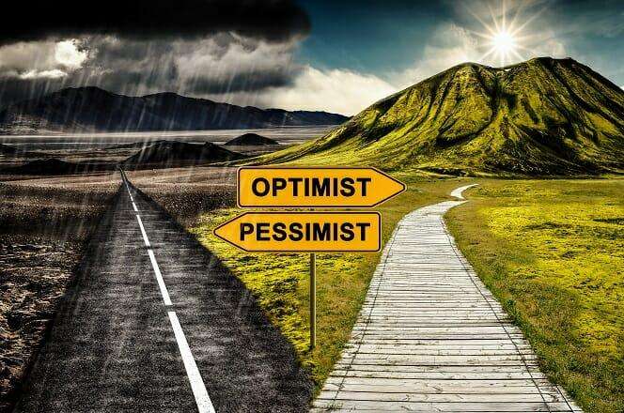
Key Takeaway - Optimism (or a positive money attitude) often leads to financial stability and success.
(n.d.). Pessimism and Optimism in Finance [Digital Image]. CFI Education Inc.
https://corporatefinanceinstitute.com/resources/knowledge/trading-investing/pessimist-vs-optimist-investors/
Unless otherwise noted, all content in this document was created by Hari Chand Balachandran Pillai, Hashir Ahmad, Deepinderjit Kaur Labana, Nicholas Cheng, Jennifer Diep, Kaman Hui, Simi Sahota, Maria Palermo, Jennine Rawana, Mazen Hamadeh, & Agata Stypka in 2021, and is available under a Creative Commons Attribution-NonCommercial 4.0 International license. If you reuse this work, please attribute The Financial Wellness Project, York University and Emery Collegiate Institute.
Notes:
A key takeaway from this would be that optimism (or a positive money attitude) often leads to financial stability and success.

Slide 11

Savings
(2020). [Picture of the number of coins increasing with each row and the plant on top of each row growing] [Photograph]. Bondora Capital.
https://www.bondora.com/blog/7-signs-you-are-bad-at-saving-money/
Unless otherwise noted, all content in this document was created by Hari Chand Balachandran Pillai, Hashir Ahmad, Deepinderjit Kaur Labana, Nicholas Cheng, Jennifer Diep, Kaman Hui, Simi Sahota, Maria Palermo, Jennine Rawana, Mazen Hamadeh, & Agata Stypka in 2021, and is available under a Creative Commons Attribution-NonCommercial 4.0 International license. If you reuse this work, please attribute The Financial Wellness Project, York University and Emery Collegiate Institute.
Notes:
Next is Savings. Savings refer to money you put aside for future use rather than spending it immediately.
Your savings can be used to increase your income through investing.
You should save money for three basic reasons: emergency fund, purchases and wealth building
An emergency fund will be your safety net in case something unexpected happens.
Saving up for purchases help you to avoid credit cards and it can help improve your credit.
You can build your wealth from savings by investing it and there are a multitude of ways to invest.

Slide 12

(2013). An Education in Inflation: Ontario (1990-2013) [Digital Image]. Canadian Centre for Policy Alternatives.
https://www.policyalternatives.ca/publications/facts-infographics/infographic-education-inflation
Unless otherwise noted, all content in this document was created by Hari Chand Balachandran Pillai, Hashir Ahmad, Deepinderjit Kaur Labana, Nicholas Cheng, Jennifer Diep, Kaman Hui, Simi Sahota, Maria Palermo, Jennine Rawana, Mazen Hamadeh, & Agata Stypka in 2021, and is available under a Creative Commons Attribution-NonCommercial 4.0 International license. If you reuse this work, please attribute The Financial Wellness Project, York University and Emery Collegiate Institute.
Notes:
The importance of savings is reinforced as the cost of a university education in Ontario has increased by 400% since 1990, whereas everything else has increased by a much lower percentage.

Slide 13
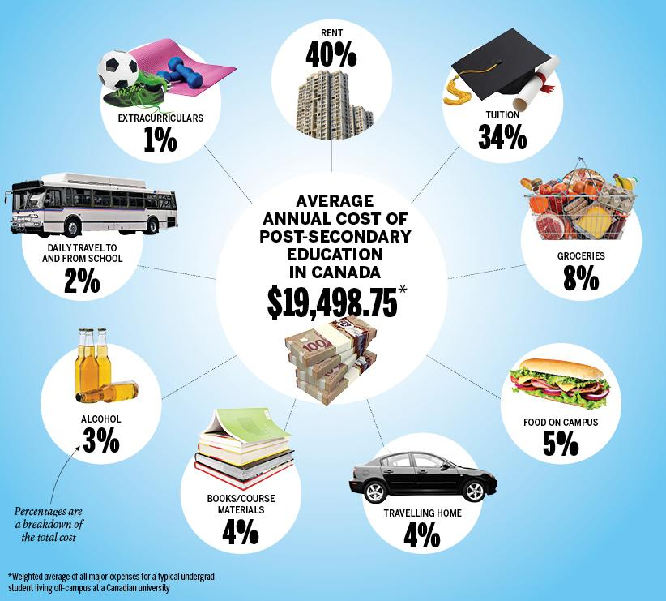
Brown, M. (2018). The total average cost of a post-secondary education [Digital Image]. St. Joseph Communications.
https://www.macleans.ca/education/pay-for-university-education-tuition/
Unless otherwise noted, all content in this document was created by Hari Chand Balachandran Pillai, Hashir Ahmad, Deepinderjit Kaur Labana, Nicholas Cheng, Jennifer Diep, Kaman Hui, Simi Sahota, Maria Palermo, Jennine Rawana, Mazen Hamadeh, & Agata Stypka in 2021, and is available under a Creative Commons Attribution-NonCommercial 4.0 International license. If you reuse this work, please attribute The Financial Wellness Project, York University and Emery Collegiate Institute.
Notes:
The average annual cost for a student living off-campus at a Canadian university is $19,498.75. This includes students pursuing all sorts of degrees. Again, some savings would definitely help you to cover some of these post-secondary expenses.

Slide 14
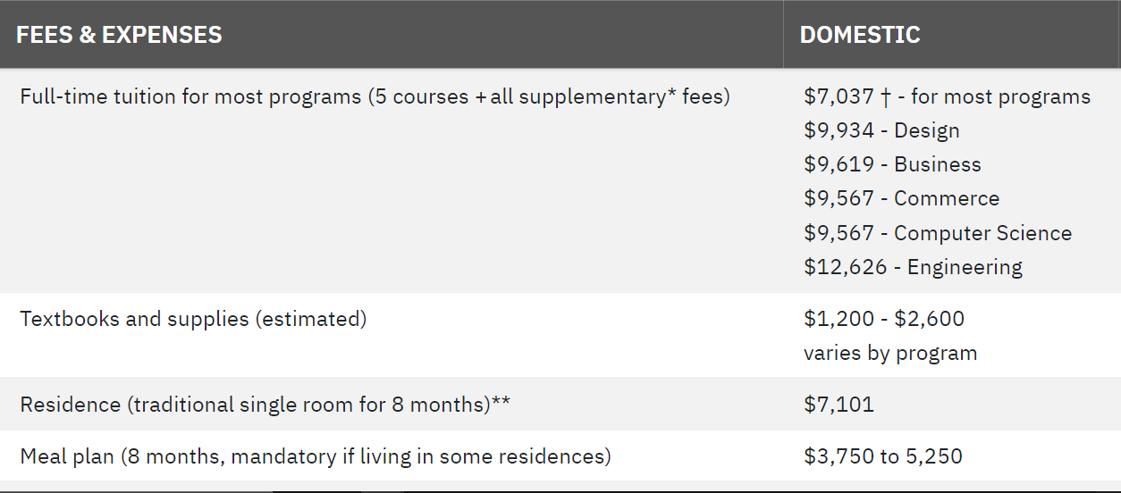

Yearly Costs Based on a Full-time Student Pursuing a Bachelor of Arts at York University
Source: York U Website
(2020). Yearly costs based on a full-time student pursuing a Bachelor of Arts for the fall/winter 2020-2021 [Digital Image]. York University.
https://futurestudents.yorku.ca/tuition
Unless otherwise noted, all content in this document was created by Hari Chand Balachandran Pillai, Hashir Ahmad, Deepinderjit Kaur Labana, Nicholas Cheng, Jennifer Diep, Kaman Hui, Simi Sahota, Maria Palermo, Jennine Rawana, Mazen Hamadeh, & Agata Stypka in 2021, and is available under a Creative Commons Attribution-NonCommercial 4.0 International license. If you reuse this work, please attribute The Financial Wellness Project, York University and Emery Collegiate Institute.

Slide 15
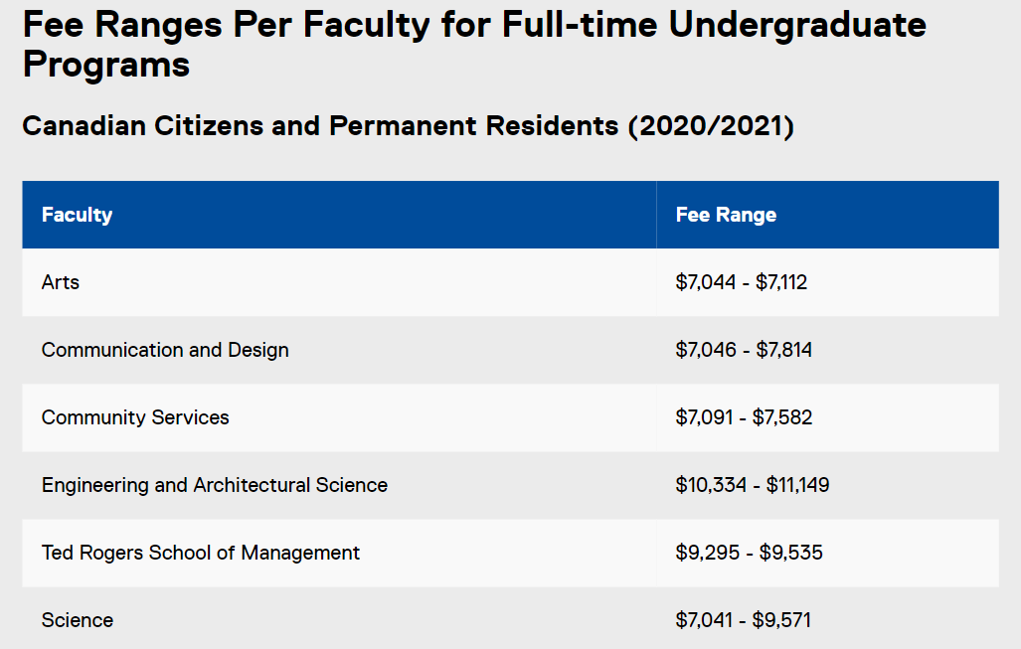

Source: Ryerson U Website
(n.d.). Ryerson Logo [Digital Image]. Ryerson University.
https://www.ryerson.ca/brand/visual-toolkit/university-logo/
(n.d.). York University [Digital Image]. Quacquarelli Symonds Limited.
https://www.topuniversities.com/universities/york-university
Unless otherwise noted, all content in this document was created by Hari Chand Balachandran Pillai, Hashir Ahmad, Deepinderjit Kaur Labana, Nicholas Cheng, Jennifer Diep, Kaman Hui, Simi Sahota, Maria Palermo, Jennine Rawana, Mazen Hamadeh, & Agata Stypka in 2021, and is available under a Creative Commons Attribution-NonCommercial 4.0 International license. If you reuse this work, please attribute The Financial Wellness Project, York University and Emery Collegiate Institute.

Slide 16
Source: Ryerson U Website
(n.d.). Ryerson Logo [Digital Image]. Ryerson University.
https://www.ryerson.ca/brand/visual-toolkit/university-logo/
(2020). Fee Ranges Per Faculty for Full-time Undergraduate Programs [Digital Image]. Ryerson University.
https://www.ryerson.ca/admissions/tuition-fees/
Unless otherwise noted, all content in this document was created by Hari Chand Balachandran Pillai, Hashir Ahmad, Deepinderjit Kaur Labana, Nicholas Cheng, Jennifer Diep, Kaman Hui, Simi Sahota, Maria Palermo, Jennine Rawana, Mazen Hamadeh, & Agata Stypka in 2021, and is available under a Creative Commons Attribution-NonCommercial 4.0 International license. If you reuse this work, please attribute The Financial Wellness Project, York University and Emery Collegiate Institute.

Slide 17

Engineering
Computer Engineering Undergraduate Program @University of Toronto
  Length of Program: Four Years or Five Years including Co-Op option.
  Tuition Cost Per Year: Approximately $14,180 per year for Canadian Citizens and Permanent Residents.
  Total Tuition Cost: Finishing the program would add up to an approximate total tuition cost of $56,720.
Mechanical Engineering @Ryerson University
  Length of Program: Four Years or Five Years including Co-Op option.
  Tuition Cost Per Year: Approximately $11,148.94 per year for Canadian Citizens and Permanent Residents.
  Total Tuition Cost: Finishing the program would add up to an approximate total tuition cost of $44,595.
(n.d.). Ryerson Logo [Digital Image]. Ryerson University.
https://www.ryerson.ca/brand/visual-toolkit/university-logo/
(2021). University of Toronto [Digital Image]. Glassdoor.
https://www.glassdoor.ca/Reviews/University-of-Toronto-Reviews-E31043.htm
Unless otherwise noted, all content in this document was created by Hari Chand Balachandran Pillai, Hashir Ahmad, Deepinderjit Kaur Labana, Nicholas Cheng, Jennifer Diep, Kaman Hui, Simi Sahota, Maria Palermo, Jennine Rawana, Mazen Hamadeh, & Agata Stypka in 2021, and is available under a Creative Commons Attribution-NonCommercial 4.0 International license. If you reuse this work, please attribute The Financial Wellness Project, York University and Emery Collegiate Institute.

Slide 18
Engineering
3. Civil Engineering @York University
  Length of Program: Four Years or Five Years including Co-Op option.
  Tuition Cost Per Year: Approximately $12,626 per year for Canadian Citizens and Permanent Residents.
  Total Tuition Cost: Finishing the program would add up to an approximate total tuition cost of $50,504.
Unless otherwise noted, all content in this document was created by Hari Chand Balachandran Pillai, Hashir Ahmad, Deepinderjit Kaur Labana, Nicholas Cheng, Jennifer Diep, Kaman Hui, Simi Sahota, Maria Palermo, Jennine Rawana, Mazen Hamadeh, & Agata Stypka in 2021, and is available under a Creative Commons Attribution-NonCommercial 4.0 International license. If you reuse this work, please attribute The Financial Wellness Project, York University and Emery Collegiate Institute.

Slide 19

Medical Field
Doctor
  Life Sciences Program (University of Waterloo)
  Length of Program: Four Years or Five Years including Co-Op option.
  Tuition Cost Per Year: Approximately $7,700 per year, additional $2,290 for first-year books and supplies
  Total Tuition Cost: Finishing the program would add up to an approximate total tuition cost of $39,960.
  Four-year MD Program (University of Toronto)
  Tuition Cost Per Year: Approximately $25,000 per year of study, additional $1,700 for first-year books and supplies
  Total Tuition Cost: Finishing the program would add up to an approximate total tuition cost of $100,000.
Grand Total: $139,960
(2021). University of Toronto [Digital Image]. Glassdoor.
https://www.glassdoor.ca/Reviews/University-of-Toronto-Reviews-E31043.htm
(n.d.). [Picture of University of Waterloo Logo] [Digital Image]. The University of Waterloo.
https://uwaterloo.ca/engineering/about/our-history/timelines
Unless otherwise noted, all content in this document was created by Hari Chand Balachandran Pillai, Hashir Ahmad, Deepinderjit Kaur Labana, Nicholas Cheng, Jennifer Diep, Kaman Hui, Simi Sahota, Maria Palermo, Jennine Rawana, Mazen Hamadeh, & Agata Stypka in 2021, and is available under a Creative Commons Attribution-NonCommercial 4.0 International license. If you reuse this work, please attribute The Financial Wellness Project, York University and Emery Collegiate Institute.
Notes:
Contrary to popular belief, you can apply to medical school from any undergraduate program, you may prefer a Science-based program though.

Slide 20
Medical Field
2. Nurse
  Collaborative Bachelor of Science in Nursing @Georgian/Seneca College + York University
  Length of Program: 4-year full-time program
  Tuition Cost Per Year: Approximately $7,311.12 per year, additional $4,200 for Books and Supplies.
  Total Tuition Cost: Finishing the program would add up to an approximate total tuition cost of $35,000.
Unless otherwise noted, all content in this document was created by Hari Chand Balachandran Pillai, Hashir Ahmad, Deepinderjit Kaur Labana, Nicholas Cheng, Jennifer Diep, Kaman Hui, Simi Sahota, Maria Palermo, Jennine Rawana, Mazen Hamadeh, & Agata Stypka in 2021, and is available under a Creative Commons Attribution-NonCommercial 4.0 International license. If you reuse this work, please attribute The Financial Wellness Project, York University and Emery Collegiate Institute.
Notes:
There are multiple ways to become a nurse; one of them is..

Slide 21
Other Examples
Bachelor of Business (York University)
  Length of Program: 4 Years
  Tuition Cost Per Year: Average yearly tuition cost is $9,619.
  Total Tuition Cost: Finishing the program would add up to an approximate total tuition cost of $39,000.
Criminology @Ryerson University
  Length of Program: 4 Years
  Tuition Cost Per Year: Average yearly tuition cost is $7,112.
  Total Tuition Cost: Finishing the program would add up to an approximate total tuition cost of $28,500.
(n.d.). Ryerson Logo [Digital Image]. Ryerson University.
https://www.ryerson.ca/brand/visual-toolkit/university-logo/
Unless otherwise noted, all content in this document was created by Hari Chand Balachandran Pillai, Hashir Ahmad, Deepinderjit Kaur Labana, Nicholas Cheng, Jennifer Diep, Kaman Hui, Simi Sahota, Maria Palermo, Jennine Rawana, Mazen Hamadeh, & Agata Stypka in 2021, and is available under a Creative Commons Attribution-NonCommercial 4.0 International license. If you reuse this work, please attribute The Financial Wellness Project, York University and Emery Collegiate Institute.
Notes:
There are multiple ways to become a nurse; one of them is..

Slide 22
Other Examples
3. Image Arts: Photography Studies @Ryerson University
  Length of Program: 4 Years
  Tuition Cost Per Year: Average yearly tuition cost is $7,814.
  Total Tuition Cost: Finishing the program would add up to an approximate total tuition cost of $31,256.
(n.d.). Ryerson Logo [Digital Image]. Ryerson University.
https://www.ryerson.ca/brand/visual-toolkit/university-logo/
Unless otherwise noted, all content in this document was created by Hari Chand Balachandran Pillai, Hashir Ahmad, Deepinderjit Kaur Labana, Nicholas Cheng, Jennifer Diep, Kaman Hui, Simi Sahota, Maria Palermo, Jennine Rawana, Mazen Hamadeh, & Agata Stypka in 2021, and is available under a Creative Commons Attribution-NonCommercial 4.0 International license. If you reuse this work, please attribute The Financial Wellness Project, York University and Emery Collegiate Institute.
Notes:
There are multiple ways to become a nurse; one of them is..

Slide 23
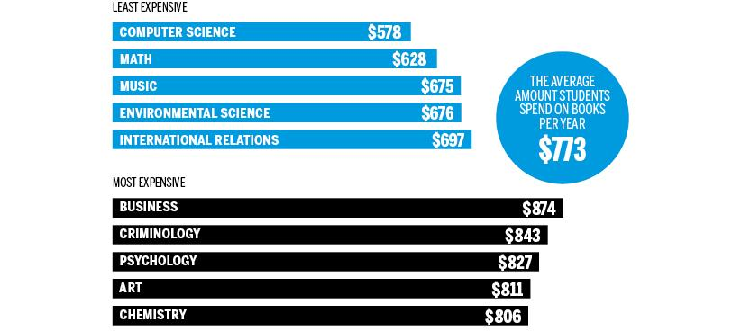
Brown, M. (2018). The cost of books by program [Digital Image]. St. Joseph Communications.
https://www.macleans.ca/education/the-cost-of-a-canadian-university-education-in-six-charts/
Unless otherwise noted, all content in this document was created by Hari Chand Balachandran Pillai, Hashir Ahmad, Deepinderjit Kaur Labana, Nicholas Cheng, Jennifer Diep, Kaman Hui, Simi Sahota, Maria Palermo, Jennine Rawana, Mazen Hamadeh, & Agata Stypka in 2021, and is available under a Creative Commons Attribution-NonCommercial 4.0 International license. If you reuse this work, please attribute The Financial Wellness Project, York University and Emery Collegiate Institute.
Notes:
These are one of the expenses that aren’t a part of the upfront tuition fees.
My Blueprint is a great resource you should check out

Slide 24
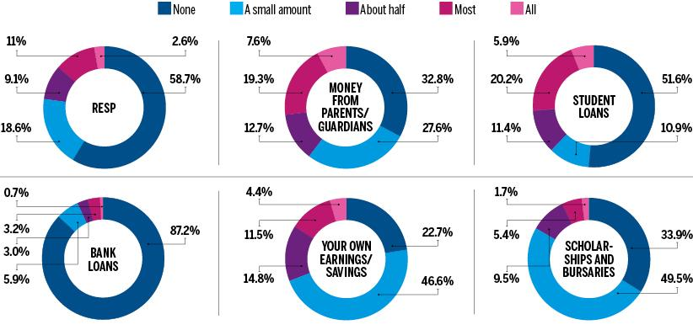
Brown, M. (2018). Where does the money come from to pay for school? [Digital Image]. St. Joseph Communications.
https://www.macleans.ca/education/the-cost-of-a-canadian-university-education-in-six-charts/
Unless otherwise noted, all content in this document was created by Hari Chand Balachandran Pillai, Hashir Ahmad, Deepinderjit Kaur Labana, Nicholas Cheng, Jennifer Diep, Kaman Hui, Simi Sahota, Maria Palermo, Jennine Rawana, Mazen Hamadeh, & Agata Stypka in 2021, and is available under a Creative Commons Attribution-NonCommercial 4.0 International license. If you reuse this work, please attribute The Financial Wellness Project, York University and Emery Collegiate Institute.
Notes:
This chart answers the question: Where does the money come from to pay for school?
The good news is that only half of students are in debt. The bad news is that parents are picking up these expenses and not in a very efficient way. Nearly two-thirds of students say they don’t have an RESP, a Registered Education Savings Plan. And so… (next slide)

Slide 25

Key Takeaway - The importance of saving money is simple: It allows you to enjoy greater security in your life.
Weliver, D. (2021). How To Budget [Photograph]. Moneyunder30.
https://www.moneyunder30.com/no-more-budgets
Unless otherwise noted, all content in this document was created by Hari Chand Balachandran Pillai, Hashir Ahmad, Deepinderjit Kaur Labana, Nicholas Cheng, Jennifer Diep, Kaman Hui, Simi Sahota, Maria Palermo, Jennine Rawana, Mazen Hamadeh, & Agata Stypka in 2021, and is available under a Creative Commons Attribution-NonCommercial 4.0 International license. If you reuse this work, please attribute The Financial Wellness Project, York University and Emery Collegiate Institute.
Notes:
...The importance of saving money is simple: It allows you to enjoy greater security in your life. ‘Security’ relates to that peace of mind that I talked about before.

Slide 26

Budgeting
Weliver, D. (2020). Budget Well, Save More [Digital Image]. Moneyunder30.
https://www.moneyunder30.com/budgeting-in-your-twenties
Unless otherwise noted, all content in this document was created by Hari Chand Balachandran Pillai, Hashir Ahmad, Deepinderjit Kaur Labana, Nicholas Cheng, Jennifer Diep, Kaman Hui, Simi Sahota, Maria Palermo, Jennine Rawana, Mazen Hamadeh, & Agata Stypka in 2021, and is available under a Creative Commons Attribution-NonCommercial 4.0 International license. If you reuse this work, please attribute The Financial Wellness Project, York University and Emery Collegiate Institute.
Notes:
Now, Budgeting. Budgeting is the process of creating a plan to spend your money with your income and expenses. This spending plan is called a budget.
Creating this spending plan allows you to determine in advance whether you will have enough money to do the things you need to do or would like to do.
For example, a budget will tell you approximately how much money you will have leftover after you fulfil your needs such as rent, food, and gas.
Then, you can create another plan to decide where the rest of your money will go, whether it’s your savings or entertainment.
A budget would also be useful to plan how you would pay for your post-secondary education.

Slide 27
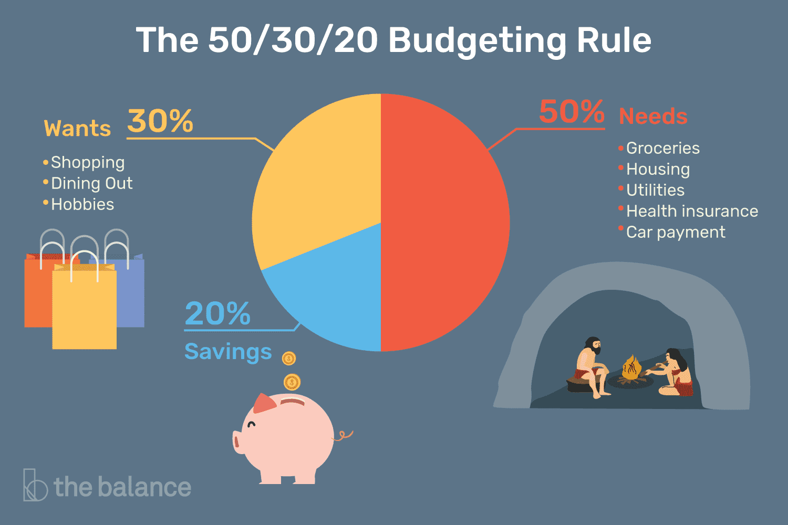
Key Takeaway - 50-30-20 Budget Rule - Divide up after-tax income and allocate it to spend: 50% on needs, 30% on wants, and 20% to savings.
Vansomeren, L. (2021). The 50/30/20 Budgeting Rule [Digital Image]. The Balance.
https://www.thebalance.com/the-50-30-20-rule-of-thumb-453922
Unless otherwise noted, all content in this document was created by Hari Chand Balachandran Pillai, Hashir Ahmad, Deepinderjit Kaur Labana, Nicholas Cheng, Jennifer Diep, Kaman Hui, Simi Sahota, Maria Palermo, Jennine Rawana, Mazen Hamadeh, & Agata Stypka in 2021, and is available under a Creative Commons Attribution-NonCommercial 4.0 International license. If you reuse this work, please attribute The Financial Wellness Project, York University and Emery Collegiate Institute.
Notes:
A key takeaway from this section would be the 50-30-20 Budget Rule. This budget divides your after-tax income into 3 sections: 50 percent to your needs like groceries, housing, utilities, 30 percent to your wants like shopping, dining out, and 20 percent to your savings.

Slide 28

Goal-Setting
(n.d.). SMART stands for Specific, Measurable, Achievable, Relevant and Timely. [Digital Image]. Youth Affairs Council Victoria.
https://www.yacvic.org.au/ydas/resources-and-training/map-your-future/setting-goals/how-to-set-goals/
Unless otherwise noted, all content in this document was created by Hari Chand Balachandran Pillai, Hashir Ahmad, Deepinderjit Kaur Labana, Nicholas Cheng, Jennifer Diep, Kaman Hui, Simi Sahota, Maria Palermo, Jennine Rawana, Mazen Hamadeh, & Agata Stypka in 2021, and is available under a Creative Commons Attribution-NonCommercial 4.0 International license. If you reuse this work, please attribute The Financial Wellness Project, York University and Emery Collegiate Institute.
Notes:
The next topic is Goal-Setting.
Setting goals helps trigger new behaviors, it helps guide your focus and to sustain that momentum in life.
Financial goals are savings, investment or spending targets you hope to achieve over a set period of time.
Keep SMART in mind when setting goals, make sure they are specific, measurable, achievable, realistic and timely.

Slide 29

An Effective Goal-Setting Plan.
(2013). [Picture of a goal setting plan on a chalkboard] [Digital Image]. Idealist Careers.
https://idealistcareers.org/tag/goal-setting/
Unless otherwise noted, all content in this document was created by Hari Chand Balachandran Pillai, Hashir Ahmad, Deepinderjit Kaur Labana, Nicholas Cheng, Jennifer Diep, Kaman Hui, Simi Sahota, Maria Palermo, Jennine Rawana, Mazen Hamadeh, & Agata Stypka in 2021, and is available under a Creative Commons Attribution-NonCommercial 4.0 International license. If you reuse this work, please attribute The Financial Wellness Project, York University and Emery Collegiate Institute.
Notes:
An effective goal-setting plan involves these steps: First, set the goal. Then, make your plan. Get to work and stick to your plan. Finally, you will reach your goal and if not, then change up your plan to make it happen.

Slide 30

Horsfall, K. (2016). Mistakes in setting goals [Digital Image]. K2 Transformation.
http://www.k2transformation.com.au/goal-setting/
Unless otherwise noted, all content in this document was created by Hari Chand Balachandran Pillai, Hashir Ahmad, Deepinderjit Kaur Labana, Nicholas Cheng, Jennifer Diep, Kaman Hui, Simi Sahota, Maria Palermo, Jennine Rawana, Mazen Hamadeh, & Agata Stypka in 2021, and is available under a Creative Commons Attribution-NonCommercial 4.0 International license. If you reuse this work, please attribute The Financial Wellness Project, York University and Emery Collegiate Institute.
Notes:
These are some mistakes made when setting goals. The goal is too big, you have too many goals, the goal is not specific enough, or the goal is not written. And so… (next slide)

Slide 31

Key Takeaway - Goal-setting is the process of taking active steps to achieve your desired outcome.
Uliasz, M. (2018). A Goal Without A Plan Is Just A Wish [Photograph]. I GOT A LEAD FOR YOU.
https://www.igotaleadforyou.com/blog/a-goal-without-a-plan-is-just-a-wish-six-steps-to-setting-your-goals/
Unless otherwise noted, all content in this document was created by Hari Chand Balachandran Pillai, Hashir Ahmad, Deepinderjit Kaur Labana, Nicholas Cheng, Jennifer Diep, Kaman Hui, Simi Sahota, Maria Palermo, Jennine Rawana, Mazen Hamadeh, & Agata Stypka in 2021, and is available under a Creative Commons Attribution-NonCommercial 4.0 International license. If you reuse this work, please attribute The Financial Wellness Project, York University and Emery Collegiate Institute.
Notes:
Goal setting is the process of taking active steps to achieve your desired outcome. And remember that a goal without a plan is just a wish.

Slide 32

Family-Values
Crouse, J. (2017). Faith and family values [Photograph]. The Washington Times.
https://m.washingtontimes.com/news/2017/oct/19/faith-and-family-values-listen-chris-youngs-voices/
Unless otherwise noted, all content in this document was created by Hari Chand Balachandran Pillai, Hashir Ahmad, Deepinderjit Kaur Labana, Nicholas Cheng, Jennifer Diep, Kaman Hui, Simi Sahota, Maria Palermo, Jennine Rawana, Mazen Hamadeh, & Agata Stypka in 2021, and is available under a Creative Commons Attribution-NonCommercial 4.0 International license. If you reuse this work, please attribute The Financial Wellness Project, York University and Emery Collegiate Institute.
Notes:
Last is Family Values. They are the moral and ethical principles traditionally upheld and passed on within a family, such as fidelity, honesty, truth, and faith.
Some common family-values are valuing our elders, hard work, respect, and eating together.
We learn from our experiences and our unique values, beliefs, and perspectives help us make decisions.

Slide 33
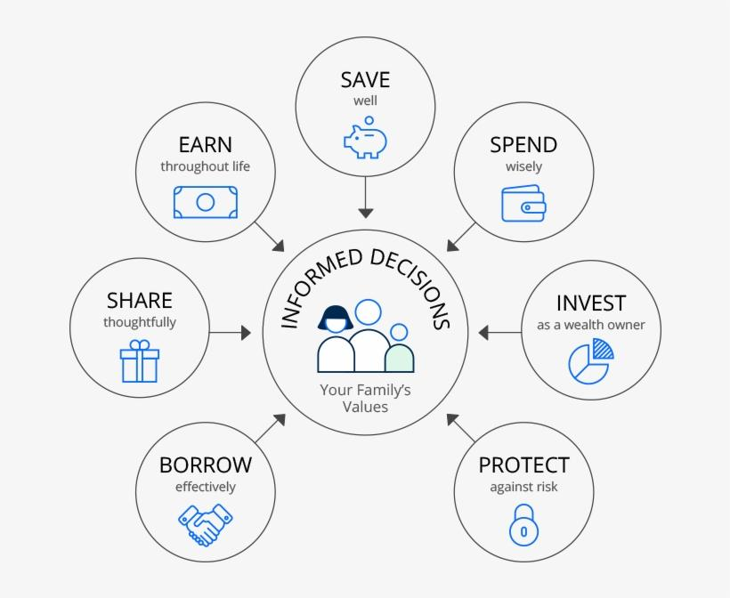
Key Takeaway - Family-values provide a foundation that can protect and guide children against making hurtful decisions in the future as they teach a sense of right and wrong.
(n.d.). Seven fundamental skills to support informed decision making in line with your family’s values [Digital Image]. JPMorgan Chase & Co.
https://chaseprivateclient.chase.com/newsletter/teach-children-skills/?jp_cmp
Unless otherwise noted, all content in this document was created by Hari Chand Balachandran Pillai, Hashir Ahmad, Deepinderjit Kaur Labana, Nicholas Cheng, Jennifer Diep, Kaman Hui, Simi Sahota, Maria Palermo, Jennine Rawana, Mazen Hamadeh, & Agata Stypka in 2021, and is available under a Creative Commons Attribution-NonCommercial 4.0 International license. If you reuse this work, please attribute The Financial Wellness Project, York University and Emery Collegiate Institute.
Notes:
The key takeaway is that family-values are important because they provide a foundation that can protect and guide children against making hurtful decisions in the future as they teach a sense of right and wrong. Now, onto our last set of questions...

Slide 34

Which
character do
you think you resemble most?
Chauhan, M. (n.d.). Person Question Mark Png [Digital Image]. Clipartkey.
https://www.clipartkey.com/view/iiRhoRb_person-question-mark-png/
Unless otherwise noted, all content in this document was created by Hari Chand Balachandran Pillai, Hashir Ahmad, Deepinderjit Kaur Labana, Nicholas Cheng, Jennifer Diep, Kaman Hui, Simi Sahota, Maria Palermo, Jennine Rawana, Mazen Hamadeh, & Agata Stypka in 2021, and is available under a Creative Commons Attribution-NonCommercial 4.0 International license. If you reuse this work, please attribute The Financial Wellness Project, York University and Emery Collegiate Institute.
Notes:
Read Question. Feel free to respond in the chat, or you use your mic, that would be great.

Slide 35

Which
money
attitude do
you think is the best attitude to have?
(2020). Ways to Save Money on Monthly Expenses [Photograph]. Canada Today Technology.
https://www.canada-todaytechnology.com/ways-to-save-money-on-monthly-expenses/
Unless otherwise noted, all content in this document was created by Hari Chand Balachandran Pillai, Hashir Ahmad, Deepinderjit Kaur Labana, Nicholas Cheng, Jennifer Diep, Kaman Hui, Simi Sahota, Maria Palermo, Jennine Rawana, Mazen Hamadeh, & Agata Stypka in 2021, and is available under a Creative Commons Attribution-NonCommercial 4.0 International license. If you reuse this work, please attribute The Financial Wellness Project, York University and Emery Collegiate Institute.
Notes:
Read Question.

Slide 36
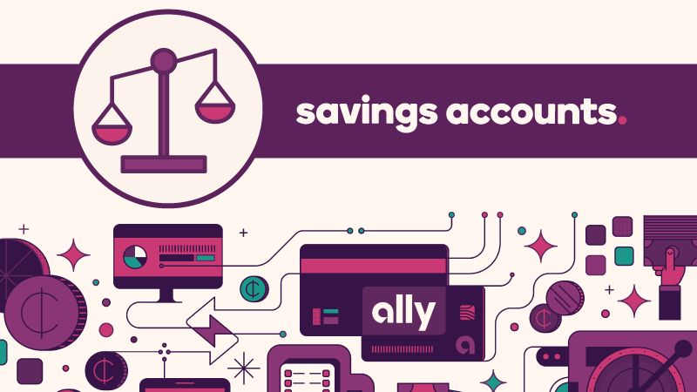
What are
some of the
benefits to opening a savings account?
(2020). [The Pros and Cons of Savings Accounts: Maximizing Your Money] [Digital Image]. Ally Financial Inc.
https://www.ally.com/do-it-right/banking/savings-account-pros-and-cons/
Unless otherwise noted, all content in this document was created by Hari Chand Balachandran Pillai, Hashir Ahmad, Deepinderjit Kaur Labana, Nicholas Cheng, Jennifer Diep, Kaman Hui, Simi Sahota, Maria Palermo, Jennine Rawana, Mazen Hamadeh, & Agata Stypka in 2021, and is available under a Creative Commons Attribution-NonCommercial 4.0 International license. If you reuse this work, please attribute The Financial Wellness Project, York University and Emery Collegiate Institute.
Notes:
Read Question.

Slide 37


If you were
given $1,000,
how would you use your money?
Lucidio Studio Inc. (2012). [Picture of multiple one hundred dollar canadian bills] [Photograph]. TIME USA.
https://newsfeed.time.com/2012/07/17/is-canadas-plastic-money-actually-melting/
Unless otherwise noted, all content in this document was created by Hari Chand Balachandran Pillai, Hashir Ahmad, Deepinderjit Kaur Labana, Nicholas Cheng, Jennifer Diep, Kaman Hui, Simi Sahota, Maria Palermo, Jennine Rawana, Mazen Hamadeh, & Agata Stypka in 2021, and is available under a Creative Commons Attribution-NonCommercial 4.0 International license. If you reuse this work, please attribute The Financial Wellness Project, York University and Emery Collegiate Institute.
Notes:
Read Question.

Slide 38

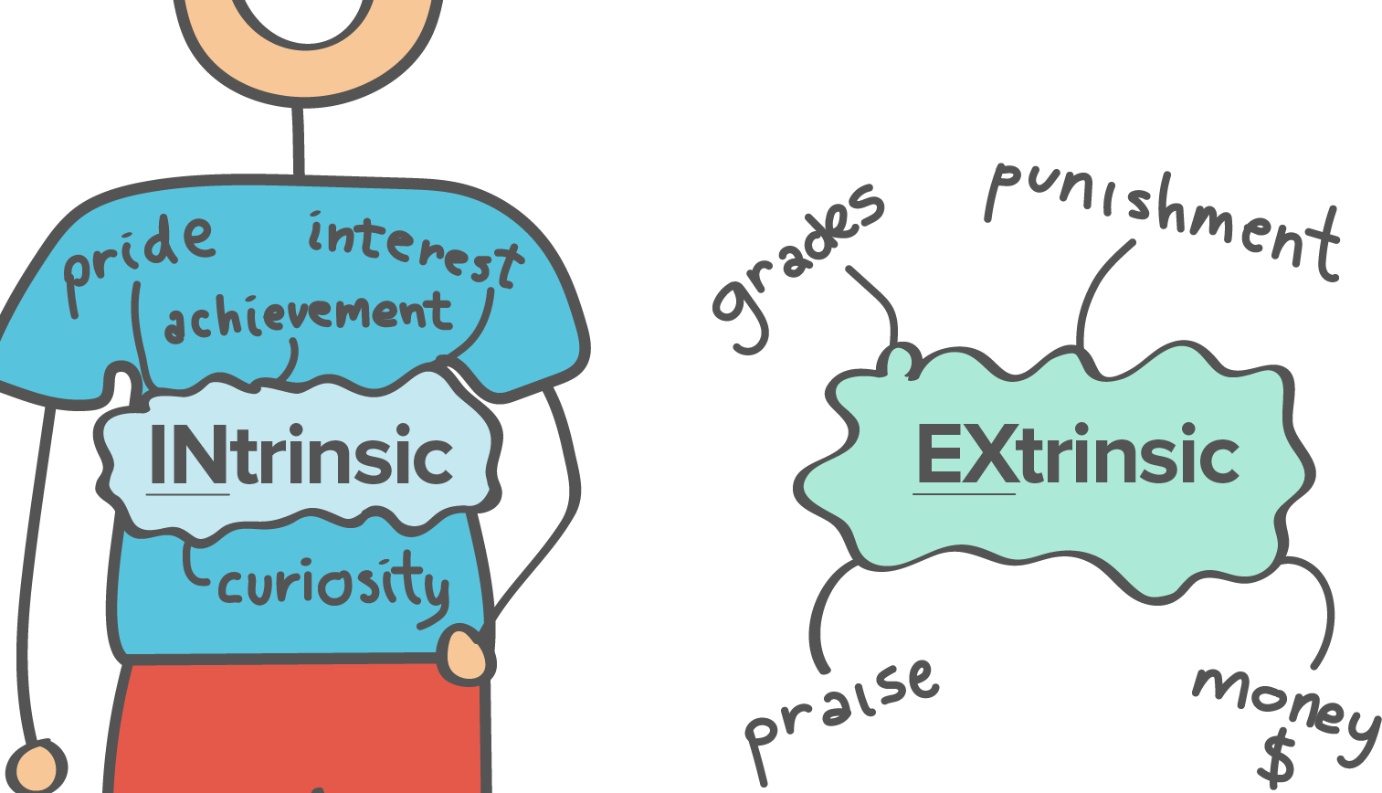
Reflect and discuss whether or not your goals are intrinsically or extrinsically motivated?
(n.d.). What is intrinsic and extrinsic motivation? [Digital Image]. Khan Academy.
https://www.khanacademy.org/test-prep/mcat/behavior/physiological-and-sociocultural-concepts-of-motivation-and-attitudes/a/motivation-article-2
Unless otherwise noted, all content in this document was created by Hari Chand Balachandran Pillai, Hashir Ahmad, Deepinderjit Kaur Labana, Nicholas Cheng, Jennifer Diep, Kaman Hui, Simi Sahota, Maria Palermo, Jennine Rawana, Mazen Hamadeh, & Agata Stypka in 2021, and is available under a Creative Commons Attribution-NonCommercial 4.0 International license. If you reuse this work, please attribute The Financial Wellness Project, York University and Emery Collegiate Institute.
Notes:
Read Question.
Intrinsically motivated refers to behavior that is driven by internal rewards such as pride, interest, achievement, or curiosity. Extrinsic motivation refers to behavior that is driven by external rewards such as money, fame, grades, and praise.

Slide 39
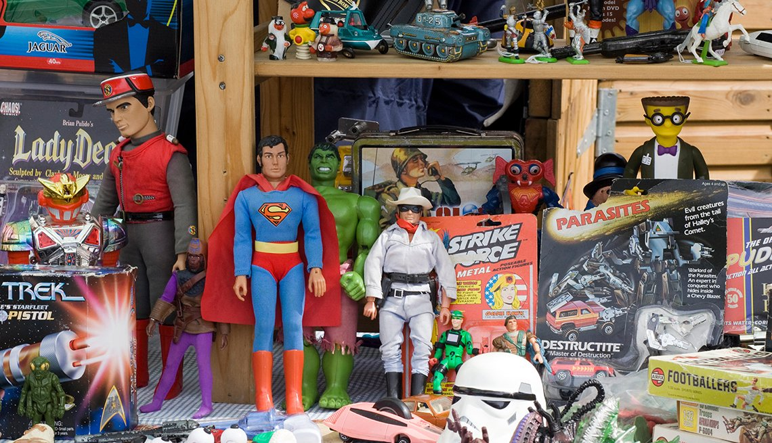
Have you ever invested in the collectibles market and what was your experience
like?
Alamy Stock Photo. (n.d.). Action figures [Photograph]. American Association of Retired Persons (AARP).
https://www.aarp.org/money/budgeting-saving/info-2020/trending-collectible-categories.html
Unless otherwise noted, all content in this document was created by Hari Chand Balachandran Pillai, Hashir Ahmad, Deepinderjit Kaur Labana, Nicholas Cheng, Jennifer Diep, Kaman Hui, Simi Sahota, Maria Palermo, Jennine Rawana, Mazen Hamadeh, & Agata Stypka in 2021, and is available under a Creative Commons Attribution-NonCommercial 4.0 International license. If you reuse this work, please attribute The Financial Wellness Project, York University and Emery Collegiate Institute.
Notes:
Read Question. Great answer! / Well, that’s okay, this was my last question. So, thank you all for being such a great audience, I hope you learned a lot about Financial Wellness today.

