Slide 1

Money Matters
Financial Wellness Series #3
Unless otherwise noted, all content in this document was created by Hari Chand Balachandran Pillai, Hashir Ahmad, Deepinderjit Kaur Labana, Nicholas Cheng, Jennifer Diep, Kaman Hui, Simi Sahota, Maria Palermo, Jennine Rawana, Mazen Hamadeh, & Agata Stypka in 2021, and is available under a Creative Commons Attribution-NonCommercial 4.0 International license. If you reuse this work, please attribute The Financial Wellness Project, York University and Emery Collegiate Institute.

Slide 2
Objective
Increase overall financial knowledge
Learn to spend and invest wisely to build future and reach goals
Unless otherwise noted, all content in this document was created by Hari Chand Balachandran Pillai, Hashir Ahmad, Deepinderjit Kaur Labana, Nicholas Cheng, Jennifer Diep, Kaman Hui, Simi Sahota, Maria Palermo, Jennine Rawana, Mazen Hamadeh, & Agata Stypka in 2021, and is available under a Creative Commons Attribution-NonCommercial 4.0 International license. If you reuse this work, please attribute The Financial Wellness Project, York University and Emery Collegiate Institute.

Slide 3
Areas of Focus
Debt repayment
Investment and financial products
Risk tolerance
Financial advisor
Financial goals
Non-monetary value: volunteering, mentorship, shadowing
Unless otherwise noted, all content in this document was created by Hari Chand Balachandran Pillai, Hashir Ahmad, Deepinderjit Kaur Labana, Nicholas Cheng, Jennifer Diep, Kaman Hui, Simi Sahota, Maria Palermo, Jennine Rawana, Mazen Hamadeh, & Agata Stypka in 2021, and is available under a Creative Commons Attribution-NonCommercial 4.0 International license. If you reuse this work, please attribute The Financial Wellness Project, York University and Emery Collegiate Institute.

Slide 4

Poll & Discussion #1
Are you team Debt Snowball or team Debt Avalanche?
(2018). Debt Snowball vs Avalanche: Which is best to start paying off debt? [Digital Image]. Steemit.
https://steemit.com/life/@itzalesh/debt-snowball-vs-avalanche-which-is-best-to-start-paying-off-debt
Unless otherwise noted, all content in this document was created by Hari Chand Balachandran Pillai, Hashir Ahmad, Deepinderjit Kaur Labana, Nicholas Cheng, Jennifer Diep, Kaman Hui, Simi Sahota, Maria Palermo, Jennine Rawana, Mazen Hamadeh, & Agata Stypka in 2021, and is available under a Creative Commons Attribution-NonCommercial 4.0 International license. If you reuse this work, please attribute The Financial Wellness Project, York University and Emery Collegiate Institute.

Slide 5
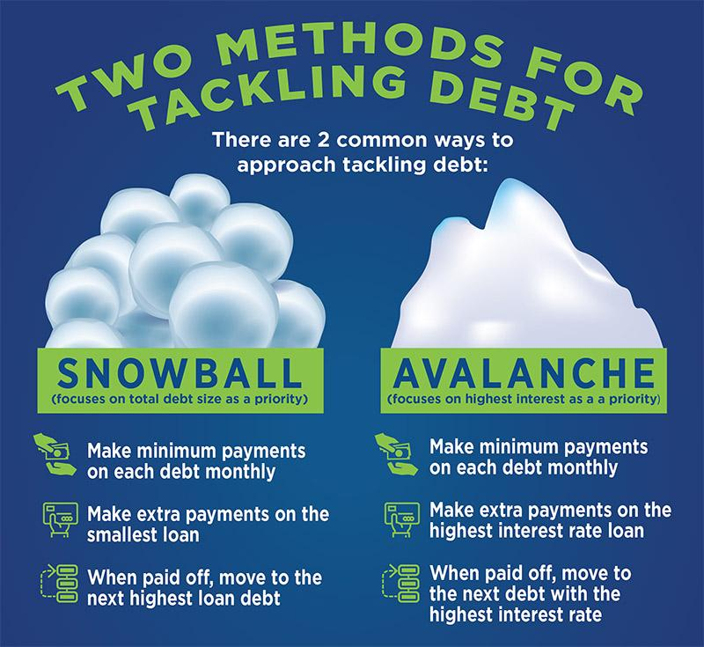
(n.d.). Two Methods For Tackling Debt [Digital Image]. Community Resource Credit Union.
https://www.crcu.org/snowball-method-vs--avalanche-method--whats-the-best-way-to-tackle-debt-
Unless otherwise noted, all content in this document was created by Hari Chand Balachandran Pillai, Hashir Ahmad, Deepinderjit Kaur Labana, Nicholas Cheng, Jennifer Diep, Kaman Hui, Simi Sahota, Maria Palermo, Jennine Rawana, Mazen Hamadeh, & Agata Stypka in 2021, and is available under a Creative Commons Attribution-NonCommercial 4.0 International license. If you reuse this work, please attribute The Financial Wellness Project, York University and Emery Collegiate Institute.

Slide 6
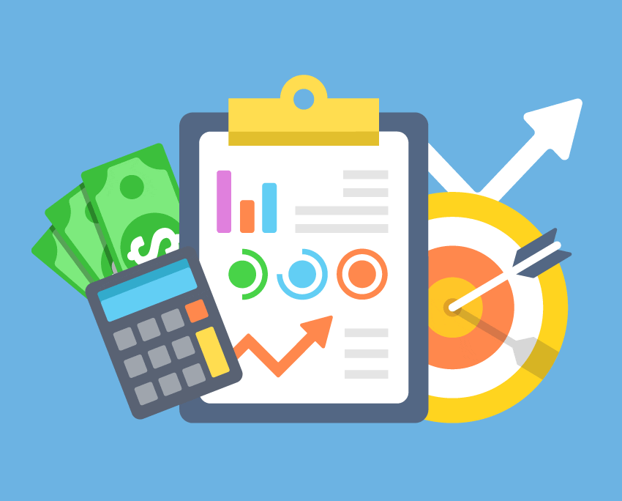
Poll & Discussion #2
Do you have any financial goals? What are they?
(n.d.). How to Set and Achieve Financial Goals [Digital Image]. InCharge Debt Solutions.
https://www.incharge.org/financial-literacy/budgeting-saving/how-to-set-financial-goals/
Unless otherwise noted, all content in this document was created by Hari Chand Balachandran Pillai, Hashir Ahmad, Deepinderjit Kaur Labana, Nicholas Cheng, Jennifer Diep, Kaman Hui, Simi Sahota, Maria Palermo, Jennine Rawana, Mazen Hamadeh, & Agata Stypka in 2021, and is available under a Creative Commons Attribution-NonCommercial 4.0 International license. If you reuse this work, please attribute The Financial Wellness Project, York University and Emery Collegiate Institute.

Slide 7
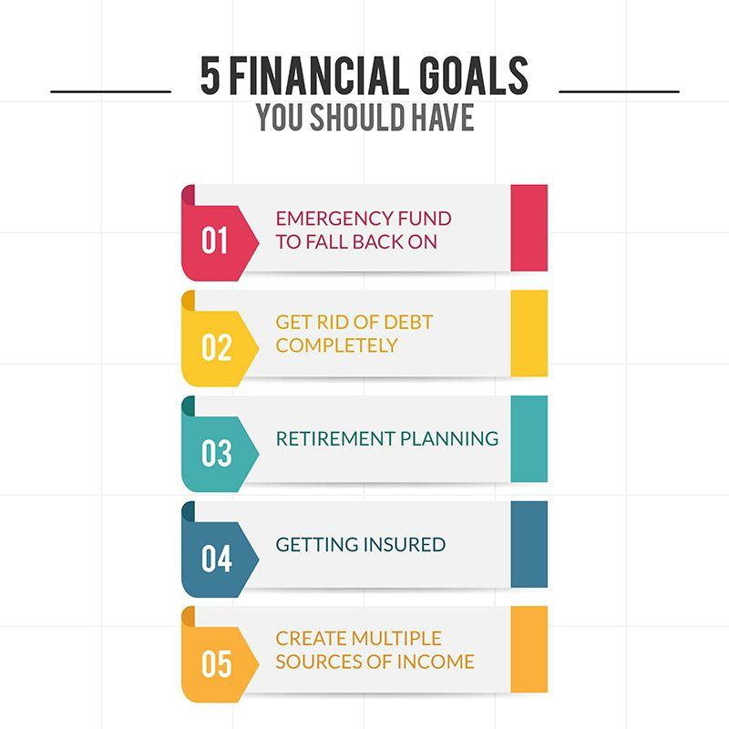
(2020). 5 Financial Goals You Should Have [Digital Image]. Global Travel Media.
https://eglobaltravelmedia.com.au/reach-your-financial-goals-with-these-6-helpful-tips/
Unless otherwise noted, all content in this document was created by Hari Chand Balachandran Pillai, Hashir Ahmad, Deepinderjit Kaur Labana, Nicholas Cheng, Jennifer Diep, Kaman Hui, Simi Sahota, Maria Palermo, Jennine Rawana, Mazen Hamadeh, & Agata Stypka in 2021, and is available under a Creative Commons Attribution-NonCommercial 4.0 International license. If you reuse this work, please attribute The Financial Wellness Project, York University and Emery Collegiate Institute.

Slide 8
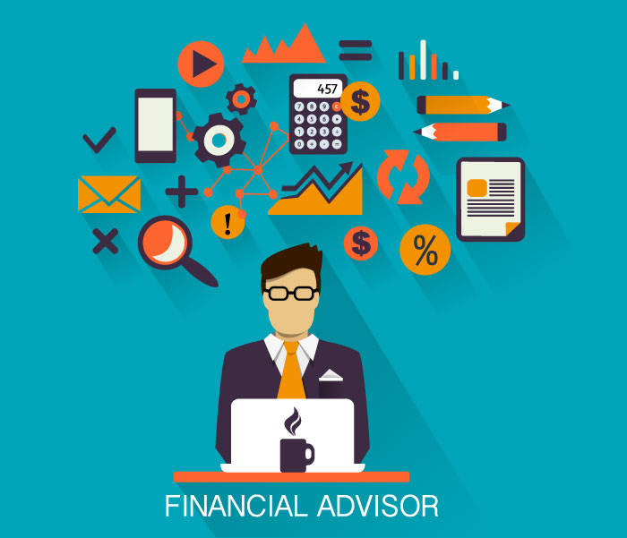
Poll & Discussion #3
Would you consider using a financial advisor to help you in the future? How come?
(2020). Financial Advisor [Digital Image]. 360° Family Office.
https://360familyoffice.la/the-four-types-of-financial-advisors/
Unless otherwise noted, all content in this document was created by Hari Chand Balachandran Pillai, Hashir Ahmad, Deepinderjit Kaur Labana, Nicholas Cheng, Jennifer Diep, Kaman Hui, Simi Sahota, Maria Palermo, Jennine Rawana, Mazen Hamadeh, & Agata Stypka in 2021, and is available under a Creative Commons Attribution-NonCommercial 4.0 International license. If you reuse this work, please attribute The Financial Wellness Project, York University and Emery Collegiate Institute.

Slide 9
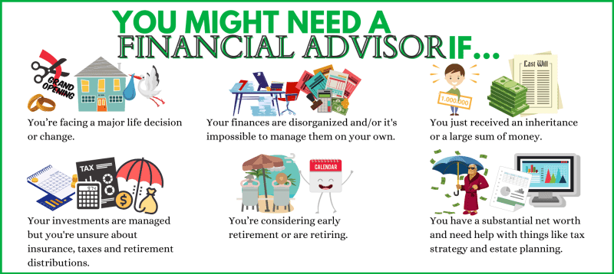
Smith, C. (2021). Who Should Use a Financial Advisor? [Digital Image]. Clark Howard Inc.
https://clark.com/personal-finance-credit/investing-retirement/what-is-a-financial-advisor/
Unless otherwise noted, all content in this document was created by Hari Chand Balachandran Pillai, Hashir Ahmad, Deepinderjit Kaur Labana, Nicholas Cheng, Jennifer Diep, Kaman Hui, Simi Sahota, Maria Palermo, Jennine Rawana, Mazen Hamadeh, & Agata Stypka in 2021, and is available under a Creative Commons Attribution-NonCommercial 4.0 International license. If you reuse this work, please attribute The Financial Wellness Project, York University and Emery Collegiate Institute.

Slide 10
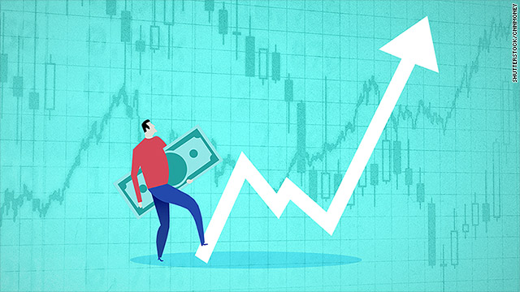
Poll & Discussion #4
Does the idea of investing make you nervous or excited?
Shutterstock. (2018). [Picture of a person looking at a line graph representing an investment] [Digital Image]. CNN Money.
https://money.cnn.com/2018/05/17/pf/how-to-start-investing/index.html
Unless otherwise noted, all content in this document was created by Hari Chand Balachandran Pillai, Hashir Ahmad, Deepinderjit Kaur Labana, Nicholas Cheng, Jennifer Diep, Kaman Hui, Simi Sahota, Maria Palermo, Jennine Rawana, Mazen Hamadeh, & Agata Stypka in 2021, and is available under a Creative Commons Attribution-NonCommercial 4.0 International license. If you reuse this work, please attribute The Financial Wellness Project, York University and Emery Collegiate Institute.

Slide 11
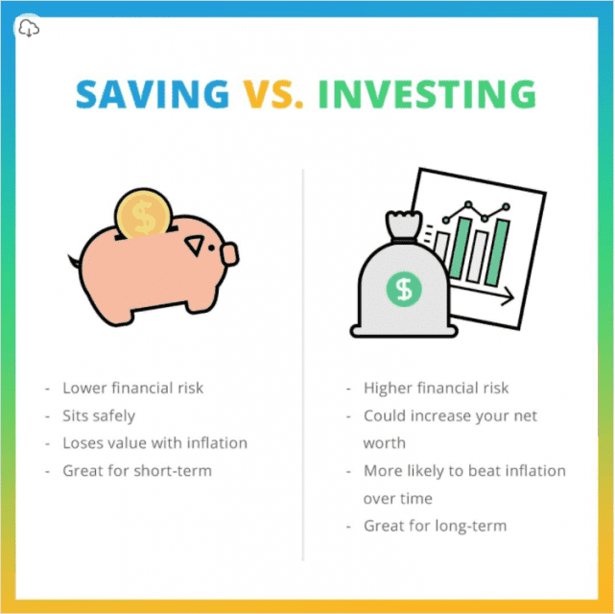
(n.d.). Saving VS. Investing [Digital Image]. Rule One Investing.
https://www.ruleoneinvesting.com/blog/how-to-invest/types-of-investments/
Unless otherwise noted, all content in this document was created by Hari Chand Balachandran Pillai, Hashir Ahmad, Deepinderjit Kaur Labana, Nicholas Cheng, Jennifer Diep, Kaman Hui, Simi Sahota, Maria Palermo, Jennine Rawana, Mazen Hamadeh, & Agata Stypka in 2021, and is available under a Creative Commons Attribution-NonCommercial 4.0 International license. If you reuse this work, please attribute The Financial Wellness Project, York University and Emery Collegiate Institute.

Slide 12
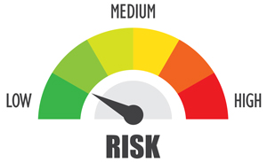
Poll & Discussion #5
Why do you think Rupee has a low risk tolerance?
(n.d.). [Picture of a meter measuring risk tolerance] [Digital Image]. Murphy Wealth Management Group, Inc.
https://www.murphywealth.com/discover-your-tolerance-for-risk-now/
Unless otherwise noted, all content in this document was created by Hari Chand Balachandran Pillai, Hashir Ahmad, Deepinderjit Kaur Labana, Nicholas Cheng, Jennifer Diep, Kaman Hui, Simi Sahota, Maria Palermo, Jennine Rawana, Mazen Hamadeh, & Agata Stypka in 2021, and is available under a Creative Commons Attribution-NonCommercial 4.0 International license. If you reuse this work, please attribute The Financial Wellness Project, York University and Emery Collegiate Institute.

Slide 13
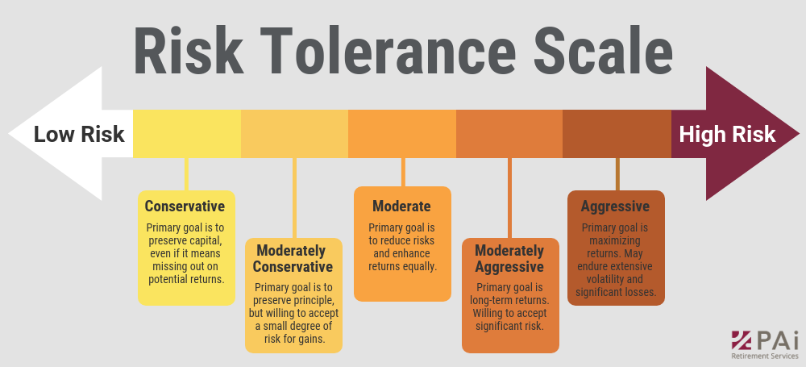
(n.d.). Risk Tolerance Scale [Digital Image]. PAI RETIREMENT SERVICES.
https://www.pai.com/blog/how-to-talk-to-clients-about-their-risk-tolerance
Unless otherwise noted, all content in this document was created by Hari Chand Balachandran Pillai, Hashir Ahmad, Deepinderjit Kaur Labana, Nicholas Cheng, Jennifer Diep, Kaman Hui, Simi Sahota, Maria Palermo, Jennine Rawana, Mazen Hamadeh, & Agata Stypka in 2021, and is available under a Creative Commons Attribution-NonCommercial 4.0 International license. If you reuse this work, please attribute The Financial Wellness Project, York University and Emery Collegiate Institute.

Slide 14
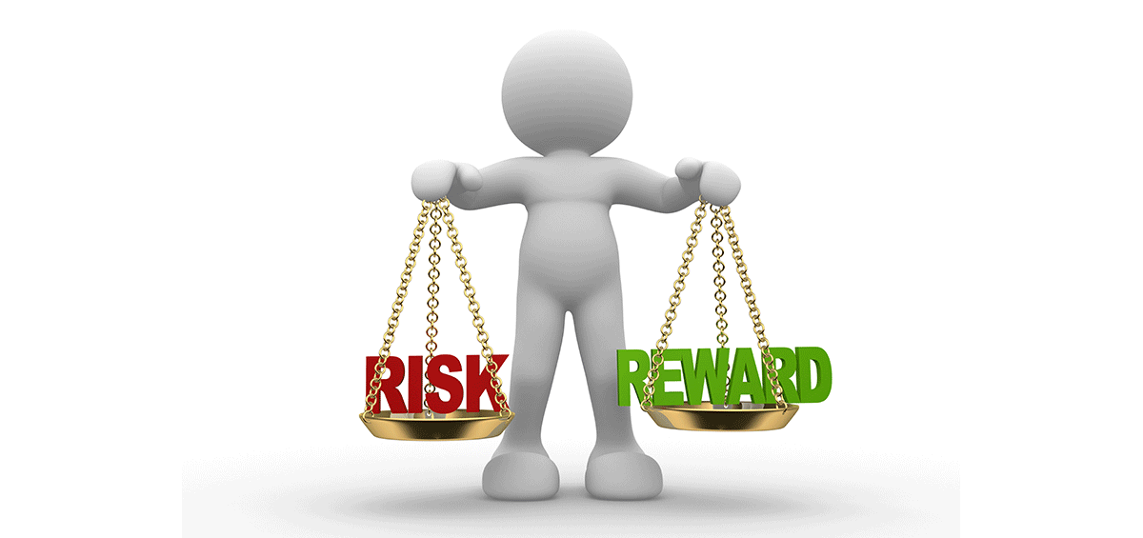
Quiz & Knowledge Reiterate
What’s your risk tolerance?
Gabel, M. (2018). How can I gauge my risk tolerance? [Digital Image]. Coastal wealth management.
https://www.coastalwealthmanagement24.com/gauge-risk-tolerance/
Unless otherwise noted, all content in this document was created by Hari Chand Balachandran Pillai, Hashir Ahmad, Deepinderjit Kaur Labana, Nicholas Cheng, Jennifer Diep, Kaman Hui, Simi Sahota, Maria Palermo, Jennine Rawana, Mazen Hamadeh, & Agata Stypka in 2021, and is available under a Creative Commons Attribution-NonCommercial 4.0 International license. If you reuse this work, please attribute The Financial Wellness Project, York University and Emery Collegiate Institute.

Slide 15

Activity & Sharing
Financial goals setting:
Think about 2-3 financial goals, then fill out a premade worksheet
Rojal. (2018). [Picture of arrows hitting targets that represent goals] [Digital Image]. PNG ALL.
http://www.pngall.com/goal-png
Unless otherwise noted, all content in this document was created by Hari Chand Balachandran Pillai, Hashir Ahmad, Deepinderjit Kaur Labana, Nicholas Cheng, Jennifer Diep, Kaman Hui, Simi Sahota, Maria Palermo, Jennine Rawana, Mazen Hamadeh, & Agata Stypka in 2021, and is available under a Creative Commons Attribution-NonCommercial 4.0 International license. If you reuse this work, please attribute The Financial Wellness Project, York University and Emery Collegiate Institute.

Slide 16
General 5-Step Goal Setting Approach:
Choose your goals
Make them SMART
Put a plan in place (micro-goals)
Set review periods
Hold yourself accountable (Resource)
Jeremy. (2018). [Picture of coins stacked on top of each other] [Photograph]. Stress Proof Your Money.
https://stressproofyourmoney.com/your-attitude-towards-your-personal-finance
Unless otherwise noted, all content in this document was created by Hari Chand Balachandran Pillai, Hashir Ahmad, Deepinderjit Kaur Labana, Nicholas Cheng, Jennifer Diep, Kaman Hui, Simi Sahota, Maria Palermo, Jennine Rawana, Mazen Hamadeh, & Agata Stypka in 2021, and is available under a Creative Commons Attribution-NonCommercial 4.0 International license. If you reuse this work, please attribute The Financial Wellness Project, York University and Emery Collegiate Institute.

Slide 17
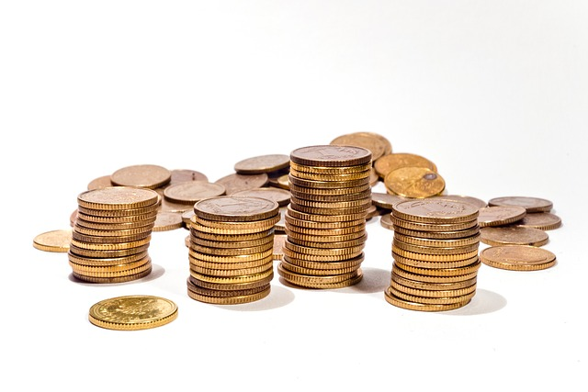
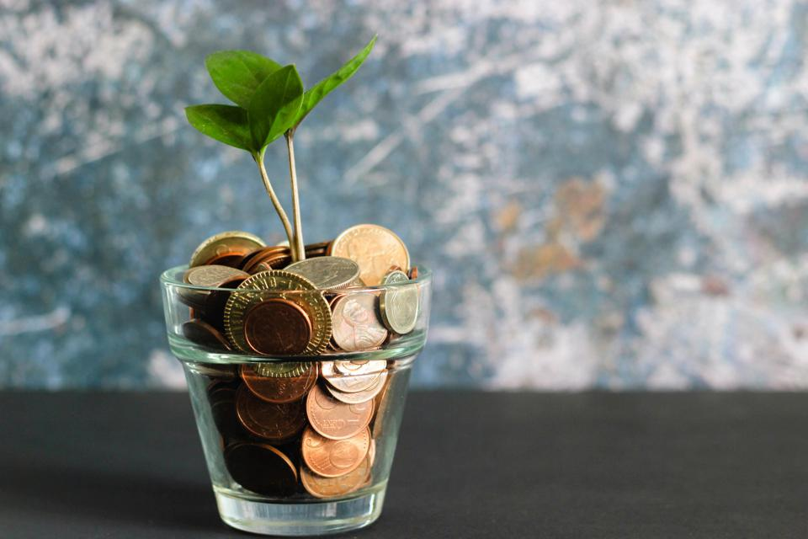
Series Wrap Up & Final Sharing
Has your money attitude changed from before the video series to now? Why or why not? If yes, what is it now?
MJ. (2020). [Picture of a plant on top of a bunch of coins in a glass] [Photograph]. Panda Gossips.
https://pandagossips.com/posts/6139
Unless otherwise noted, all content in this document was created by Hari Chand Balachandran Pillai, Hashir Ahmad, Deepinderjit Kaur Labana, Nicholas Cheng, Jennifer Diep, Kaman Hui, Simi Sahota, Maria Palermo, Jennine Rawana, Mazen Hamadeh, & Agata Stypka in 2021, and is available under a Creative Commons Attribution-NonCommercial 4.0 International license. If you reuse this work, please attribute The Financial Wellness Project, York University and Emery Collegiate Institute.

Slide 18
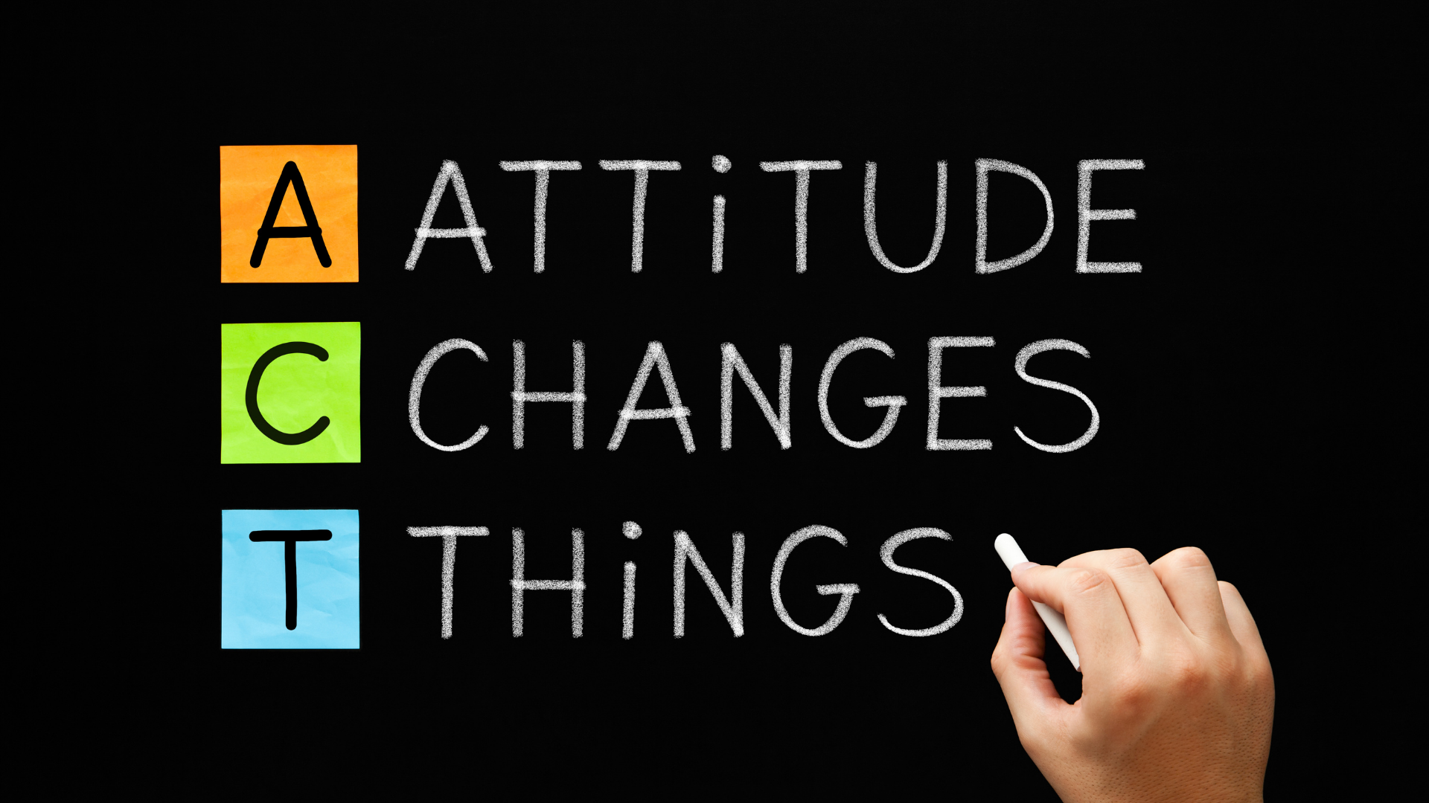
Canva Pro. (2020). [Picture of attitude changes things written on a chalkboard] [Digital Image]. Medium.
https://medium.com/illumination-curated/a-healthy-attitude-towards-money-helps-to-achieve-financial-security-efd9b0a0f5ec
Unless otherwise noted, all content in this document was created by Hari Chand Balachandran Pillai, Hashir Ahmad, Deepinderjit Kaur Labana, Nicholas Cheng, Jennifer Diep, Kaman Hui, Simi Sahota, Maria Palermo, Jennine Rawana, Mazen Hamadeh, & Agata Stypka in 2021, and is available under a Creative Commons Attribution-NonCommercial 4.0 International license. If you reuse this work, please attribute The Financial Wellness Project, York University and Emery Collegiate Institute.

