Slide 1
Keeping Google My Business info up-to-date

Slide 2
Types of information you can update
Business hours
Physical address
  If you change your address, you need to complete the verification process again to confirm the new address.
Phone number
Category
  Explain what kind of business you run.
Website URL

Slide 3
Requesting ownership of a business profile
Step 1. Find the Business Profile you want to request ownership of, using either of these methods:
  Go to business.google.com/add, enter the name and address of the business, then choose it from the search results.
  Find your business using Google Search or Google maps, under the Business Profile, click "Claim this business"
Step 2. Click continue, you'll get a message that says someone else verified the profile. Request ownership from the current profile owner clicking "Request access".
Step 3. Fill out the request access form and submit.
The current profile owner will get an email that asks them to contact you and you'll get a confirmation email.

Slide 4
How to edit your information
Step 1. Log in to Google My Business.
  Choose the page you’d like to manage.
Step 2. From the left side menu, click Info.
Step 3. Click the section you want to change, then enter the new information.
  It may take up to 60 days to delete information you previously added. Information that is also publicly available or from other sources might not be removed.
  Business descriptions, like summaries or keywords from the web that appear next to your business, aren’t editable.
Step 4. Click Done editing.

Slide 5
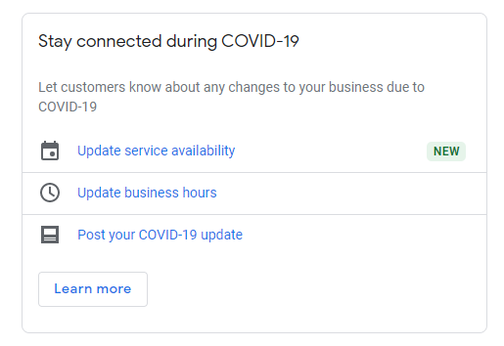
How to edit hours during Covid
Step 1. Log in to Google My Business.
  Choose the page you’d like to manage
Step 2. From the Home screen, click the section you want to modify from the "Stay Connected during Covid-19" widget.
Step 3. Click Done.

Slide 6
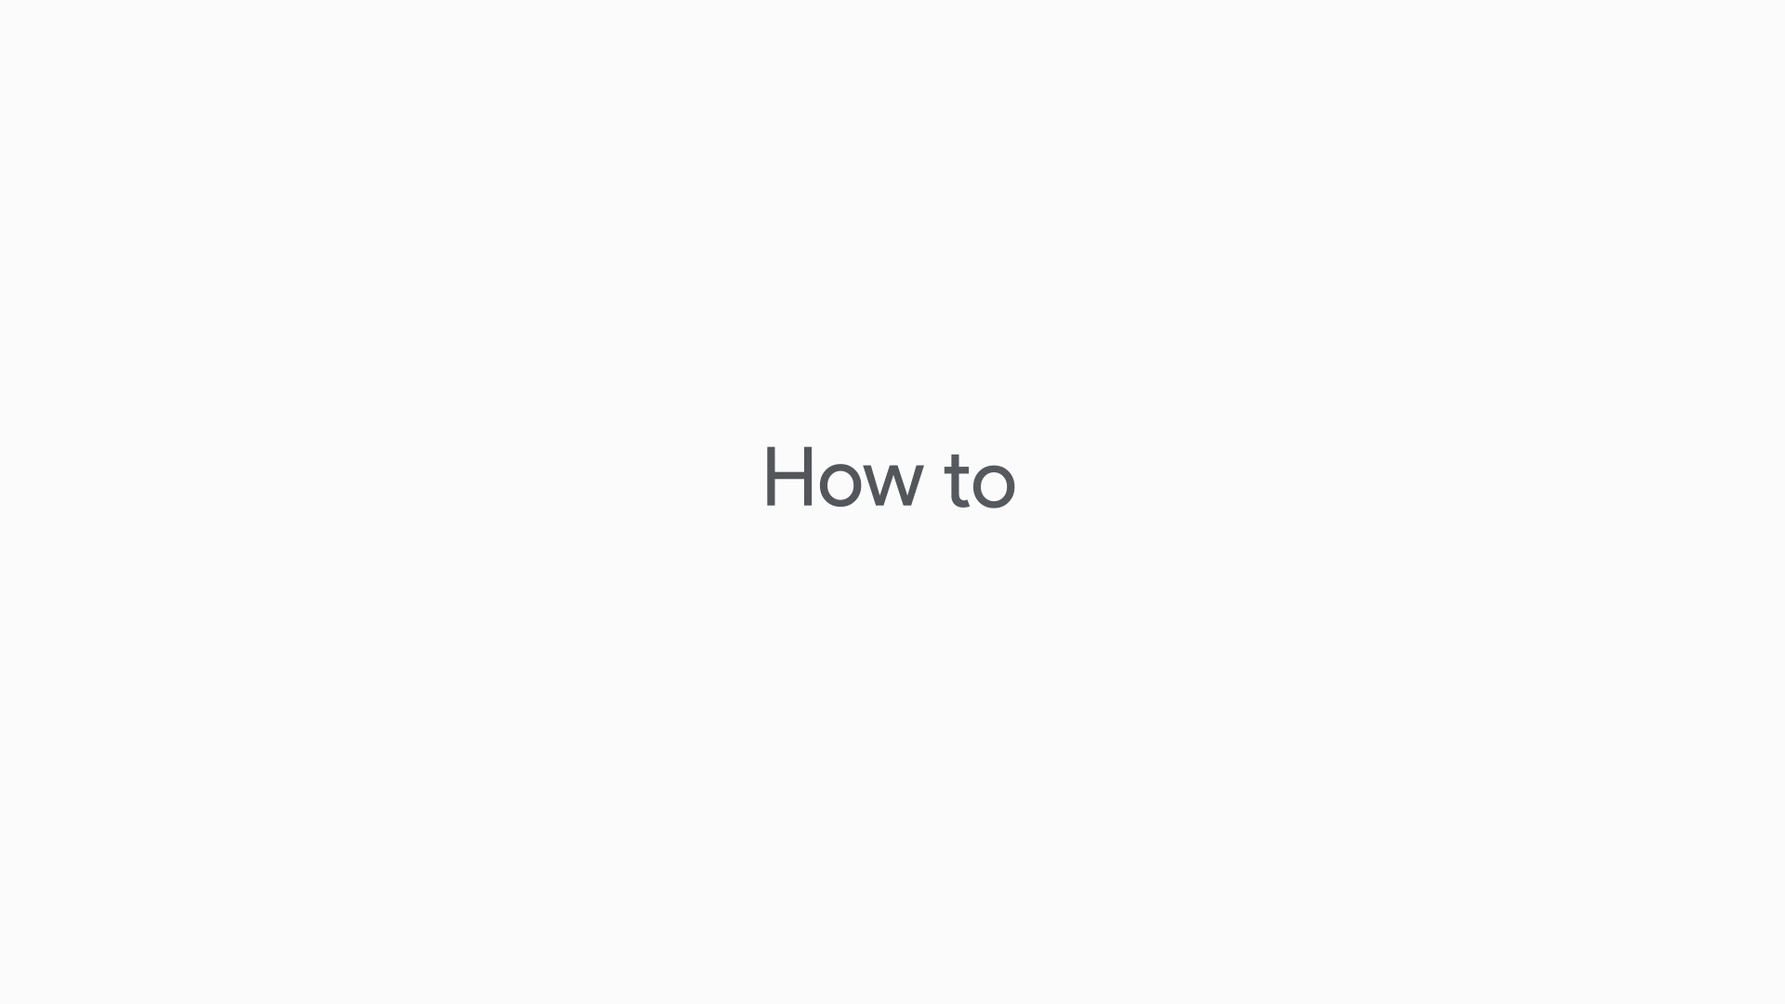
How to set special hours
Setting special business hours for:
Holidays
Special events
Other exceptional circumstances

