Slide 1
Assyrian and Chaldean Dialects of English in Southeast Michigan

Slide 2
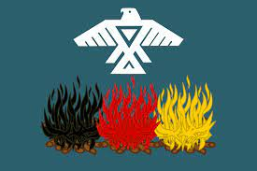
THE LAND
www.native-land.ca
Anishinaabe -
Council of Three Fires
Notes:
I reside on, work from, and come to you today from the traditional lands of the Anishinaabe - the homelands of the people of the Council of Three Fires including the Ojibwe, Potawatomi and Odawa. I acknowledge them as the past, present and future caretakers of this land which has been stewarded by Indigenous peoples for thousands of years before the arrival of colonial settlers.

Slide 3
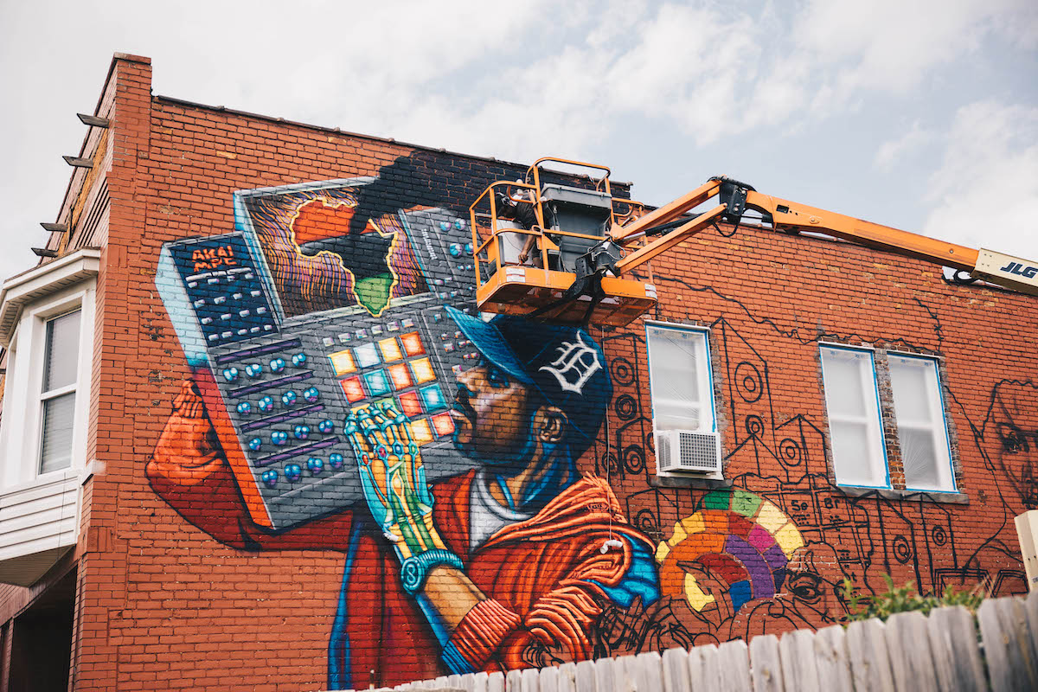
This is Black Detroit
Notes:
Without meaning to diminish the recognition of the Indigenous rights to this land, I would also like to acknowledge that the city of Detroit has been cared for in its own right primarily by African Americans for decades. While my African-American neighbors have been nothing but warm and welcoming to me and my family, I still recognize that I appear to be part of a wave of Caucasian “gentrifiers” and I am aware that there is a well-warranted fear of erasure of the distinctive Black heritage of this city, and of displacement of the population. I see it as my duty to continue to uplift, celebrate, and preserve this heritage and ownership in every way possible without being disingenuous. I am open to receive feedback from anyone about ways in which I might better follow through on both these acknowledgements in a truly impactful way.

Slide 4
Full Disclosure…
Notes:
As often as we tell our students, Don’t apologize! No disclaimers! Also know that this advice is often easier spoken than followed. For those of you who have trained and worked with me before, you will know that the work I have done has most often been by the skin of my teeth: done up to the very last minute, with great anxiety, and haphazardly. This has not changed. While this is an ongoing symptom of ADHD and other neurodivergences, I also take responsibility for the effect this way of working has on colleagues, students and clients. I am honored to be working in the company of Eric and Julie, the quality of whose work is an inspiration to me.

Slide 5
Why This Accent?
Proximity to significant population
Work of Heather Raffo, particularly her “Iraq Plays” (Nine Parts of Desire, Fallujah, and Noura) and its significance and impact to an underrepresented community, both for audiences and artists.
Notes:
My impetus for researching this dialect, or set of dialects, is that I reside in Detroit (only a mile or so from the neighborhood known as Chaldean town, which is itself, ironically, now only contains an almost infinitesimal population of Chaldean people). Also, this accent is present in many of the widely produced plays of Heather Raffo, who is herself a Chaldean-American Southeast Michigander. Because so many of us here work with actors, I hoped this research would serve as a jumping off point for coaches, designers, and actors working on these plays. As a side note, I had a Chaldean-American acting student to whom I offered Raffo’s work to explore in class — she said that she really identified more with her European-American peers from her upbringing in Western Michigan, and didn’t particularly need material suited to her ethnicity. I told her I’d find her something else, but when I came back with other material, she said she’d read over it and actually did want to do it, as she had begun to find great delight in reading dialogue that sounded “exactly like my aunts” and really hadn’t encountered anything like that in a script before. Sarab Kamoo, a Michigan-based Chaldean-American actor and one of my contributors, described the joy of “coming home to this work,” both for the striking portraits of a community that Raffo draws and can be inhabited, and for the too-rare experience of working with other actors of Middle Eastern descent.

Slide 6
Contributors
Nedhal Kamoo
Came here with her husband at age 18 from Northern Iraq and raised her family here in Farmington Michigan.
Sarab Kamoo
Daughter of Nedhal, Sarab fondly described to me her childhood experience with language, particularly with her mother, who, more often than not, would speak, within the span of one sentence, three languages: Chaldean, Arabic, and English.
Robert David
Born in Northern Iraq, speaking Assyrian (Suret) in the home, Arabic in school. Father learned and began teaching English to his family as well. At the age of 12, moved to Lebanon for 7 years where he had to adjust from Iraqi Arabic to Lebanese Arabic, but also continued to learn English in school (where they had a choice between English and French as foreign languages). Moved to United States in early 1970s.
Mattico (or Matt, Matthew) David
Son of Robert, born in Flint, Michigan, and has spent time in SE Michigan, Chicago, Modesto California, and professionally in New York and LA. Trained and working actor. Mother is Lebanese/Irish/American.

Slide 7
Background and History of Accent
What is the L1 here??
A variety of Northeastern Neo-Aramaic?
Syriac?
Assyrian?
Chaldean?
Suret
Notes:
Syriac
One of my contributors said “Well, I think that’s what, you know, English linguists call it” with what I take to be a healthy skepticism over having a Western academic term assigned to a person’s native language.
Northeastern Neo-Aramaic or NENA.
Chaldean
People who identify as Assyrian (which I’ll get into momentarily) tend, when speaking English, to call the language Assyrian.
People who identify as Chaldean tend to call the language Chaldean. There are, however, actual dialectal differences between the two, despite being mutually intelligible. At least from an academic anthropological perspective, the two groups are ethnically the same: ethnic Assyrians, who are descendants of the original inhabitants of ancient Mesopotamia. By modern political boundaries these people currently inhabit or have in the past inhabited northern Iraq, parts of Iran, parts of Turkiye, and parts of Syria.
Due to political upheavals, persecutions, war, and other conditions, there is a significant diaspora in the United States and elsewhere, many Assyrians and Chaldeans having settled in Southeast Michigan.
My impetus for researching this dialect, or set of dialects, is that I reside in Detroit (only a mile or so from the neighborhood known as Chaldean town, which is itself, ironically, now only contains an almost infinitesimal population of Chaldean people). Also, this accent is present in many of the widely produced plays of Heather Raffo, who is herself a Chaldean-American Southeast Michigander. Because so many of us here work with actors, I hoped this research would serve as a jumping off point for coaches, designers, and actors working on these plays. As a side note, I had a Chaldean-American acting student to whom I offered Raffo’s work to explore in class — she said that she really identified more with her European-American peers from her upbringing in Western Michigan, and didn’t particularly need material suited to her ethnicity. I told her I’d find her something else, but when I came back with other material, she said she’d read over it and actually did want to do it, as she had begun to find great delight in reading dialogue that sounded “exactly like my aunts” and really hadn’t encountered anything like that in a script before.
This said, I am certainly not the first person to research this dialect, as many illustrious coaches and dialect designers, perhaps some of them here at this conference, have worked on these plays before. I’d be more than happy for input from anyone who has done these plays, even if it’s to vehemently dispute some part of my research.
The difference between Assyrian and Chaldean seems, then, essentially to be a religious difference, but closely related even there. The Assyrian Church and the Chaldean Catholic Church.
Classical Syriac is read and spoken in liturgical contexts - it is not fully mutually intelligible with modern Suret, but due to its ubiquity within church services many Assyrians and Chaldeans can at least sound it out confidently, much as Christians in the West were, in earlier eras, familiar with Latin.
Members of these communities hold that in these services, they are speaking the Aramaic spoken by Jesus Christ. I have come across some literature that suggests that Classical Syriac is related to Jesus’ Aramaic but is not exactly the same, however at this point in my research I certainly don’t feel confident about disputing outright the people who are closest to the language, nor is it my desire to be able to do so.

Slide 8
Background and History of Accent
Assyrian people: Mesopotamia
Northern Iraq
Iran
Turkiye*
Syria
*/tuɹ.kɪ.yɛ/ - not a bird
Chaldean
The Church
The Diaspora
Notes:
Syriac
One of my contributors said “Well, I think that’s what, you know, English linguists call it” with what I take to be a healthy skepticism over having a Western academic term assigned to a person’s native language.
Northeastern Neo-Aramaic or NENA.
Chaldean
People who identify as Assyrian (which I’ll get into momentarily) tend, when speaking English, to call the language Assyrian.
People who identify as Chaldean tend to call the language Chaldean. There are, however, actual dialectal differences between the two, despite being mutually intelligible. At least from an academic anthropological perspective, the two groups are ethnically the same: ethnic Assyrians, who are descendants of the original inhabitants of ancient Mesopotamia. By modern political boundaries these people currently inhabit or have in the past inhabited northern Iraq, parts of Iran, parts of Turkiye, and parts of Syria.
Due to political upheavals, persecutions, war, and other conditions, there is a significant diaspora in the United States and elsewhere, many Assyrians and Chaldeans having settled in Southeast Michigan.
My impetus for researching this dialect, or set of dialects, is that I reside in Detroit (only a mile or so from the neighborhood known as Chaldean town, which is itself, ironically, now only contains an almost infinitesimal population of Chaldean people). Also, this accent is present in many of the widely produced plays of Heather Raffo, who is herself a Chaldean-American Southeast Michigander. Because so many of us here work with actors, I hoped this research would serve as a jumping off point for coaches, designers, and actors working on these plays. As a side note, I had a Chaldean-American acting student to whom I offered Raffo’s work to explore in class — she said that she really identified more with her European-American peers from her upbringing in Western Michigan, and didn’t particularly need material suited to her ethnicity. I told her I’d find her something else, but when I came back with other material, she said she’d read over it and actually did want to do it, as she had begun to find great delight in reading dialogue that sounded “exactly like my aunts” and really hadn’t encountered anything like that in a script before.
This said, I am certainly not the first person to research this dialect, as many illustrious coaches and dialect designers, perhaps some of them here at this conference, have worked on these plays before. I’d be more than happy for input from anyone who has done these plays, even if it’s to vehemently dispute some part of my research.
The difference between Assyrian and Chaldean seems, then, essentially to be a religious difference, but closely related even there. The Assyrian Church and the Chaldean Catholic Church.
Classical Syriac is read and spoken in liturgical contexts - it is not fully mutually intelligible with modern Suret, but due to its ubiquity within church services many Assyrians and Chaldeans can at least sound it out confidently, much as Christians in the West were, in earlier eras, familiar with Latin.
Members of these communities hold that in these services, they are speaking the Aramaic spoken by Jesus Christ. I have come across some literature that suggests that Classical Syriac is related to Jesus’ Aramaic but is not exactly the same, however at this point in my research I certainly don’t feel confident about disputing outright the people who are closest to the language, nor is it my desire to be able to do so.

Slide 9
Prosody
Very much stress timed
Volume and very slight pitch raise for emphasis
“Half-note shifts”
Mid-syllable inflection
Extended, held vowels, marked by sporadic clipping of consonants, often coarticulated with glottal stops

Slide 10
Posture
- Nedhal appears (acoustically) to have almost no lip rounding. I hear that on THOUGHT, and the various sets that are merged with it and on GOOSE.
Lip corner Retraction
Jaw height is quite high
Tongue held close to palate, usually forward, although front vowels tend towards the more open end of the phonemic spectrum
Notes:
This posture was based on audial observation of all contributors,

Slide 11
Consonants
<R>
<L>
<TH>
<NG>

Slide 12
R
Variable treatment of R
Tapped or occasionally trilled, generally pre-vocalically
Postalv approx ɹ post-vocalically
Weaker tap often intervocalically, OR assimilated into a triphthong

Slide 13
L
~her /l/s are not as far back on the roof of the mouth as my speaker's. As opposed to Roni, our Lebanese contributor, who is close to using a retroflex lateral approximant.
Robert has velarized /l/ post-vocalically before a consonant. The /l/ also tends to affect the preceding vowel in these cases.

Slide 14
TH
For Nedhal, <th> sounds are more consistently realized as [s z]
But later in the passage.
For Robert, more often dentalized /d/

Slide 15
NG
“Hard” pronunciation of <ng> → [ŋg] for Nedhal
  When followed by a vowel or approximant
Frequent dropping to /n/, often pronounced as the syllabic consonant following a prior consonant, for Robert

Slide 16
Vowels 1
GOAT = THOUGHT
GOAT is merged with THOUGHT [ɔ̞] some of the time, but I think I heard [ʌu], too.
~her THOUGHT vowel is not as raised as Lebanese
LOT = CLOTH, sometimes = THOUGHT
MOUTH
~reinforcing Eric's observation that the nucleus of MOUTH is [ɑ]
NURSE (and lettER) is usually(?) non-rhotic, more fronted and slightly rounded to my ear, moving into the œ or ɞ̟ territory, which is similar to Lebanese, while NURSE in Egyptian is either merged with SQUARE or in the schwa zone.
NEAR

Slide 17
Vowels 2
KIT
KIT seems much like schwa or STRUT. My speaker is pretty much in the ɪ area. Definitely a Weak Vowel Merger going on for unstressed KIT, but I think that’s been applied to ALL of KIT.
FACE
- FACE seems monophthongal at least some of the time. “named” sounded almost palatalized, like [njem]
-- FOOT merged with GOOSE. Egyptian has a distinct FOOT.
GOOSE
- GOOSE doesnt seem as backed as it is for Egyptian sample

Slide 18
Other notable phenomena
<el> → [al ~ æl ~ əl]
Sporadic elimination of plural <s>
<ern> → /ɾən/
“The” → /dɛ/ ~ /ðæ/
^
(where on God’s green Earth is the dentalization diacritic on this stupid IPA keyboard???)

