Slide 1

Strategic Research Plan 2023-2028
Presentation to Faculty of Graduate Studies Faculty Council, November 3, 2022

Slide 2
SRP Advisory Committee
Amir Asif, VP Research & Innovation (Chair)
Joycelyn Amos, Markham Research Operations Manager, VPRI
Nation Cheong, VP Community Opportunities and Mobilization, United Way Greater Toronto
Krista Davidson, Interim Director, Communications, Office of the President
Tamara Daly, Director YU-CARE, Professor, School of Health Policy & Management, Health
Susan Dion, Associate VP Indigenous Initiatives, VPEPC, Professor, Faculty of Education
Barbara Edwards, Senior Policy Advisor, Research, VPRI
Trevor Farrow, Associate Dean, Research & Institutional Relations, Professor, Osgoode
Eileen Fischer, Associate Dean Research, Director Marketing Specialization, PhD Program, Entrepreneurial Studies, Schulich
Sarah Flicker, YRC in Community-Based Participatory Research, Professor, EUC
Jane Gertner, VP Partnerships, venture LAB
Luann Good Gingrich, Professor, School of Social Work, LA&PS, Director Global Labour Research Centre
Jennifer MacLean, Assistant VP, Innovation & Research Partnerships, Innovation York
Michael Moir, University Archivist, Office of the Dean of Libraries, Chair APPRC
Carmela Murdocca, Professor, Dept of Sociology, LA&PS
Swann Paradis, Associate Principal Research and Graduate Studies, Associate Professor French Studies, Glendon College
Gillian Parekh, CRC in Disability Studies in Education, Associate Professor, Education
Sarah Parsons, Associate Professor, Dept of Visual Arts & Art History, AMPD
Joel Prowting, PhD candidate (CIHR)
Mark Roseman, Director SIRI, Office of Research Services, VPRI
Vivian Saridakis, Associate Dean Research and Graduate Education, Associate Professor, Dept. of Biology, Science
Jen Steeves, Associate VP Research, YRC in Non-Invasive Visual Brain Stimulation, Professor, Dept of Psychology, Health
Yvonne Su, Assistant Professor, Dept of Equity Studies, LA&PS
Skandha Sunderasen, Associate Director, Global Engagement and Strategic Directions, York International
Cheryl van Daalen-Smith, Associate Dean Academic, FGS, Associate Professor, School of Nursing, Health
Rick Wildes, Associate Professor, Vice-Chair Graduate Program, Dept of Electrical Engineering & Computer Science, Lassonde
Xiaohui Yu, Associate Professor, Graduate Program Director, School of Information Technology, LA&PS

Slide 3
Consultations Engagement- Fall 2022
Open Forum:
September 28th
Community Chat Sessions- series of unstructured feedback sessions across the University to discuss SRP development with the VPRI
Friday October 21st – 9:00am – 10:00am, 402 HNES
Tuesday November 1st – 1:00pm – 2:00pm , 283 Winters College
Tuesday November 29th – 11:00am – 12:00pm, 305B Lumbers
Faculty Feedback- VPRI along with members of the SRP Advisory Committee will consult faculty members at all Faculty Council meetings
Health- October 5 Schulich- November 4 Libraries- TBC
Lassonde- October 7 Science- November 8 FGS- November 3
LA&PS- October 13 AMPD- November 9
Education - October 28 EUC- November 24
Glendon- October 28 Osgoode- October 31

Slide 4
Consultations Engagement- Fall 2022
Fall 2022
Continued consultations with Advisory Bodies- VPRI presentations and engagement of Senior Advisory Bodies throughout the fall term
Graduate Student engagement- post-doc feedback session TBC
Organized Research Units- VPRI consulting with the Council of Research Directors - November 16th 1:00pm – 2:30pm
Indigenous Council- VPRI arranging a feedback session this fall
Online Engagement: SRP website found on Research & Innovation site: https://www.yorku.ca/research/strategic-research-plan-2023-2028
Regular updates on SRP planning and consultation activities.
Online feedback is also solicited, welcomed and accessible through the SRP website

Slide 5
Overview: Strategic Research Plan (2018-2023)
In 2018 York University began a new five-year Strategic Research Plan (SRP), developed over an 8-month period with substantial input from the York community as well as internal and external research partners.
The SRP document reflects our research strengths across the institution across intersecting themes. These areas are those in which the university commits to ongoing investment which, in turn, will enhance the influence and recognition of our scholarship and creative
activities.
The document also articulates five areas of opportunity to further accelerate research growth and success. These areas of opportunity are timely and address both newly emerging challenges and areas where we can further bolster our established research leadership.
Advancing Fundamental Inquiry and Critical Knowledge
Analyzing Cultures & Mobilizing Creativity
Building Healthy Lives, Communities & Environments
Exploring and Interrogating the Frontiers of Science & Technology
Forging a Just & Equitable World
Integrating Entrepreneurial Innovation & the Public Good
Digital Cultures
Healthy Individuals, Healthy Communities and Global Health
Indigenous Futurities
Integration of Artificial Intelligence into Society
Public Engagement for a Just and Sustainable World
Notes:
York’s SRP (2013-2018) describes six broad themes for research at York (Areas of Strength) that describe research that crosses disciplinary boundaries.
six intersecting themes:
Advancing Fundamental Inquiry and Critical Knowledge
Analyzing Cultures and Mobilizing Creativity
Building Healthy Lives, Communities and Environments
Exploring and Interrogating the Frontiers of Science
and Technology
Forging a Just and Equitable World
Integrating Entrepreneurial Innovation and the Public Good

Slide 6
Since 2018 ….
  Added new ORUs in all 5 areas of Opportunity, total of 8 new ORUs since 2018
  York’s total publication output has increased 27%
  York’s Tri-Council funding has increased 17.38%, currently over $44M in 2020/21, our highest level ever
  Research applications at York have increased 45%, with successful applications increasing by 63% from 2017/18 to 2020/21
  York has ramped up our York Research Chairs and have appointed 54 YRCs
  York has filled our Canada Research Chair positions with 30 new and renewed Chairs
  York has had 28 new RSC Fellows and new members of the RSC College- which now totals 93 new Fellows and 53 new members
  York’s externally sponsored research funding exceeds $110M – the highest level ever

Slide 7
Current Graduate Objectives
Supporting Research Development
Ongoing expansion and quality of our graduate student and postdoctoral fellow population, including increasing our number of international students
Promote and support external scholarships and awards for graduate students and post-doctoral fellows
Long-term goal of doubling the numbers of our postdoctoral fellows
Notes:
PIER Recommendations:
INVESTING IN AND PROMOTING PEOPLE:
#9 Increase and strengthen York’s thesis-based graduate population and make York a destination of
choice for postdoctoral training.
graduate programs to develop plans to collectively enable York to exceed domestic graduate
student targets and grow its international cohort;
Increase outreach and efficiency of internal processes to ensure competitive student recruitment;
simplify graduate student packages;
Promote and support external scholarships and awards for graduate students and post-doctoral fellows
enhance administrative and professional development supports for graduate students and postdoctoral fellows;
encourage maximum use of faculty external research grant/award funding to support graduate students and fellows;
Double the cohort of post-doctoral fellows within five years.

Slide 8
What are we hearing so far
SRP Open Forum
September 28th, 1-3pm
Among the comments offered by those present at the open forum:
An emphasis on reinforcing our leadership on partnered and community-based research into the overall research aspirations of the University
The desire to integrate the United Nations Sustainability Development Goals within the Plan
A greater focus on sustainability and climate crisis, as a separate or enhanced opportunity area within the Plan
An emphasis on continuing our work in advancing pathways for Indigenous and other racialized scholars and enabling their research success
The importance of highlighting our advancements in scientific discovery including STEM, social sciences, humanities, and arts through collaborative, large-scale initiatives and international partnerships
Reference to pandemic and post-pandemic world
New strategy document needs to be ‘rousing’ and inspiring to internal folks as well as external
Reinforced importance of integrating with other strategic York documents
Attention on differentiating ourselves- sharpen focus on the overarching mission and vision of the University
Additional comments included areas around healthy aging, racial justice, equity, diversity and inclusion, enhanced research services, and increased support for research infrastructure in enabling strategic research success.
https://www.yorku.ca/research/strategic-research-plan-2023-2028/

Slide 9
Graduate Studies @ York
York ranks 6th in number of Graduate students in the Province, falling from 4th in 2016/17:
1. Toronto,
2. Ottawa,
3. Western,
4. Queens,
York lags behind most research-intensive universities in number of Postdocs
5. Waterloo,
6. York
York’s graduate student and postdoctoral fellows are key drivers of the University’s research excellence and scholarly success
Graduate students represent the largest group of researchers on campus- 6400+, including 2000+ PhD
Notes:
York welcomed 21 Post Docs Fellows in 2022

Slide 10
Graduate Studies @ York – Graduate Students
Total York Population (fall count) | 2016-2017 | 2017-2018 | 2018-2019 | 2019-2020 | 2020-2021 | 2021-2022
Undergraduate Students | 46,320 | 47,570 | 49,659 | 49,578 | 49,543 | 48,276
Graduate Students | 5,802 | 5,801 | 5,983 | 6,082 | 6,283 | 6,446
Total York Students | 52,122 | 53,371 | 55,642 | 55,660 | 55,826 | 54,722
% of Graduate Students (out of total York Population) | 11.1% | 10.8% | 10.7% | 10.9% | 11.2% | 11.8%

Slide 11
Graduate Studies @ York – International Graduate Students
Total Grad Population (fall count) | 2016-2017 | 2017-2018 | 2018-2019 | 2019-2020 | 2020-2021 | 2021-2022
Canadian Graduate Students | 4,262 | 4,155 | 4,220 | 4,111 | 4,253 | 4,167
Visa Graduate Students | 918 | 1,007 | 1,079 | 1,219 | 1,230 | 1,442
Total Grad Population | 5,802 | 5,801 | 5,983 | 6,082 | 6,283 | 6,446
% of Visa Students (out of total York Grad Population) | 15.8% | 17.3% | 18% | 20% | 19.6% | 22.4%

Slide 12
Considerations for the SRP (2023-2028)
How do we enhance the presence of graduate students & postdoctoral fellows at York?
How do we ensure full integration into the SRP?
  Continue with our current objectives?
  New aspirations for next SRP?
  Other?

Slide 13
SRP Process – Phase 1
Advisory Committee Formation and Continued meetings
SRP Website and feedback portal developed
Yfile story to launch SRP & consultations
SRP Launch & Open Forum- September 28th
Presentations to Deans, ADRs and CRD mtgs. for feedback
Ongoing Fall
Presentations to Senior Administrative Bodies (APPRC, PVP, Board etc.)
Ongoing Fall
Integrate input into draft plan
Feedback from Faculty Councils, Research Committees, GPDs, PDFs
Ongoing Fall
Community Feedback Sessions
Ongoing Fall
Notes:
Community Engagement Phase: series of open and strategic consultations
designed to build consensus on how best to describe the renewed scope and aspirations for research at York going forward

Slide 14
SRP Process – Phase 2
Release draft plan to York community
Advisory Committee – continued meetings
Town Hall
To receive final feedback on Plan
Final Plan Released Spring 2023
Senate- For Approval
Board- for info/ endorsement
Presentations to Senior Administrative Bodies
Ongoing Winter
VPRI Community Feedback Sessions
Ongoing Winter
Feedback from Faculty Councils, Research Committees
Ongoing Winter
External Consultation
(ventureLAB, United Way Greater Toronto)
Ongoing Winter
Notes:
Draft Plan created: objective of seeking feedback on preliminary draft and working towards finalizing the draft through university-wide consultations, Faculty engagement and meetings with leadership bodies as well as possible visits with external community groups. Identifying gaps and refining draft with a final draft completed by spring 2023

Slide 15

Questions, Comments, Discussion:

Slide 16
For Information:
The following slides will not be presented and are for information only.

Slide 17
Some Major Accomplishments in Five Areas of Opportunities
Integration of Artificial Intelligence into Society
Establishing AI & Society Task Force to examine options for expanding and enhancing AI teaching and research at York
AI Task Force Report “Fostering the Future of Artificial Intelligence: Report from the York University Task Force on AI & Society”
Supported the development of the AI@YorkU website which establishes our digital presence of our interdisciplinary and transdisciplinary AI expertise ai.yorku.ca
AI & Society researchers have been awarded an internal research grant under the Catalyzing Interdisciplinary Research Clusters initiative “AI Systems: Engineering, Governance & Society”
New ORU approved: Centre for AI & Society (CAIS), as of July 1, 2022
Ongoing meetings with the Vector Institute for Artificial Intelligence in expanding our academic partnership
AI & Society has been identified as one of the Markham Campus research clusters for research intensification
Hosted multiple AI focused conferences and workshops including a National AI Conference/ Graphics Interface / Computer and Robot Vision Conference 2018
Notes:
York’s SRP (2013-2018) describes six broad themes for research at York (Areas of Strength) that describe research that crosses disciplinary boundaries.
six intersecting themes:
Advancing Fundamental Inquiry and Critical Knowledge
Analyzing Cultures and Mobilizing Creativity
Building Healthy Lives, Communities and Environments
Exploring and Interrogating the Frontiers of Science
and Technology
Forging a Just and Equitable World
Integrating Entrepreneurial Innovation and the Public Good

Slide 18
Some Major Accomplishments in Five Areas of Opportunities
Healthy Individuals, Healthy Communities and Global Health
MOU with hospitals including Cortellucci Vaughan Hospital, Mackenzie Health, and Oak Valley Hospital on collaborating in areas that include education, professional and community development
Virtual AMR Policy Think Tank: funded by Wellcome Trust antimicrobial resistance (AMR) Priority Program -$8 million / 3 years. Led by Steven Hoffman
WHO Collaborating Centre on Global Governance of Antimicrobial Resistance (WHOCC) at York as a part of York University’s Global Strategy Lab
SSHRC Partnership Grant: 2018, Tamara Daly, Imagining Age-Friendly ‘Communities within Communities:’ International Promising Practices; SSHRC Partnership Grant: 2022, Steven Hoffman, will pursue research into a global framework for sustainable antimicrobial drug use and preventing the proliferation of drug-resistant bacteria; CIHR HRTP: 2022, Rebecca Pillai Riddell, Digital, Inclusive, Virtual, and Equitable Research Training in Mental Health Platform (DIVERT Platform)
New ORU approved: Centre for Integrative and Applied Neuroscience
International Development Research Centre (IDRC) grant for the 5-year project: Global South Artificial Intelligence for Pandemic and Epidemic Preparedness and Response Network. $7.25M. PI: Jude Kong (Faculty of Science)
York has increased its CIHR funding by 20% from 2017-18 to 2020-21
Notes:
York’s SRP (2013-2018) describes six broad themes for research at York (Areas of Strength) that describe research that crosses disciplinary boundaries.
six intersecting themes:
Advancing Fundamental Inquiry and Critical Knowledge
Analyzing Cultures and Mobilizing Creativity
Building Healthy Lives, Communities and Environments
Exploring and Interrogating the Frontiers of Science
and Technology
Forging a Just and Equitable World
Integrating Entrepreneurial Innovation and the Public Good

Slide 19
Some Major Accomplishments in Five Areas of Opportunities
Digital Cultures
2018- SSHRC Partnership Grant – Janine Marchessault Archive/Counter-Archive: Activating Canada’s Moving Image Heritage, which involves 43 co-applicants and has collaborators from Canada and across the world.
NCRN (2018-2023) A $5.5 million NSERC Strategic Partnership Grant is funding the NSERC Canadian Robotics Network (NCRN). The Interactive Autonomy theme of the network is led by Michael Jenkin (EECS, Lassonde).
DITA (2019-2025) A $1.65 million NSERC grant established the NSERC CREATE Training Program in Dependable Internet of Things Applications (DITA), led by Professor Marin Litoiu (EECS, Lassonde; School of Information Technology, LA&PS).
Over the last five years, AMPD researchers averaged $1.2 million in annual Tri-Council grants, with a 52 per cent success rate for other competitive funding sources and over $700,000 in annual commissions, arts grants and other non-council awards
New ORU approved: Institute for Technoscience & Society (ITS), as of July 1, 2022
Digital Cultures has been identified as one of the Markham Campus research clusters for research intensification
Notes:
York’s SRP (2013-2018) describes six broad themes for research at York (Areas of Strength) that describe research that crosses disciplinary boundaries.
six intersecting themes:
Advancing Fundamental Inquiry and Critical Knowledge
Analyzing Cultures and Mobilizing Creativity
Building Healthy Lives, Communities and Environments
Exploring and Interrogating the Frontiers of Science
and Technology
Forging a Just and Equitable World
Integrating Entrepreneurial Innovation and the Public Good

Slide 20
Some Major Accomplishments in Five Areas of Opportunities
Indigenous Futurities
Established Centre for Indigenous Knowledges & Languages (CIKL)- facilitate research and knowledge production and dissemination, by Indigenous and non-Indigenous scholars, that re-centres Indigenous knowledges, languages, practices, and ways of being
Decolonizing Research Administration Framework- Report, Action Plan, & funding. Enabling a research culture that interacts in positive and respectful ways with Indigenous people & Indigenous knowledge.
Supporting Indigenous scholars: Indigenous Research Seed funding - 10 scholars awarded with Indigenous Research Seed Fund grants. Investing $250k this year, $300k for next 3 years.
Researchers awarded an internal research grant under the Catalyzing Interdisciplinary Research Clusters initiative “Indigenous Climate Leadership and Self-Determined Futures”
SSHRC Partnership Grant: 2022, Dayna Scott, “Infrastructure Beyond Extractivism: Material Approaches to Restoring Indigenous Jurisdiction”
Completed planning for the first Indigenous Research Ethics Board in Canada, to be presented to Senate Ongoing regular consultations with Office of VPEPC and Indigenous Council
Notes:
York’s SRP (2013-2018) describes six broad themes for research at York (Areas of Strength) that describe research that crosses disciplinary boundaries.
six intersecting themes:
Advancing Fundamental Inquiry and Critical Knowledge
Analyzing Cultures and Mobilizing Creativity
Building Healthy Lives, Communities and Environments
Exploring and Interrogating the Frontiers of Science
and Technology
Forging a Just and Equitable World
Integrating Entrepreneurial Innovation and the Public Good

Slide 21
Some Major Accomplishments in Five Areas of Opportunities
Public Engagement for a Just and Sustainable World
Establishment of ORU Bee Ecology, Evolution & Conservation (BEEc) - fostering interdisciplinary, innovative, collaborative, and cutting-edge research to be used for the advancement of knowledge and implementation of policy changes to help sustain pollinators globally.
Network of Centres of Excellence – “Making the Shift” ($43M in total funds) combining academic research and community expertise to inform solutions and prevention strategies for youth homelessness (2019-2024)
Supporting the Equity Strategy and related EDI Frameworks and Action Plans- seed funding for Black community, and engagement and research, and intersectionality research and Knowledge Mobilization. Additional support for EDI focused ORUs
POLARIS (Place of Online Learning of the Adjudication of Researchers Inclusively and Supportively): Online EDI training module for adjudication committees
Two new ORUs approved: York Emergency Mitigation, Engagement, Response and Governance (Y-EMERGE) and One WATER, as of July 1, 2022
United Nations firsts at York: CIFAL: First Canadian UN leadership training centre opens at York. UNECE- UN Economic Commission for Europe (UNECE) established the Toronto Centre of Excellence on Youth Homelessness Prevention, the first Geneva UN Charter Centre of Excellence in North America. ​
Notes:
York’s SRP (2013-2018) describes six broad themes for research at York (Areas of Strength) that describe research that crosses disciplinary boundaries.
six intersecting themes:
Advancing Fundamental Inquiry and Critical Knowledge
Analyzing Cultures and Mobilizing Creativity
Building Healthy Lives, Communities and Environments
Exploring and Interrogating the Frontiers of Science
and Technology
Forging a Just and Equitable World
Integrating Entrepreneurial Innovation and the Public Good

Slide 22
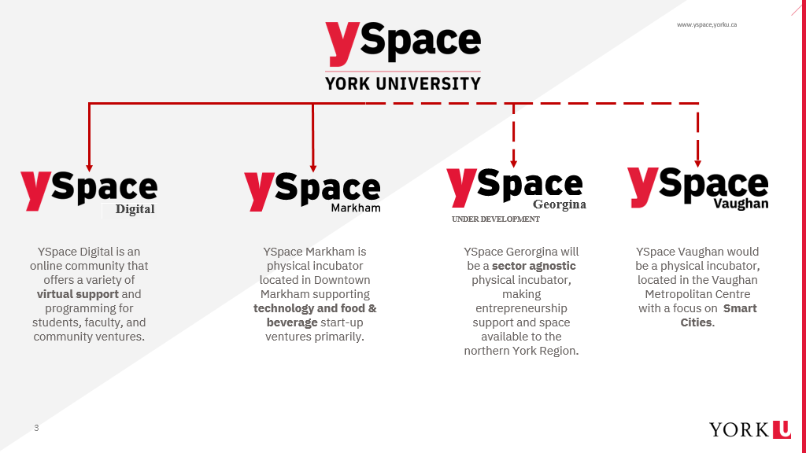
APPROVED IN PRINCIPLE
Notes:
Successfully worked with Towns of Georgina & East Gwillimbury to build YSpace Georgina.
Physical YSpace in Vaughan is under development with the City of Vaughan in smart cities (has been approved in principle by Council).

Slide 23

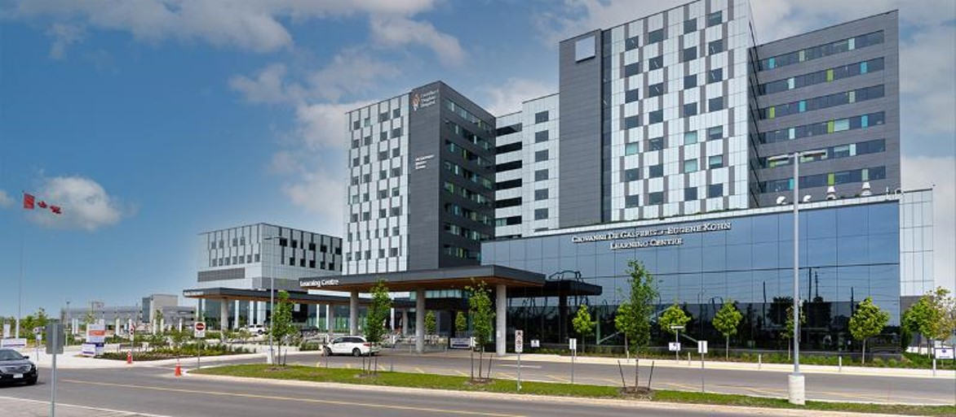

Ongoing projects
  Markham Campus- Research Clusters in AI & Society, FinTech, Digital Cultures, as well as 4 Ontario Research Chairs in Public Policy: leading critical policy research that addresses broader issues of ethics, governance, and public policy.
  VHCP/ research collaborations- establish potential collaboration in the areas of Allied Health and Nursing as well as Advancing Health Informatics, health intelligence, population analytics etc.
  Canada First Research Excellence Fund (CFREF)– submitted Connected Minds: Neural & Machine Systems for a Healthy, Just Society with a request of $106M, with a $126M of University matching funds- growing out of our successful VISTA grant.
  YSpace expansion- continuing to expand physical presence of Yspace in York Region, as well as establishing new programming
  New ORUs as transdisciplinary research centres/ institutes as incubators of interdisciplinary scholarship, research & action
    Institute for Technoscience & Society
    One WATER
    Centre for Artificial Intelligence & Society
    Centre for Integrative and Applied Neuroscience
    York Emergency Mitigation, Engagement, Response and Governance (Y-EMERGE)

Slide 24
Ongoing projects
  Continue to foster existing and strategic clusters of research: 2nd Edition of the Catalyzing Interdisciplinary Research Clusters (CIRC) grants in strategic areas- 18 full proposals were submitted end of July 2022
  Research Commons- Research grant preparation mentorship programming Research focused on workshops to faculty members, research staff, post-docs and graduate students at the university. Targeted workshops for faculty members who have not held a research grant in the last 5 years.
  YRC program- internal counterpart for the national Canada Research Chairs (CRC) program and recognizes outstanding researchers at York. VPRI continues to add new York Research Chairs annually.
  Working to develop York’s internationalization strategy particularly with respect to research partnerships with international partners. Fostering more international research partnerships and funding opportunities
  Digitization:
    Electronic CV (eCV): An online software to capture and organize scholarly achievements that enables output in multiple formats and enables collection of summarized research data in anonymized manner.
    DocuSign- extending contract, ORS checklist consultation with faculty on improvements, adding in attachments
    Invest in an updated online system where all processes, documents, certificates can be tracked by ORE
    Renew ORCID adaptation efforts: Ensure researchers receive correct attribution for their research outputs
  Research Service Excellence Transformation- creating efficient research services and support. Working with NOUS to determine which can be accomplished in VPRI

Slide 25
Considerations for the SRP (2023-2028)- Science, Technology and Innovation Priorities for the Canada Excellence Research Chairs Program and the Canada First Research Excellence Fund
Healthy Canadians
Focus Areas: Aging population, antimicrobial resistance, Indigenous health, Brain Health, Mental Health, precision Medicine, Population Health, Regenerative Medicine, Vaccinology, Problematic Substance Abuse, Primary Care (delivery models, access, outcome improvements)
Innovative and Resilient Communities
Focus Areas: Data Governance & Security, Governance and Public Institutions, Social Dimensions of Aging; Business-Sector Innovation, Digital Economy, Reconciliation, Systemic Barriers, Inequality (social, economic, health), The North, Resilient Infrastructure, Smart Cities, Technology & Society
Sustainable Food Systems
Focus Areas: Agri- and aqua-culture, Agri- and irrigation technology, Bioeconomy, Food Sovereignty, Indigenous-led Agriculture, Livestock heath and sustainability, Plant Health, Proteins and Alternative Food Sources, Safety and Security of Food Supply Chain
Technologically Advanced Canada
Clean and Resource-Rich Canada
Focus Areas: Alternative Energy Technologies, Circular Economy (waste treatment, greening manufacturing, sustainable food packing), Clean Technologies, Clean Transportation, Climate Change Research, Conservation Ecology, Energy, Forestry, Green Chemistry Low Carbon Materials for Construction, Modern Mining, Northern and Arctic, Water
Focus Areas: AI, Big Data technologies and Analytics, Biomanufacturing, Cybersecurity, Genomics and Applied Science, Materials and Processing Technologies, Micro-Electronics and Semi-Conductors, Communication Technology, Quantum Technologies, Photonics, Smart and Digital Manufacturing, Space Economy
Notes:
Example of Government research-focused areas for investment

Slide 26
Current SRP (2018-2023), Chairs, ORUs Related Fit
Healthy Canadians
Health Individuals, Healthy Communities and Global Health
Innovative and Resilient Communities
Digital Cultures
Sustainable Food Systems
Technologically Advanced Canada
Clean and Resource-Rich Canada
Integration of Artificial Intelligence into Society
Public Engagement for a Just and Sustainable World
Public Engagement for a Just and Sustainable World
12 CRCs and
22 YRCs in related areas
12 CRCs and
13 YRCs in related areas
3 CRCs and 7 YRCs in related areas
2 YRCs in related areas
4 CRCs and 4 YRCs in related areas
6 ORUs
12 ORUs
1 ORU
1 ORU
5 ORUs
Digital Cultures
Notes:
Example of Government research-focused areas for investment

Slide 27
What are the SRP Focus Areas @ Peer Institutions
 | TMU (2020-2025) | McMaster (2018-2023) | University of Toronto (2018-2023) | Queens University (2018-2023)
Environment & Energy (Public Engagement for a Just & Sustainable World) | Energy (Centre for Urban Energy) | Environment & Energy | Societies, the Environment and Natural Resources | Environment & Resources (Cleantech, Energy solutions)
AI & Society |  | Data, AI and Digital Society | Technologies for the Future (AI, Data, Robotics) | Research in Materials, Computational Analytics and Human-Machine Interactions
Equity, Diversity and Sustainable / Just Society (Public Engagement for a Just & Sustainable World) | Democracy Studies, Migration and Settlement | Equitable, Prosperous & Sustainable Societies | Governance, Diversity and Social Justice | Successful & Just Societies through Scholarship, Governance and Policy
Indigenous Knowledge {Indigenous Futurities] |  | Indigenous Knowledge & Research |  | Mobilizing Creativity and Enabling Cultures (creative production, society, culture, Indigenous research)
Communications Technology, Digital Cultures | Cybersecurity, Creative Innovation |  | Language, Culture, Art, Values (digital communications,) | Mobilizing Creativity and Enabling Cultures
Urban Innovation/ Smart Cities (Public Engagement for a Just & Sustainable World) | City Building & Urban Innovation |  | Community and Livable Societies
Advancing Materials & Manufacturing |  | Advanced Materials and Manufacturing
Healthy Individuals, Healthy Communities and Global Health | Biomedical Engineering | Chronic Disease, Aging, Infectious Disease | Healthy People, Healthy Communities, Healthy World | Health, Wellness and the Determinants of Human Health
Other | Future Skills Centre |  | Understanding of Humanity and the Universe | Principles of Nature: Discovery to Application & Innovation
Notes:
Source: https://www.chairs-chaires.gc.ca/program-programme/strategic_research_plan-plan_recherche_strategique-eng.aspx
CRC Secretariat: SRP Summaries

