Slide 1
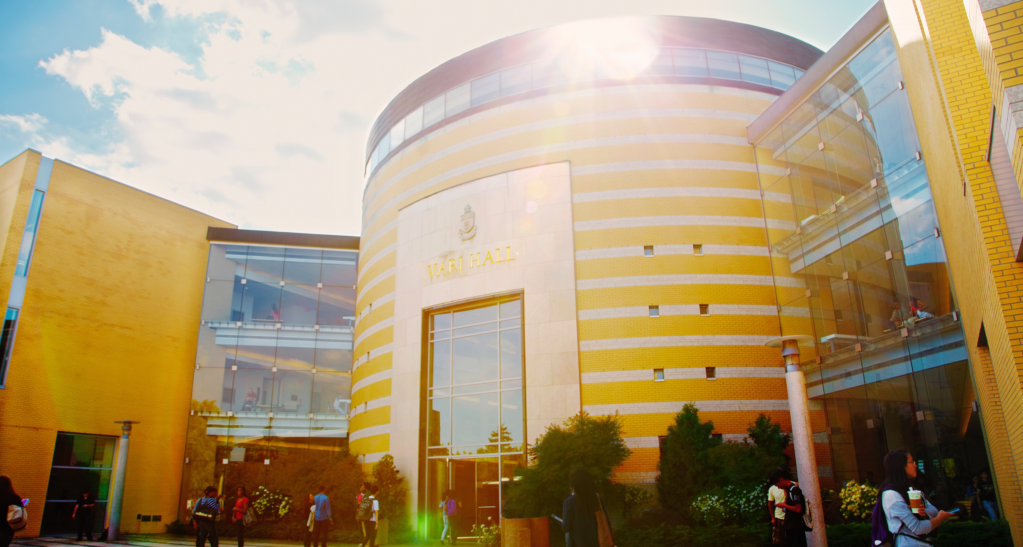
York University
Institutional Research Data Management Strategy
FGS Faculty Council
November 3, 2022

Slide 2

Open Access Open Data Steering Committee
The York University Open Access and Open Data Steering Committee engages in broad stakeholder discussions to advance:
Campus-wide education on open access and data management
Coordinated service models that support faculty with requirements of OA and RDM policies
Discussion and consideration on changes to the system of scholarship, sustainability of current economic models of scholarship, access to publicly funded research, issues surrounding authors rights in the digital age, and new scholarly distribution systems and other connected open movements
Notes:
DS

Slide 3

A Commitment to Open Scholarship

Slide 4





UNESCO Recommendation on Open Science
“Open Science is defined as an inclusive construct that combines various movements and practices aiming to make scientific knowledge openly available, accessible and reusable for everyone, to increase scientific collaborations and sharing of information for the benefits of science and society, and to open the processes of scientific knowledge creation, evaluation and communication to societal actors beyond the traditional scientific community. It includes all scientific disciplines and aspects of scholarly practices, including basic and applied sciences, natural and social sciences and the humanities.”

Slide 5
Open Scholarship
Key open science pillars (UNESCO):​
  Open access to scientific knowledge
  Open science infrastructures
  Open science communication
  Open engagement of societal actors
  Open dialogue with other knowledge systems
“Understanding the knowledge creation, curation, and circulation undertaken by academics as a public good and responsibility, Open Scholarship calls upon researchers to render their research processes and practices transparent.”

Slide 6

Developing and enabling policies for Open Scholarship
Tri-Agency Policy on Open Access Publications
Tri-Agency Statement on Digital Data Management
York University Senate Policy on Open Access
Tri-Agency Policy on Research Data Management
York University will develop an institutional strategy on research data management strategy by 2023 to align with Tri-Council policies

Slide 7

Research Data Management

Slide 8
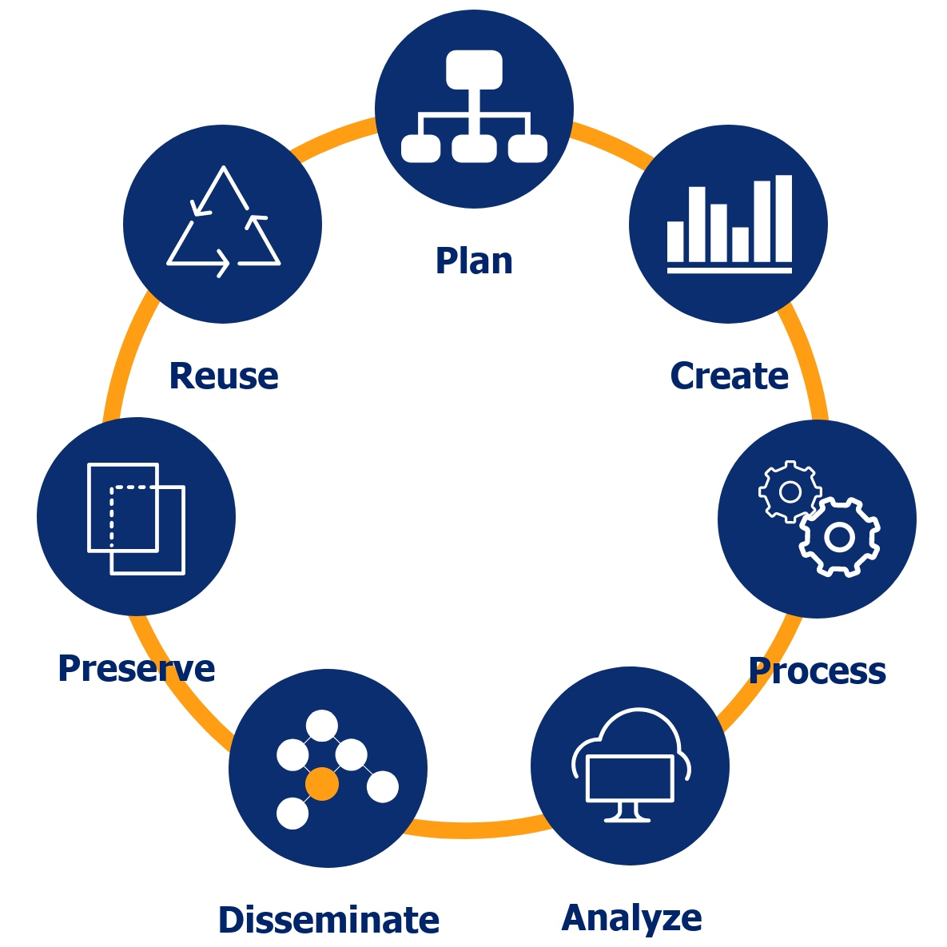
Research Data Management (RDM)
RDM refers to the processes applied throughout the lifecycle of a research project to guide the collection, documentation, storage, sharing, and preservation of research data.
RDM practices are integral to conducting responsible research and can help researchers save resources by ensuring their data is complete, understandable, and secure.
RDM practices also follow institutional and funding agency guidelines that protect their investments.
The broader research community can derive maximum value from research data that can be accessed, shared, reused and repurposed.
Notes:
A reminder that the Tri-Agency Research Data Management Policy states that researchers are responsible for developing a Data Management Plans and that they need to make data related to funded research projects available, not OPEN.
Raise awareness about data management practices, including secure storage, organization and documentation of data, and sharing and reuse of data.
This can help with disciplines where reproducibility of data is critical
Journals across disciplines are asking or starting to ask for data depost
Ensure research data is made available in such a way that it is useful to other researchers to advance their work
This is why the Tri Agency Policy is asking researchers to develop a data management plan, which is essentially a list of questions that encourage researchers to think critically about their data at all stages in the data mgmt lifecycle.

Slide 9
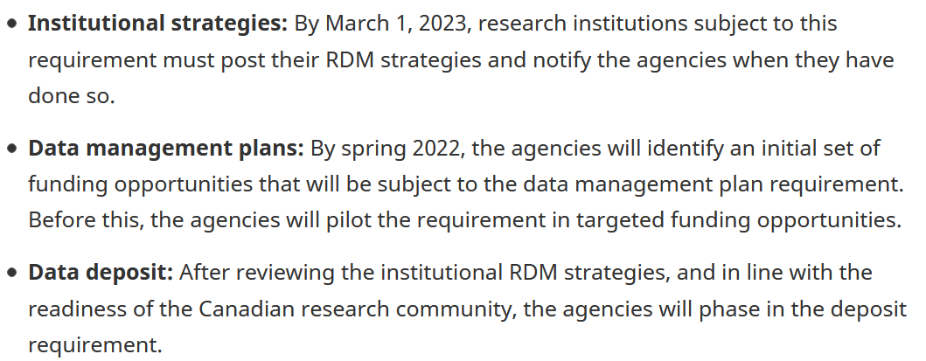
Tri-Agency RDM Policy (2021/3/15)
Government of Canada, I. (n.d.). Tri-Agency Research Data Management Policy—Science.gc.ca. Innovation, Science and Economic Development Canada. Retrieved March 24, 2021, from https://ic.gc.ca/eic/site/063.nsf/eng/h_97610.html

Slide 10
Faculty Council Discussions:
Understanding What Constitutes Research Data
Primary sources supporting research, scholarship or artistic endeavors
Evidence to validate or substantiate findings and results
Experimental data, observational data, operational data, third-party data, public sector data, monitoring data, processed data, or repurposed data
All other digital and non-digital content have the potential to become research data
Benefits of Sharing Research Data
Promotes future research growth through open access
Supports research integrity
Prevents duplication and loss of research
Increases reproducibility of research
Provides opportunities for collaboration
Is recognized as an important aspect of research across many research communities
Respects Mandatory Privacy Agreements and Confidentiality
Notes:
An opportunity to bring these conversations to the table and learn a bit more about existing adoption of data management across the faculties, and where there may be existing gaps.
We’d like to hear from you. Do your faculty self-identify as research data creators? What constitutes data?
Have you encoutered any data-related challenges?
Review of data management plans is anticipated to happen within faculties, would that pose a resourcing challenge?
"Under the guidance of VPRI and Libraries, research deans’ offices will review grant applications to ensure research data management plans and their associated costs are considered in proposals."

Slide 11

Draft Institutional Research Data Management Strategy
Draft is available on the Steering Committee site along with an FAQ
Faculty Council discussions, APPRC and possibly Senate presentation​
By March 1, 2023, the strategy will be posted on the TriCouncil website
It will be considered a living document subject to annual review and updating.​
Notes:
What are some of the challenges you’re facing?
Review of data management plans is anticipated to happen within faculties, would that pose a resourcing challenge?
"Under the guidance of VPRI and Libraries, research deans’ offices will review grant applications to ensure research data management plans and their associated costs are considered in proposals."

Slide 12

Draft Institutional Research Data Management Strategy
Informed by:
Campus consultations with researchers engaging with data management
Three OAOD task groups looked at Institutional Policies, our IT Infrastructure and related supports, and Data Management in the Humanities and Social Sciences, respectively
Identified our current state and desired future state, and faculty councils will help to further inform this work
Institutional strategy outlines:
Background, stakeholders and existing policies
Supporting units internal and external to the university, outlining current and anticipated future assistance needed
Ethical, Legal, and Commercial Considerations
Future timeline

