Slide 1
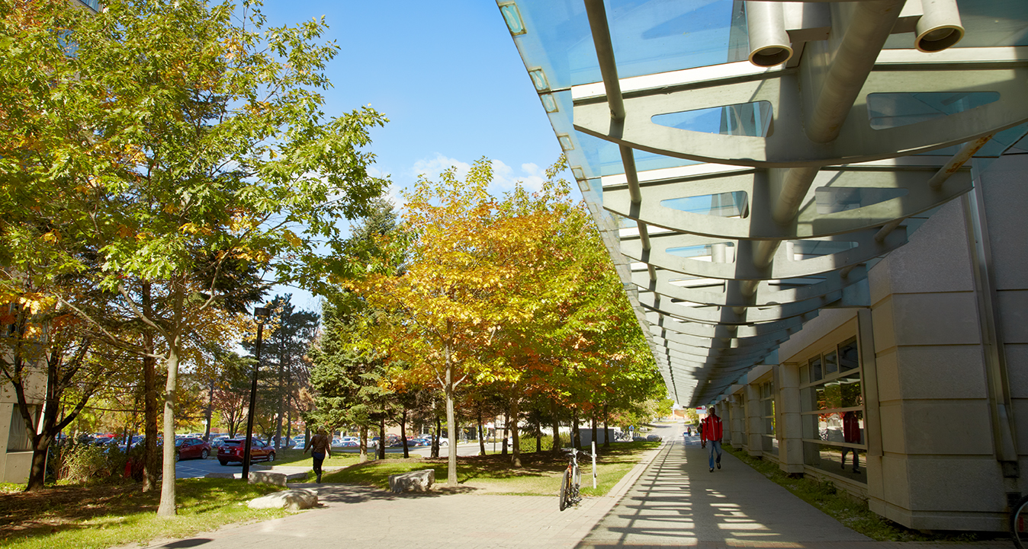
Library Support for Grant-Funded Research
York University Libraries
Kris Joseph
Mar 7, 2024

Slide 2

The story so far (Winter 2024)
Currently: York Libraries are supporting 11 grants, and has signed 12 memos of support for grant applications submitted in Sept/Oct 2023
These grants:
  Are largely SSHRC (Partnership, Insight, Development, Connect), Heritage Canada, CEWIL, Canada Council
  Represent researchers and teams in AMPD, Communications & Culture, DLLL, EUC, Education, History, Sociology
Since Fall 2023, the Libraries committed 715 hours of in-kind support (value $85,825) to grant projects that will run from 2024-2031
Notes:
SARAH
-Libraries as places for knowledge production (not just consumption)
-by comparison last Sept/Oct we only signed one memo.
-For projects that require large amounts of a librarian's time (i.e. more than 10 hours) we usually advise to budget in the grant for the hiring of a part-time librarian or a short term contract librarian. We have several of these currently running out of the libraries including a CEWIL grant and SSHRC Connection Grant. We can assist with the job posting and hiring process as needed.
-Science/Health perspective: we are consulting on the Connected Minds: Neural and Machine Systems for a Healthy, Just Society Project and also will be folding into this menu systematic reviews, scoping reviews (Knowledge Synthesis in general).
DLLL –Department of Languages, Literature and Linguistics

Slide 3

Value-Added Services the Libraries can Provide for Researchers
Computational Research Methods and Tools
Digital humanities methods for data collection, data analysis, collaborative research techniques, tool selection, etc.
Digital Preservation
Preparing digital objects for preservation and archiving
Storage costs
Exhibits and Discovery
Consultation and support for creation of online digital exhibits using online platforms
Full details: https://bit.ly/libgrants
Notes:
AK note: might want to mention that people forget to factor/budget for a project management for their exhibits and discovery projects
KRIS
I’ll provide a brief overview of our menu of pre-existing in-kind services that we offer. These are all online at the link you’ll see on this slide.
Computational methods: has been a lot of DH work, but also bridges into data services and topics like geospatial processing and data visualization, HPRC
All pre-grant consultation includes guidance on topics like budgeting for project management, which is often not considered

Slide 4

Value-Added Services the Libraries can Provide for Researchers
Media Creation Lab
Access to studio spaces and equipment for media creation
Consultation services related to media production work
Metadata Consultation
Guidance on standards and conventions for describing digital objects
Open Access Publishing
Deposits into the YorkSpace repository
Choosing open access publishing channels, open licensing of content
Full details: https://bit.ly/libgrants
Notes:
AK note: would it be prudent to mention that for the MCL we have to balance curricular uses with research uses and are exploring models where lab time (paying for staff time to cover lab) can be made available for grant-funded projects.
KRIS
MCL is a popular venue for studio space and equipment use; in very high demand by students so we’re looking at models where grants budget to account for staff time to ensure capacity is available
-noting here that LAPS and AMPD are expected as heavy users to the MCL, but Lassonde is the 3rd highest user (by faculty) as novel forms of knowledge mobilization become more normalized in STEM fields
Metadata consultation covers digital objects, but can also account for describing data sets in ways that make them more discoverable

Slide 5

Value-Added Services the Libraries can Provide for Researchers
Research Data Management (RDM)
Compliance with Tri-Agency Research Data Management policy requirements
Consultation and workshops RDM best practices
Data management strategy and planning consultations
Guidance on data deposit
Research Visibility and Impact
Strategies to plan for and assess research impact
Workshops on the research impact landscape, emerging developments, metrics, tools and best practices
Our formalized model for systematic and scoping review support is coming soon
Full details: https://bit.ly/libgrants
Notes:
KRIS
These topics are becoming mandatory aspects of grant applications and are still new to many researchers. Libraries excel in this area
Note that demand for assistance with scoping and systematic reviews is extremely high

Slide 6
The process
Consultation: meet as early as possible with the research team to help shape the grant
Partnerships: in-kind and paid opportunities are outlined for the research team
Commitment: The Dean’s office provides a signed letter of support to be included as part of the grant application
No partnerships or in-kind services can be offered in the absence of a signed letter
Contact libgrants@yorku.ca at least 2 weeks before
internal submission deadlines
Notes:
SARAH
For projects that require large amounts of a librarian's time (i.e. more than 10 hours) we usually advise to budget in the grant for the hiring of a part-time librarian or a short term contract position housed either in the libraries or the department where the grant is being administered.

Slide 7
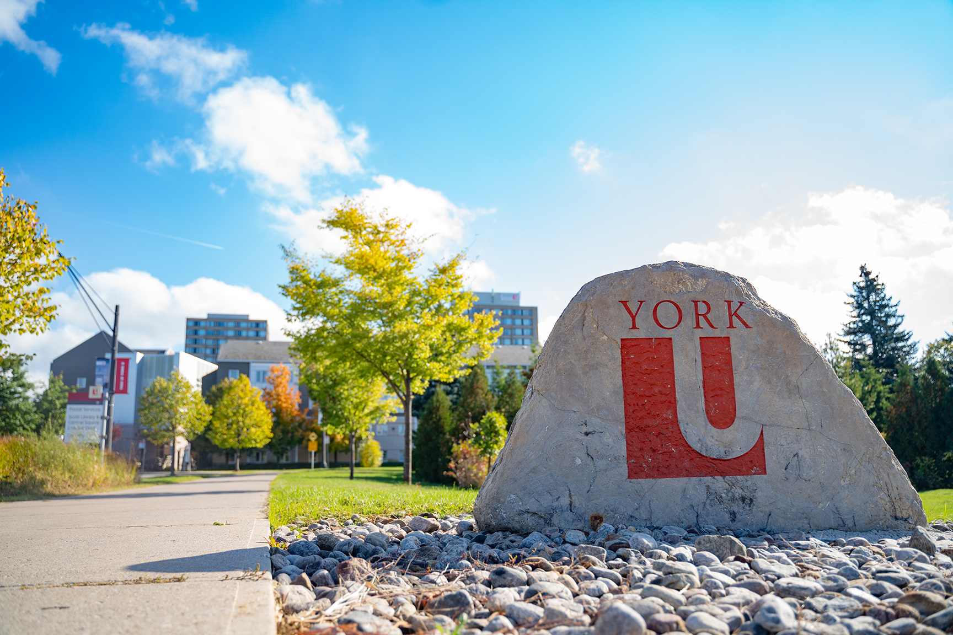
Questions
Contact us: scoysh@yorku.ca , kjo@yorku.ca, or libgrants@yorku.ca

