Slide 1
Discussion of the Draft University Academic Plan 2020-2025
LA&PS Faculty Council
March 12, 2020

Slide 2
3 Strategic Documents Spanning 27 Years
1992
2020 Vision
2020
2010
White Paper
2015
UAP

Slide 3

UAP Process
White Paper and UAP Achievement Report
Community Engagement
UAP 2020-2025 Drafting
Community Consultation on Draft UAP
UAP Finalisation and Senate Submission
Fall 2019
Winter 2020
May 2020
MARCH 2020

Slide 4




Community Consultations
3036 Responses Collected Through Survey Software
Other
Senate
Grad Students
Faculty Councils
21 Consultations Conducted
Other Feedback Collected By:
Undergrad Students
Indigenous Council
Contract Faculty
Staff
E-Mail
Web Form
Public Bulletin Boards

Slide 5
Engagement Options
Ways to provide input on the draft to the Senate Committee:
Participate in today’s discussion
Feedback form on the UAP Renewal website
By email to info.univsec@yorku.ca

Slide 6
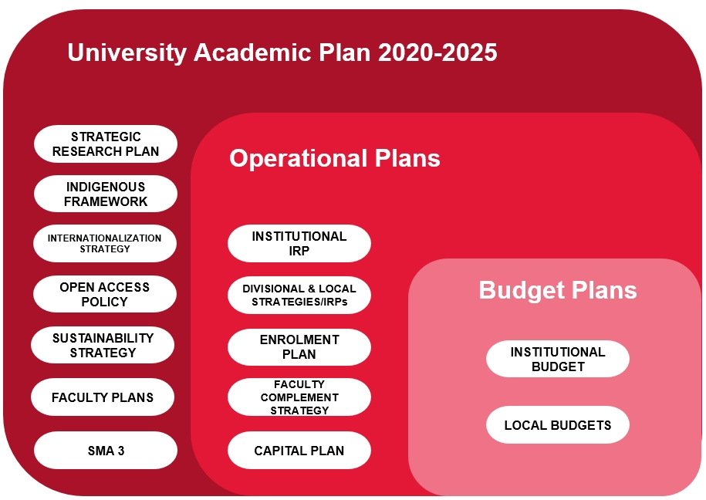
York University’s Planning Ecosystem

Slide 7
York’s Current UAP: 7 Priorities
Innovative, Quality Programs for Academic Excellence
Advancing Exploration, Innovation and Achievement in Scholarship, Research and Related Creative Activities
Enhanced Quality in Teaching and Student Learning
A Student-Centred Approach
Enhanced Campus Experience
Enhanced Community Engagement
Enabling the Plan

Slide 8
Approach to the UAP
Considerable enthusiasm from the community around the idea of “Grand Challenges”
Also significant cautions around inclusivity, and divergent opinions about how to express challenges
Draft proposes a hybrid approach
Traditional “Priorities” Approach
Grand Challenge

Slide 9

Building a Better Future:
York University Academic Plan 2020-2025
Overall theme: coming together to make positive change for our students, our campuses, and our local and global communities.
Traditional “Priorities” Approach
Grand Challenge

Slide 10
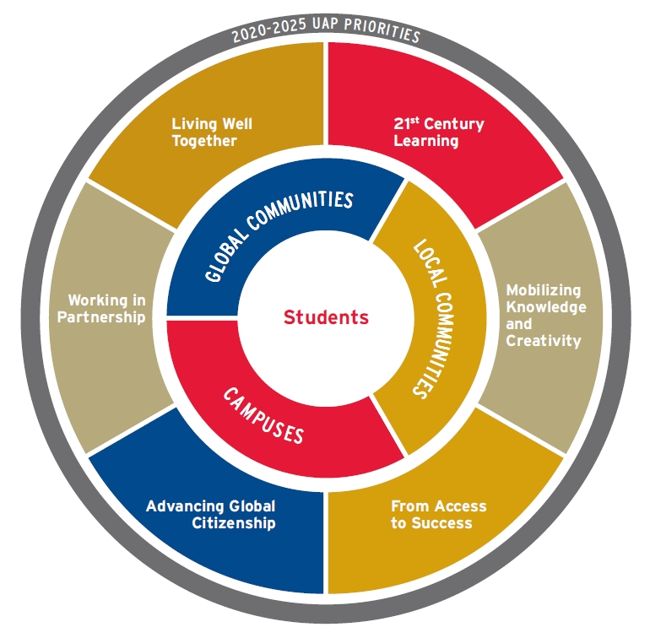
Proposed UAP 2020-2025 Priorities

Slide 11
Proposed UAP 2020-2025 Priorities
Why 21st Century Learning: Diversifying Whom, What and How we Teach
At York University we are determined to equip every student, regardless of background or field of study, with the knowledge, transferable skills, and values to navigate a 21st century world in which change is the only constant.

Slide 12
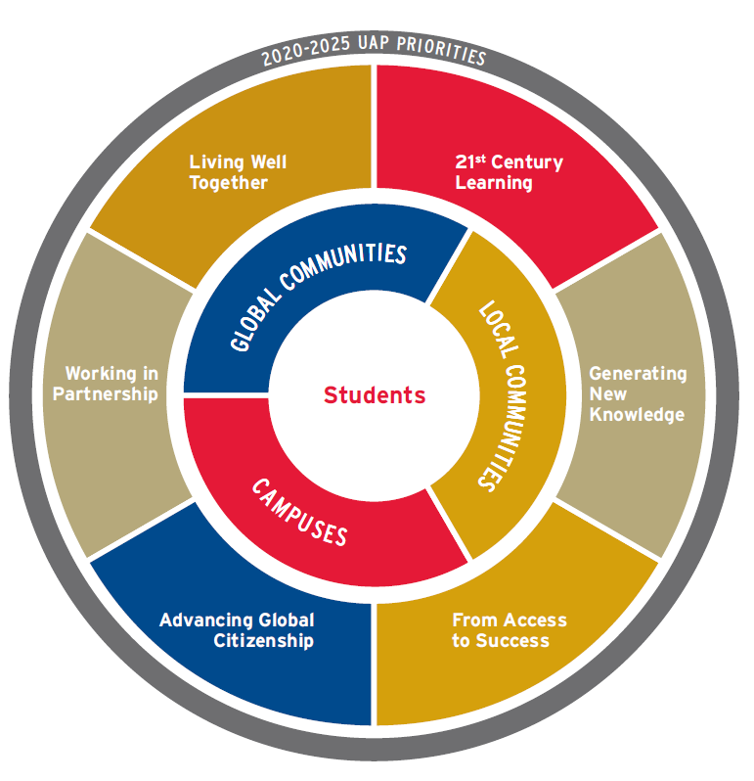
Proposed UAP 2020-2025 Priorities
Why Mobilizing Knowledge and Creativity:
As change accelerates around us, we aim to be more responsive to our communities by generating critical knowledge and works of art, ideas that engage multiple perspectives, and innovations that propel Ontario as a global knowledge-economy leader.

Slide 13
Proposed UAP 2020-2025 Priorities
Why From Access to Success: Next Gen Student Supports
With many of our students facing life challenges that affect their studies, York will devote additional attention to supporting students of all backgrounds and circumstances to complete their studies successfully and to realize their full potential.

Slide 14
Proposed UAP 2020-2025 Priorities
Why Advancing Global Citizenship:
York University draws people from around the world who seek to learn from each other and to gain the global fluencies needed to work locally and across borders toward a better future.

Slide 15
Proposed UAP 2020-2025 Priorities
Why Working in Partnership:
York University understands that by partnering with other entities and sectors we can maximize positive impact on our students, our campuses, and our broader communities.

Slide 16
Proposed UAP 2020-2025 Priorities
Why Living Well Together:
Making positive change requires that all members of our diverse community feel welcomed into a sense of belonging, common purpose, and shared responsibility to support and enrich each other's work.

Slide 17

A University-Wide Challenge to Contribute to the UN Sustainable Development Goals

Slide 18

Discussion: Does the draft effectively capture York’s identity and who we aspire to be?
Does it sufficiently differentiate York from other institutions?

Slide 19
Thank you for your participation!

