Slide 1
University Academic Plan
Community Consultations
Fall/Winter 2019-20

Slide 2
Consultation goal
To share ideas on the future of York University and the University Academic Plan 2020-2025

Slide 3
What is the UAP and why talk about it now?
The University Academic Plan (UAP) is a foundational document, approved by the University Senate, to articulate our vision and academic priorities as an institution.
The current UAP runs from 2015-20.
The Academic Policy, Planning & Research Committee (APPRC) of Senate has initiated the process to create our next UAP.

Slide 4
3 Strategic Documents Spanning 27 Years
1992
2020 Vision
2020
2010
White Paper
2015
UAP

Slide 5
York’s Current UAP: 7 Priorities
Innovative, Quality Programs for Academic Excellence
Advancing Exploration, Innovation and Achievement in Scholarship, Research and Related Creative Activities
Enhanced Quality in Teaching and Student Learning
A Student-Centred Approach
Enhanced Campus Experience
Enhanced Community Engagement
Enabling the Plan

Slide 6
What are Other Universities Doing?
Brief Environmental Scan
We reviewed:
21 International Universities and 19 Canadian Universities across 11 Countries and 5 continents
Top QS schools, Canadian Universities across provinces, comprehensive universities
Three formats are common across institutions:
Traditional: organized around excellence in programming, research, student success, and community engagement
Thematic: organized around one or more central themes (e.g., impact of technology on society)
Grand Challenges: organized around local/global challenges/opportunities

Slide 7
Traditional UAP Themes
Advancing:
  the teaching mission
  research, scholarship and creative activity
  student success
  community engagement

Slide 8
Thematic Approaches
E.g. Northeastern University
Focus on evolving a new kind of university for a digital and artificial intelligence age: blueprint for the “networked university”
E.g. Sorbonne University strategic themes
Acting in a global world
Contributing to the open science, digital and data revolutions
Learning, understanding and undertaking in a changing world

Slide 9
What is a “Grand Challenge?”
complex and urgent societal issues of our time
with global and local dimensions
too big to be understood from any one perspective
calls for thinking across disciplines, collaborating across institutions, sectors and borders
focus on social innovation, solutions and impact

Slide 10
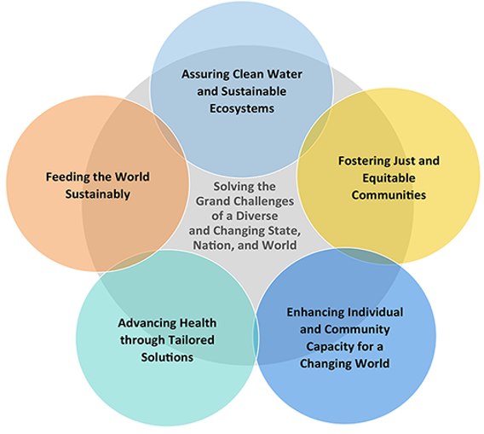
Grand Challenges Approach:
E.g. University of Minnesota

Slide 11
What do you see as York's greatest values?
Q1

Slide 12
Describe using one word the greatest opportunities for York that should inform the next University Academic Plan.
Q2

Slide 13
Which of these approaches seems most appealing to you?
Q3
Standard approach (organized by different activities of research, teaching ,etc.)
Thematic approach
Grand challenges/big questions approach

Slide 14
Are there local or global challenges that York is especially well placed to help solve?
Q4

Slide 15
Should APPRC frame the University Academic Plan around Grand Challenges?
Q5

Slide 16
How might we best advance the teaching mission of the University over the next 5 years?
Q6

Slide 17
How might we best advance research, scholarship and creative activity over the next 5 years?
Q7

Slide 18
How might we best advance student success over the next 5 years?
Q8

Slide 19
How might we best advance community engagement over the next 5 years?
Q9

Slide 20
UAP Process
White Paper and UAP Progress Report
Community Engagement
UAP 2020-2025 Drafting
Community Consultation on Draft UAP
UAP Finalisation and Senate Submission
Fall 2019
Winter 2020
April 2020

Slide 21
Engagement Options
There are many ways to provide input to the Senate Committee:
Faculty Council discussions
By posting your thoughts on public bulletin boards located at Scott Library and Vari Hall
Through the feedback form on the UAP Renewal website
By email to info.univsec@yorku.ca

Slide 22
Thank you for your participation!

Slide 23
Links to Notable UAP Examples
Delft University of Technology: Interactive plan online
University of Saskatchewan: The University the World Needs
Northeastern University: No boundaries
Sorbonne University: Focus on technology
OCADU: Strategic Directions and Summary
University of Sydney: Best title

