Slide 1
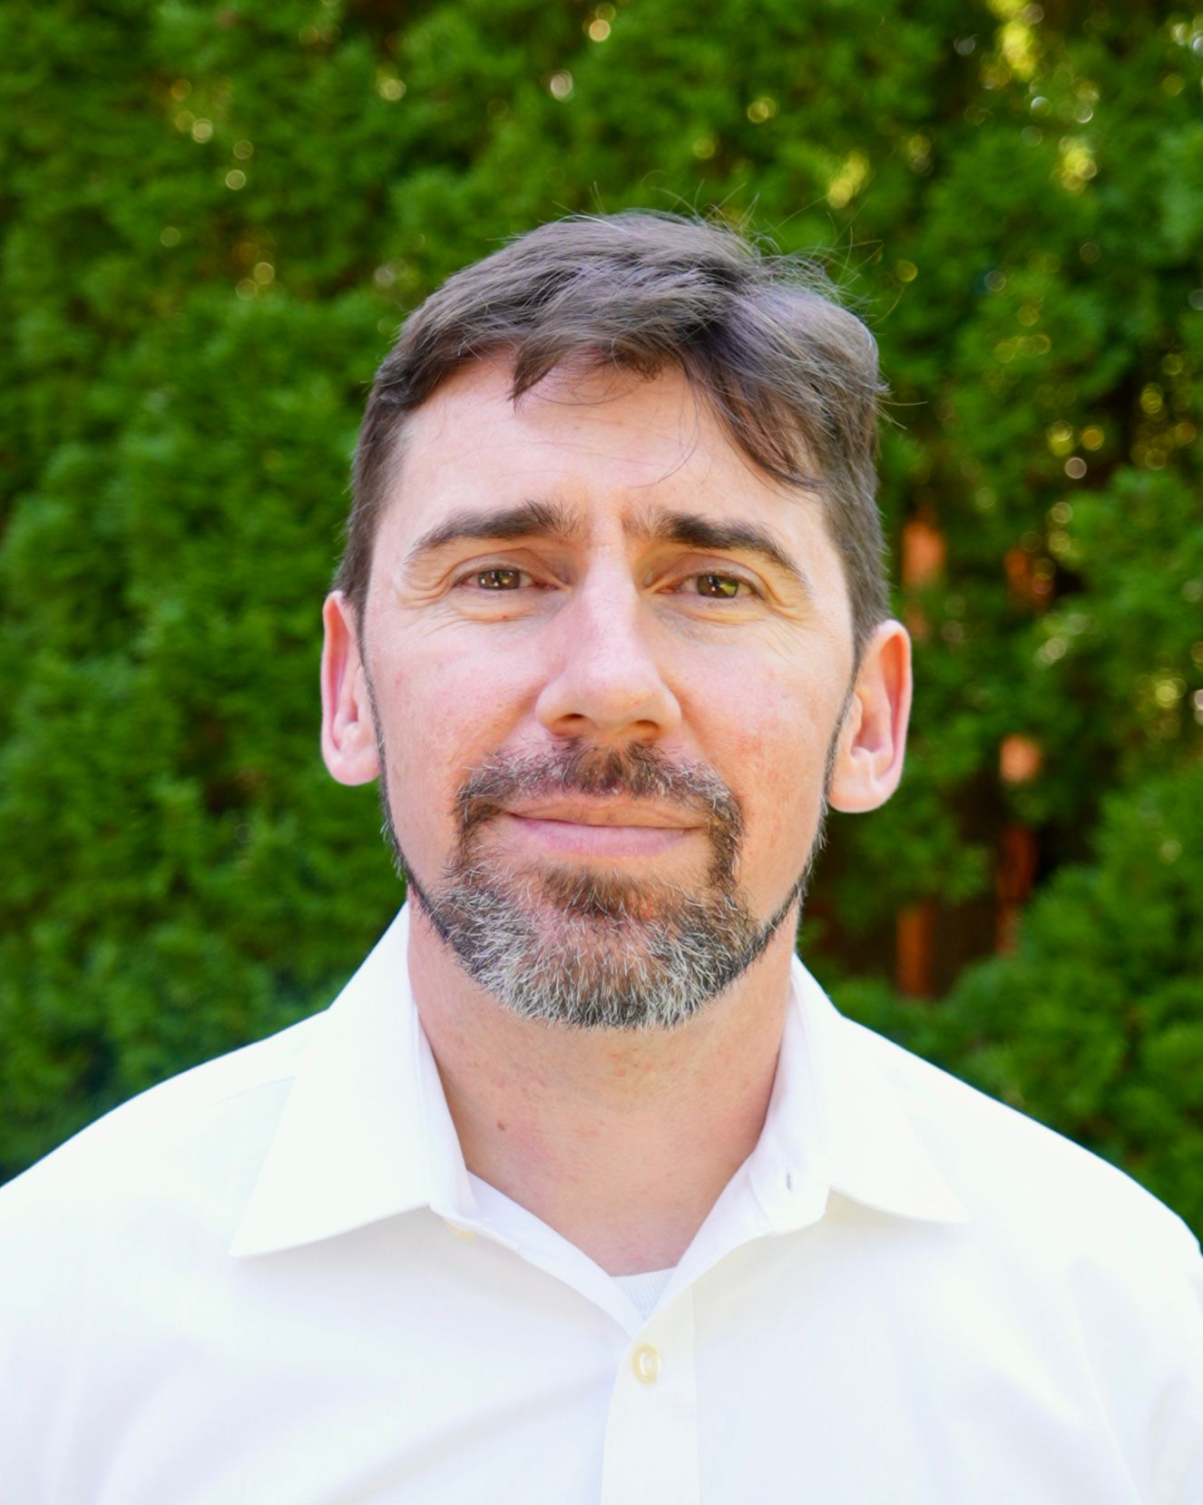
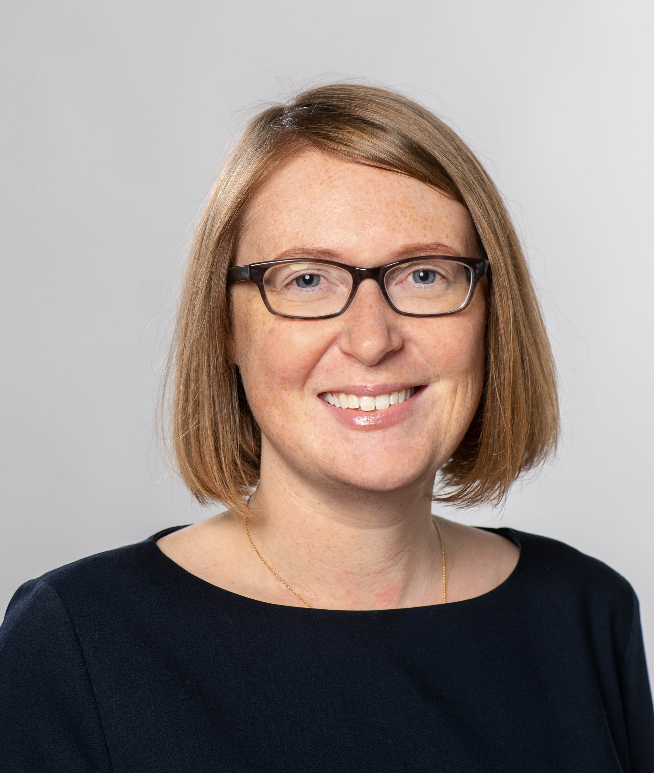
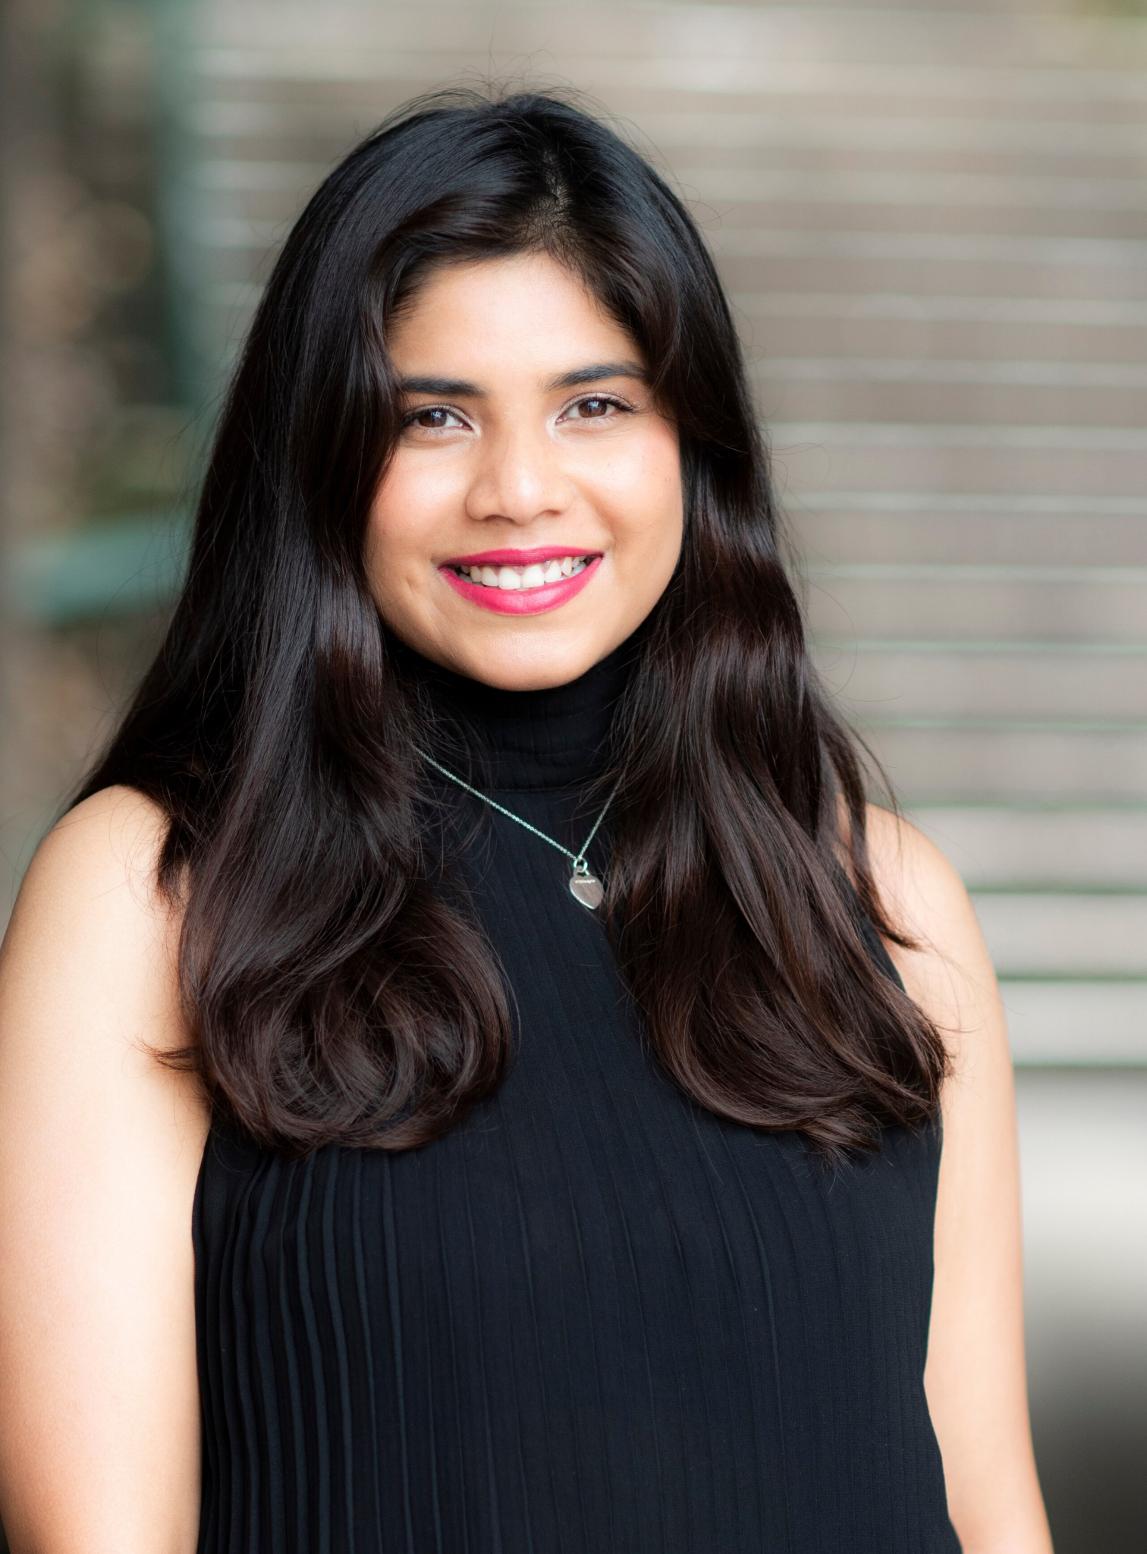
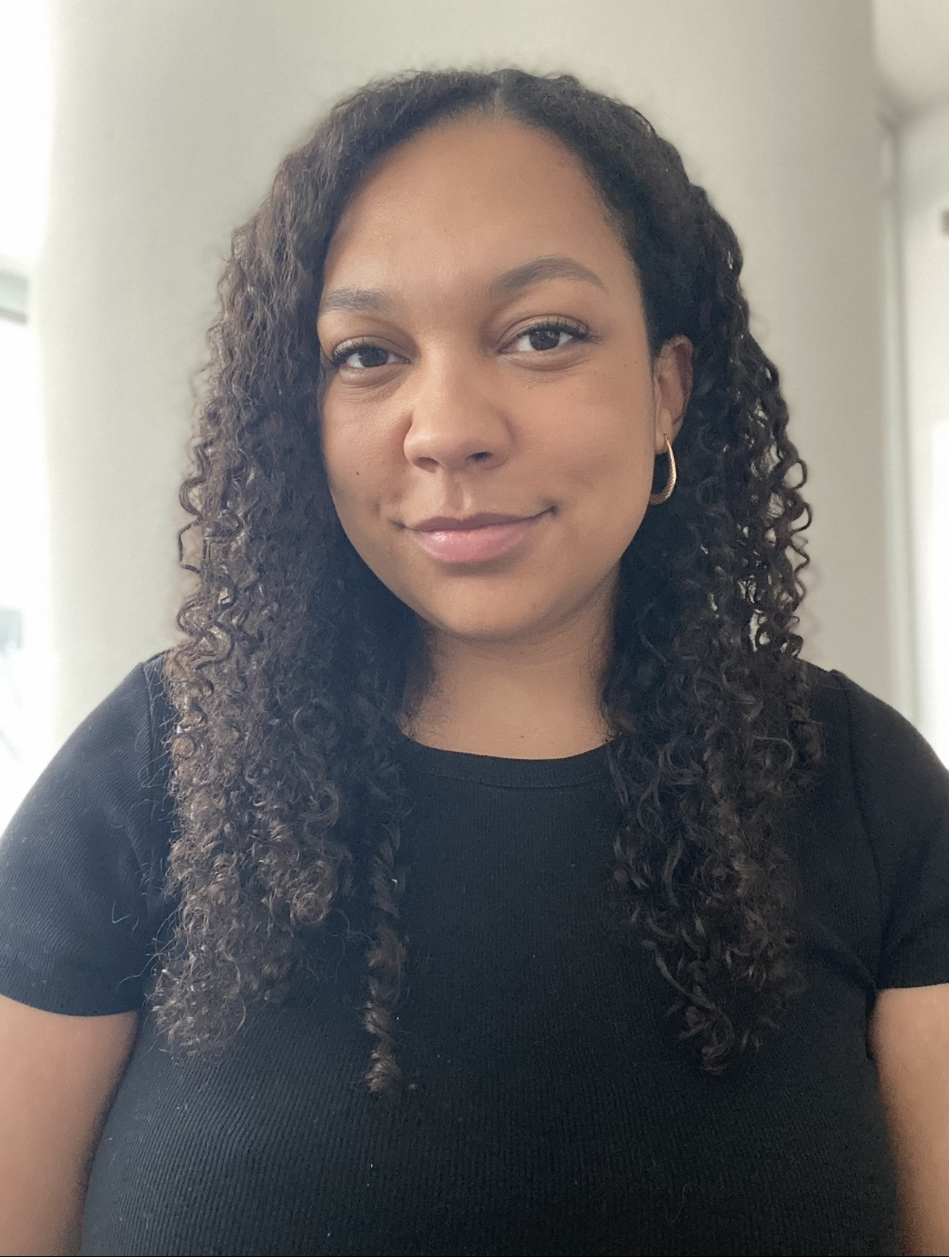
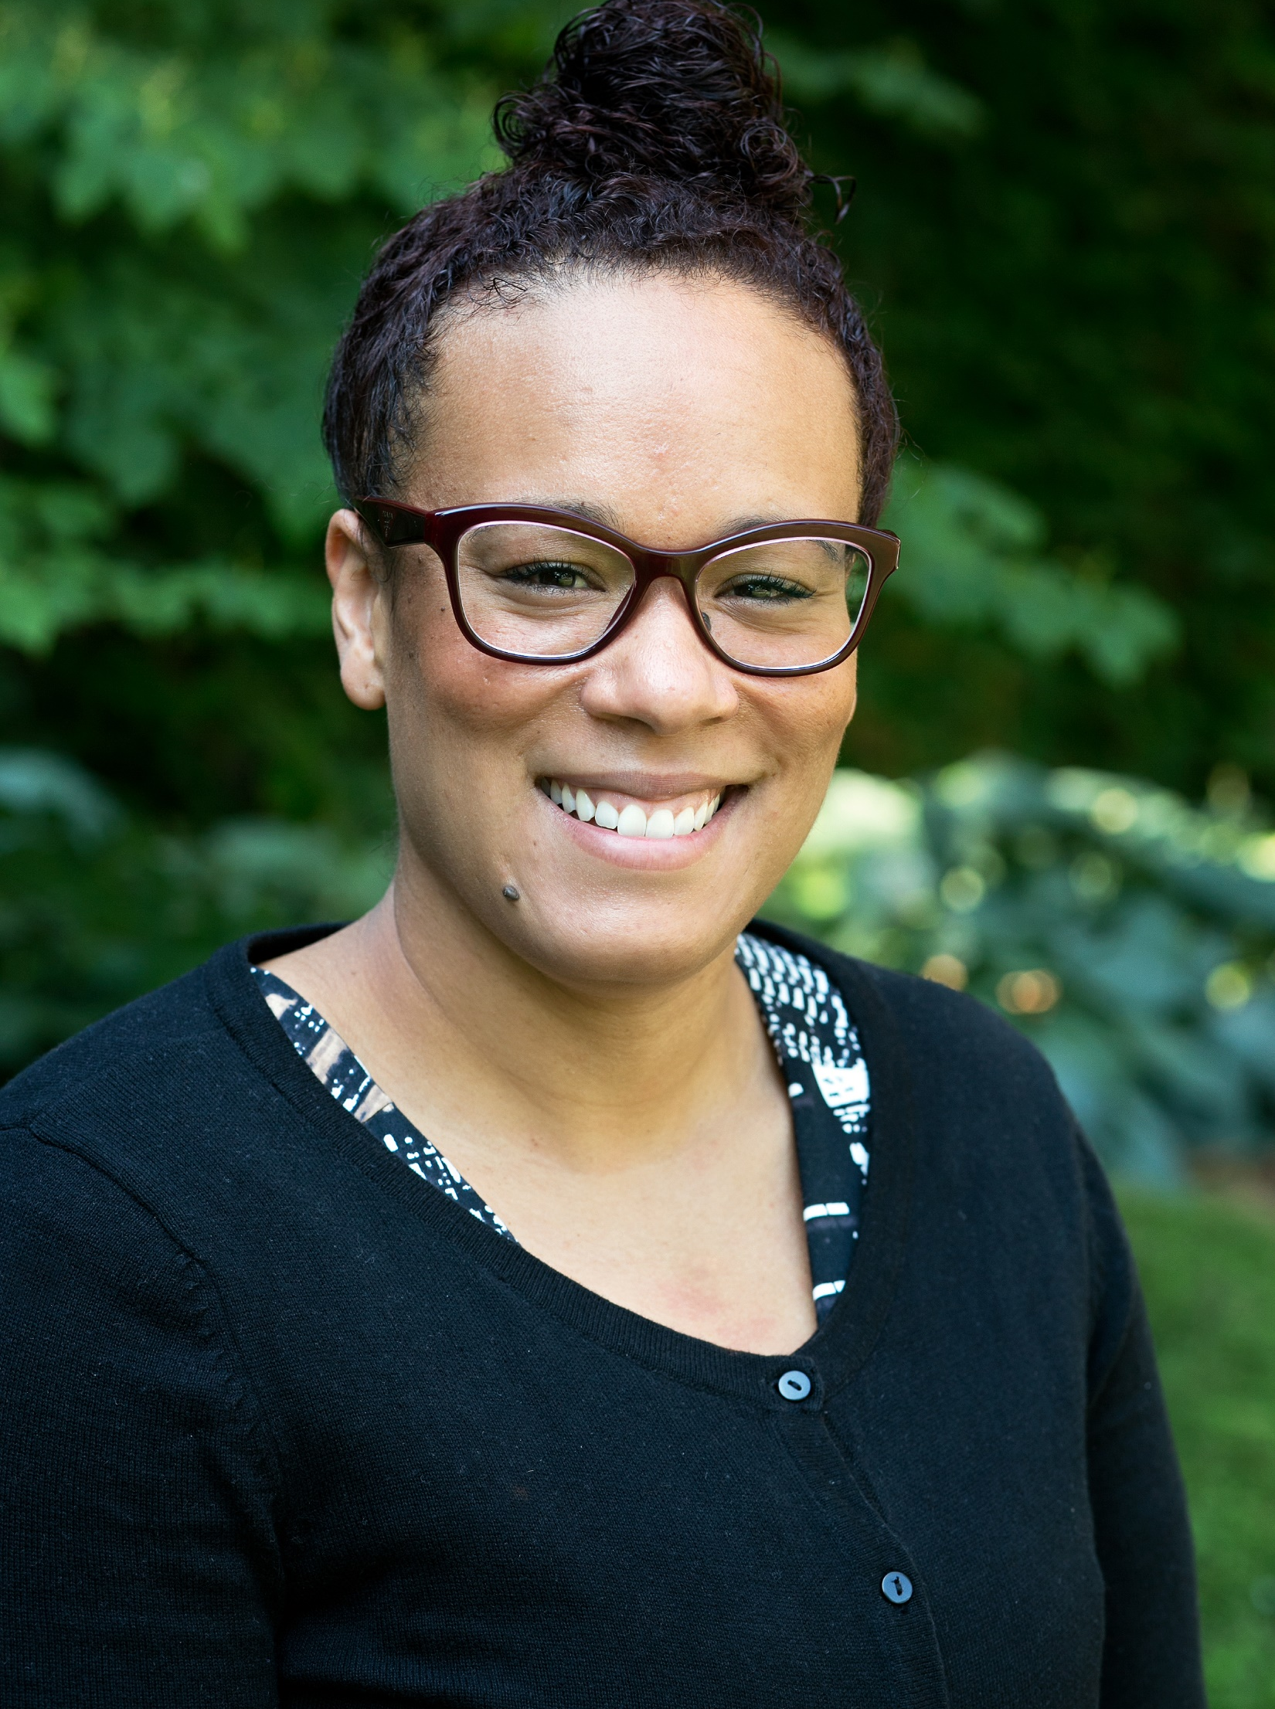
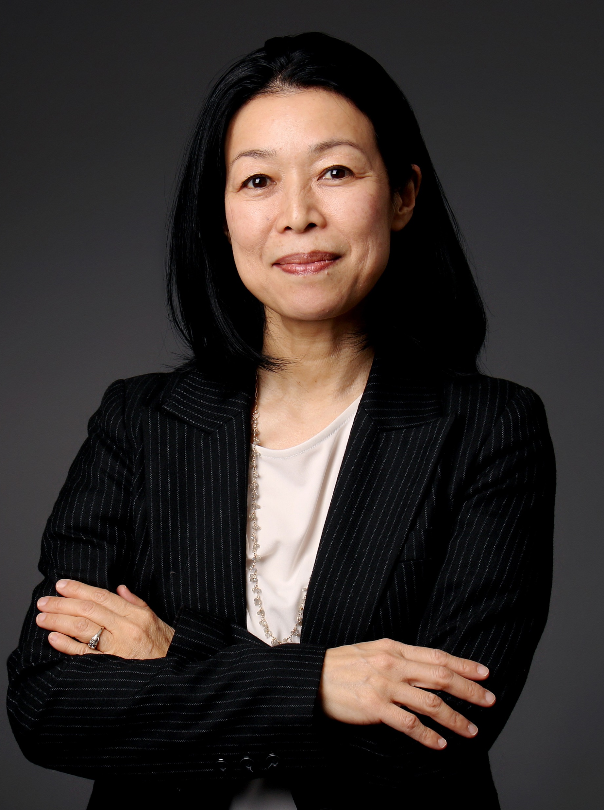
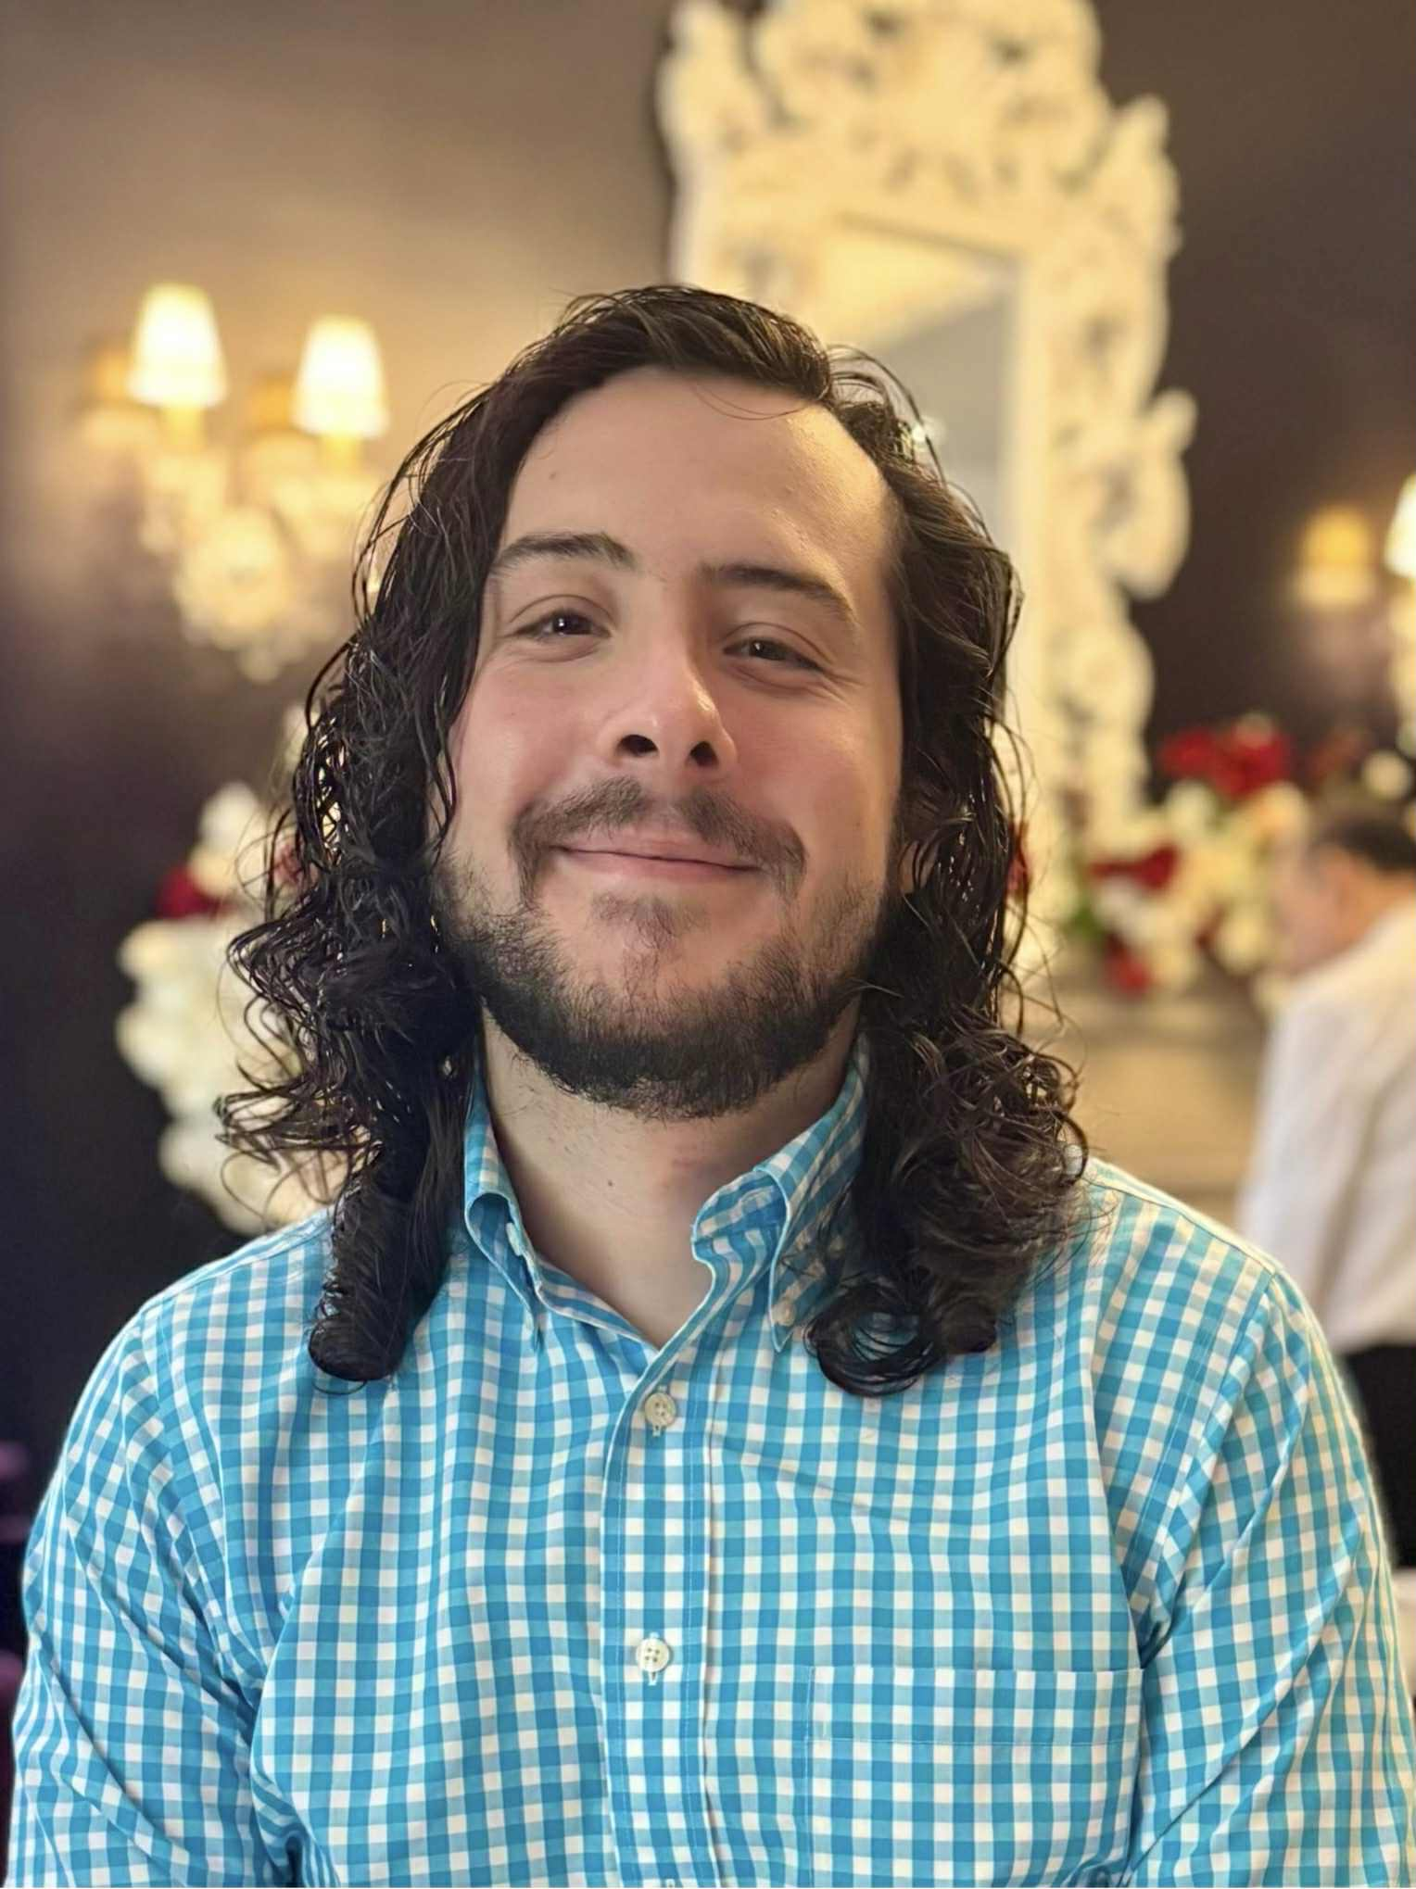
2024-2025
DEAN’S AWARD FOR EXCELLENCE IN TEACHING
Dean JJ Mcmurtry

Slide 2
Full-Time Tenured Faculty
Robert J. McKeown, PhD, CFA is an Associate Professor, Teaching Stream, in the Department of Economics at York University and was Academic Director of the Student Numeracy Assistance Centre at Keele (SNACK) from 2021-2025. Colleagues and students alike commend him for fostering deep, sustained learning that aligns with students’ academic and career trajectories. Actively engaged in a thriving community of practice, he demonstrates an ongoing commitment to collaborative, research-informed pedagogy. Student nominees highlight his innovative use of educational technology, including the adaptive learning software ALEKS, which personalizes learning journeys and supports the development of foundational skills. The Sub-Committee also applauds his leadership in redesigning core courses and developing new ones, such as ECO305, which integrates career-oriented exercises to build professional readiness.
- Students, Colleagues & Sub-Committee
Robert McKeown
Department of Economics

Slide 3

Contract Faculty
Dr. Blacker’s current book project, Warding off Disease: Racialization and Health in Settler Colonial Canada, examines how biomedical pronouncements on race shape social realities, reinforcing colonial and systemic racist practices. Her teaching embodies the principles of decolonization, equity, diversity, and inclusion (DEDI), fostering an inclusive classroom environment where dialogue and reflection are central.
Colleagues and students alike commend Dr. Blacker for her transformative approach to education, which cultivates critical thinking, inclusive dialogue, and real-world engagement. Student testimonials describe her teaching style as “engaging, accessible, and thoughtful,” underscoring her ability to connect meaningfully with learners. Her passion for experiential learning is evident in her use of real-world contexts to deepen understanding, as well as her mentorship beyond the classroom. From supporting student research and helping secure funding to co-organizing academic panels, Dr. Blacker actively integrates experiential education and networking opportunities that enrich her students’ academic and professional development.
- Students, Colleagues & Sub-Committee
Sarah Blacker
Department of Social Science

Slide 4

Teaching Assistant
Antara Dey, recipient of the award in the Teaching Assistant category for year 2024-2025, is a Ph.D. candidate in Communication and Culture at York University. She is recognized for her inclusive, student-centered approach to teaching, where she consistently adapts to support diverse learners, including those on the autism spectrum. Her tutorials emphasize both academic development and personal growth, fostering confidence, belonging, and real-world readiness among her students. Dedicated to equity, inclusion, and neurodiverse education, she embodies the values of creativity, empathy, and student success.
In addition to her teaching, Antara contributes to course planning, collaborates with colleagues, and integrates guest lectures, demonstrating her leadership and commitment to enriching the student learning experience. Her doctoral research explores popular culture, food studies, consumer culture, and semiotics, focusing on how food narratives across film, television, music, and social media influence consumer behaviour.
- Students & Adjudication Sub-Committee
Antara Dey
Department of Communications and
Media Studies

Slide 5
Teaching Assistant
Brianna Garneau’s mentorship of first-generation learners and early-career scholars—through individualized guidance and resource navigation—has meaningfully contributed to student success, belonging, and retention. The Sub-Committee was deeply impressed by her teaching practice, which is grounded in clarity, care, and a strong commitment to inclusive, equity-informed pedagogy. The Sub-Committee also commends her classroom approach, which reflects a robust DEDI (Decolonization, Equity, Diversity, and Inclusion) ethos. Her ability to center students’ lived experiences and to disrupt traditional power hierarchies by fostering co-learning and mutual respect makes her a most deserving recipient of one of this year’s two TA Awards.
- Students & Adjudication Sub-Committee
Brianna Garneau
Department of Social Science

Slide 6

HONOURABLE MENTIONS
Jessica Braimoh (Department of Social Science)
Kumiko Inutsuka(Department of Languages, Literatures & Linguistics)
Braedon Balko (Department of English)

Slide 7

Full-Time Tenured Faculty
Professor Jessica Braimoh is an Assistant Professor in the Department of Social Science at York University. Her research explores the intersection of criminalization, socio-legal processes, and systemic forms of oppression, with a focus on “at-risk” populations. In teaching, she integrates critical, interdisciplinary frameworks—including feminist, Indigenous, and anti-racist perspectives—to challenge students to analyze power, imagine reform, and pursue social change. Recognized for her inclusive, student-centered pedagogy, she creates supportive learning environments, mentors students through theses and career pathways, and leads in curriculum design. Her transformative teaching has earned her an Honourable Mention, highlighting her lasting impact on students and the academic community.
- Students & Adjudication Sub-Committee
Jessica Braimoh
Department of Social Science

Slide 8

Contract Faculty
Kumiko Inutsuka is recognized in the form of an Honourable Mention for the 2024-2025 in the Contract Stream category. She is a contract faculty member in the Department of Languages, Literatures. The Sub-Committee highlighted the success of her students in national-level Japanese speech contests as a testament to her creativity, dedication, and mentorship. Students describe her as energetic, approachable, and deeply attentive to their needs, benefiting not only from strengthened language skills but also from enhanced open-mindedness, empathy, and intercultural understanding. Her research focuses on second language education, effective teaching methods for learners from diverse orthographic backgrounds, and language assessment. Colleagues value her leadership in curriculum design and online education, where her expertise has been instrumental.
- Students & Adjudication Sub-Committee
Kumiko Inutsuka
Department of Languages, Literatures, and Linguistics

Slide 9
Teaching Assistant
Braedon specializes in trans-Atlantic literary modernism, with theoretical interests in Marxist criticism, linguistic philosophy, food studies, and aesthetics. His forthcoming dissertation, The Modernist Sentence Project, examines the prose of Gertrude Stein, Ernest Hemingway, Virginia Woolf, and Langston Hughes at the level of the sentence, exploring the intersections of politics and style. The Sub-Committee commends his innovative, compassionate, and student-centered approach to teaching. His structured, scaffolded assessments and reflective practices empower students to think critically, track their growth, and achieve long-term success. Notably, his students have excelled in national Japanese speech contests under his mentorship. Students describe his classroom as inclusive, collaborative, and inspiring—a space where self-discovery, curiosity, and critical insight flourish.
- Students & Adjudication Sub-Committee
Braedon Balko
Department of English

Slide 10
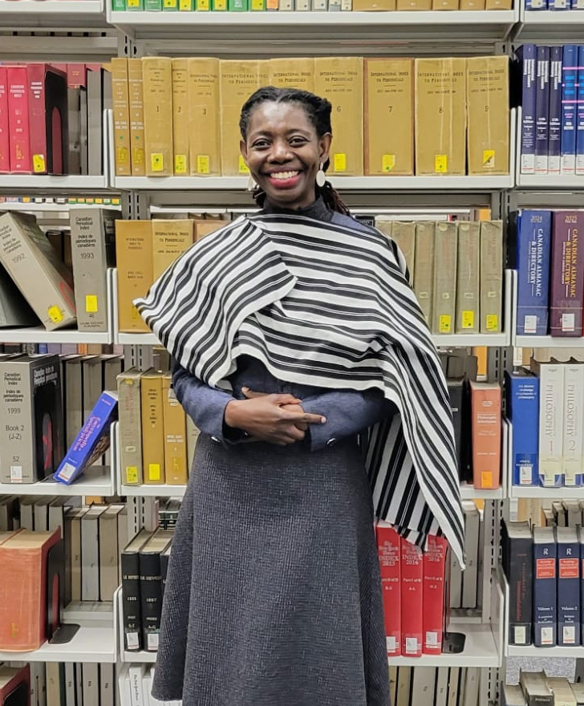
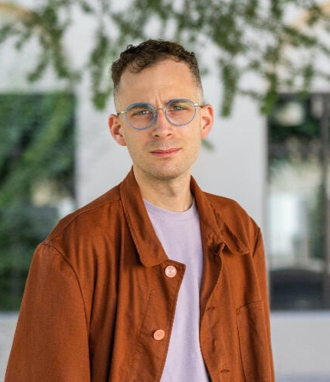
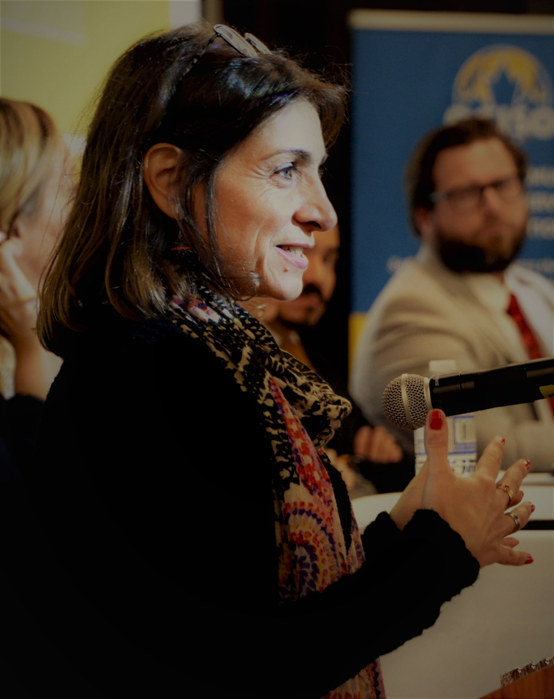
2024-2025
LA&PS DEAN’S AWARD FOR DISTINCTION IN RESEARCH

Slide 11
LA&PS Dean's Award for Distinction in Research, Creativity, or Scholarship Recipient - Emerging Researcher
Dr. Sylvia Bawa is an Associate Professor of Sociology at York University. She is a global sociologist with expertise in human rights, globalization, critical development, and postcolonial feminisms. Her research explores discourses around empowerment, decolonization, human rights, culture, and development. She has received multiple research awards for her work, including from SSHRC, CHIR, and York University, leading transnational collaborative research projects. She is the recipient of the LA&PS Dean’s Award for Research Excellence (2025). Some of her publications appear in high-impact journals, including Third World Quarterly, African Identities, Qualitative Report, Development in Practice, the Canadian Journal of African Studies, the International Journal of Human Rights of Women, and the Palgrave Handbook of African Women's Studies (Springer Major Reference Works Series). Her recently co-authored book, "Truth Commissions and State Building" (McGill-Queen’s, 2023), was selected as a runner-up for the best book anthology on African Studies by the African Studies Association.
Dr. Bawa’s decolonial praxis has broadened her reach beyond academic publications. For example, she and her team collaborated with Nollywood filmmakers to produce two short films on human rights in Africa, 'Help' and 'A Time to Live', in 2021, to share their research findings.
Specifically, at York University and in the GTA, her research impact and leadership activities include mobilizing and sustaining transnational and interdisciplinary research groups; establishing global community and academic dialogues and collaborations; leading, organizing, and maintaining transnational mentorship with diverse graduate students across various programs; directing academic centres; and serving on research and educational boards. Dr. Bawa is well-known and respected for her public and community engagement work, having received numerous community awards in recognition of her efforts.
Dr. Bawa is an elected member of the Federation of Humanities and Social Sciences' Board of Directors in Canada and serves as editor for two interdisciplinary journals: Studies in Social Justice and the Contemporary Journal of African Studies.
Importantly, she is a passionate foodie and avid sci-fi enthusiast, currently exploring research on the nexus of Afrofuturism, AI, and human rights.
Sylvia Bawa
Associate Professor
Department of Sociology

Slide 12
LA&PS Dean's Award for Distinction in Research, Creativity, or Scholarship Recipient - Emerging Researcher
Dr. Jean-Thomas Tremblay is an Associate Professor in the Department of English and the Director of the Graduate Program in Social and Political Thought at York University. He is the author of Breathing Aesthetics (Duke University Press, 2022), the co-author, with Steven Swarbrick, of Negative Life: The Cinema of Extinction (“Superimpositions: Philosophy and the Moving Image” series, Northwestern University Press, 2024), and the co-editor, with Andrew Strombeck, of Avant-Gardes in Crisis: Art and Politics in the Long 1970s (State University of New York Press, 2021).
Dr. Tremblay’s research in the fields of literary studies, cinema studies, sexuality studies, and the environmental humanities is supported by an Insight Development Grant from the Social Sciences and Humanities Research Council. Excerpts from his current project, tentatively titled “The Climate after the Fact,” have appeared in Critical Inquiry and Representations.
Dr. Tremblay serves on the editorial board of the journals Differences and Discourse.
Jean-Thomas Tremblay
Associate Professor
Department of English

Slide 13
LA&PS Dean's Award for Distinction in Research, Creativity, or Scholarship Recipient - Established Researcher
Dr. Jelena Zikic, PhD (University of Toronto, Rotman School of Management) is a Professor at York University, School of Human Resource Management. Her research focuses on Career Transitions and associated challenges of various populations (migrants, baby boomers, unemployed, expats and others). In her work, she seeks to bridge micro type phenomena, such as Professional Identity with more macro-organizational processes (i.e., Integration of diverse workforce).
Dr. Zikic brings significant international background, cross-cultural research collaborations and varied teaching expertise. Her work appeared in top ranked journals in her field such as Academy of Management Discoveries, Journal of Organizational Behavior, and Human Relations, among others; and her practical advise is often featured in the media and outlets such Harvard Business Review.
Jelena Zikic
Professor
School of Human Resource Management

Slide 14
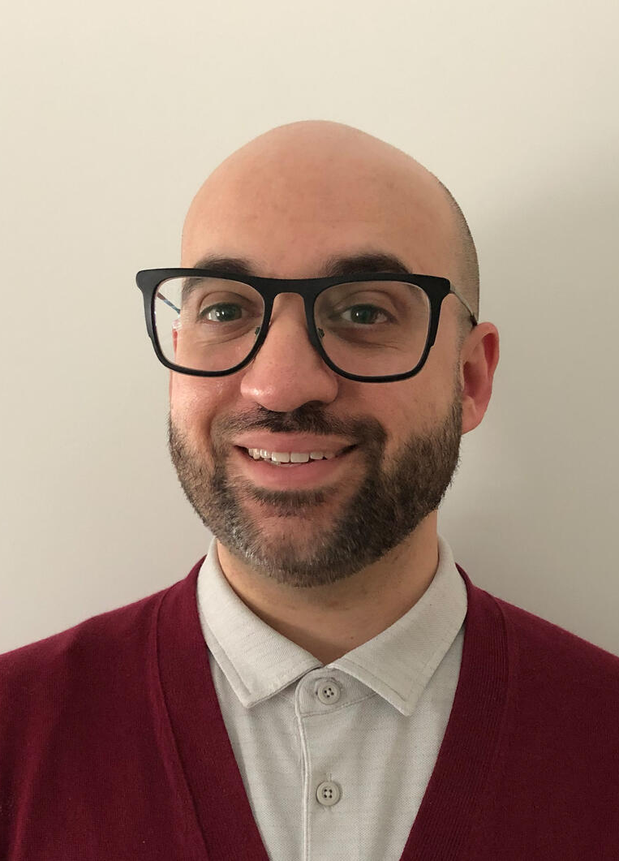
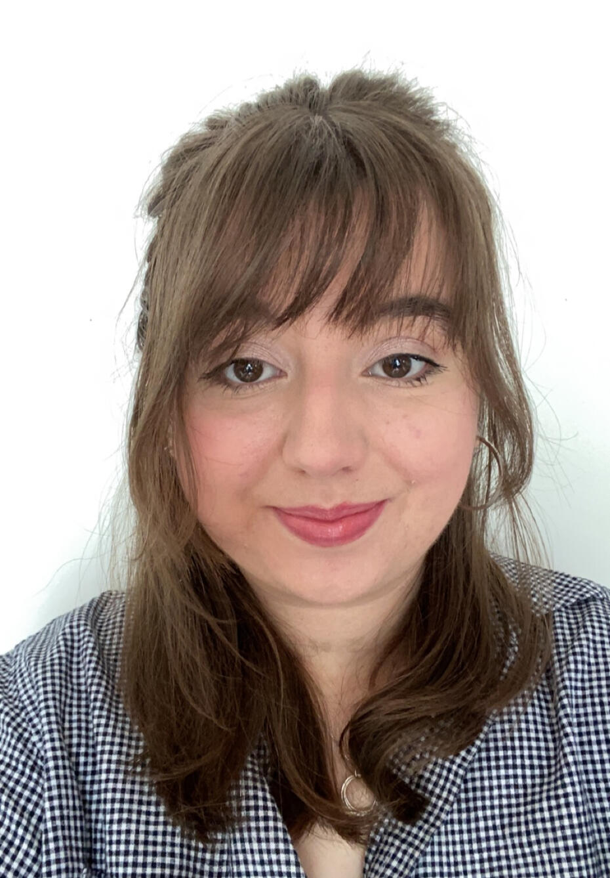
2024-2025
Ian Greene Award for Teaching Excellence

Slide 15

Ian Greene Award
Presented by the
Student Council of LA&PS
for Teaching Excellence
Professor Recipient
TA Recipient
Professor Bucemi was recognized for his relationship with students, his holistic impact on his classes, and the innovative learning opportunities he crafted.
.
Ms. McKoen was celebrated for her responsiveness, engaging presentation style, and kind demeanor tempered with constructive guidance.
Dr. Matthew Bucemi
Writing Department
Margrethe McKoen Department of History
More information: iangreeneaward.carrd.co

