Slide 1
Human Rights based approach
Lorne Foster
equity policy Law & planning-PPAL 6130 3.0 A

Slide 2
Overview
History of Canada through a human rights lens
Key Concepts
Ontario’s human rights system
Ontario Human Rights Code
Forms of discrimination

Slide 3
History of Canada through a human rights lens
Student will be divided into groups and will be assigned one of the following ethno-racial communities.
Identify three important historical events or issues of discrimination or social exclusion pertaining to the community.
Identify the contemporary relevance
First Nations
African Canadian
Jewish People
Chinese Canadians
South Asians
Japanese

Slide 4
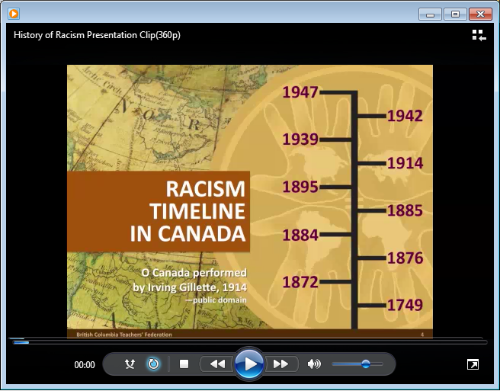
Context:
History Of Racism In Canada
Video by: British Columbia Teacher’ Federation

Slide 5
NOT JUST HISTORY …
The past has enduring effects and inequalities persist
Significant intergenerational impacts
Notes:
EX: Social scientist – SS – have identified – “Intergenerational trauma”➔ as the transmission of historical oppression and its negative consequences across generations.
There is now ‘ample’ evidence of the impact of intergenerational trauma on the health and well-‐being and on the health and social disparities facing Aboriginal peoples in Canada and other countries.
{{Ex: The health consequences are measurable ➔(1) First Nations life expectancies, at 73-74 years for men and 78-80 years for women ➔ almost 10 years less for men than national average
➔ FN – more health problems, higher rates of unemployment, rates of incarceration, substance abuse,, homelessness, fetal alcohol syndrome, lower levels of education and higher levels of poverty.}
--------------------------------------------------------------------------------------------------------
{{{Let’s drill down into this further ➔ [to see how ‘the domination’ and ‘marginalization’ processes work
➔ or to see – How different groups are situated differently in society – with differentiated opportunities and advantages ]}}}

Slide 6
Ongoing Hate & Discrimination
Incidents of hate and systemic discrimination are still very widespread in Canadian society.
Example – Statistics on police-reported hate crimes:
In 2017, police reported 2,073 criminal incidents in Canada that were motivated by hate, amounting to 47% more 975 reported incidents than in 2016
Some 16 per cent (one in six) of all incidents involved Black victims.
2017 hate crime motivators:
  race or ethnicity: (43% overall); 892 incidents (up from 611 in 2016); Black community most targeted up 84% from 2016
  religion: (41% overall); 469 incidents (up from 429 in 2014); Jewish community most targeted with 38%; hate crimes against Muslim community increased by 207% for 2016
  sexual orientation: (10% overall); 141 incidents (down from 155 in 2016) gay and lesbian people most targeted with 86%
  (Statistics Canada, June 13, 2018)

Slide 7
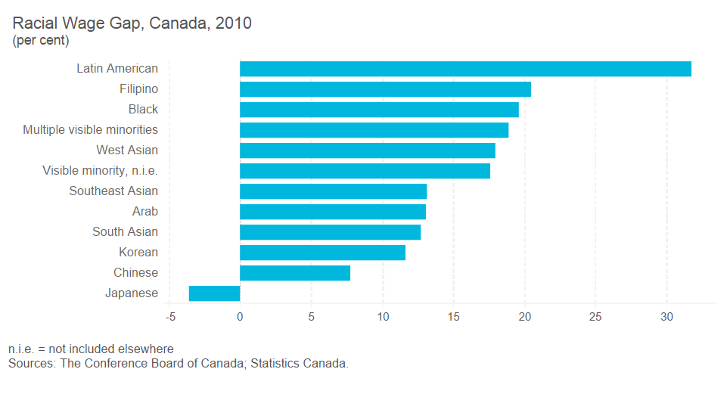
The Racial Wage Gap 2010

Slide 8
Low Income Measures
Low income measure after tax LIM50-AT
  Fixed percentage set at 50% of median adjusted after-tax income of persons in private households
Notes:
What is the LIM?
For the purpose of making international comparisons, the low income measure (LIM) is the most commonly used low income measure
Unlike the low income cut-offs, which are derived from an expenditure survey and then compared to an income survey, the LIMs are both derived and applied using a single income survey.
======================================================
Poverty Reduction Strategy (Annual Report 2017)
This report highlights our progress – and what we plan to do next – in our efforts to reduce child poverty, eliminate chronic homelessness, help people move towards employment, increase food security, develop an action plan for income security reform and invest in programs and community-designed solutions. {Targeted Universalism?}

Slide 9
LIM50-AT % By Visible Minority and Generations

Slide 10
LIM50-AT % By Disability Ontario
Canadian Income Survey 2013
2014 Study Released 2017

Slide 11
Indigenous Trauma
“…it is also regrettably the fact that the justice system generally as applied to First Nations peoples, particularly in the North, is quite frankly in a crisis. If we continue the status quo we will aggravate what is already a serious situation, and any hope of true reconciliation between First Nations and Ontarians generally will vanish. Put more directly, the time for talk is over, what is desperately needed is action.”
Honourable Frank Iacobucci

Slide 12
The Crisis
1999: Aboriginal people were 17% of the jail population (both provincial and federal).
2011: Aboriginal people were almost 20% of the federal system and 27% of the provincial system.
2013/2014: Aboriginal youth accounted for 41% of all admissions to custody while representing 7% of the youth population in these same jurisdictions.
2013/2014: While representing 3% of the Canadian adult population, Aboriginal adults represented 20% of admissions to sentenced custody in federal correctional services. Aboriginal females accounted for a higher proportion of female admissions to provincial/territorial sentenced custody (36%) than did Aboriginal males for male admissions (25%).

Slide 13
The Human Rights Approach

Slide 14
What Are Human Rights in a Canadian Context
A body of ‘LAW’
An organized ‘MOVEMENT’
It is an ‘INDUSTRY’

Slide 15
Primacy of the Human Rights Charter & Code
The Supreme Court of Canada has said that human rights legislation such as the Code is “quasi-constitutional.” You must comply with it before other laws, unless there is a specific exception.
For example, In terms of police activity, the Code supersedes the Police Services Act. When there is a conflict between the Code and the Police Services Act, the Code will prevail.

Slide 16
WHAT IS A HUMAN RIGHTS APPROACH
Empowerment research that is aimed at fostering greater ‘agency’ in citizens and communities by preventing interference with fundamental freedoms, entitlements and human dignity.
The Conceptual Overlay:
• Dignity and worth of each person
• Climate of respect and mutual understanding
• Fully participate in society
• Equal rights and opportunities

Slide 17
What are the Characteristics of a Human Rights Approach
Situates human rights at “the very centre of any social process”
The focus of attention on – how the realization of human rights is essential to combating issues of poverty, injustice, conflict, marginalization, etc.
It is a deliberate and mindful move to guide topics toward the principle of equality – (taken to mean) fulfilling individual human capacities/ realizing human empowerment
At the collective level – rights-based approaches aim to strengthen the ability of states to fulfill their obligations as duty-bearers and increase the opportunities for constructive dialogues with rights-holders

Slide 18
Key Concepts
Equality
Equity
Fairness
Discrimination
Anti-Racism
Inclusivity

Slide 19
Ontario’s Human Rights System

Slide 20
Milestones In Legislation
1944 Racial Discrimination Act
1950 amendment to Conveyancing and Law of Property Act – to end discrimination in buying and selling real estate property against certain racial and creed groups
1951 Fair Employment Practices Act - prohibited discrimination based on race and religion in employment
1952 Female Employee’s Fair Remuneration Act
1954 Fair Accommodation Practices Act – prohibited discrimination in public places on racial, religious or ethnic grounds
1960 Canadian Bill of Rights (Federal)
1962 Ontario Human Rights Code
2006 Human Rights Code Amendment Act
2017 The Anti-Racism Act

Slide 21
Timeline:
Human Rights Legislation in Ontario
(Cont’d)
Development of these laws and increasing social pressure led politicians to realize need for comprehensive human rights legislation
Ontario was the first jurisdiction in Canada to enact comprehensive human rights legislation and establish a human rights commission.

Slide 22
Timeline:
Human Rights Legislation IN ONTARIO
(cont’D)
Human Rights Code (1962)
Original Code reflected the thinking of the time
prohibited discrimination in:
signs and notices public accommodation
services and facilities employment
trade union membership
prohibited discrimination based on the grounds of:
race creed colour
ancestry nationality place of origin
As society has changed, the social areas and grounds of discrimination have been expanded.

Slide 23
History of Human Rights Legislation in Canada
Canadian Bill of Rights (1961)
Ontario Human Rights Code (1962)
Canadian Human Rights Act (1977)
All other provinces pass similar human rights legislation during the 1960s and 1970s
Charter of Rights And Freedoms (1982)

Slide 24
Charter Of Rights And Freedoms (1982)
Set of common core rights, applicable across the country
Includes:
  specific civil and political rights
  fundamental freedoms
  section 15 equality provision
  sections 25 and 35 Aboriginal rights provisions
Only applies to government action, not private institutions
Enforceable through Canadian courts

Slide 25
Ontario’s Human Rights System

Slide 26



Ontario’s
Human Rights System
Ontario Human Rights Commission
(OHRC)
Human Rights Tribunal of Ontario
(HRTO)
Human Rights Legal Support Centre
(HRLSC)

Slide 27
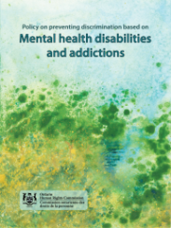


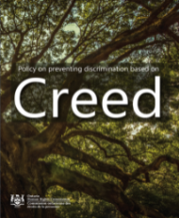





Ontario Human Rights Commission (OHRC) – www.ohrc.on.ca
Policy
Legal cases (initiates, intervenes)
Monitoring
Public inquiries
Community outreach
Public education
Notes:
27

Slide 28



Human Rights Tribunal Of Ontario (HRTO) – www.sjto.gov.on.ca/hrto
Mediates and hears complaints
Considers evidence
Makes decisions
Notes:
28

Slide 29


Human Rights Legal Support Centre (HRLSC) – www.hrlsc.on.ca
Provides human rights legal advice
Assists with filing an application
Provides representation at the Tribunal
Notes:
29

Slide 30
Ontario Human Rights Code

Slide 31
Human Rights Code
Preamble
Preamble sets out the goals of the Code:
Protect the dignity and worth of each person
Ensure equal rights and opportunities
Create climate of respect and mutual understanding
Ensure that everyone can take part fully in society

Slide 32
Human Rights Code
The Human Rights Code:
  has primacy over other legislation
  is remedial
  considers effect not intent
  is provincial

Slide 33
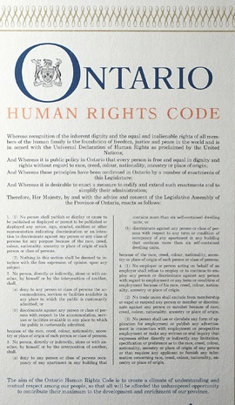
Human Rights Code
SCOPE
Code prohibits discrimination
and harassment in
5 social areas,
based on
17 protected grounds

Slide 34





5 Protected Social Areas
Employment
Housing
Services, goods and facilities
Contracts
Membership in unions or professional associations

Slide 35
17 Protected Grounds
Race
Ancestry
Place of origin
Colour
Ethnic origin
Citizenship
Creed
Age
Disability
Sexual orientation
Sex (includes pregnancy)
Gender identity
Gender expression
Family status
Marital status
Receiving public assistance (housing only)
Record of offences (employment only)

Slide 36
Applications To The HRTO
By Social Area* (2013-2014)
Employment
74%
Services, goods and facilities
22%
Housing
6%
Contracts
1%
Membership in unions, professional associations
1%
No social area
2%
*some applications cited more than one social area

Slide 37
Applications To The HRTO
By Protected Ground (2013-2014)
Disability | 54% |  | Creed | 8%
Sex | 25% |  | Marital status | 8%
Race | 22% |  | Sexual orientation | 8%
Ethnic origin | 17% |  | Gender identity | 7%
Colour | 16% |  | Gender expression | 5%
Age | 13% |  | Citizenship | 5%
Place of origin | 15% |  | Record of offences | 3%
Ancestry | 13% |  | Receipt public assistance | 2%
Family status | 13% |  | No grounds | 4%

