Slide 1
Immigrants and Immigration in Canada
The Condensed Version

Slide 2
Paradox:
Canada needs immigration more than immigrants need Canada [?]

Slide 3
Why Canada needs Immigrants
Offset the declining birth rate
Ensure a sufficient tax base
Expand the size of the domestic market
To strengthen Canada’s global economy
Stimulate sustained economic activity through production and consumption

Slide 4
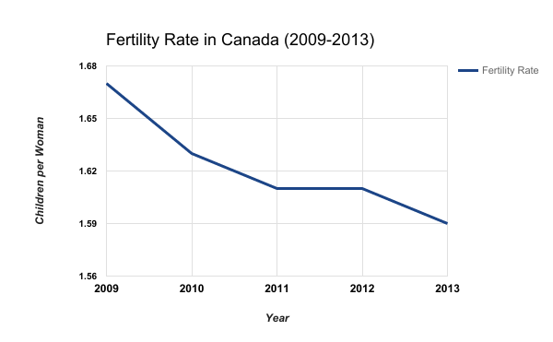
Canada’s Declining Fertility Rate
1985 - Annual Report to Parliament on Future Immigration Levels:
Canada’s fertility rate has fallen below replacement levels (2.1 children per woman)
Prompts a change in policy that looks toward immigration for the future of population and economic growth
1971: 2.13*
2009: 1.67
2010: 1.63
2011: 1.61
2012: 1.61
2013: 1.59
*The last time Canada’s fertility rate
was above replacement level
Notes:
Chart can be a bit misleading; next slide shows more data to give a bigger picture and idea of trends
http://www.statcan.gc.ca/pub/11-630-x/11-630-x2014002-eng.htm

Slide 5
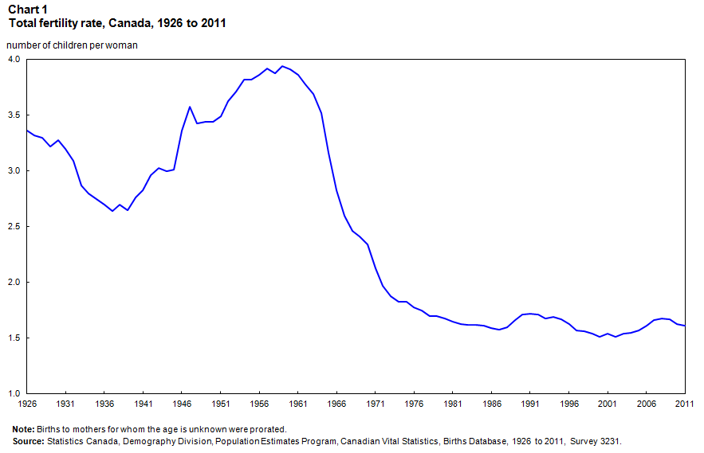
Fertility Rate in Canada - Trends
Canada needs immigrants to replace its aging population and workforce

Slide 6
Paradoxes of Immigration
Canada relies on “temporary foreign workers to address short-term labour needs at the expensive of Canada’s long-term interests”
In a 2010 survey, 81.4% of Canadians agreed (65.3%) or somewhat agreed (16.1%) that:
  Immigration reflects a positive feature about Canada
  Immigration strengthens economy
  The government should do more through language/labour market support to assist immigration settlement
  Immigrants do a good job of fitting into Canada
On the other hand, there are some double standards exhibited:
  Immigrants steal jobs from “real” Canadians
  Unemployed immigrants are “freeloading parasites”
Canadians are willing to support immigration as a policy, but unwilling to support the integration of immigrants as practice

Slide 7
Canada as an Immigrant Society – Facts and Figures
An immigration society is one that takes a principled and proactive approach to immigration based on four criteria:
Policies and principles regulate the entry of immigrants
Programs are in place facilitate the integration and settlement of immigrants
Immigrants are entitled to all rights, including permanent residency and citizenship
Immigration and immigrants are viewed as an asset for society-building
“Canada is the destination of choice for international immigrants”
More than half the people (53%) from the world’s 24 leading economics say that move to Canada if they could:
  77% of Chinese, 71% of Mexicans, 68% of Indians, 64% of Turks, 62% of Polish/South Africans
  However, Canadians remain conflicted over the pros and cons of immigration
In principle (and sometimes by policy), Canada endorses these attributes, but this is not necessarily translated into practice.

Slide 8
The Three Pillars of Immigration
Economic Class
(a) Entrepreneurial Program – (i) Self-employed, (ii) Start up Visa
(b) Provincial Nominee Program
(c) Canadian Experience Class – (1) International Students Program, (ii) Temporary Foreign Workers Program
Family Class
(a) Family Sponsorships (See Attached)
(b) Independent Immigrant
Applications *(Includes Assisted Relatives/ Selected Workers = Technically Economic Class)
Humanitarian Class
(a) refugees (persecuted on the basis of – (i) political association, (ii) membership in a social group, (iii) religious affiliation, (iv) nationality, or (v) race).
(b) Persons Eligible Under Special Humanitarian Measures.
__________________________________________________________________________________________
Temporary Residents
(a) Work Visa
(b) Student
(c) Visitors
(d) *Live-in Caregivers – (i) Home Child Care Provider Pilot , (ii) Home Support Worker Pilot {medical needs}

Slide 9
Family Class Immigration
Family Class:
- Family reunification to improve integration
Two entry strategies:
1. Migrate as a unit
2. Sponsoring family members
Processing times vary (6 months - 30 months, + years)
Some family ties are tested through DNA testing (especially for those from Africa, the Caribbean, India and Pakistan)

Slide 10
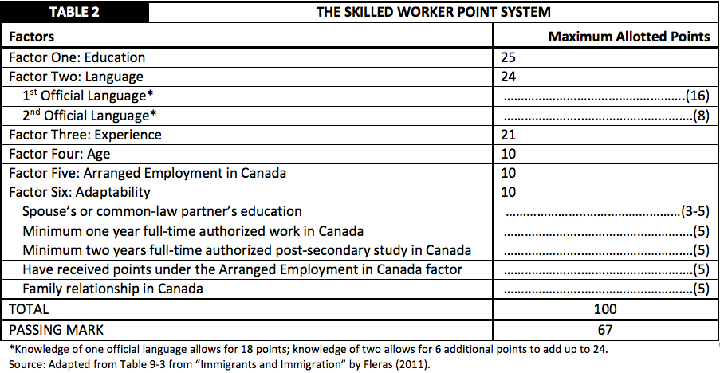
Notes:
p. 272

Slide 11
Economic Class Immigration
Three programs:
Entrepreneurial Program (businesses, investors)
Provincial Nominee Program
- aimed to meet specific labour needs in certain provinces
Canadian Experience Class
- creates “designer” immigrants
- targeted to international students and temporary workers
- values “high end” work vs. “lower skill levels”

Slide 12
Humanitarian Class Immigration
Refugees and Protected Persons Class:
Humanitarian and legal obligations
Three categories of refugees:
Sponsored Refugees (government, private, individual, clubs, church groups)
Refugee Claimants (claim refugee status upon arrival – “spontaneous arrivals”)
Rejected Refugee Claimants (protected under the Pre-Removal Risk Assessment)

