Slide 1
What is Unconscious Bias: considerations and top tips.
Lorne Foster
York University

Slide 2
Outline of Session
What is Unconscious Bias: considerations and top tips.
1. Overview – What is Unconscious Bias
2. Examples of Unconscious Bias
3. Mitigate - what can you do
4. Case studies

Slide 3
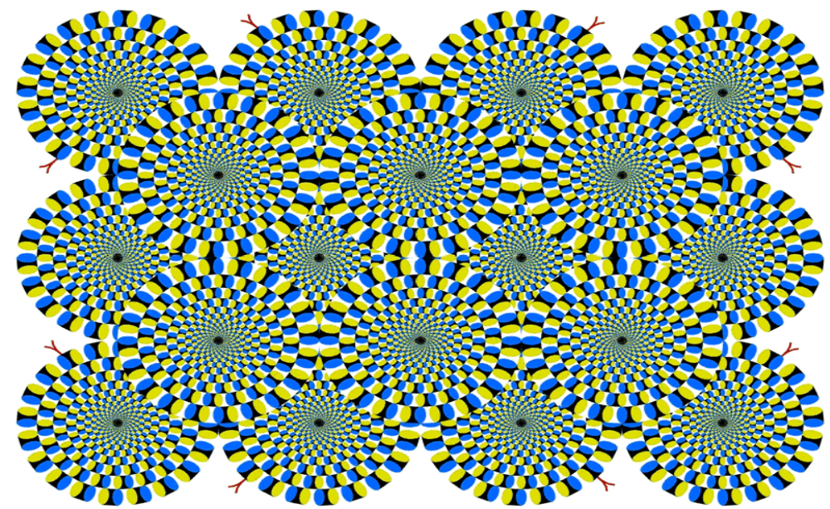

Slide 4
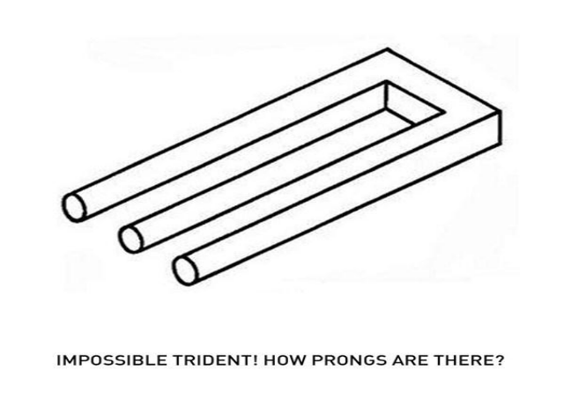
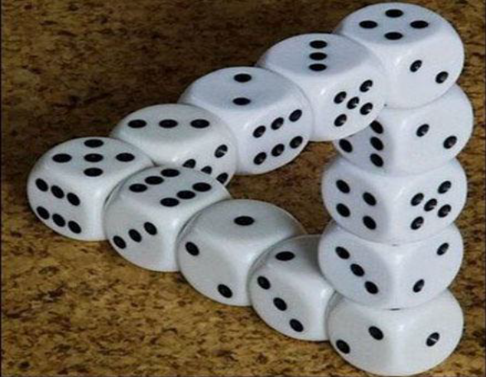
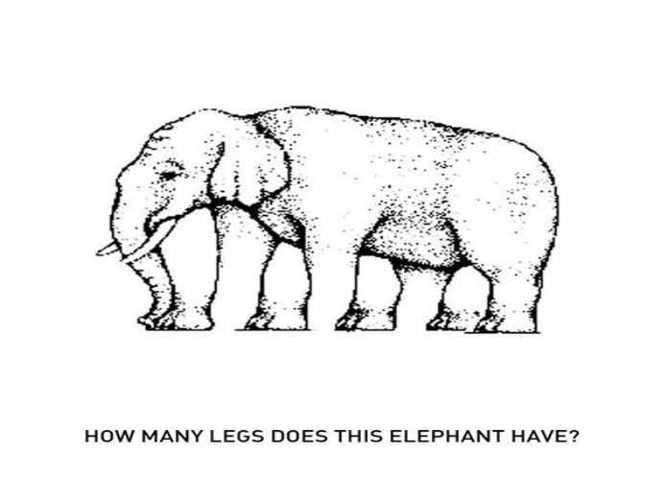

Slide 5
The Reality
Despite multicultural narratives, data show how equity and diversity have become diversifying whiteness projects:
White people constitute 96% of judges (Tutton, 2016),
93% of corporate boards (McFarland, 2014), 86.4% of MPs (Tulley, 2015), and
82% of university professors (CAUT, 2010).
Racialized Canadians earn only 81.4 cents for every dollar paid to non-racialized Canadians.
Canadian Association of University Teachers (CAUT). 2010. The Changing Academy? A Portrait of Canada’s University Teachers. January | Vol 12 No 1.
Tolley, E. 2015. Framed: Media and the Coverage of Race in Canadian Politics. Vancouver: UBC Press.
Tutton, M. 2016. Canada must boost racial diversity in ‘judiciary of whiteness,’ advocates urge. The Canadian Press, July 18.

Slide 6
What is Unconscious Bias?
Unconscious bias refers to a bias that we are unaware of, and which happens outside of our control. It is a bias that happens automatically and is triggered by our brain making quick judgments and assessments of people and situations, influenced by our background, cultural environment and personal experiences

Slide 7
Microaggression
Microaggressions: everyday verbal, nonverbal, and environmental slights, snubs, or insults, whether intentional or unintentional, which communicate hostile, derogatory, or negative messages to target persons based solely upon their marginalized group membership.
- Derald Wing Sue, Ph.D.

Slide 8
Microaggression Examples
Failing to learn to pronounce or continuing to mispronounce the names of students after they have corrected you.
Scheduling tests and project due dates on religious or cultural holidays.
Using the term “illegals” to reference undocumented students.
Expecting students of any particular group to ‘represent’ the perspectives of others of their race, gender, etc. in class discussions or debates.
Using sexist language.
Using heteronormative metaphors or examples in class.
Complimenting non-white students on their use of “good English.”
Making assumptions about students and their backgrounds.
Featuring pictures of students of only one ethnicity or gender on the school website.
Having students engage in required reading where the protagonists are always white.

Slide 9
2019 The Canada Border Services Agency
The Canada Border Services Agency (CBSA) Officer Findings:
Border officers order secondary inspections for travellers from the Middle East, Africa and the Caribbean at far higher rates than for travellers from the U.S. or Western Europe.
Iranian travellers arriving in Canada in 2017 were on average about twenty times as likely to be referred to secondary inspections for Customs purposes — and about six times as likely to be referred for immigration purposes — as were visiting Icelanders.
Jamaican visitors were approximately ten times as likely as a Dane to face a secondary inspection for Customs purposes, and almost ten times as likely to be followed up for immigration purposes.
Border officers are more likely to look twice at the customs declaration of a returning Canadian traveller than that of a U.S. visitor.
The new Primary Inspection Kiosks (PIK) that read passports (‘facial recognition’) at some Canadian airports may have higher error rates when processing people with certain ethnic backgrounds.

Slide 10
African Canadian vs. Black
Recent association research in the United States even suggests that people tend to be much more disposed to the identification of people as “African American” as opposed to those who identify as “Blacks”, and this can have remunerative consequences particularly for professionals (Hall, Phillips & Townsend, 2015).
Through a series of tests, the researchers concluded the stereotype content for Blacks was significantly more negative than for African-Americans.
In contrast, the stereotype content for African-Americans did not significantly differ in perceived negativity from that of Whites.
The research findings suggest that image embedded in the Black stereotype is generally more negative, and less warm and competent, than that in the African-American stereotype.
These different associations carry consequences for how Whites perceive Americans of African descent are labeled with either term.

Slide 11
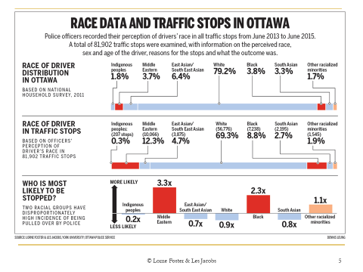

Slide 12
What can we do?
Be awareness/ conscious
Considerations / vigilance
Small changes
Challenging stereotypes and counter stereotypical information
Using context to explain a situation
Changing perception and relationship with out-group members
Being an active bystander
Improving processes, policies & procedures

Slide 13
Summary
We all have unconscious biases and we are all affected by bias
We can take action to manage the impact on our behaviour and decision making
It’s up to individuals to decide what action to take
1.Introduction to Unconscious Bias
2.Examples of Unconscious Bias
3.Mitigating Unconscious Bias

