Slide 1
RACISM IN CANADA THROUGH A HUMAN RIGHTS LENS
Lorne Foster
York University

Slide 2
Overview
History of Canada through a human rights lens
Key concepts
Ontario’s human rights system
Ontario Human Rights Code
Organizational responsibility
Forms of discrimination
Systemic racism in education
Duty to accommodate
Inclusive design
Balancing competing human rights

Slide 3
SESQUICENTENNIAL
In 2017, Canada celebrated its 150th birthday. Although there are many important events and episodes to celebrate, that past is also a checkered one from a human rights perspective. It is marked by many issues and episodes of social exclusion and discrimination that are important for contextualizing human rights in Ontario today.

Slide 4
Recalling Canada’s Past Activity
Each table will be assigned one of the following areas to focus on for this activity:
First Nations
African Canadians
Jewish People
Chinese Canadians
People of Asian Origins
Japanese

Slide 5
Recalling Canada’s Past Activity
Focusing on Canadian history prior to 1967, identify three important events or issues of discrimination or social exclusion pertaining to your assigned racial category. Discuss with your group and choose a member to record your responses and the three events or issues.
Answer the following questions: What is the contemporary relevance, if any, of these historical events and issues? Do they impact Canadian children and their parents today?

Slide 6
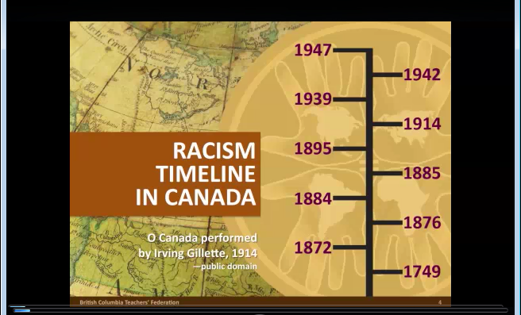
CONTEXT:
HISTORY OF RACISM IN CANADA
Video by: British Columbia Teachers Federation
https://www.youtube.com/watch?v=dvqXh83IJgM&feature=plcp

Slide 7
Examples in Canadian History
Indian Act of 1876
Residential schools
Denial of the Right to Vote
Black slavery
Racially Segregated Schools
MS St. Louis (1939)
Chinese Head Tax
Japanese Internment
Komagata Maru Incident (1914)

Slide 8
Ongoing hate & discrimination
Incidents of hate and systemic discrimination are still very widespread in Canadian society.
Example – Statistics on police-reported hate crimes:
In 2015, police reported 1,362 criminal incidents in Canada that were motivated by hate, amounting to 5% or 67 more reported incidents than in 2014
2015 hate crime motivators:
  race or ethnicity: (48% overall); 647 incidents (up from 611 in 2014); black community most targeted with 35%
  religion: (35% overall); 469 incidents (up from 429 in 2014); Jewish community most targeted with 38%; hate crimes against Muslim community increased by 61% from 2014
  sexual orientation: (11% overall); 141 incidents (down from 155 in 2014) (gay and lesbian people most targeted with 86%
  (Statistics Canada, June 13, 2017)

Slide 9
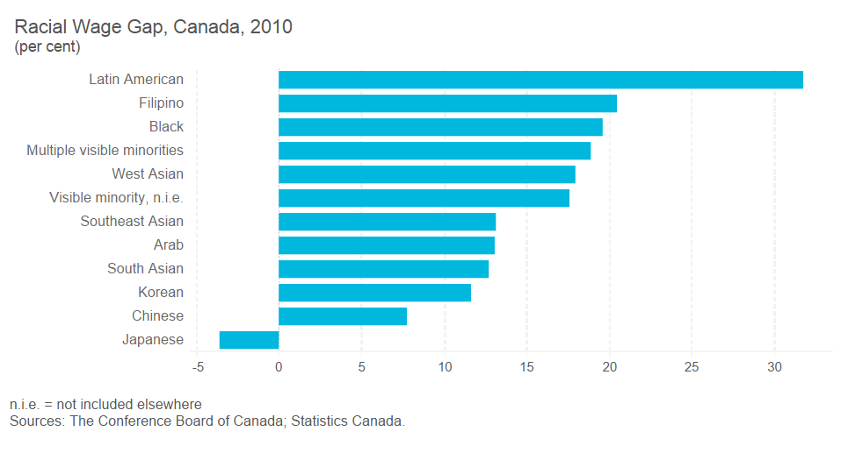
The Racial Wage Gap 2010

Slide 10
Ontario’s Human Rights System

Slide 11
Milestones in Legislation
1944 Racial Discrimination Act
1950 amendment to Conveyancing and Law of Property Act – to end discrimination in buying and selling real estate property against certain racial and creed groups
1951 Fair Employment Practices Act - prohibited discrimination based on race and religion in employment
1952 Female Employee’s Fair Remuneration Act
1954 Fair Accommodation Practices Act – prohibited discrimination in public places on racial, religious or ethnic grounds
1962 Ontario Human Rights Code
2006 Human Rights Code Amendment Act
2017 The Anti-Racism Act

Slide 12
Key Concepts
Equality
Equity
Human Rights
Fairness
Discrimination
Anti-Racism

Slide 13



Ontario’s
Human Rights Institutions
Ontario Human Rights Commission
(OHRC)
Human Rights Tribunal of Ontario
(HRTO)
Human Rights Legal Support Centre
(HRLSC)

Slide 14









Ontario Human
Rights Commission (OHRC) www.ohrc.on.ca
Policy
Legal cases (initiates, intervenes)
Monitoring
Public inquiries
Community outreach
Public education
Notes:
14

Slide 15



Human Rights Tribunal of Ontario (HRTO) www.sjto.gov.on.ca/hrto
Mediates and hears complaints
Considers evidence
Makes decisions
Notes:
15

Slide 16


Human Rights Legal
Support Centre (HRLSC) www.hrlsc.on.ca
Provides human rights legal advice
Assists with filing
an HRTO application (complaint)
Provides representation
at the Tribunal
Notes:
16

Slide 17
Ontario Human Rights Code
Core Principles
  has primacy over other legislation
  is remedial
  considers effect not intent
  is provincial

Slide 18
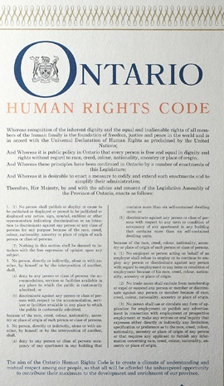
Human Rights Code
SCOPE
Code prohibits discrimination
and harassment in
5 social areas,
based on
17 protected grounds

Slide 19





5 protected social areas
Employment
Housing
Services, goods and facilities
Contracts
Membership in unions or professional associations

Slide 20
17 protected grounds
Sexual orientation
Sex (includes pregnancy)
Gender identity
Gender expression
Family status
Marital status
Receiving public assistance (housing only)
Record of offences (employment only)
Race
Ancestry
Place of origin
Colour
Ethnic origin
Citizenship
Creed
Age
Disability

Slide 21
RACE AND RELATED GROUNDS
Race
Ancestry
Citizenship
Colour
Place of origin
Ethnic origin
Creed (sometimes)
Call these “race and related grounds”

Slide 22
Responsibilities of School
Boards
School Boards, their members and staff can be held liable for discrimination and harassment
Must deal with complaints and with discrimination or harassment they become aware of, whether or not there is a complaint
Should take steps to identify and prevent problems
– including proactively addressing current policies, practices, etc. that may pose barriers to Code-protected groups

Slide 23
Exceptions and Exemptions from the Code
Special programs that creates a preference or advantage are exempt when they are designed to
  relieve hardship or economic disadvantage
  assist disadvantaged persons or groups to achieve or attempt to achieve equal opportunity
  help eliminate the infringement of rights that are protected under the Code.
The Code allows a religious, philanthropic, educational, fraternal or social institution or organization, which primarily serves the interests of a particular group, to restrict membership or participation to members of that group.
Separate schools in Ontario have special rights guaranteed by the Constitution and by the Education Act . Section 19 means that the Code cannot affect those rights, which are mainly related to the existence and funding of Roman Catholic schools
Exemption for scholarships or awards offered by employers to employees and their families.

Slide 24
Applications Against School Boards by Social Area

Slide 25
Applications Against School Boards in EMPLOYMENT by CODE GROUND

Slide 26
Applications Against School Boards in SERVICES, GOODS & FACILITIES by CODE GROUND

Slide 27
Applying the Code Exercise
This exercise is designed to encourage reflection on the application of the Ontario Human Rights Code in educational contexts.
At your table as a group:
Review the pink piece of paper summarizing the applicable social areas, grounds, and organizational responsibilities.
Complete the questions for the three scenarios provided on the pink Forms of Discrimination sheet.

Slide 28
LUNCH

Slide 29
DISCRIMINATION and HUMAN RIGHTS

Slide 30
Discrimination
    Negative treatment or impact, e.g. exclusion, benefits withheld, burdens imposed
    Focus is on effect, not intention
Discrimination can be unique or distinct when it occurs based on multiple overlapping identities:
e.g. young Black male
Sex
Racial identity
Age
UNIQUE
EXPERIENCE

Slide 31
Some Types of Discrimination
Harassment: unwelcome distressing or annoying comment or conduct, e.g. threats, bullying, name-calling, emailing, social media, jokes, questions, images
Poisoned Environment: Hostile or oppressive atmosphere for one or more people based on serious incident or ongoing conduct
Adverse Effect Discrimination: Neutral rule, policy, procedure, requirement, qualification or factor has a negative impact on a group because of their identification with a Code ground
At your table as a group:
Review the pink piece of paper summarizing the applicable social areas, grounds, and organizational responsibilities.
Complete the questions for the three scenarios provided on the white Forms of Discrimination sheet.

Slide 32
Three Scenarios for Discussion
A school establishes a monthly “Stellar Student Award” to encourage student achievement. To be eligible to receive the award, a student must be nominated by a teacher, involved in extra-curricular activities, and have excellence attendance for the month.
A school board questions whether a Sikh teacher and student should be allowed to wear the kirpan (ceremonial dagger) to class. The kirpan, they argue, could be used as a weapon and schools are required by the Ministry’s Policy on Non-violence to have a “no weapons” policy on school property.
On several occasions, a South Asian student gets into a physical altercation with other students after weeks of racist taunting, jokes and harassment. The school principal considers suspending the student, saying that although she does not dispute that a poisoned environment existed, the student acted in a way that is grounds for suspension in accordance with Board policy.

Slide 33
Systemic Racial Discrimination
Systemic racial discrimination refers to patterns of behaviour, policies and practices that are part of the administrative structure or informal “culture” of an organization/institution/sector that purposely or inadvertently create or perpetuate disadvantage based on race or related grounds
Systemic racial discrimination can often be sourced to stereotypes, prejudice, bias, “isms” and phobias
Systemic discrimination may be subtle, unconscious, and normalized

Slide 34
How to identify systemic racial discrimination
OHRC’s Racism Policy identifies 3 considerations for identifying and assessing systemic racial discrimination:
1. Policies, practices and decision-making processes
2. Organizational culture
3. Numerical data

Slide 35
Systemic Racial Discrimination in Education Activity
With the others at your table, review and discuss the Fact Sheet. Record on the blank yellow sheet of paper two surprising pieces of information contained in the Fact Sheet.
Discuss whether any specific educational policies or aspect of school culture may have contributed to the racial disparities reported on the Fact Sheet. Record these on the yellow piece of paper.
Identify what changes in educational policies or school culture may help to mitigate for racial disparities in school such as those reported on the Fact Sheet. Record these on the yellow piece of paper.

Slide 36
THE DUTY TO ACCOMMODATE

Slide 37
Employers and service providers have a duty to accommodate the needs of Code-protected groups to the point of undue hardship (based on cost, health & safety)
Three principles of accommodation:
    Respect for dignity
    Individualization
    Integration and full participation

Slide 38
Appropriate Accommodation
Promotes three principles (dignity, individualization, full participation)
Continuum of options
Aims to ensure equal opportunity to attain same level of performance or enjoy same level of benefits and privileges
Notes:
38

Slide 39
ACCOMMODATION PROCESS
Substantive and procedural duties are equally important
Both the person seeking an accommodation and the employer/service provider responsible for making the accommodation have duties in the accommodation process
Accommodation provider should only ask for the information needed to provide the accommodation and keep that information confidential

Slide 40
Limits on the Duty to Accommodate
Undue Hardship
Accommodation does not need to be provided if it would cause “undue hardship”
Standard for undue hardship is high
Onus of proof is on the accommodation provider
Factors Considered:
  Costs
  Outside sources of funding (if any)
  Health and safety
Notes:
40

Slide 41
Duty to Accommodate –
Other Limits
No accommodation available that allows the person to fulfill the essential requirements of the job or service
Person does not participate in the accommodation process
Balancing duty to accommodate the rights of others (competing rights)
Notes:
41

Slide 42
Disability
Examples of Accommodation Requests:
classroom integration
testing procedures
behavioural plans; modified disciplinary procedures
adaptive technology; alternate formats
physical modifications to buildings, facilities
modified job duties; schedules

Slide 43
Creed
Examples of Accommodation Requests:
  prayer observances (space, time)
  creed-based exemptions (curriculum, activities)
  dress codes, appearance rules
  creed-based holidays, leaves and ritual observances

Slide 44
Gender Identity and Expression
Examples of Accommodation Requests
  during transition (e.g. medical appointments, when/how/if information is communicated to others)
  washroom and change room use
  school records
  dress codes

Slide 45
FAMILY STATUS
ACCOMMODATION REQUESTS
Examples:
Child care responsibilities
Busing
Elderly parents

Slide 46
Inclusive design
Designing / changing facilities, systems, policies, practices to avoid, eliminate or reduce barriers based on Code grounds
Barriers can be attitudinal, communication, physical and systemic
Effective inclusive design will reduce the need for people to ask for individual accommodations
Three dimensions of inclusive design:
  Recognize Diversity and Uniqueness
  Inclusive Process and Tools
  Broader Beneficial Impact

Slide 47
Achieving Integration
Design inclusively
Remove barriers when they become known
Accommodate remaining needs
Notes:
47

Slide 48
BALANCING COMPETING HUMAN RIGHTS

Slide 49
Competing human rights claims are pervasive in modern, diverse societies such as Canada
Competing human rights claims are situations in which legally codified human rights are claimed by two or more parties to a dispute, thus complicating the normal approach to resolving a human rights dispute where only one side claims a human right in relation to an alleged violator.
In 2012, the Ontario Human Rights Commission became the first body in the world to establish a policy on these situations.
This policy involved identifying possible types of competing rights claims and then mapping out a process for approaching different scenarios.

Slide 51
Competing Human Rights Scenario & Role Playing
At your table, create a competing human rights scenario that you can imagine arising in a school setting. Using the large white piece of paper provided, describe your scenario briefly in 3 or 4 sentences.
Identify four key participants in the scenario (Party 1, Party 2, Principal, Mediator). Assign each member to a role. If there are more than 4 group members, add a vice-principal role. Record the roles and their players on the paper.
Each participant briefly presents in role their perspective on the dispute. Party 1 & Party 2 advance their own human rights claim. Principal (and Vice-Principal if applicable) explain the educational professional perspective. Mediator offers some tentative resolutions (but clearly prior to the formal OHRC process).

Slide 52
Competing Human Rights Scenario & Role Playing
Guided by the handout with the OHRC process for addressing competing human rights claim, the group follows in sequence the three stage process with all participants remaining in character. The decision is recorded on the bottom of the white piece of paper.
Reflect on the strengths and weaknesses of the OHRC process.

Slide 53
Revisiting Morning
Take-a-Way Activity

