Slide 1

Some notes on a virus model
1 – the SIR model
Peter A. Taylor <pat@yorku.ca>
Department of Earth and Space Science and Engineering,
Lassonde School of Engineering, York University,
Toronto, Ontario M3J 1P3, CANADA

Slide 2
Some notes on a Virus spread model: Peter Taylor - March 25 2020: First let me emphasize that I am not an expert in epidemiology or related areas - this is just a simple application of some basic Applied Math.
Logistic equation solution.
With I/N = in and BN = b the equation becomes d(in)/dt = b in(1-in) and we can run a solution with b = 0.5 and in(0) = 10⁻⁶ - i.e. I in a million; red are infected, green are susceptible = (1-in)
A starting point is the simple, but non-linear “logistic equation” for the spread of disease,
dI/dt = B*I*(N-I)
where I is the number infected and N is the total population. This has no recovery, just continuous infection. There is exponential growth initially, if I(0) is a small initial seed, and eventually the whole population is infected. It has an analytic solution suited to 1st year calculus! The mathematics gets more complicated when some I recover but initially there is still exponential growth.
The next step is the SIR (Susceptible, Infected, Recovered (or dead)) version which seems more realistic. It is well described at https://www.maa.org/press/periodicals/loci/joma/the-sir-model-for-spread-of-disease-the-differential-equation-model and originates from a 1927 paper by Kermack and McKendrick. (Kermack, W.O. and McKendrick, A.G. (1927) Contributions to the Mathematical Theory of Epidemics. Proceedings of the Royal Society of London A, 115, 700-721).

Slide 3
The basic SIR equations set up in Kermack and McKendrick (1927) relate, S(t)-the number of susceptible individuals, I(t)-the number of infected individuals, and R(t)-the number of recovered (or deceased) individuals. The total population N = S + I + R, and N is considered constant.
S, I and R can be normalized by N, s = S/N, in = I/N etc., using “in” to avoid confusion with (-1)^{1/2} and the governing equations become:
din/dt = b*s*in – k*in; with infections increasing as a result of interactions between infected and susceptible members of the community.
dr/dt = k*in; so some infected members recover, and some die. Recovery implies immunity and no longer susceptible.
s = 1 – in – r. The total, normalized population is 1 so s represents the remaining susceptible members.
A simple set of 3 equations in the 3 variables: s, in, and r. The din/dt equation is however non- linear, as is the logistic equation, and that is what makes things interesting.

Slide 4
With t measured in days, k, in the recovery equation is an average recovery rate for an infected individual in days⁻¹ while b is a little more complicated in that in the un-normalized version of the equation it is bS that is in days⁻¹. Thus, b could be interpreted as the number of infection transfers per day from an infected individual to another individual (who may or may not be susceptible). A key parameter is the ratio of b/k, which is the dynamic model equivalent of the “basic reproduction number” (not rate, no units!), R₀, used in epidemiology, see (https://en.wikipedia.org/wiki/Basic_reproduction_number). If transmission is fast and recovery slow there will be problems. We may not be able to control k but b can be reduced by reducing “social contacts”.
I couldn’t get an analytic solution to the non-linear system of ODE equations above, although there are analytic solutions to the logistic equation. However a simple forward Euler numerical scheme works, as would other numerical solution methods for ODEs. In Matlab I used the code as on the right and get sample results as shown. It also gives the same results as the maa web site if you use their input.
%SIR model – Matlab code
t=0:0.1:200;
dt=0.1; in=0.01; s = 1-in; r = 0;
S(1)= s;IN(1)=in; R(1)= r;
for j = 2:2001
[dindt,drdt] = deriv(s,in);
in = in + dindt*dt; r = r + drdt*dt; s = 1-in-r;
S(j)=s; IN(j)=in; R(j)=r;
end
plot(t,IN,'r')
xlim([0 200]); ylim([0 1]); xlabel('time in days')
ylabel('fraction of the population')
hold on; plot(t,S,'blue'); plot(t,R,'g')
function [dindt,drdt] = deriv(s,in)
b=0.2; k=0.1;
dindt=b*s*in - k*in;
drdt=k*in;
end

Slide 5
The model was run with b=0.2 and k = 0.1, both in units of days⁻¹. Results are as a fraction of the population – the natural way to look at infections of this type! The k and b values can be interpreted as a typical recovery time of 10 days and an infection of a susceptible individual by a single infected individual every 5 days, if, as early in the spread, most of the population is susceptible. Once recovered (including the deceased) individuals are assumed immune.
The four sets of curves are for initial values in(0) = 10⁻³, 10⁻⁴, 10⁻⁵ and 10⁻⁶. Lower initial values delay the peak infection but do not reduce it.
The color code is
Red – infected
Blue – susceptible
Green – recovered or dead.

Slide 6
You are encouraged to code and play with the model, varying b and k to see what the impacts are. The higher the b/k ratio the more rapidly the infection takes off and the higher the peak. In the case shown above 80% of the population is infected at some point before either recovery or death while 20% escape. The biggest problem is the number infected at the peak (15.4% of the population). Even if only 1 in 10 require hospital treatment no country is set up to handle those numbers.
Two examples with different b/k ratios are shown on the right. Note that both of these are in units of (days)⁻¹ but one could simply scale the time and the results would be essentially the same with a stretched or compressed time axis. Running the model with b = 0.4 and k = 0.2 gives the same curves, but everything speeds up by a factor 2.
Both figures are for in(0) = 10⁻³ and b = 0.2 days⁻¹, so the same rate of infection. The top figure is with a longer recovery time, k = 0.05 days⁻¹, while the lower has k = 0.15 days⁻¹. With k ≥ b , i.e. a short recovery time, the spread of the virus does not occur and those infected initially recover, or die, without infecting too many others, i.e. less than one each.

Slide 7
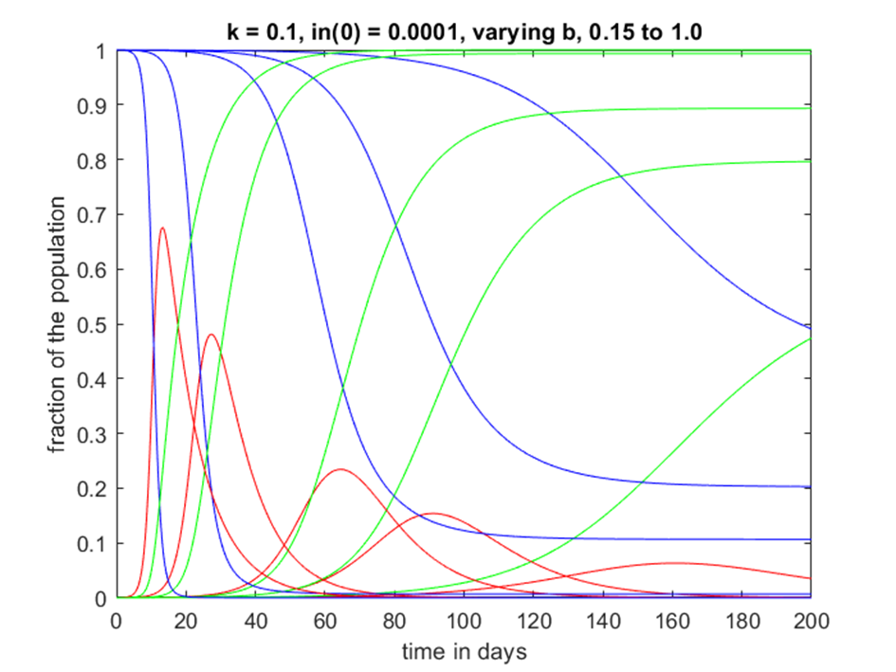
Again, the critical parameter, in this simple model, is the parameter b, and its relationship with k. If we fix in(0) at 10⁻⁴ and k = 0.1 days⁻¹ we can vary b. The figure below uses b = 1.0, 0.5, 0.25, 0.2, 0.15 days⁻¹, (from left to right!). The conclusion is that we should limit contacts, and probably do that for an extended period, maybe 6 months. By then it might be hoped that vaccines might have been developed and treatment refined. Ignoring things and having rapid growth with b=1 would get it over faster but stress hospitals and morgues.

Slide 8
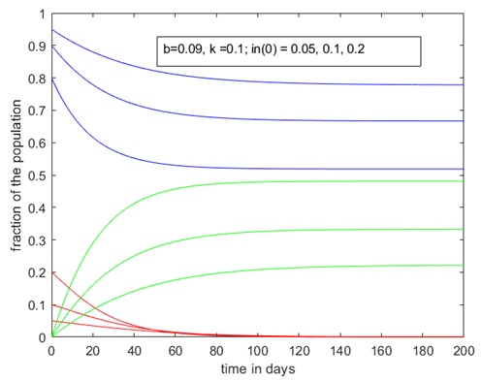
Given the present and potential situation in the next few weeks we consider the situation with a dramatic change of behavior to push b < k. If that can be done then the infection would decrease and eventually cease, as shown here. The numbers infected may be large initially but will decrease with time if b<k. This needs to be maintained until in is very close to 0. At that point tracking and isolating any infected individuals might be possible to prevent a second wave of infections as social contacts increase and b could creep back above k. Remember that the color code is
Red – infected ; Blue – susceptible
Green – recovered or dead.
The basic idea here is to show a simple model that anyone with 1st year university or college mathematics should be able to follow. Limiting contacts and potential infection is critical, for all of us, if we want to reduce the potential to overload the hospitals and death rates.
A next step is a slightly extended model, SEIRD, which has exposed but not symptomatic individuals and splits r into recovered and deceased. Some notes are on my web site at http://www.yorku.ca/pat/SEIRDmodel.pdf

