Slide 1

Budget Context for Academic Planning
Senate
D. Peters, Interim Provost and VP Academic
N. Kishinchandani, VP Finance and Administration
June 26, 2025

Slide 2

Planning Context

Slide 3
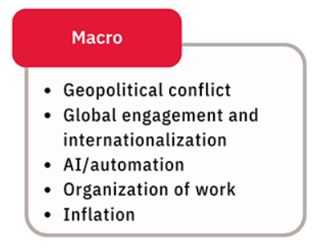
How We Got Here: 2019 through 2024
2020
Global Pandemic
Online/Remote Teaching
2021
Contingency planning
2022
Markham Campus Construction
2023
Auditor General Audit
2024
Bill 124 overturned
2019
10% Tuition Rollback
Tuition freeze begins
International Caps
Good reserves and carry forwards
Continued tuition freeze & SMA4
Labour disruption

Slide 4

Impact of Tuition Policy on Domestic Revenue
10% tuition cut in 2019-20 = $45M
Tuition freeze in 2019-20 continuing to 2026-27 = $635M
Cumulative impact = $680M
Notes:
Cumulative loss includes both undergraduate and graduate. If these changes had not happened, the undergraduate domestic tuition per FFTE would have been $8,611/year as opposed to $6,118. Universities had committed to resources to support students who could not pay.

Slide 5
Impact of Tuition Policy on Domestic Revenue
10 percent cut in 2019-20 and tuition frozen thereafter
Estimated cumulative loss of $680M in domestic tuition revenue by 2026–27 due to the tuition cut and ongoing freeze.
Notes:
The chart illustrates the gap between the actual undergraduate tuition rate for regular Arts and Science programs and the projected rate if it had increased by 3% annually.
The cumulative loss includes both graduate and undergraduate revenue assuming enrolments at the 2018-19- level.
The 10% tuition cut resulted in an estimated $45M loss in 2019–20 alone.

Slide 6
Impact of IRCC Policy Changes on International Revenue
Undergraduate international new student headcount: 40% lower in 2024-25 vs 2023-24, with a further year-over-year decline of 30% projected for 2025-26
Graduate international new student headcount: 27% lower in 2024-25 vs 2023-24
Estimated cumulative loss of $335M in international tuition revenue by 2026–27 due to the reduction in new student enrolment in 2024-25 and 2025-26 only.
Note: Cap stabilization after 2025-26 will deepen revenue losses in 2026-27 and beyond (not included in estimate)
Notes:
International represents international fee-paying students only.
Using the COU International Survey methodology; includes impact of a drop relative to 2023 levels and additional impact relative to planned growth.
Assume 2025 Graduate intakes will be at the same level as 2024, with no further reduction.
Excludes the impact on School of Continuing Studies enrolments.

Slide 7

Emerging Risk on International Student Enrolment
Emerging delays in study permit processing pose an additional risk to tuition revenue. These impacts will be felt in 2025-26 and could extend into future years.
COU is actively advocating for measures to mitigate the impact of these visa processing delays.

Slide 8
Managing the Emerging Risk
The Strategic Enrolment Management Executive Committee and the ISEM Working Group met on May 29, 2025, to devise a plan to address an evolving enrolment risk. A follow-up meeting was held on June 6, 2025.
Purpose of the Meetings:
1) Address Fall 2025 IRCC study permit delays
2) Review immediate institutional responses
3) Confirm coordination mechanisms across units
4) Identify and prioritize next steps

Slide 9

Ontario Universities’ Application Centre (OUAC)
Data

Slide 10
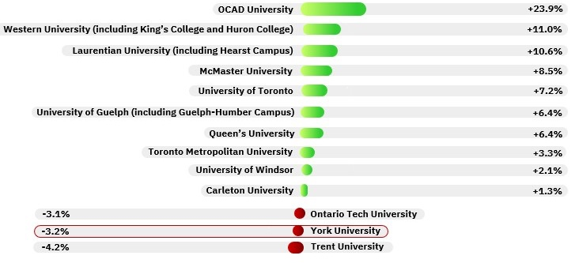
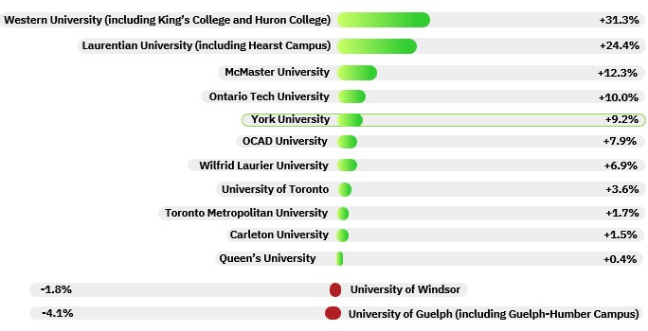
Change in Applications and Confirmations for 101 Domestic Applicants from 2024-2025
Applications May 2025
York saw a 3.2% decline
Acceptances June 2025
York saw a 9.2% increase

Slide 11
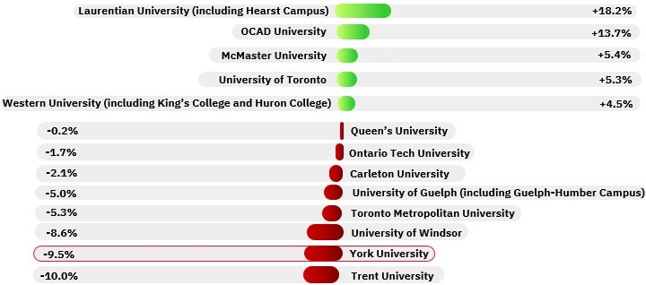
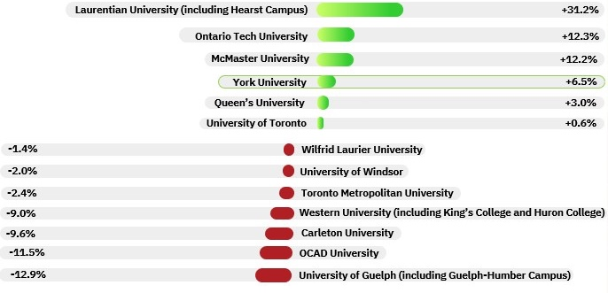
Change in Applications and Confirmations for 105 Domestic Applicants from 2024-2025
Applications May 2025
York saw a 9.5% decline
Acceptances June 2025
York saw a 6.5% increase

Slide 12
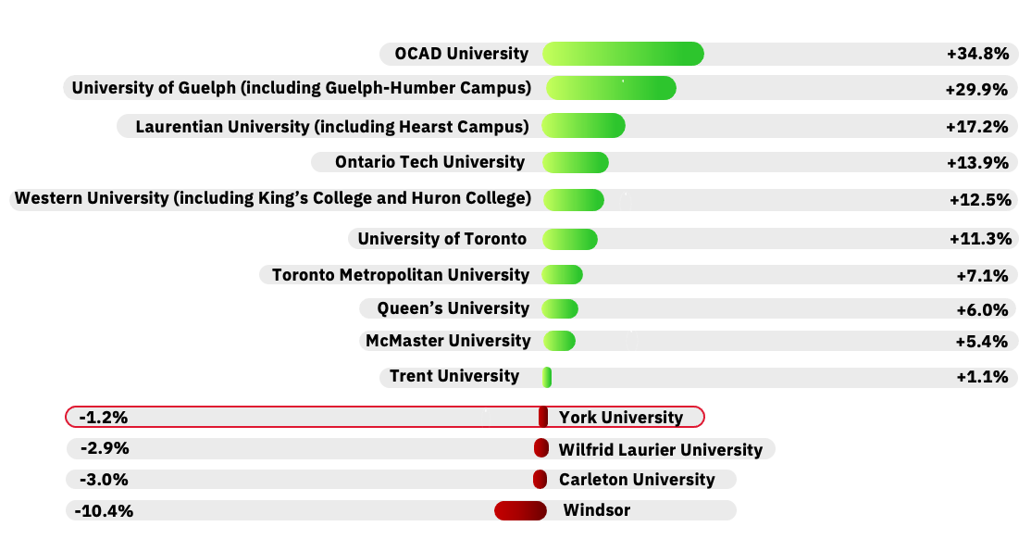
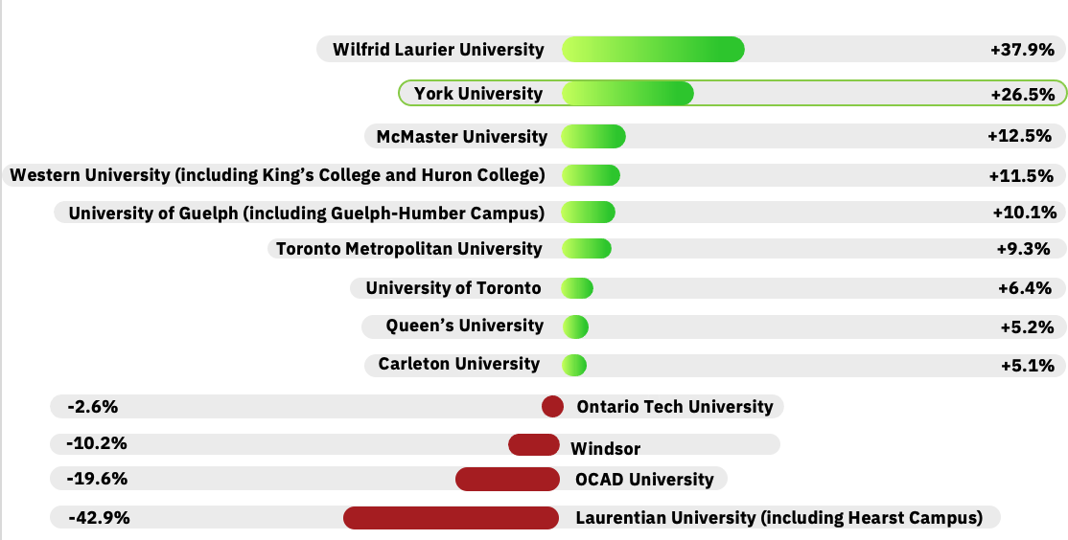
Change in Applications and Confirmations for 101 International Applicants from 2024-2025
Applications May 2025
York saw a 1.2% decline
Acceptances June 2025
York saw a 26.5% increase

Slide 13
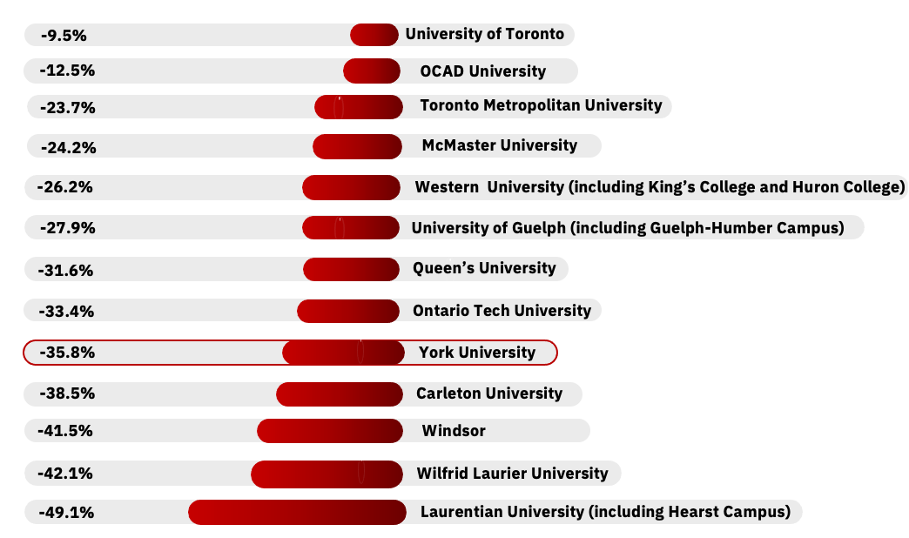
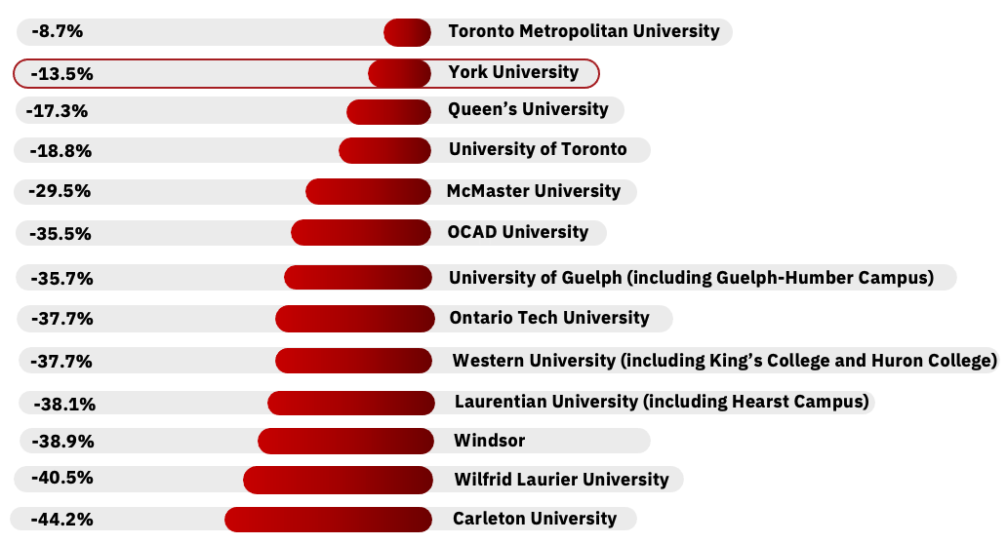
Change in Applications and Confirmations for 105 International Applicants from 2024-2025
Applications May 2025
York saw a 35.8% decline
Acceptances June 2025
York saw a 13.5% decrease

Slide 14

Fall 2025 Enrolment Update
Notes:
Context: Several Factors affected Enrolments this year, including:
CUPE strike during time of application (Feb – April 2024) had typical effect of dampening enrolment.
International enrolment particularly affected by caps on the International Student Program in January 2024, and with further restrictive measures on September 2024.
Diplomatic crisis in India which is our major source of international students
Also growing competition for Colleges with 4 year degree programs

Slide 15

Keele and Glendon Undergraduate 2025-26 Fall Term Eligible New Student Headcount by Faculty Relative to Enrolment Contract Target
 |  |  |  |  | 2025-26 estimates relative to contract targets
Fall Term Eligible New Student Headcount | 2024-25 Actuals |  | 2025-26 Contract Targets |  | Early Estimate (Feb 2025) |  | Early Estimate (Mar 2025) Budget Plan | Estimate (Jun 2025)
AMPD | 552 |  | 588 |  | -116 (-20%) |  | -114 (-19%) | -60 (-10%)
Education - BA | 150 |  | 145 |  | - |  | - | -
EUC | 113 |  | 181 |  | -84 (-46%) |  | -84 (-46%) | -72 (-40%)
Glendon | 312 |  | 364 |  | -101 (-28%) |  | -77 (-21%) | -84 (-23%)
Health (excl Nursing) | 1,638 |  | 2,084 |  | -441 (-21%) |  | -460 (-22%) | -317 (-15%)
Health-Direct Entry Nursing | 204 |  | 235 |  | - |  | - | -
LA&PS | 2,986 |  | 3,120 |  | -413 (-13%) |  | -406 (-13%) | -23 (-1%)
Lassonde | 1,017 |  | 885 |  | -15 (-2%) |  | -14 (-2%) | +83 (+9%)
Osgoode | 337 |  | 340 |  | - |  | - | -
Schulich | 537 |  | 490 |  | +102 (+21%) |  | +102 (+21%) | +319 (+65%)
Science | 909 |  | 1,058 |  | -175 (-17%) |  | -188 (-18%) | -143 (-14%)
Total | 8,755 |  | 9,490 |  | -1,243 (-13%) |  | -1,241 (-13%) | -297 (-3%)
Based on June confirmations data:
Schulich is expected to significantly exceed its contract target but they have expanded capacity to accommodate a large incoming class.
Lassonde is currently assessing its capacity to accommodate high student demand for its Engineering program. It may issue alternate offers to the Markham Campus First-Year Engineering program to help manage the above capacity enrolments in Keele Campus.
Notes:
This slide compares estimates of Fall 2025 new student enrolment to our contract targets.
As of June, we're projecting to be down by 297 students, or 3% below target,
Excludes new student headcount for Education- BED, Second Entry and IEN Nursing, Osgoode JD/MBA, JD/MA and JD/MES, and Schulich MBA/JD, Keele and Glendon campus only.
Intake targets for 2025-26 were reduced by 7 percent for eligible students in the 2025-26 contract (October 2024) relative to 2024-25 contract (October 2023).
June 2025 projection:
Projection of Fall 2025 intakes as received from OUR, based on acceptance data as of June 9th. Uses Fall 2024 conversion ratios (accept-to-enrol ratios) to project Fall 2025-26 new student headcount. To estimate the number of international students who will pay domestic fee, we use a two-year average of Fall 2023 and Fall 2024.
Estimate for Fall 2025 is equal to a 3 percent decline in undergraduate eligible students for Fall admissions relative to targets.
Undergraduate Winter 2026 intake estimates are projected by applying the Fall to Winter intake proportions for the last two years at the Faculty Level to the Fall 2025 intake estimates.
Mar 2025 projection:
Early projection of Fall 2025 intakes as received from OUR, based on application data as of March 18th. Uses Fall 2024 conversion ratios (application-to-offer and offer-to-enrol ratios) to project Fall 2025-26 new student headcount. To estimate the number of international students who will pay domestic fee, we use a two-year average of Fall 2023 and Fall 2024.
ns relative to the intake targets set for Fall 2025 in October 2024.

Slide 16
Keele and Glendon Undergraduate 2025-26 Fall Term Ineligible Visa New Student Headcount by Faculty Relative to Enrolment Contract Target
 |  |  |  |  |  | 2025-26 estimates relative to contract targets
Fall Term Eligible New Student Headcount | 2024-25 Actuals |  |  | 2025-26 Contract Targets |  | Early Estimate (Feb 2025) |  | Early Estimate (Mar 2025) Budget Plan | Estimate (Jun 2025)
AMPD | 47 |  |  | 87 |  | -43 (-49%) |  | -46(-53%) | -35(-40%)
Education - BA | 1 |  |  | 7 |  | - |  | -6 (-86%) | -6 (-86%)
EUC | 8 |  |  | 26 |  | -20 (-77%) |  | -20 (-77%) | -21 (-81%)
Glendon | 33 |  |  | 32 |  | -9 (-28%) |  | -10 (-31%) | -6 (-19%)
Health (excl Nursing) | 72 |  |  | 89 |  | -28 (-31%) |  | -28 (-31%) | -9 (-10%)
Health-Direct Entry Nursing | 8 |  |  | 10 |  | - |  | - | -
LA&PS | 321 |  |  | 455 |  | -267 (-59%) |  | -270 (-59%) | -241 (-53%)
Lassonde | 156 |  |  | 250 |  | -139 (-56%) |  | -140 (-56%) | -109 (-44%)
Osgoode | 16 |  |  | 10 |  | - |  | - | -
Schulich | 58 |  |  | 80 |  | -36 (-45%) |  | -35 (-44%) | -17 (-21%)
Science | 96 |  |  | 193 |  | -83 (-43%) |  | -111 (-58%) | -105 (-54%)
Total | 816 |  |  | 1,239 |  | -625 (-50%) |  | -666 (-54%) | -549 (-44%)
These estimates do not account for the high study permit extension processing times affecting in-Canada international applicants which is expected to worsen the institutional gap to target.
Various scenarios have been separately modelled to identify the potential impact of these processing delays.
Notes:
This slide shows projected shortfalls in ineligible visa students.
We’re now projecting to be down by 549 students, or 44 percent below target. The estimates do not account for the impact of study permit processing delays.
.
__________________________________________________________________________________________________________________
*Excludes new student headcount for Education- BED, Second Entry and IEN Nursing, Osgoode JD/MBA, JD/MA and JD/MES, and Schulich MBA/JD, Keele and Glendon campus only.
Intake targets for 2025-26 were reduced by 35 percent for visa students in the 2025-26 contract (October 2024) relative to 2024-25 contract (October 2023).
June 2025 projection:
Projection of Fall 2025 intakes as received from OUR, based on acceptance data as of June 9th. Uses Fall 2024 conversion ratios (accept-to-enrol ratios) to project Fall 2025-26 new student headcount. To estimate the number of international students who will pay domestic fee, we use a two-year average of Fall 2023 and Fall 2024.
Estimate for Fall 2025 is equal to a 44 percent decline in undergraduate visa students for Fall admissions relative to the intake targets set for Fall 2025 in October 2024.
Undergraduate Winter 2026 intake estimates are projected by applying the Fall to Winter intake proportions for the last two years at the Faculty Level to the Fall 2025 intake estimates.
Mar 2025 projection:
Early projection of Fall 2025 intakes as received from OUR, based on application data as of March 18th. Uses Fall 2024 conversion ratios (application-to-offer and offer-to-enrol ratios) to project Fall 2025-26 new student headcount. To estimate the number of international students who will pay domestic fee, we use a two-year average of Fall 2023 and Fall 2024.
Early estimate for Fall 2025 is equal to a 54 percent decline in undergraduate visa students for Fall admissions relative to the intake targets set for Fall 2025 in October 2024.

Slide 17
Markham Campus Undergraduate 2025-26 Fall Term Eligible and Ineligible Visa New Student Headcount by Faculty Relative to Enrolment Contract Target
Fall Term New Student Headcount | 2024-25 Actuals | 2025-26 Enrolment Contract Targets | 2025-26 Estimate (Jun 2025) Fall 2025 Projected Headcount | Variance to Target
Eligible
Education | -- | -- | 180 | 180
AMPD | 29 | 35 | 25 | -10
LA&PS | 101 | 160 | 97 | -63
Lassonde | 161 | 206 | 118 | -88
Science | 9 | 20 | 11 | -9
Eligible Total | 300 | 421 | 431 | 10
Ineligible Visa
AMPD | 2 | 4 | 0 | -4
LA&PS | 8 | 34 | 13 | -21
Lassonde | 1 | 19 | 11 | -8
Science | 1 | 12 | 1 | -11
Ineligible Visa Total | 12 | 69 | 25 | -44
Faculty of Education-Teacher Education intake estimates are new and not reflected in the budget plan.
Notes:
This slide provides a view of how we are tracking at the Markham campus based on the June acceptance data.
_________________________________________________________________________________________________________________
Intake targets for 2025-26 were reduced by 25 percent for eligible students and 54 percent for visa students in the 2025-26 contract (October 2024) relative to 2024-25 contract (October 2023).
June 2025 projection:
Projection of Fall 2025 intakes as received from OUR, based on acceptance data as of June 9th. Uses Fall 2024 conversion ratios (accept-to-enrol ratios) to project Fall 2025-26 new student headcount. To estimate the number of international students who will pay domestic fee, we use a two-year average of Fall 2023 and Fall 2024.

Slide 18
Historical Undergraduate Fall Term New Student Headcount
Undergraduate Fall Term New Student Headcount
 | 2015 | 2016 | 2017 | 2018 | 2019 | 2020 | 2021 | 2022 | 2023 | 2024 | 2025 projected
Domestic fee-paying | 9,659 | 9,352 | 9,962 | 9,336 | 8,684 | 8,222 | 8,871 | 9,490 | 9,760 | 8,755 | 9,193
YOY change (%) |  | -3% | +7% | -6% | -7% | -5% | +8% | +7% | +3% | -10% | +5%
International fee-paying | 1,156 | 1,371 | 1,501 | 1,666 | 1,824 | 1,398 | 1,249 | 1,248 | 1,357 | 816 | 690
YOY change (%) |  | +19% | +9% | +11% | +9% | -23% | -11% | -0% | +9% | -40% | -15%
Total Undergraduate (excluding Markham Campus) | 10,815 | 10,723 | 11,463 | 11,002 | 10,508 | 9,620 | 10,120 | 10,738 | 11,117 | 9,571 | 9,883
Following the 2018 labour disruption, domestic intakes declined year-over-year before rebounding in 2021 . However, based on confirmations data for Fall 2025, York is projected to recover from the decline experienced in 2024 due to the labour disruption.
IRCC policy changes have led to a sharp year-over-year decline in international intakes. Study permit processing delays are expected to have an additional negative impact on the Fall 2025 intake.
Notes:
Notes:
November 1 (Fall term) new student headcounts are reported in this table.
Excludes the count for Education-BED, Schulich MBA/JD, Osgoode JD/MBA, JD/MA and JD/MES, Health-Nursing(Collab and General)
Excludes other ineligible students and Markham campus enrolments.
Projection of Fall 2025 intakes as received from OUR, based on acceptance data as of June 9th. Uses Fall 2024 conversion ratios (accept-to-enrol ratios) to project Fall 2025-26 new student headcount. To estimate the number of international students who will pay domestic fee, we use a two-year average of Fall 2023 and Fall 2024.

Slide 19

Strategic Enrolment Management (SEM) Update

Slide 20

Current SEM Priorities
Mitigate and manage International Enrolment Risk.
Conversion Support. Program-specific conversion activities continue across faculties.
Continue to improve Retention (Collegial Forum on Retention – Project 11).
Finalize the 2025–2030 International Recruitment Strategy (International Strategic Enrolment – Project 7).
Finalize the Out-of-Province Strategy (Project 8).
Strengthen Marketing, Communications, and Digital Engagement. Implement Phase 1 of Website Evolution Project (by August 2025) to improve recruitment focus, consistency, and content alignment across sites.

Slide 21

SEM Conversion Initiatives
Immediate
  Targeted survey and outreach to international applicants
  Faculty/program-specific follow-up and admissions handoff
  Peer outreach and compliance guidance (“Do’s and Don’ts”)
  Website updates to clarify IRCC timelines and risks
  Development of non-credit audited course for in-Canada 101 visa students
  Graduate pathways for international UG graduates
  Coordination with COU/CBIE for advocacy
  New admissions dashboard launched
  Idea submission process to support SEM innovation
Short-Term (Next 3–6 months)
  Winter 2026 planning underway (Faculty-specific and coordinated LAPS → Schulich handoff)
  Ongoing student story, career, and alumni promotion
  Deferral and transfer strategy implementation
Longer-Term
  New admissions CRM (Salesforce) – targeted for Fall 2026

Slide 22
2024-25 Operational Budget Results
202

Slide 23
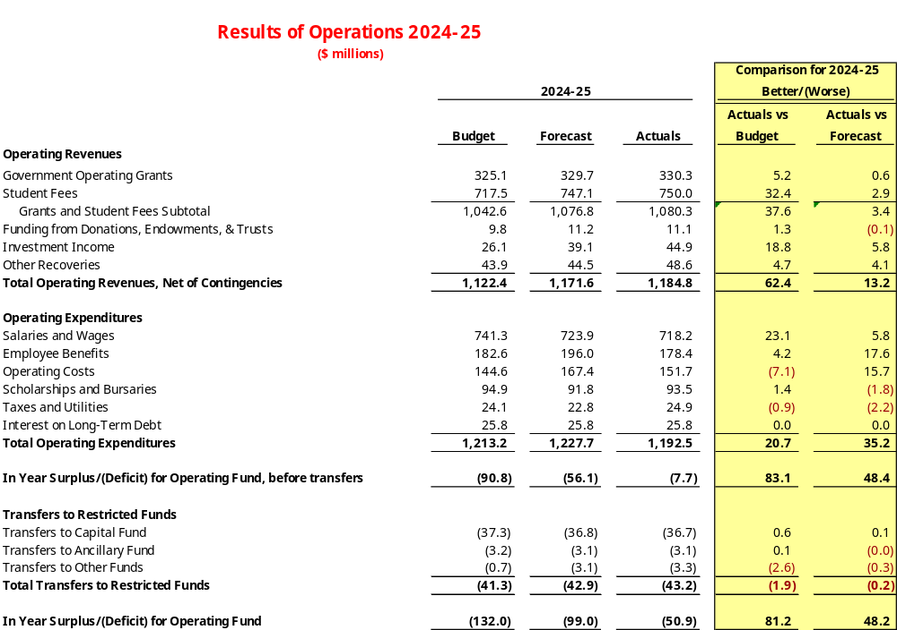
Notes:
The University’s 2024-25 results present an in-year deficit of $50.9 million which represents a favourable variance of $81.2 million against budget.
Next slide.
Note: Other Recoveries consists of sales and services revenue, tax rebate, interfund recoveries including contribution for shared services/GI costs and UF from Ancillaries, fines, rental income, gifts in kinds, conference registration fees and other external recoveries.

Slide 24
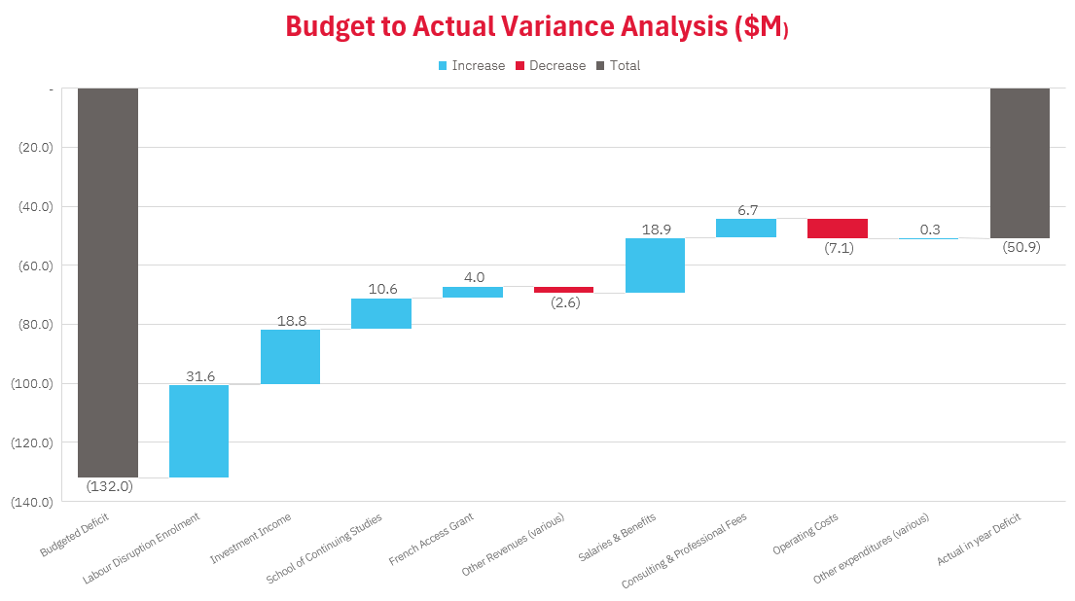
$18.8 million net Favourable expenses
$62.4 million net Favourable revenues
Increase = Favourable
Decrease = Unfavourable
Notes:
The Favourable Variance to budget of $81.2 million is primarily due to:
Revenues variance ($62.4 million Favourable) explained by:
Favourable grant revenue of $4.0 million French Access Grant (deferred from 2023-24);
Favourable enrolment revenues (net of enrolment related contingencies) of $31.6 million due to labour disruption related deferral for coursework not concluded in 2023-24;
Favourable investment income of $18.8 million;
Favourable School of Continuing Studies revenue of $10.6 million; offset by
Unfavourable various other revenues of $2.6 million.
Salaries & Benefits expenditures (25.6 million Favourable) explained by:
Budgeted accruals and central contingencies relating to Salaries and Benefits totalling $106.5 million intended to account for the known payments and estimated costs relating to the repeal of Bill 124 in February 2024 offset by higher than budgeted Salaries & Benefits expenditures totalling $87.6 million. Salaries & Benefits did not increase to the amount expected in part due to strict restrictions on filling vacant positions in place during the year; and
Favourable variance in Consulting & External Professional fees of $6.7 million .
Operating Costs Unfavourable variance of $7.1 million due to:
The University budgeted lower spend of $30.0 million (per the University’s 30/80/90 plan) in operating costs and achieved $22.8 million towards this goal in this category of expenditures.

Slide 25

Draft Multi-Year Operating Budget Plan - Spring 2025

Slide 26
Planning Horizon Considerations –
Switching From a 3 Yr. Plan to a New 5 Yr. Plan Horizon
Ministry Requirement The 5 year plan aligns with the planning horizon required by MCURES for Universities in a medium / high risk classification under the Ministry’s Financial Accountability Framework.
Smooths Volatility Potential changes to Government Policy and results of Forward Action Plan initiatives are expected to impact revenue trends in the later years of the planning horizon, helping to mitigate risk and reduce the need for sharp corrective measures that might otherwise arise under a shorter-term budget
Enables Earlier Course‑Corrections Seeing gaps emerge between outcomes and plans in the outer years gives management two extra years to implement further measures in revenue diversification or efficiency before gaps crystallise.
Strengthens Scenario Planning & Sensitivity Testing
Longer horizons make it easier to layer sensitivity analysis (e.g., enrolment patterns, inflation, etc.) and test sustainability under different trajectories.
Future Considerations
A 5-year Board approved budget is presented as an interim measure
A return to a 3-year plan with the Board, while maintaining up to a 5-year internal planning horizon, may be considered in the future.

Slide 27
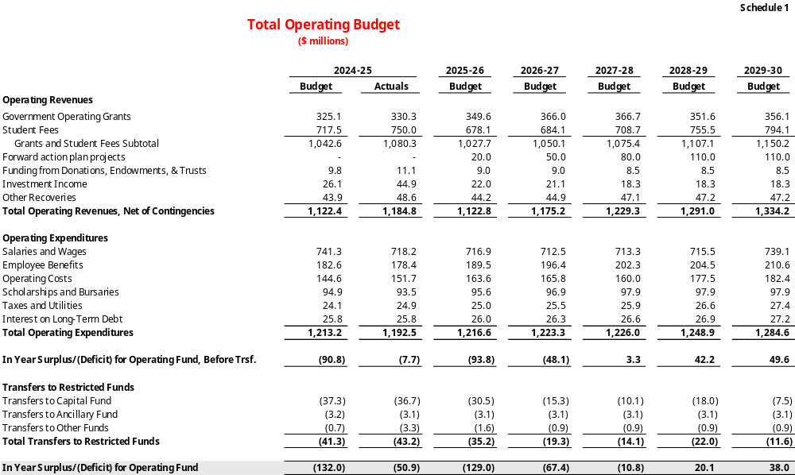
Draft Operating Budget

Slide 29

Revenue Overview
Ov

Slide 30
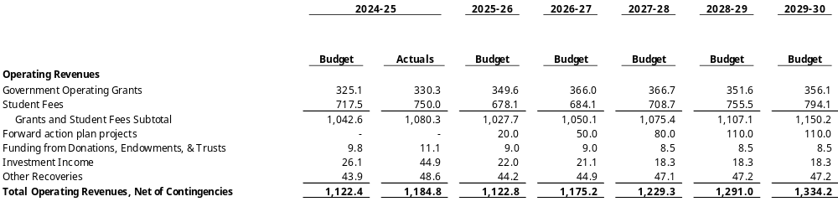
Sources of Revenue
Notes:
The following slides will take the committee through the key assumptions included in these budgeted revenues.
NOTE: Funding from Donations, Endowments & Trusts as well as investment income and other recoveries are held constant in the outer two years with 2027-28 levels. These are considered to be conservatively estimated in this budget.

Slide 31
Notes:
Other Revenues:
We have now taken the committee through the assumptions for Grants and Student fees, other revenue assumptions are as follows:
Funding from Donations, Investment income and other recoveries are assumed to stay relatively constant at $75.1 million in 2025-26 and dropping to $74.0 million in 2028/29 and 2029/30, mostly due to investment income assumed to decline as cash reserves are drawn down.
Forward Action Plan projects reflects revenues which are expected to be achieved through the ongoing strategic initiatives carried out across the institution targeting the University’s financial sustainability. The next few slides will detail some of these initiatives that are underway which are expected to support the delivery of revenue enhancement or cost reductions in the budget over the upcoming budget period.

Slide 32
York U Forward Action Plan Update
Program Enhancement & Sustainability Stream
#1: Course Enrolment Optimization
#2: Faculties of the Future
#3: Redesigning the Undergraduate Degree Framework
#4: Program Sustainability Review
#5: Supporting Program Innovation
#6: Improve Metrics Performance
Enrolment Recovery Stream
#7: International Strategic Enrolment Management Working Group
#8: New Out of Province Strategy
#9: Student Housing Working Group
#10: New Pathways to Degrees
#11: Collegial Forum on UG Retention
#12: Expand Capacity in Programs with Unmet Demand
Administrative Projects Stream
#13: Administrative Service Efficiencies
#14: E-License Optimization
#15: Space Optimization
#16: HR Initiatives
#17: Diversification of Revenues/Asset Monetization
On Track
Progressing

Slide 33
Budget Actions
Extended the Budget plan to a 5 Year planning timeframe in alignment with MCURES EAF approach and smooth volatility to reflect internal revenue generating activities taking shape and potential government policy changes that may arise in an updated Tuition Fee Framework beginning in 2027-28.
Updated enrolment projections included in Faculties budgeted revenues to better align divisional and unit level cost planning to expected revenues.
Many Forward Action Plan projects and their costs / revenue impacts are included in the 5 Year Budget. Confirming and monitoring KPIs, timeline for expected outcomes, and targets will ensure University’s ability to pivot to alternative options as needed.
New centralized expense fund of $4 million per year for 2 years established to provide start-up funding for projects requiring some investment to deliver on planned and achievable outcomes.
Complemented by Government Advocacy

Slide 34
Expense Overview

Slide 35
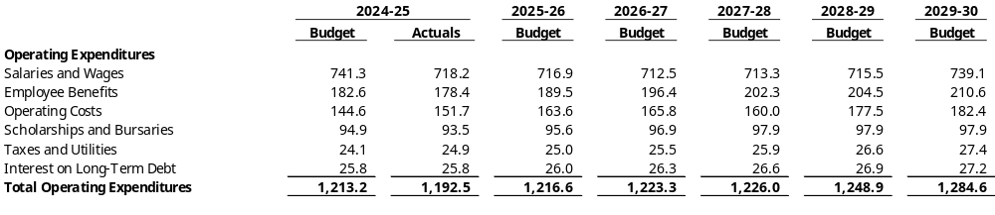
Operating Expenses

Slide 36
Closing The Gap: Shared Services Cost Reduction Measures
The University has established a target that Shared Services costs attributed to Faculties should be no greater than 30% of Faculties revenues
2025-26
$24.4 million
2026-27
$22 million
& Balanced Budgets
2027-28
$22 million
Note: A central budgeted expense of $10 million per year in each of 2025-26, 2026-27 and 2027-28 has been included to provide for one-time costs associated with workforce reduction.
Notes:
Good prospects in the pipeline to be identified, set up timelines / intake targets and allow department level to carry funds to support strategic initiatives. New and rebranded program areas.

Slide 37
Planned Efficiencies – Other Cost Reduction Measures
University Operations
Restrictions on discretionary expenditures, such as travel and hospitality, continues to be in place.
Markham campus operations continue to control expenses carefully to align with lower than planned revenues; a revised Markham forecast is under development to further inform budget and action plans.
Forward Action Plan projects continue to submit recommendations, projects approved are closely monitored to track outcomes against targets.
Delaying spend on capital projects where suitable. This includes a reduction in IT and Facilities capital spend and a freeze on discretionary capital improvements or projects.
Workforce Planning
Hiring Restrictions and strict approval requirements established for both filling vacancies or establishing new roles.
A new Voluntary Separation Agreement (VSA) offered to YUFA members
Cash Reserves Control and Tracking
Temporary reduction in spend on Capital Deferred maintenance for the next three years
Pause on spend of Departmental and Capital reserve balances

Slide 38
Conclusion

Slide 39

Summative Budget Messages
Favourable 2024–25 in-year results ($81.2M better than budget)
Multi-year deficit remains – projected shortfalls continue through 2027–28
Revenue diversification efforts and cost containment underway through Forward Action Plan (target: $110M over 4 years) and Shared Services budget cuts (target: 68.4 million over 3 years)
Next Steps
  Advance implementation of Forward Action Plan projects and monitoring of successful outcomes
  Advance organizational design review and shared services budget reductions
  Monitor and adjust based on real-time revenue/expense performance
  Continue government advocacy on tuition fees, international and STEM funding
  Support enrolment recovery beginning in 2025–26, with a focus on improving applicant-to-acceptance & accept-to-enrol conversion rates.

Slide 40
Appendix

Slide 41

OUAC Application Data
May 2025

Slide 42
Sector Enrolment Data – OUAC 101s (May 2025) - Applications
International 101s: International applications currently attending an Ontario high school.
York saw a 1.2% decrease in 101 visa applications.
 | May 2024 (Total) | May 2025 (Total)
OCAD University | 276 | 372
University of Guelph (including Guelph-Humber Campus) | 945 | 1,228
Laurentian University (including Hearst Campus) | 157 | 184
Ontario Tech University | 793 | 903
Western University (including King’s College and Huron College) | 5,070 | 5,702
University of Toronto | 11,218 | 12,490
Toronto Metropolitan University | 3,015 | 3,228
Queen’s University | 2,999 | 3,178
McMaster University | 5,794 | 6,105
Trent University | 552 | 558
York University | 5,222 | 5,161
Carleton University | 1,321 | 1,282
Wilfrid Laurier University | 960 | 932
University of Windsor | 664 | 595
+34.8%
OCAD University
University of Guelph (including Guelph-Humber Campus)
Laurentian University (including Hearst Campus)
+29.9%
+17.2%
Ontario Tech University
+13.9%
Western University (including King’s College and Huron College)
+12.5%
University of Toronto
+11.3%
Toronto Metropolitan University
+7.1%
Queen’s University
+6.0%
McMaster University
+5.4%
Trent University
+1.1%
York University
-1.2%
-2.9%
Wilfrid Laurier University
-3.0%
Carleton University
-10.4%
Windsor

Slide 43
Sector Enrolment Data – OUAC 105s (May 2025) - Applications
Visa 105s: International applications not currently attending an Ontario high school.
Every university saw decreases in 105 visa applications. York’s applications decreased by 35.8%.
 | May 2024 (Total) | May 2025 (Total)
University of Toronto | 30,390 | 27,500
OCAD University | 679 | 594
Toronto Metropolitan University | 2,496 | 1,904
McMaster University | 7,243 | 5,489
Western University (including King’s College and Huron College) | 6,650 | 4,905
University of Guelph (including Guelph-Humber Campus) | 1,145 | 826
Queen’s University | 4,566 | 3,122
Ontario Tech University | 842 | 561
York University | 6,032 | 3,874
Carleton University | 1,824 | 1,121
University of Windsor | 884 | 517
Wilfrid Laurier University | 1,184 | 685
Laurentian University (including Hearst Campus) | 686 | 349
University of Toronto
-9.5%
OCAD University
-12.5%
Toronto Metropolitan University
-23.7%
-24.2%
McMaster University
-26.2%
Western University (including King’s College and Huron College)
-27.9%
University of Guelph (including Guelph-Humber Campus)
Queen’s University
-31.6%
Ontario Tech University
-33.4%
York University
-35.8%
-38.5%
Carleton University
-41.5%
Windsor
Wilfrid Laurier University
-42.1%
-49.1%
Laurentian University (including Hearst Campus)

Slide 44
OUAC Confirmation Data
June 2025

Slide 45
Sector Enrolment Data – OUAC 101s (June 2025) - Confirmations
International 101s: International confirmations currently attending an Ontario high school.
York saw an increase of 26.5% in 101 visa confirmations.
 | June 2024 (Total) | June 2025 (Total)
Wilfrid Laurier University | 58 | 80
York University | 461 | 583
McMaster University | 352 | 396
Western University (including King’s College and Huron College) | 347 | 387
University of Guelph (including Guelph-Humber Campus) | 138 | 152
Toronto Metropolitan University | 291 | 318
University of Toronto | 1,817 | 1,933
Queen’s University | 210 | 221
Carleton University | 99 | 104
Ontario Tech University | 116 | 113
University of Windsor | 59 | 53
OCAD University | 92 | 74
Laurentian University (including Hearst Campus) | 14 | 8
Wilfrid Laurier University
+37.9%
York University
+26.5%
McMaster University
+12.5%
Western University (including King’s College and Huron College)
+11.5%
University of Guelph (including Guelph-Humber Campus)
+10.1%
Toronto Metropolitan University
+9.3%
University of Toronto
+6.4%
Queen’s University
+5.2%
Carleton University
+5.1%
Ontario Tech University
-2.6%
-10.2%
Windsor
-19.6%
OCAD University
-42.9%
Laurentian University (including Hearst Campus)

Slide 46
Sector Enrolment Data – OUAC 105s (June 2025) - Confirmations
Visa 105s: International confirmations not currently attending an Ontario high school.
York’s confirmations decreased by 13.5%.
 | June 2024 (Total) | June 2025 (Total)
Toronto Metropolitan University | 300 | 274
York University | 616 | 533
Queen’s University | 237 | 196
University of Toronto | 4,298 | 3,492
McMaster University | 455 | 321
OCAD University | 203 | 131
University of Guelph (including Guelph-Humber Campus) | 157 | 101
Ontario Tech University | 106 | 66
Western University (including King’s College and Huron College) | 507 | 316
Laurentian University (including Hearst Campus) | 84 | 52
University of Windsor | 72 | 44
Wilfrid Laurier University | 148 | 88
Carleton University | 154 | 86
Toronto Metropolitan University
-8.7%
York University
-13.5%
Queen’s University
-17.3%
University of Toronto
-18.8%
McMaster University
-29.5%
OCAD University
-35.5%
University of Guelph (including Guelph-Humber Campus)
-35.7%
Ontario Tech University
-37.7%
-37.7%
Western University (including King’s College and Huron College)
-38.1%
Laurentian University (including Hearst Campus)
Windsor
-38.9%
Wilfrid Laurier University
-40.5%
-44.2%
Carleton University

Slide 47

Evolving Risk

Slide 48
Changes to Study Permit Requirements
As of November 8, 2024: All international students changing Designated Learning Institutions or level of study must receive a new study permit approval before they may begin their studies
All international students must have their current DLI listed on their study permit
These students must also submit a PAL with their study permit application
Students currently in Canada with a valid study permit and changing DLIs must apply for a study permit extension
Type of International Student | PAL Required? | New Study Permit Required?
High school transferring to PSI | Yes | Yes
Transfer from one DLI to another (regardless of study level change) | Yes | Yes
Changing study level at the same DLI – non-grad* to grad | No | No
Changing from one non-grad* to another non-grad | No | No

Slide 49
Prolonged Study Permit Processing Times
Processing Times
Students Impacted
Study Permit Extension processing time is 234 days* as of May 28, 2025
  223 days (as of May 6)
  120 days is service standard for IRCC
New study permit application within Canada is 5 weeks (as of May 20, 2025)
IRCC says most applications are processed within 145-155 days or within service standard (120 days)
  Posted processing times include complex cases
COU is requesting sub-sector data to see if university processing times are shorter and for advocacy
101 Visa – as of May 23:
  4,011 offers
  361 accepts
A student who applies for a SP on June 1 will receive their study permit by early/mid January based on 145-155 days processing time
Deferrals will increase for this group of students to a January start
Some will need to defer to SU26 or FA26 depending on when they apply and their program
105 transfers will be impacted in much smaller numbers

Slide 50

What’s Restricted
Studies:
  Attending class
  Doing assigned readings
  Following along “at home”
  Writing papers, mid-terms, finals
  Anything that is a required part of their program/degree
  Online studies from within Canada
Students can audit a course while waiting for their study permit but cannot receive credit for it at any time
  i.e., cannot be counted towards program completion if/when permit is received
Any new international student must have a study permit approval in hand BEFORE they begin studies

Slide 51
Can an international student waiting for a study permit:
Audit a course?
Audit a course now and receive credit for it later?
No
Study online within Canada?
No
Study online outside Canada?
Yes!
Attend classes then tell IRCC that they didn’t go to class until after they received their permit?
No
Just do the readings but not go to class?
No
Attend non-academic events on campus like campus tours?
Yes!
Yes!

Slide 52
“Does IRCC check?”
Yes, and it is getting more stringent over time
IRCC has communicated that they are increasing scrutiny on study permit applications due to increased instances of misrepresentation (fraud)
IRCC reviews applications and scrutinizes details such as study start dates, transcripts, Letters of Admission, previous study permit issue dates
Will impact future applications
  Study permit extensions
  Co-op Work Permit
  Post-graduation Work Permit
  Permanent Residence
DLIs found to be participating in misrepresentation will also face consequences that range from a warning to loss of DLI status
Misrepresentation:
submitting false or altered documents, lying on an application or in an interview

