Slide 1
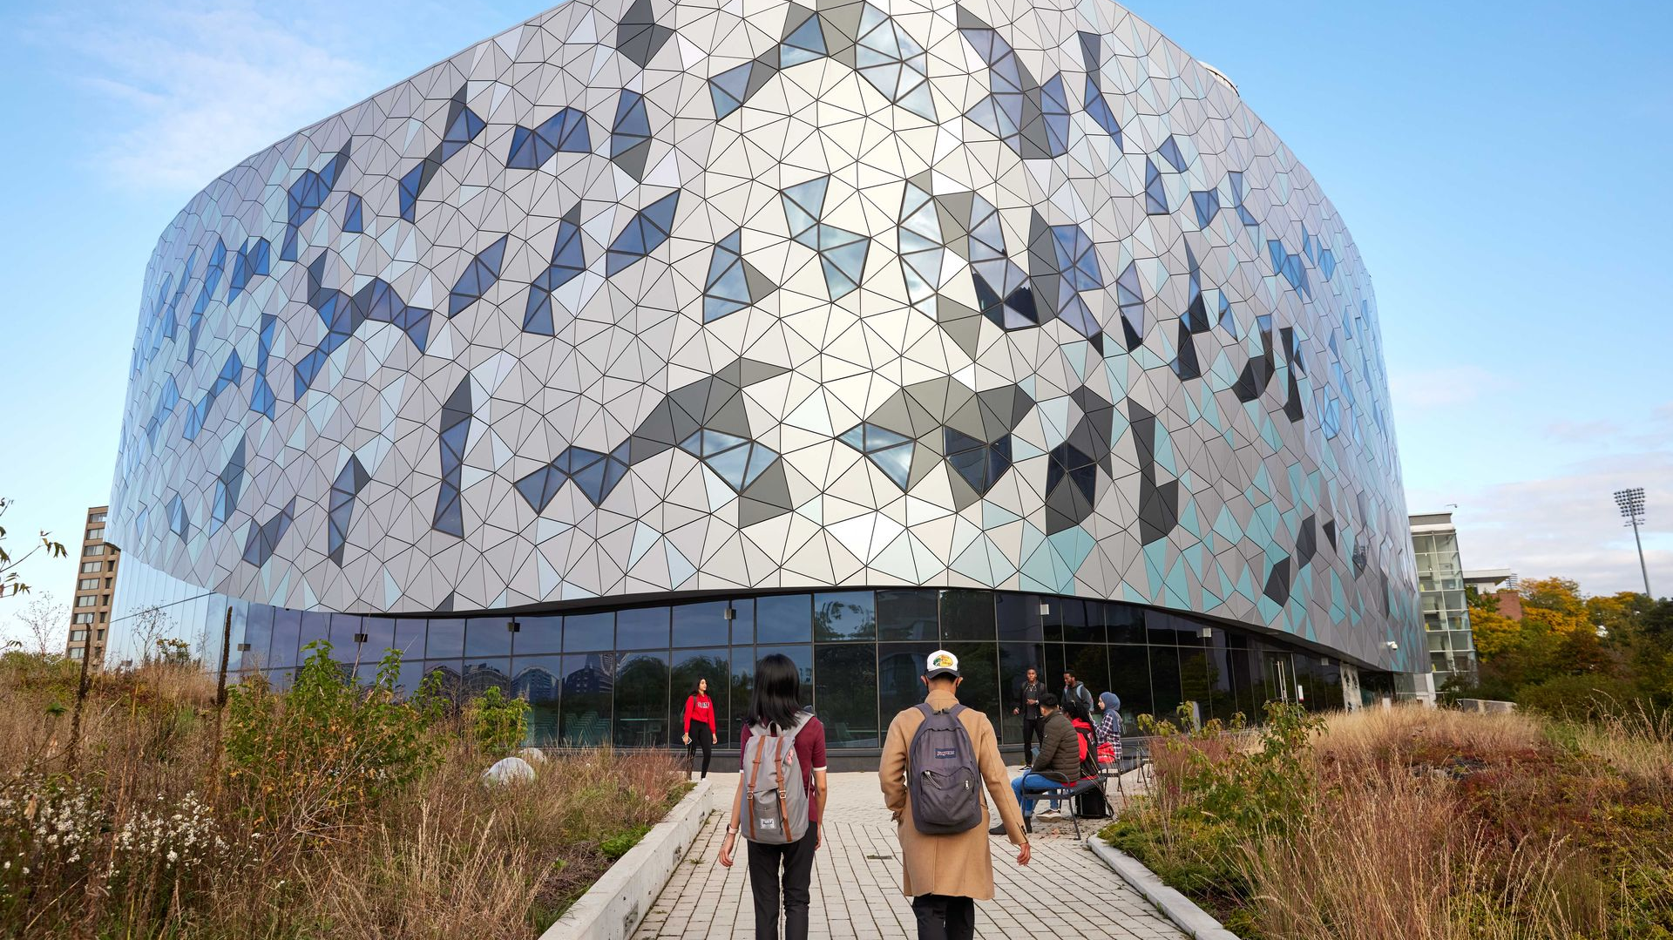
Proposed YU Green Building Standards
Prepared by: Desmond Asiedu
For: YU Office of Sustainability

Slide 2
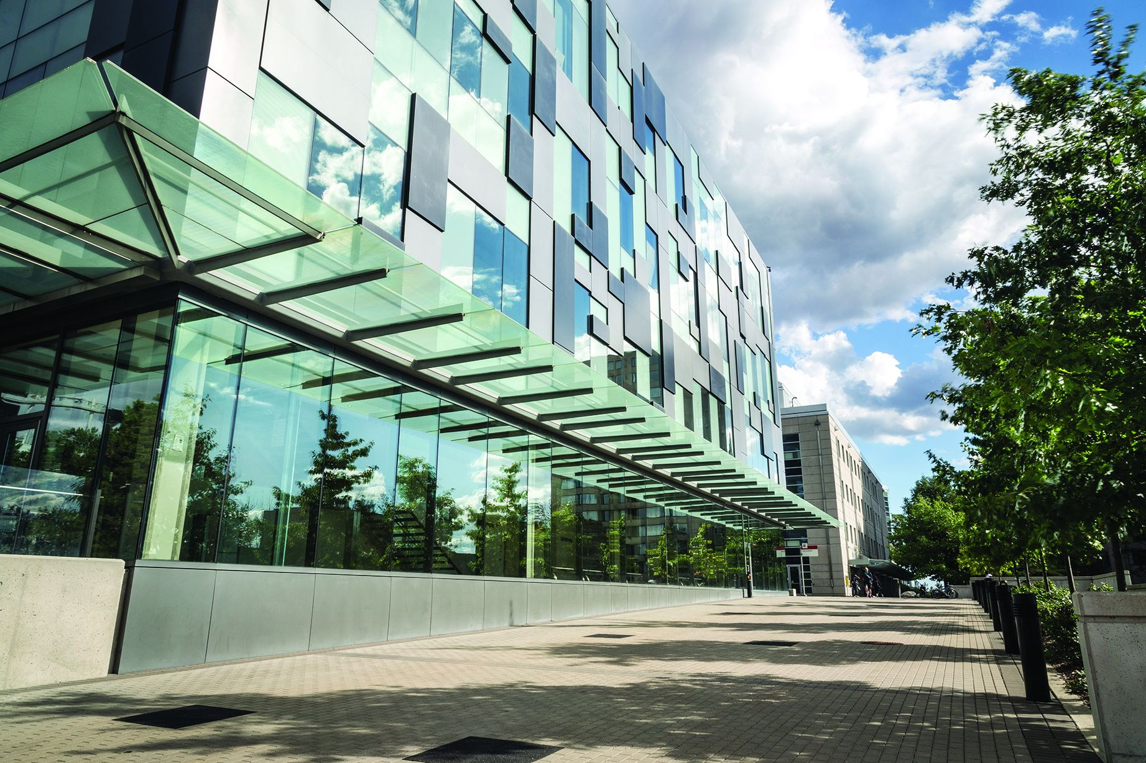

Presentation Roadmap
1
Strategic Context
Policy changes, funding realities, and the need for integrated action.
2
Solution
York University Green Building Framework: integration, benchmarks, and targets.
3
Implementation & Economics
Cost-benefit analysis, phased approach, community engagement, and timeline.
4
Discussion
Questions and feedback.

Slide 3
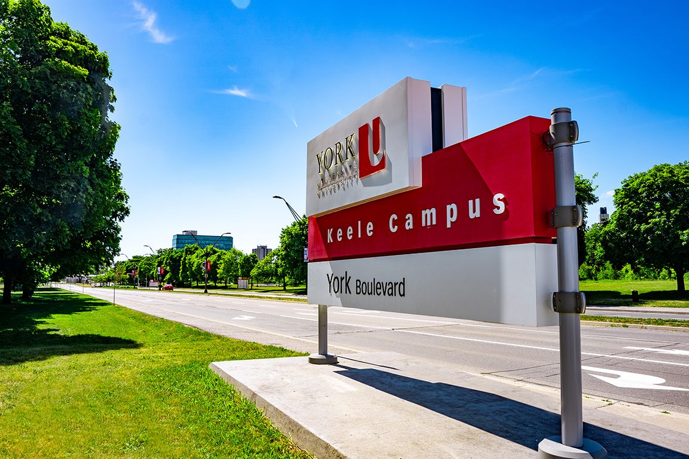



The Challenge We Face
Situation
Complication
The Question
Answer
York University aims to reach carbon neutrality by 2040,
Buildings are largest emissions source.
Pressure is mounting from regulations and stakeholders.
Budget constraints limit capital investments.
Regulatory uncertainty with new GHG targets.
Variety of green building standards
Peer universities advancing faster pose competitive risks.
How can York University craft a cost-effective, integrated green building strategy to lead on regulations despite budget constraints?
Adopt a comprehensive, phased framework that leverages existing commitments, anticipates regulations, and creates self-funding mechanisms

Slide 4






YU’s Integrated Green Building Framework
Proposed strategy harmonizes external directives with internal initiatives and peer best practices:
External Drivers
Federal Policy
Provincial & Municipal
International Standards
Canada Green Building Strategy (2024)
Toronto Green Standard Evolution
LEED v5 (2025)
National Building Code (2025)
Ontario Building Code Updates
Zero Carbon Buildings Standard
York University Integrated Strategy
Energy Performance
Materials & Embodied Carbon
Smart Building Technologies
Optimizing consumption and efficiency across all campus
operations.
Prioritizing sustainable sourcing and reducing material lifecycle
impacts.
Implementing AI-driven systems for intelligent building
management.
Water Management
Resilience & Climate Adaptation
Community Engagement
Implementing conservation strategies and greywater reuse
systems.
Protecting campus infrastructure from future climate impacts.
Fostering a culture of sustainability among students, faculty,
and staff.
Peer Benchmarks
1
Univ. of Toronto
2
Univ. of British Columbia
3
UC Berkeley
4
Univ. of Waterloo
$8.5M Revolving Fund,
37% GHG reduction.
Zero Carbon buildings
Standard adoption,
thermal energy storage.
LEED Gold+ commitment,
strong resilience focus.
50% energy efficiency gains,
industry partnerships.
Key Integration Points
1
2
3
4
Exceeds current Toronto Green Standard (v4) requirements while anticipating v5 updates.
Aligns with leading peer institution best practices across all performance areas.
Anticipates LEED v5's carbon-focused approach and embodied carbon requirements.
Creates academic opportunities through ‘Campus as Living Lab’ integration.

Slide 5
Why Act Now Despite Budget Constraints
Strategic Investment in YU’s Future
The Cost of Delay
Regulatory Compliance
Operational Escalation
Competitive Risk
NBC 2025 GHG targets will significantly increase retrofit costs if not integrated proactively into current planning.
Energy costs are rising 3-5% annually, eroding budgets that fixed efficiency savings could protect long-term.
THE Impact Rankings increasingly prioritize sustainability, impacting student recruitment and university reputation globally.
Plausible Financially Smart Approach
Phase 3: Portfolio Transformation
Phase 2: Self-Funding Expansion
(3-10 years)
Phase 1: High-ROI Pilots
(18-36 months)
(0-18 months)
Reinvest demonstrated savings into broader retrofits across
campus.
Establish a Green Revolving Fund using Phase 1
savings.
Target projects with 7-10 year payback periods.
Access increasing federal and provincial green building
incentives.
Leverage existing capital maintenance budgets.
Utilize energy performance contracts to minimize upfront capital costs.
Secure external grants and strategic partnerships.
Explore alumni and corporate partnership opportunities for
funding.
Bottom Line Benefits
Financial Returns
Risk Mitigation
Revenue Protection
Projected 10-year Net Present Value (NPV) of $15-25M in operational savings.
Proactively ensure regulatory compliance and protect the university's brand reputation.
Maintain a competitive edge in attracting and recruiting top students and faculty.

Slide 6
Introduction and Research Objectives
Setting the Stage for Sustainability
Why Green Building Matters
Align YU infrastructure with institutional sustainability goals and commitments
Develop comprehensive green building framework for new construction and retrofits
Support York University’s net-zero goal by 2040
Inform evidence-based decision-making for future campus development
Integrate sustainability principles into planning, design, construction, and operations
Enhance York's position as a leader in environmental stewardship in higher education
Reduce environmental impact and carbon emissions from campus operations
Enhance occupant well-being, productivity, and learning outcomes
Align with global sustainability trends and expectations in higher education
Potential for significant long-term cost savings through reduced energy and resource consumption
Improve York's performance in global sustainability rankings (e.g., THE Impact Rankings)
Demonstrate leadership and attract sustainability-minded students, faculty, and partners

Slide 7
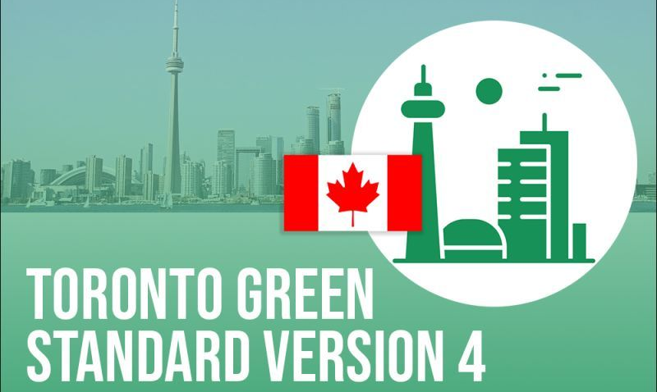









Benchmarks Assessed
Green Building Key Focus Areas
Energy Efficiency
Renewable Energy
DEI
Stormwater Management
Governance Frameworks
Embodied Carbon & Material Usage
Occupant Health & Wellbeing/ IEQ
Water Management
STARS, Times Higher Ed.
Green Building Standards
Peer Higher Education Institutions

Slide 8

Updates since 2024 Draft Report (1)
Current Canadian Policy Landscape
Federal
Leadership
Provincial & Municipal Developments
Implications for York
University
Canada Green Buildings Strategy: $903.5M federal investment targeting energy efficiency and carbon reduction in buildings
National Building Code 2025: First inclusion of operational GHG targets directly in building codes - carbon is now in the code
Enhanced Federal Funding: $800M Canada Greener Homes Affordability Program and $73.5M for energy efficiency tools
Federal Buildings Targets: Government targeting 40% emissions reduction by 2025, net-zero by 2050 for all federal facilities
Toronto Green Standard Evolution: Net Zero Transition Study underway (2024-2025) to accelerate GHG limits for buildings (TGS 5 & 6)
Ontario Building Code Updates: Expected alignment with federal GHG targets and embodied carbon requirements by 2030
Regulatory Direction: Clear policy momentum toward mandatory carbon performance standards across all jurisdictions
Proposed YU standard anticipates and exceeds emerging regulatory requirements
Early adoption positions York ahead of mandatory compliance timelines
Federal investments create new financing streams for institutional green building projects

Slide 9

Updates since 2024 Draft Report (2)
Evolving Green Building Standards
LEED v5 Transformation (Q1 2025)
Toronto Green Standard Acceleration
Validation Of Proposed YU Strategy
Carbon-Centric Approach: ~50% of certification points now tied to carbon emissions reduction
Mandatory Embodied Carbon: Structural materials embodied carbon assessment now a prerequisite, not optional credit
Three Impact Areas: Climate action, quality of life, and ecological conservation
Enhanced Assessment Requirements: New climate resilience assessments mandatory for all projects
Net Zero Timeline: TGS v5 expected Fall 2025 with accelerated GHG limits targeting near-zero emissions by 2030
Higher Performance Tiers: Current Tier 2 becoming Tier 1, pushing all development toward higher performance
Embodied Carbon Integration: TGS now requires upfront embodied emissions assessment for Tier 2+ projects
Proposed standards align with LEED v5’s enhanced carbon focus and mandatory embodied carbon requirements
Framework anticipates National Building Code 2025 operational GHG targets
Positions York at forefront of next-generation green building practices before they become mandatory

Slide 10
Overview of Assessed Green Building Standards
LEED
Toronto Green Standard
Passive house
BOMA BEST
Comprehensive, globally recognized system
Multiple certification levels (Certified, Silver, Gold, Platinum)
Covers new construction, existing buildings, and various building types
Strong focus on energy efficiency, water conservation, and indoor environmental quality
Regular updates to maintain relevance and push industry standards
Locally contextualized, mandatory for new developments in Toronto
Progressive tier system with increasing performance requirements
Tier 1 mandatory with Tier 2-4 voluntary with financial incentives
Addresses climate change resilience and adaptation strategies
Integrates with local planning processes and development approvals
Regular updates aligned with Toronto's climate action goals
Ultra-low energy performance standard
Emphasis on building envelope and passive design strategies
Specific, stringent criteria for heating/cooling demand and airtightness
Applicable to various climates and building types
Growing adoption in institutional and multi-unit residential sectors
Focused on existing buildings and ongoing operations
Five certification levels based on percentage scoring system
Emphasizes continuous improvement and industry-specific assessments
Particularly strong in operational practices and management strategies
Widely used in the Canadian commercial real estate sector

Slide 11
Overview of Assessed Green Building Standards cont’d.
Standards | Scope & Focus | Certification Approach | Energy Efficiency | Net Zero Approach | Embodied Carbon | Stormwater Management | Applicability to Existing Buildings | Local Context
LEED | Broad, covering various aspects of sustainability. | Points-based system with multiple certification levels. | Varies, with points awarded for energy-efficient measures. | Can support net-zero goals but doesn't require them. | Increased focus in LEED v4.1. | Comprehensive approach, including rainwater management and heat island reduction. | LEED O+M for existing buildings. | Applicable across various contexts.
CAGBC Zero Carbon Building Standard | Focused on carbon emissions, both operational and embodied. | Binary certification (certified or not) with two paths: Design and Performance. | Sets energy efficiency targets as part of carbon reduction strategy. | Requires net-zero carbon performance. | Significant emphasis on embodied carbon, requiring life-cycle assessment. | Doesn't directly address stormwater management, but indirectly through resilience focus. | Offers pathways for new and existing buildings. | Applicable across various contexts.
Passive House | Concentrates on energy efficiency and thermal performance. | Sets specific performance targets with three certification levels. | Sets stringent energy efficiency requirements. | Approaches net-zero energy performance through stringent requirements. | Doesn't explicitly address embodied carbon. | Doesn't include specific requirements for stormwater management. | EnerPHit standard for existing buildings, but primarily used in new construction. | Applicable across various contexts.
BOMA BEST | Exclusively focused on existing buildings and their operations. | Percentage-based scoring system with five certification levels. | Encourages energy efficiency improvements but doesn't set specific targets. | Doesn't specifically address net-zero targets. | Doesn't explicitly address embodied carbon. | Includes stormwater management assessment. | Specifically designed for existing buildings. | Applicable across various contexts.
Toronto Green Standard (TGS) | Tailored to Toronto's context, addressing multiple environmental performance areas. | Tiered system with mandatory Tier 1 and voluntary higher tiers. | Sets specific energy performance targets that become more stringent with higher tiers. | Incorporates net-zero goals in higher tiers. | Addresses embodied carbon indirectly through sustainable materials and waste reduction requirements. | Comprehensive approach, including water balance, water quality, water quantity, green infrastructure, and integration with Green Streets. | Primarily focuses on new developments but provides guidelines for existing building renovations. | Specifically designed for Toronto's context.

Slide 12
Overview of Assessed Peer Higher Education Institutions
Aspects | Humber College | University of Toronto | University of Waterloo | UC Berkeley
Targets and Timelines | Net zero carbon by 2050 | 37% reduction in GHG emissions below 1990 levels by 2030 | 50% increase in energy efficiency and 60% reduction in absolute carbon emissions by 2034 (compared to 2014 levels) | All new buildings and major modifications to achieve LEED Gold certification and be designed for net zero emissions
Energy Production | Implementing geo-exchange system at Lakeshore Campus | Canada's largest urban geo-exchange system under Front Campus | N/A | Requirement to evaluate feasibility of on-site solar PV for new buildings
Energy Distribution | N/A | Upgrading century-old district energy system, converting from steam to low-temperature hot water distribution | Plans to connect all new and existing buildings to upgraded campus-wide heating and cooling networks | N/A
Energy Consumption | Deep energy retrofits of existing buildings; Existing Building Optimization strategy | $8.5 million revolving fund for energy conservation projects in existing buildings | New buildings required to meet German A-rated building performance standards (approx. twice as efficient as Ontario Building Code) | New buildings must outperform California energy efficiency standards by at least 20%
Stormwater Management | -Bioswales and rain gardens across campus. -Permeable pavement in parking lots -Green roofs on new buildings | - Stormwater management pond at Scarborough campus - Green roof on Exam Centre at St. George campus - Rainwater harvesting system at Mississauga campus | - Campus-wide stormwater master plan - Low impact development (LID) features including bioswales and permeable pavement - Green roof on Environment 3 building | - Strawberry Creek Management Plan - Bioswales and rain gardens across campus - Permeable paving in pedestrian areas
Innovative Technologies | Smart building controls with predictive controls and fault detection | Carbon capture and utilization pilot; 14-story mass timber academic tower | Smart building controls with predictive controls and fault detection | Prohibition of on-site fossil fuel combustion for space and water heating in new buildings
Integration of Research and Operations | N/A | "Campus as a Living Lab" program | Creation of Strategic Implementation Network with industry partners | Encouragement of projects that 'advance sustainable building practices, learning opportunities, and leadership'
Holistic Approach to Sustainability | Focus on water efficiency | Quantifies carbon sequestration benefits of campus trees | Set ambitious water efficiency targets | Specific requirements for daylighting, indoor air quality, and thermal comfort; 40% reduction in indoor water use for new buildings
Financing and Governance Mechanisms | N/A | $8.5 million Utilities Reduction Revolving Fund | In process of creating a Strategic Implementation Network of industry partners | Mandates sustainability workshops during design and reviews through construction for all major projects

Slide 13

Snapshot of Proposed YU Building Standard (1)
Energy Performance
Water Efficiency
Materials & Embodied CO₂
Indoor Env. Quality
Total Energy Use Intensity (TEUI): ≤100 kWh/m²/year for new construction- Exceeds TGS V4 Tier 2 & Aligns with UofT
Thermal Energy Demand Intensity (TEDI): ≤30 kWh/m²/year-Aligns with TGS V4 Tier 2 & exceeds UoW
Greenhouse Gas Intensity (GHGI): ≤5 kg CO₂e/m²/year- Exceeds TGS V4 Tier 2 & aligns with UBC
Minimum 10% on-site renewable energy generation- Exceeds TGS V4 Tier 2 & similar to UCLA
Existing building retrofits: 40% energy use reduction from baseline- Exceeds TGS retrofit requirements & aligns with UofT
45% reduction in indoor water use- Exceeds TGS V4 Tier 2 & similar to UC Berkeley
60% reduction in outdoor water use for irrigation- Aligns with TGS V4 Tier 2 & exceeds UBC
Capture and reuse rainwater and greywater for non-potable uses-Aligns with TGS V4 Tier 2 & similar to UofT
Install water submeters for all major water-consuming processes- Exceeds TGS V4 & aligns with UBC
Implement comprehensive water audit and retrofit program for existing buildings- Exceeds TGS requirements & similar to UoG
30% reduction in embodied carbon compared to baseline building- Exceeds TGS V4 requirements & aligns with UofT
Minimum 30% recycled content materials- Exceeds TGS V4 & similar to UBC
20% regional materials (extracted and manufactured within 800 km)- Exceeds TGS V4 & aligns with LEED v4.1 regional materials credit
70% FSC certified wood products- Exceeds TGS V4 and LEED & similar to UBC
85% construction waste diversion from landfills-Exceeds TGS V4 Tier 2 (& aligns with UofT
Meet or exceed all ASHRAE 62.1-2019 requirements for ventilation- Exceeds TGS V4 Tier 2 & aligns with UCLA
Use only low-VOC materials and implement green cleaning program- Aligns with TGS V4 Tier 2 & similar to UofT
Provide individual thermal comfort controls for 75% of occupants- Exceeds TGS V4 and LEED v4.1 requirements & aligns with UBC
Achieve minimum 3% daylight factor in 80% of regularly occupied spaces- Exceeds TGS V4 Tier 2 & similar to UCLA
Conduct regular indoor air quality testing and monitoring- Exceeds TGS V4 & aligns with UofT

Slide 14
Snapshot of Proposed YU Building Standard (2)
Resilience & Climate Adaptation
Stormwater Management
Fossil Fuel Phase-Out
Smart Building
Technologies
Design buildings to maintain indoor temperatures within 2°C of setpoint for 72 hours during power outages- Exceeds TGS V4 Tier 2 & similar to UofT
Implement peak flow control measures to manage 25mm rainfall events on-site- Aligns with TGS V4 Tier 2 & exceeds UBC’
Provide backup power for critical systems for at least 72 hours- Exceeds TGS V4 Tier 2 & aligns with UofT
Design structures to withstand wind speeds 20% above current building code requirements- Exceeds TGS V4 & similar to UBC
Retain minimum 10mm rainfall from all site surfaces-Aligns with TGS V4 Tier 2 & similar to UofT
Achieve 85% removal of Total Suspended Solids (TSS) annually- Exceeds TGS V4 Tier 1 & aligns with UBC
Treat minimum 50% of non-roof hardscape with green infrastructure solutions- Aligns with TGS V4 Tier 2 & similar to UCLA
Implement green roofs on minimum 60% of available roof space, 50% biodiverse- Exceeds TGS V4 Tier 2 & aligns with UofT
Offset 25% of non-potable water demand through rainwater harvesting- Exceeds LEED v4.1 & similar to UBC
Zero on-site fossil fuel combustion for all end uses in new buildings- Exceeds TGS V4 Tier 2 & aligns with UCLA
Develop 10-year plan to phase out natural gas use in existing buildings- Similar to UofT
Utilize high-efficiency electric heat pump technology for heating and cooling- Aligns with leading electrification strategies & similar to UBC
Explore opportunities for thermal energy storage to support grid flexibility- Aligns with UBC's thermal energy storage initiatives
Implement IoT-enabled systems for real-time monitoring of energy, water, occupancy, and indoor environmental quality- Exceeds TGS V4 & aligns with UoW.
Utilize data analytics and machine learning to continuously optimize building performance- Similar to UofT building automation strategies.
Provide open data platforms to support academic research and student projects-Aligns with UBC's open data initiatives.
For retrofits, prioritize installation of smart meters and sensors to enable data-driven optimization- Aligns with UofT building optimization strategies

Slide 15
Snapshot of Proposed YU Building Standard (3)
Accessibility &
DEI
Occupant Health & Wellbeing
Commissioning & Verification
Provide barrier-free access to 100% of building entrances and public spaces- Aligns with WELL Building Standard & similar to UofT
Implement wayfinding systems with multi-sensory cues throughout buildings-Exceeds AODA requirements
Design 25% of prayer/meditation spaces to accommodate diverse religious and cultural practices- Similar to UofT
Conduct annual accessibility and inclusion audits of all buildings- Exceeds AODA requirements & aligns with UBC
Provide at least one open staircase servicing all floors, located physically and/or visibly before elevators-Exceeds TGS V4 Tier 2 & aligns with Humber College
Incorporate plants, nature views, and natural materials in common spaces, including culture and place design elements- Aligns with TGS V4 Tier 2 & similar to UBC
Install MERV 13 filters for RTUs and MERV 14 filters for AHUs and DOASs-Exceeds TGS V4 Tier 2 & aligns with UofT & UBC
Ensure 80% of regularly occupied spaces are within ASHRAE Standard 55-2017 comfort ranges- Exceeds TGS V4 Tier 2 & aligns with LEED
Conduct enhanced commissioning from pre-design phase through post-occupancy- Exceeds LEED v4.1 & similar to UBC's comprehensive commissioning processes
Perform envelope commissioning with blower door testing and thermal imaging- Aligns with Passive House
Implement 24-month measurement and verification period post-occupancy- Exceeds LEED v4.1 & similar to UofT
Provide comprehensive operator training and detailed systems manuals- Aligns with best practices in building operations .
Other categories discussed in report include Building Envelope, Renewable Energy Integration, HVAC Systems & Controls etc.

Slide 16
The Next Steps
Key Implementation Strategies
LIKLEY CHALLENGES AND SOLUTIONS
ACTION PLAN
Governance and Policy
  Establish Green Building Advisory Committee with diverse expertise
  Formally adopt Green Building Standard as university policy
  Integrate standard into all capital planning processes
Capacity Building
  Develop internal expertise through comprehensive training programs
  Partner with industry leaders and academic departments for knowledge transfer
Procurement and Finance
  Create a Green Revolving Fund (target: $10 million) for project financing
  Explore innovative funding sources (e.g., green bonds, alumni donations)
Monitoring and Reporting
  Implement a robust building performance tracking system
  Annual public reporting on energy, water, and carbon performance
  Regular third-party verification of reported data
High upfront costs for high-performance systems
  Mitigation: Life-cycle cost analysis, innovative financing, prioritization of projects with highest ROI
Specialized knowledge required for net-zero design and operations
  Mitigation: Partnerships with industry experts, faculty engagement, comprehensive staff training
Resistance to change, competing priorities
  Mitigation: Clear communication of benefits, early and ongoing stakeholder engagement, showcase of early successes
Evolving building codes and standards
  Mitigation: Proactive engagement with authorities, flexible design approach, advocacy for supportive policies
Ensuring actual performance matches design intent
  Mitigation: Enhanced commissioning, continuous monitoring, and occupant engagement programs
Immediate Actions (0-6 months):
Formally adopt Green Building Standard as university policy
Establish Green Building Advisory Committee
Conduct comprehensive audit of existing building stock
Short-term Goals (6-18 months):
Identify and initiate pilot projects for new construction and retrofits
Develop and launch Green Revolving Fund
Implement training program for facilities staff and project managers
Medium-term Objectives (18-36 months):
Complete and evaluate pilot projects
Integrate green building principles into relevant academic programs
Develop campus-wide energy master plan
Long-term Vision (3-10 years):
Achieve carbon neutrality for all new construction
Implement deep energy retrofits for 50% of existing building stock
Position York University as a recognized leader in sustainable campus development

Slide 17





Community Engagement & Mobilization Strategy
Fostering a vibrant culture of sustainability and shared ownership across the York University community.
Digital Engagement & Transparency
Participatory Programs & Competitions
Real-Time Campus Dashboards showing performance.
Student Green Building Ambassadors program.
#GreenYorku Social Media for impact stories.
"Campus as Our Lab" Research Challenges.
Interactive Green Building Map of features.
Inter-Building Energy Olympics.
Experiential Learning & Ownership
Celebration & Recognition
Co-Design Workshops for green spaces.
Annual "Green Impact Awards" ceremony.
Sustainability Stories video series.
Building Dedication & Legacy program.
Green Building Career Pathways.
Climate Action Festival community event.

Slide 18



Conclusion: Leading Sustainably
Global Leadership
Financial & Environmental Impact
Enriched Campus Life
Position York as a pioneer, boosting rankings and contributing to global sustainability efforts.
Achieve significant cost savings, reduce environmental footprint, and build a resilient campus.
Elevate student experience, research, and teaching through an innovative living laboratory.

