Slide 1
Moving Labs Online
Strategies and lessons learned from a large, lab-based anatomy class

Slide 2
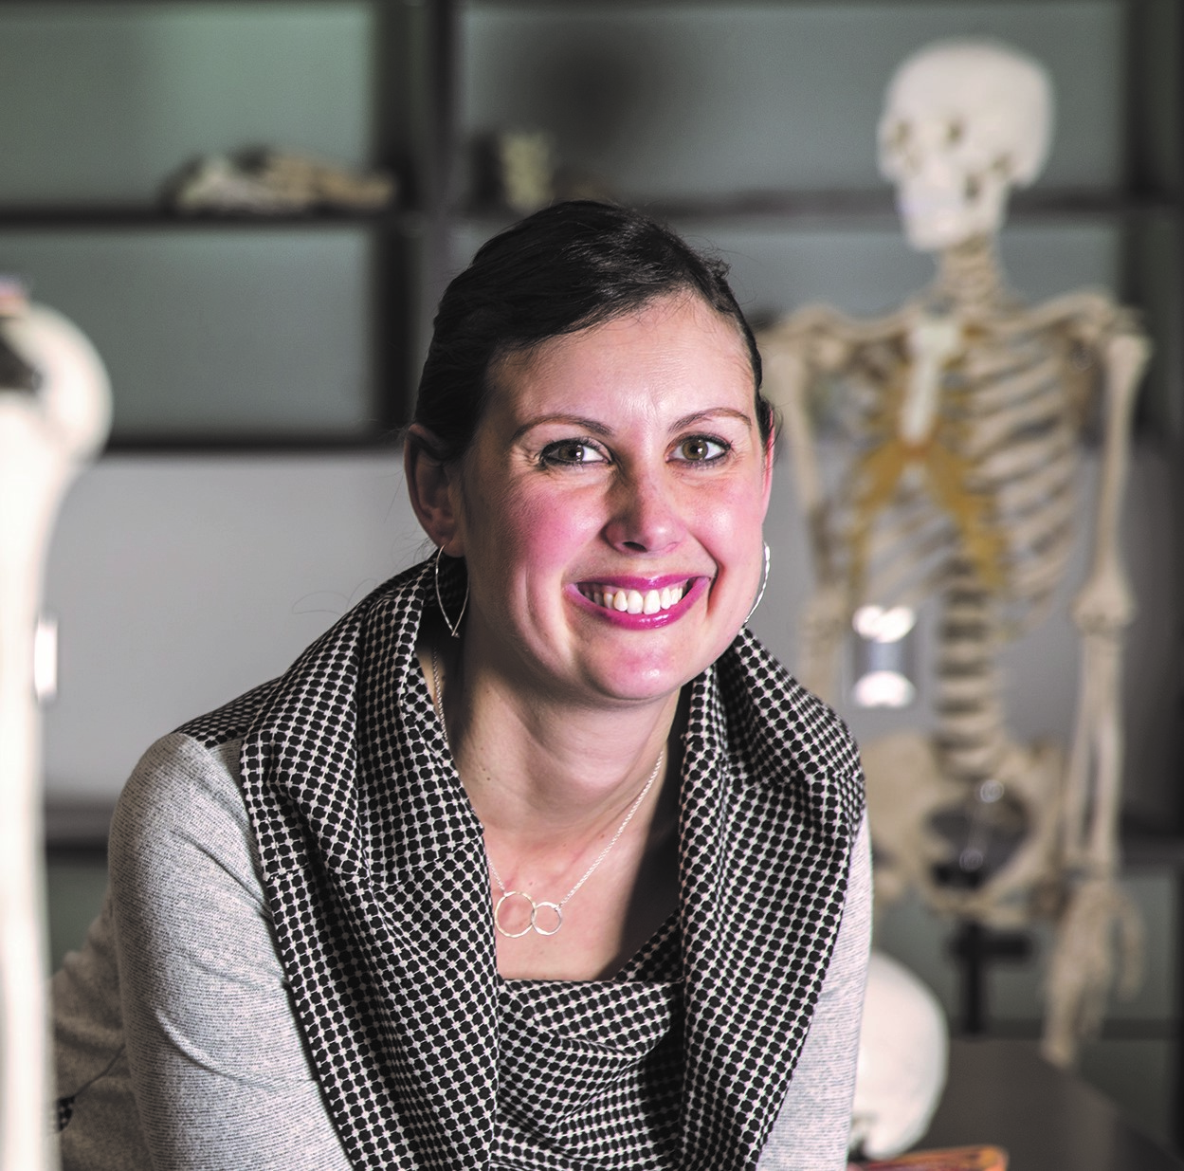

About me
Associate Professor, Teaching Stream in Kinesiology and Health Science
Six years experience teaching online human anatomy and human physiology labs (KINE 3465 and IHST 1001/2)
This summer: KINE 2031, KINE 3465
This fall: KINE 2031, NATS 1650

Slide 3
Today’s objectives
Discuss basic considerations for moving your lab online
Explore effective options for delivery of online labs and share examples
Discuss challenges surrounding the faculty, student and TA experience when labs are online
Explore effective options for assessment for online labs and discuss challenges
Share lessons learned and tips for teaching remote labs

Slide 4
Basic considerations
Moving labs online is not easy – but it is important
What do your students get out of your lab now?
  Problem solving, teamwork, critical thinking, skill development
When developing the online version, keep those skills in mind
What software do you have available?
  Through the library, with your course text
What kind of TA support do you have?
Will this be an entirely online experience? Or will there be an offline component (i.e. lab kit, collecting data at home).
Notes:
Labs are a crucial aspect to so many of our courses. Experiential aspects of students learning improve retention of material, helps them develop problem-solving and critical thinking skills, teamwork, and a number of other
We’ll discuss software a bit more later.

Slide 5
Developing an online lab structure
Keep your learning outcomes and lab-based skills in mind
Identify which of your lab activities can be delivered online
  Can your existing lab experience be easily adjusted to a remote format?
  How many labs need to be re-imagined for remote learning?

Slide 6
Technology options
Through the York library
  Primal Pictures (A&P)
With your course textbook
  Mastering (Pearson), WileyPlus
Open access labs and simulations: libguides.twu.ca/oer/labs
Notes:
Finding the right software may be how you decide if your labs can be easily moved online or not.

Slide 7
Example: Human Anatomy
KINE 3465 Regional Human Anatomy II, and KINE 2031 Human Anatomy
Students watch a guided dissection video then spend time on their own going through it.
Weekly synchronous lab meetings (optional...for now)
Notes:
Share screen and play one of the guided dissection videos.

Slide 8
Example: Ergonomics
A colleague at Wilfred Laurier University took videos of her friends/neighbours doing various “jobs”
Students will watch the short videos and break down the biomechanical components of each “job” and analyze potentially damaging aspects of the work
Lab reports will be submitted, answering specific questions about each task

Slide 9
Start of semester considerations
Provide VERY clear instructions for the students
  In our experience, an introductory video went a long way to
  ensure we weren’t bombarded with clarification questions
  Find a way to ENSURE they watch the video (i.e. a bonus question)
Be sure it is simple to find resources and get started on a lab
Have IT and other help information right on your main course page
Don’t start labs until at least one week into classes – this gives a bit of time for students to sort out tech issues
Notes:
I can send out the link to my Intro video if people want to see it.

Slide 10
Engaging Students Online
Be available for students – especially when tests are open or assignments due
Maximize communication online – discussion forums, virtual office hours
Have a synchronous course component
  Set up the synchronous component to MAXIMIZE engagement and communication
Notes:
Synchronous component: for labs, definitely (for discussion, clarification), but also possibly for lectures
- Could be mandatory or optional
We have struggled with the synchronous labs – they’re going well, but attendance is POOR (10-50%)
- In fall, considering other options: participation marks, group work (maybe groups take turns presenting dissections?), practice questions (maybe students have to create practice questions?

Slide 11
Communication with Teaching Assistants
Be available at synchronous lab times to deal with IT problems
Meet regularly with TA’s (more than you normally would)
Ask for their feedback on how labs are going and how they can be improved
Track lab attendance

Slide 12
Assessment
Lab reports submitted online
Lab tests
Oral presentations
KINE 2031: two lab tests (fill in the blank; identifying structures)
  Tight time (45s/question)
  Random question bank
  Sequential
  Have a practice test to ensure everyone’s tech will work on test day

Slide 13
Academic Integrity *sigh*
Assessments where all students hand in something different (i.e. generate their own data, create a video)
Tight times, random question bank
Proctoring software

