Slide 1

Motivation + Syllabus =?

Slide 2
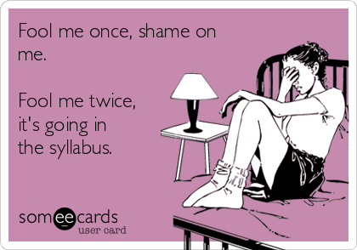
Why?
Notes:
A syllabus is NOT a contract, nor a list of dos and donts, so what should it be?

Slide 3
Why?
“Researchers have found that strong course design has been linked to positive outcomes such as increased student satisfaction, retention, and achievement of student learning outcomes in college” (Harrington & Thomas, 2018, p. 1)
Another study “found that students formed long-lasting impressions of their professors after the very first class where professors discussed course expectations” (Harrington & Thomas, 2018, p. 10)

Slide 4
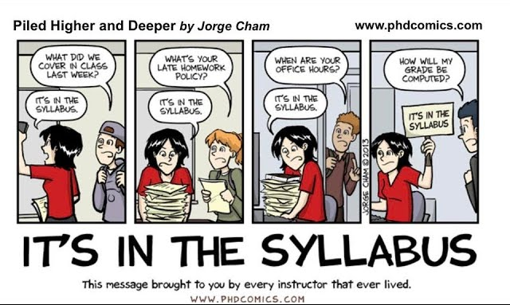
WhAT IF?

Slide 5
COSMETIC CHANGES
Add graphs to help with comprehension (pie charts for assignments weight; study cycle) and work on the layout
Forgo the usual clauses stating The students will… The instructor will…
  Instead, use You and I
Try to put a friendly positive spin to your usual clauses:
  “I welcome you to contact me outside of class and student hours” VS “If you need to contact me outside of office hours, you may e-mail me”
  “I hope you actively participate in the course” VS “Come prepared to actively participate in this course”

Slide 6
A few additions
What about a welcoming statement, maybe introducing the course and showing what’s great about it?
What about a brief teaching statement, or a short presentation?
What about transparency in the assignments? Explain how they’re related to the learning outcomes and what is expected (maybe using Bloom taxonomy, or any other)
What about a short paragraph on how to succeed?
What about resources? Both in-class and outside of it
Notes:
Research shows that students expecting to be bored will be bored, and that the perceived boredom of the instructor increases their own boredom.

Slide 7
A major upheaval
Start anew: what are the learning outcomes of your class?
What are the best assignments to check that those outcomes are met?
What are the activities you need to do in class to ensure that those outcomes are met?
Transpose that into your syllabus, in four columns: the date, what’s due on that day, the topic, and the things to do for next class
Don’t forget about the cosmetic changes and the additions!

Slide 8
Bibliography
Christine Harrington, Melissa Thomas (2018). Designing A Motivational Syllabus: Creating a Learning Path for Student Engagement. Bloomfield: Routledge.
Katy Y. Y. Tam, Wijnand A. P. Van Tilburg, Christian S. Chan (2023). “Whatever will bore, will bore: The mere anticipation of boredom exacerbates its occurrence in lectures”. British Journal of Educational Psychology, vol. 93(1), pp. 198-210.
Suzanne Tapp, Allison Boye, Mary-Ann Winkelmes, eds (2019). Transparent Design in Higher Education Teaching and Leadership: a Guide to Implementing the Transparency Framework Institution-Wide to Improve Learning and Retention. Sterling: Stylus.

